Slide 1

What is a Blockchain Smart Contract?
October 2019
By Violeta Gotcheva

Slide 2





Do the Yellow Apples Exist?
Yes, of course. What are the golden delicious?
No, even the golden delicious are green like.
MIDDLEMAN
A trusted friend to keep the bet.

Slide 3
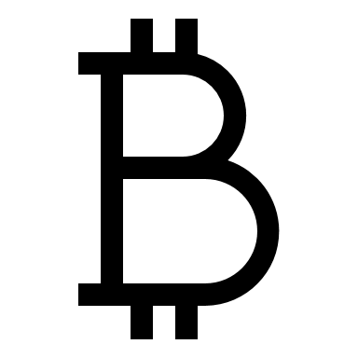

Blockchain Ledger - Immutable
A. bet $ on Oct 13
B. bet $ on Oct 13
A. bet $ on Oct 13
B. bet $ on Oct 13

Slide 4
Blockchain Distributed Ledger - Trustless

Slide 5
Blockchain Smart Contract
A. bet $ on Oct 13
B. bet $ on Oct 13
If Yellow, transfer $ to A.
If NOT Yellow, transfer $ to B.

Slide 6
Smart Contracts Tutorial
https://cryptozombies.io

