Slide 1
Alexander Popat, Josh Weekes, Taylor Wood
Feb 2024

Slide 2
The Rise of Private Credit

Slide 3
Private Credit Overview
Private Credit has Grown rapidly on investor demand for high yields and low volatility despite credit risks and liquidity constraints
GROWING ASSET CLASS
Private Credit as an asset class has been growing rapidly as investors sought yield in low rate environment
Tighter bank capital standards following GFC left many opportunities for private direct lending
ATTRACTIVE
PUBLISHED RISK / RETURN
PROFILE
Aggregated fund returns show Private Credit has delivered high single digits returns on average over the past 2 decades, with very low volatility
The private fund nature of the asset class allows managers some flexibility in valuation and avoid frequent mark to marking
CREDIT & LIQUIDITY RISK
Private Credit funds typically generate higher returns than other yielding assets by taking credit and liquidity risk
Smaller funds may be concentrated in only a handful of loans or sectors, limiting diversification benefits
LIQUIDITY CONSTRAINTS
Private credit funds typically require investors to commit capital for multiple years.
Capital must be committed prior to being invested, and returns are only generated once deployed. This limits investors ability to quickly gain access to asset class returns
Source: PitchBook

Slide 4
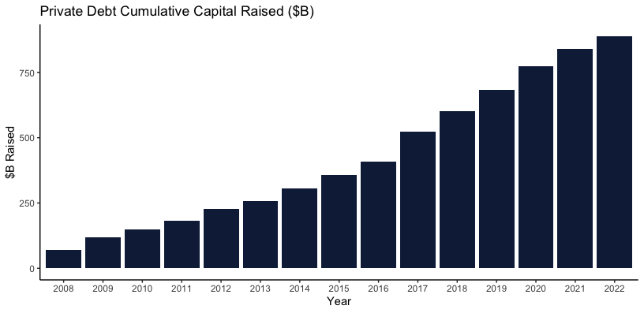
Private Credit Funds Have Raised Nearly $1 Trillion in Assets
Private Credit as an asset class has grown tremendously following the Great Financial Crisis (GFC) as investors sought high yielding securities, and banks were forced to curb direct lending
Source: PitchBook Note: Cumulative sum of capital raised in “Private Debt” measured by Pitchbook Annually from 2008 through 2022.

Slide 5
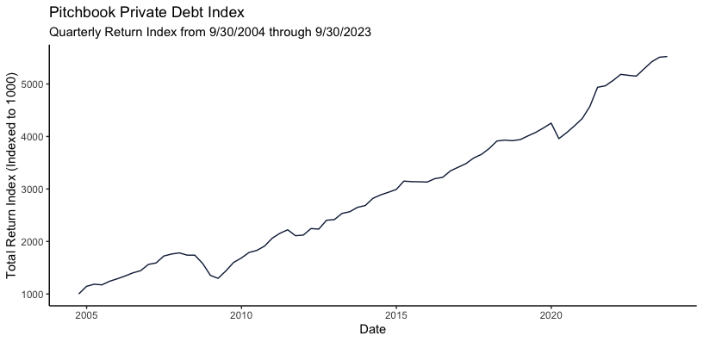
Private Credit Has Generated High Returns with Low Volatility
The Pitchbook Private Debt Index shows Private Credit has an average annual return 9.4% and an annualized volatility of 8.3%
Source: PitchBook
Note: Cumulative quarterly returns of PitchBook Private Debt Index from Q3 2004 through Q3 2023. Annualized volatility is the annualized standard deviation of quarterly returns

Slide 6
BDCs

Slide 7
Business Development Company (BDC) Overview
The market capitalization of the BDC sector has grown to nearly $59 billion but remains a relatively obscure portion of the equity market
PROVEN
INVESTMENT
STRATEGY
BDCs target private credit investments in middle market companies across the U.S.
Their investment strategy of originating senior secured loans often parallels the highly sought-after private credit funds that many BDC sponsors also manage
ATTRACTIVE
TOTAL RETURN
PROFILE
The total return profile of a BDC is mainly driven by dividends, with typical cash yields ranging from high single to low-double digits
Since 2014 the Cliffwater BDC Index has generated a total return of +100% vs. +54% for the Credit Suisse Leveraged Loan Index
STRONG
SPONSORSHIP
Today, BDCs are mostly sponsored by top tier private equity and alternative asset management firms including Blackstone, Ares and Owl Rock, among others
BDC governance has evolved significantly, with current institutional sponsors adhering to what we believe to be best-in-class management and oversight
AMPLE
LIQUIDITY
The publicly traded BDC sector currently represents nearly $59 billion in aggregate market cap with over $64 million in average daily trading volume
COMPLETE
TRANSPARENCY
Listed BDCs are public filers, adhering to the same high reporting standards as any other investment vehicle under the Investment Company Act of 1940
Quarterly earnings calls provide insight to existing and potential investors
Source: Bloomberg, Cliffwater via BDCS.com

Slide 8
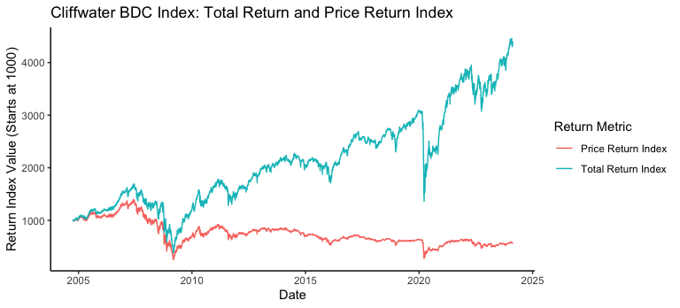
Compelling Total Return Proposition
Public BDCs can offer an attractive total return profile through a combination of dividend yield and book value appreciation
Source: Cliffwater
Note: Total Return and Price return data for Cliffwater BDC Index (CWBDC Index) from BDCs.com. Performance is measured from 9/30/2004 through 2/16/2024.

Slide 9
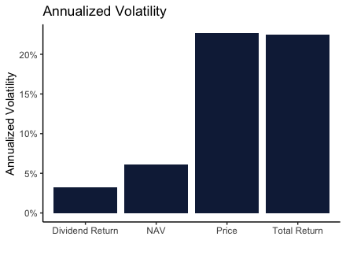
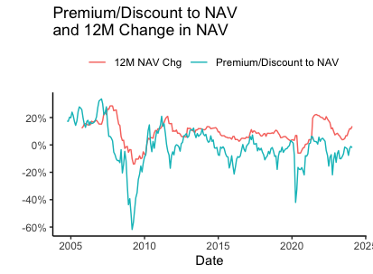
Sector Volatility
BDC valuations have tended to overshoot fundamentals during market distress
BDC share prices can demonstrate significant volatility during periods of market stress
Valuation drawdowns have historically overshot actual changes in BDCs’ Net Asset Value
Compared to BDC share prices, the volatility of the underlying portfolio NAV, or Book Value, has typically been far more stable
This may be largely attributable to the retail nature of the sector’s investor base
Source: Cliffwater via BDCS.com.
Note: Monthly premium (discount) for The Cliffwater BDC Index from 9/30/2004 through 1/31/2024. 1 Year Change in NAV is calculated as the percentage change in NAV over 1 year. Monthly Data from 9/30/2004 through 1/31/2024. Annualized Volatility is the standard deviation of the monthly change in each metric multiplied by the square root of 12. Monthly data from 9/30/2004 through 1/31/2024.

Slide 10
Synthetic Private Credit Using BDCs & Option Collars

Slide 11
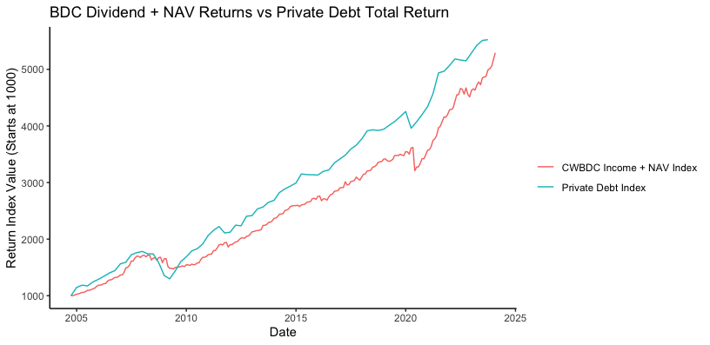
BDC Dividend Yield + NAV Changes Are Similar to Private Credit Returns
Without the price changes due to Price/NAV, BDC returns are very similar to Private Credit Returns
The assets in a BDC are very similar to the assets held in a private credit fund
When looking at just changes in BDC NAV and income returns, the returns are very similar to private credit
Removing the volatility caused by public marking could give investors a return profile like private credit but with higher liquidity
Source: Cliffwater via BDCs.com, PitchBook
Note CWBDC Income + NAV index is the sum of NAV change and income return. Performance is measured from 9/30/2004 through 2/16/2024.

Slide 12
Option Collars Can be Used to Reduce Volatility
Option Collars involve purchasing a put option and selling a call option to limit upside and downside risk on the underlying security
Protective Option Collar involves buying a put option and selling a call option
Protective Option Collars limit upside and downside to the strike prices chosen relative to the stock price
Selling the call option can help finance the purchase of the put option
Protective Option Collars change the return distribution
Note: Theoretical and assumes a zero cost option collar

Slide 13
Trading Process
Cross-hedging BDC ETF with option collar strategy can deliver the high income returns of BDCs with much lower volatility
For BDC exposure, the strategy buys the VanEck BDC Income ETF (BIZD)
Due to option liquidity and dividend ex-date issues, we hedge using the iShares iBoxx $ High Yield Corporate Bond ETF (HYG) and the Financial Select Sector SPDR Fund (XLF)
Using advanced statistical techniques, we can find the appropriate exposures to hedge BIZD
OPTIMAL HEDGING RATIO
With the target exposure to HYG and XLF we build an option collar strategy by selling puts and buying calls on the hedging ETFs
We seek to target short term expiration, with exposure equal to our optimal hedging ratio
Option Collar is added to long BIZD exposure
OPTION COLLAR
SYNTHETIC PRIVATE CREDIT

Slide 14
Backtesting Results

Slide 15
Backtest Construction
Below is the methodology and assumptions used in backtesting our strategy
BUILD TAREGT EXPOSURES FOR OPTIONS
At every rebalance date use as of date data to calculate our optimal hedging portfolio weights
Use statistical models to forecast volatility and returns to generate weights in HYG and XLF that are expected to mimic the performance of BIZD
SET TRADE TAREGTS
Find calls and puts that straddle
Since 2014 the Cliffwater BDC Index has generated a total return of +100% vs. +54% for the Credit Suisse Leveraged Loan Index
TRADE & UPDATE PORTFOLIO
Today, BDCs are mostly sponsored by top tier private equity and alternative asset management firms including Blackstone, Ares and Owl Rock, among others
BDC governance has evolved significantly, with current institutional sponsors adhering to what we believe to be best-in-class management and oversight
ASSUMPTIONS
Initial Capital is $1,000,000
Trade Costs are 10bps
Backtest is run from Jan 5, 2018 through Feb 4, 2023
Option Trades as done at Best Mid Price from WRDS. An option collar is likely to be priced more competitively than the sum of both legs due to easier delta hedging.
BIZD Trades are done at closing price
Source: Bloomberg, Cliffwater via BDCS.com

Slide 16
Thank you

