Slide 1

A Sack Full of Angry Snakes
Taming your Python dependencies with Nix
Thomas Woolford
twoolie
PyConline AU 04-08-2020

Slide 2
Packaging

Slide 3

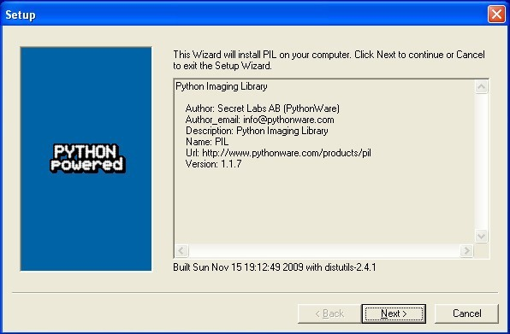
My first brush with packaging

Slide 4
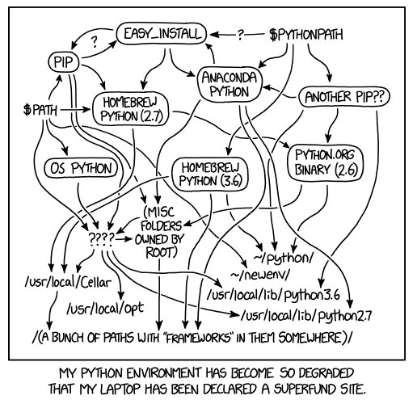
How python packages get installed
https://xkcd.com/1987/
python site_packages
  Managed by package manager (if lucky)
setup.py install
  Need root to install globally
easy_install
  Made it easier to get from pypi
pip install
  Introduced requirements files
Virtualenv, python3 venv
  Allowed separation
scipy, anaconda, beeware
  Curated package sets that integrate tightly

Slide 5
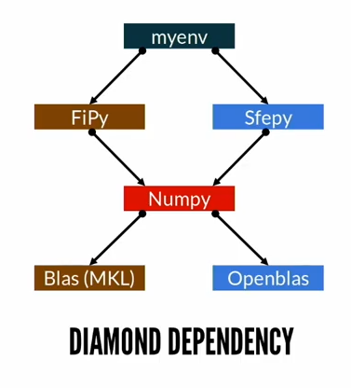
Issues still not fully solved
Incremental installations
  Install in different order, get different versions
  Diamond dependency graphs
Native dependencies
  Install requires native libs e.g. lxml, pyqt, pycrypto
  Wheels can contain shared libraries but...
  How do you patch wheels across many venvs?
System Dependencies
  How to install services provided by host system
  e.g. tests require ephemeral_pg and Redis
Using Nix for Repeatable Python Environments
SciPy 2019 – Daniel Wheeler

Slide 6
Reproducability

Slide 7
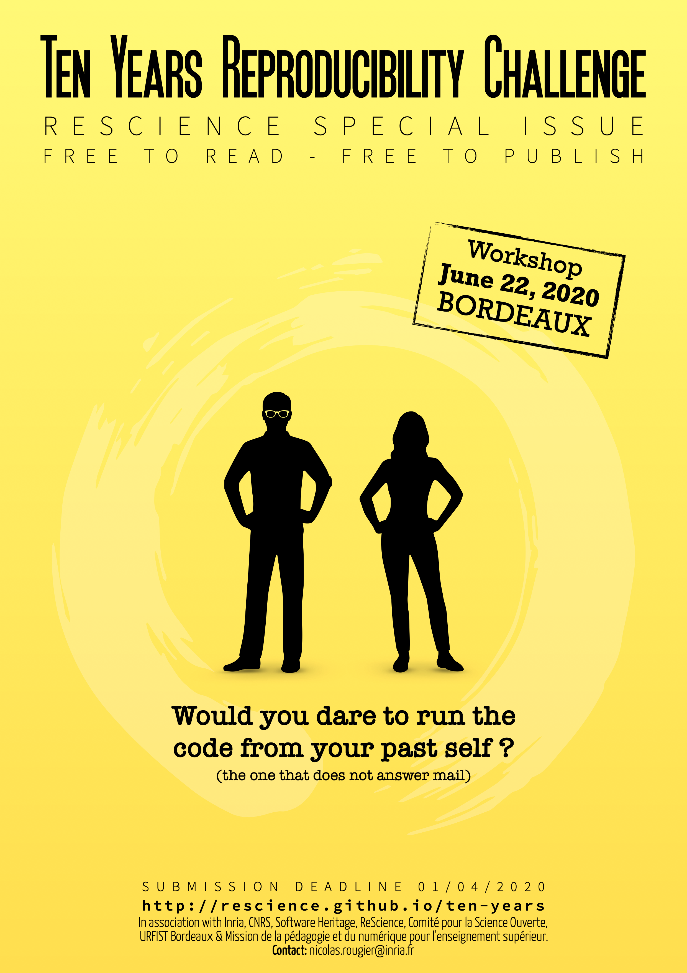
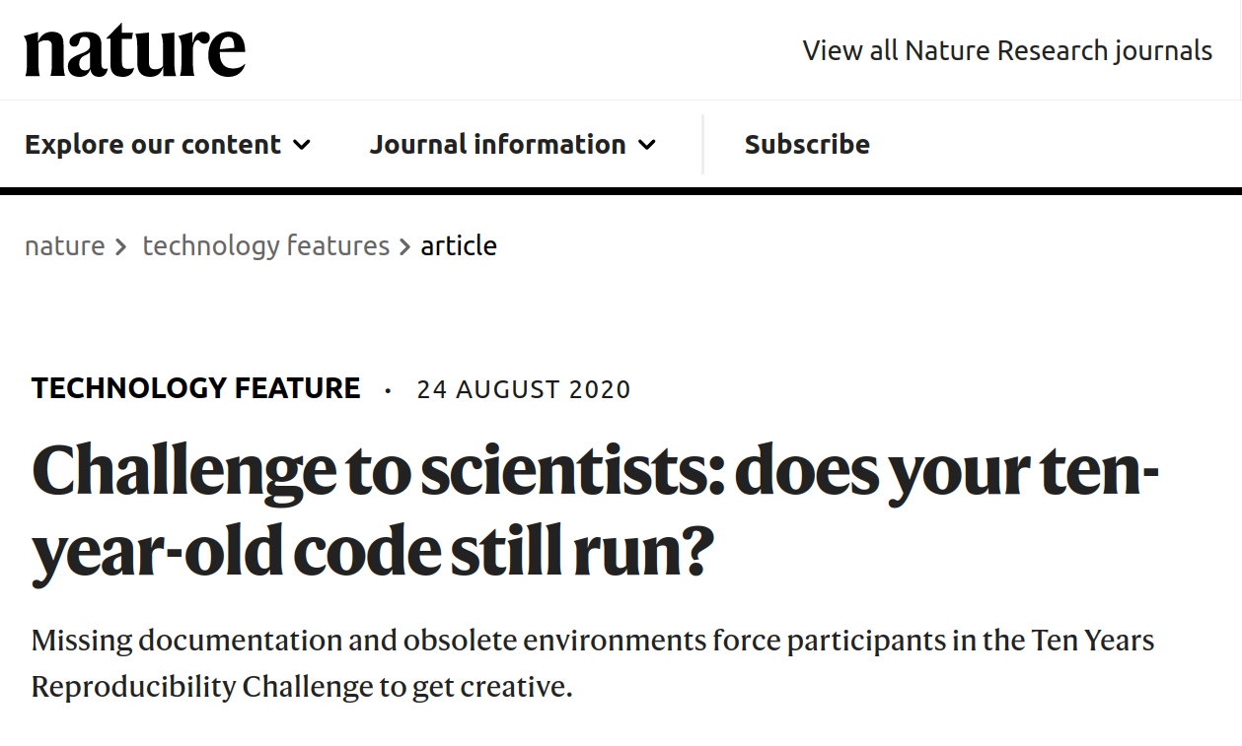
Reproducibility / Repeatability
https://www.nature.com/articles/d41586-020-02462-7

Slide 8
Reproducibility / Repeatability
Not about proving software provenance. Is about operational concerns:
How can I onboard a new developer in under a week?
  Reproducible software requires reproducible build environments
  Reproducible build environments are also development environments
How do I containerise this thing?
  Unless shipping static binaries, you should package apps within a container
  Dockerfiles are a good start, but can have surprising semantics.
Why can’t I replicate that production bug in dev?
  Someone patched the system libraries and I didn’t notice (true story)
How do I release my code along with my academic paper?
  Will my peers be able to reproduce my results in 10 years time?
Notes:
New dev onboarding can take a long time,

Slide 9

Introducing Nix
“
Nix is a powerful package manager for Linux and other Unix systems that makes package management reliable and reproducible.
”

Slide 10
What is “Nix”?
Nix – pure functional, lazy, configuration language
Nix – package manager that builds and manages environments
  Over 100 Contributors since 2003
  A swiss-army knife of tools: nix-env, nix-shell, nix-channel
Nixpkgs – community curated collection of Nix(lang) package definitions
  Nixpkgs has over 40 000 packages, over 3000 Python packages
  Multiple Stable releases per year, fast-moving unstable channel
NixOS – GNU/Linux distribution configured declaratively with Nix(lang)
  Module system makes it simple to specify services and configuration within Nix.

Slide 11
Nix Vocabulary
Expression – A pure function that describes your desired package. Dependencies become parameters to this function.
Derivation – The result of an expression, instantiated into a .drv file, that concretely defines the build inputs and build process for a package.
Result – The build output from following the rules in a Derivation. Contains only absolute paths other derivations in it’s closure.
Closure – The graph of outputs referenced by a Result.
Store – The graph database that outputs are cached into

Slide 12
Installing Nix
Single User installation - for development
$ sh <(curl https://nixos.org/nix/install) --no-daemon
Multi-User installation – for deployment
$ sh <(curl https://nixos.org/nix/install) --daemon
Enable non-free packages (e.g. chrome webdriver)
$ echo “{allowUnfree=true;}” > ~/.config/nixpkgs/config.nix
Uninstall
Remove path hook from ~/.profile
$ rm -rf /nix
https://nixos.org/manual/nix/stable/#chap-quick-start

Slide 13
Nix-env ad-hoc package management
Find a Package
$ nix-env –query --available python3
Install a package
$ nix-env --install python37
installing 'python3-3.7.8'
Upgrade a package
$ nix-env --upgrade python3
upgrading 'python3-3.7.8' to 'python3-3.9.0b5' ...
Remove a package
$ nix-env --uninstall python3
uninstalling 'python3-3.9.0b5' ...
Notes:
New dev onboarding can take a long time,

Slide 14
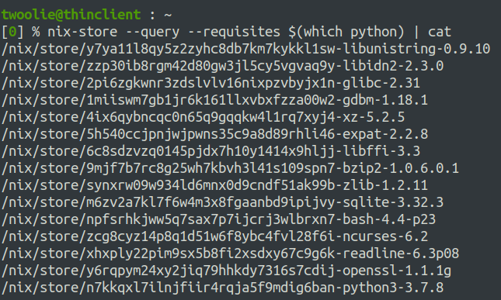
Nix-store
Notes:
New dev onboarding can take a long time,

Slide 15
Maintenance
Update package definitions (active channels are 19.09, 20.03, unstable)
$ nix-channel --update
Rollback updates
$ nix-env –rollback
switching from generation 3 to 2
Cleanup unreferenced derivations and generations
$ nix-garbage-collect --delete-older-than 30d
$ nix-store --gc
Hardlink duplicate files in store to save space
$ nix-store --optimize
Notes:
New dev onboarding can take a long time,

Slide 16
Taming the Snakes

Slide 17
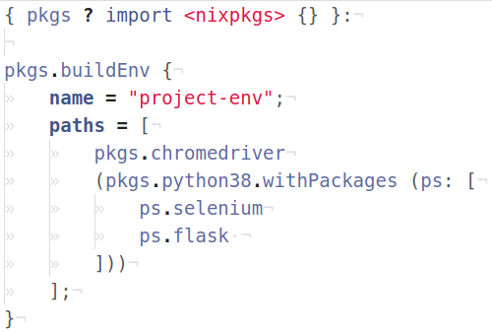
Nix-build declarative package management
$ nix-build env.nix -o ./env
Saves a symlink to the build environment, prevents nix gc from removing referenced derivations
$ nix-shell env.nix
Starts a transient sub-shell with the listed packages available on the path
env.nix

Slide 18
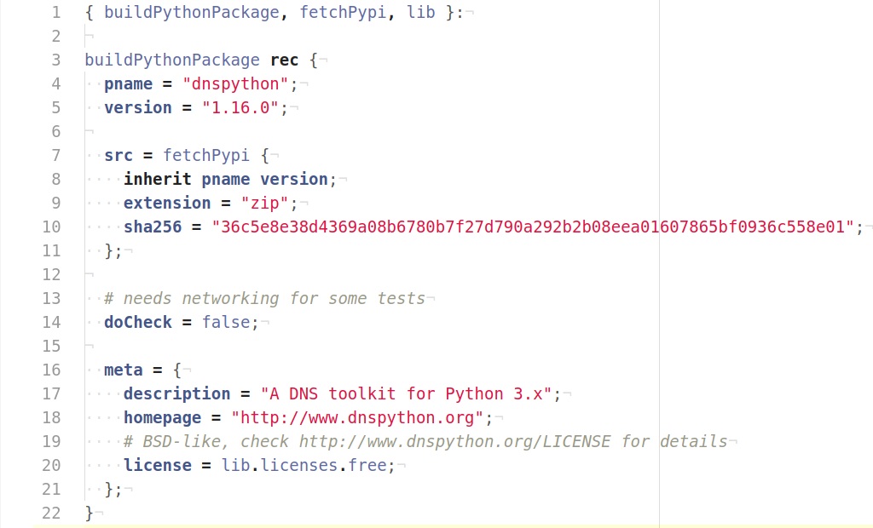
Anatomy of a Nix Derivation
This file contains a function that takes dependencies as arguments and returns a Derivation for a python package
Package will be downloaded from pypi, but must match the hash to be valid
  Source is cached in nix store
Built in a sandbox, can’t do networking.
Customary to provide metadata for tooling. Powers search.nixos.org
https://github.com/NixOS/nixpkgs/blob/master
/pkgs/development/python-modules/dnspython/default.nix

Slide 19
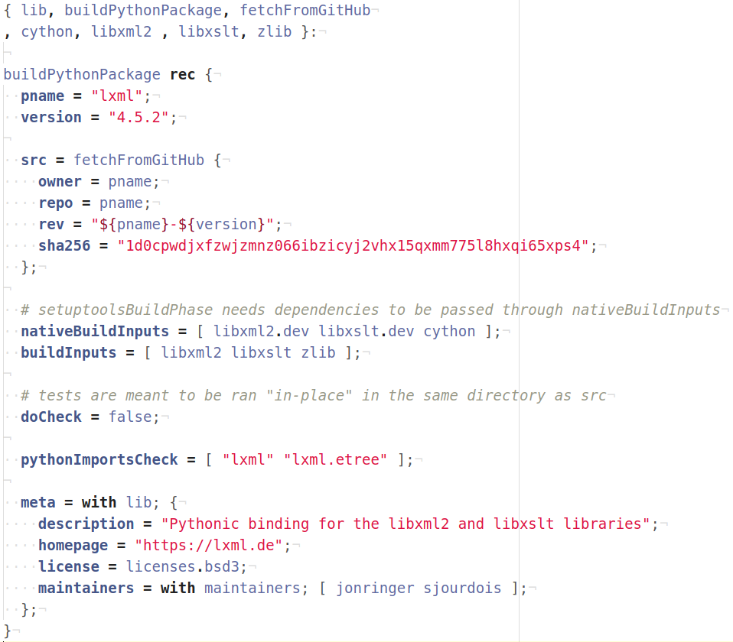
Integrating C Libs
Tarball pulled from Github by tag name.
Native Build Inputs are from host system
  “dev” package contains headers
  LXML links against libxml2 & libxslt
Build Inputs are from target system
  Cross-compilation compatible
Don’t run test-suite, but check that resulting modules import cleanly.
https://github.com/NixOS/nixpkgs/blob/master
/pkgs/development/python-modules/lxml/default.nix

Slide 20
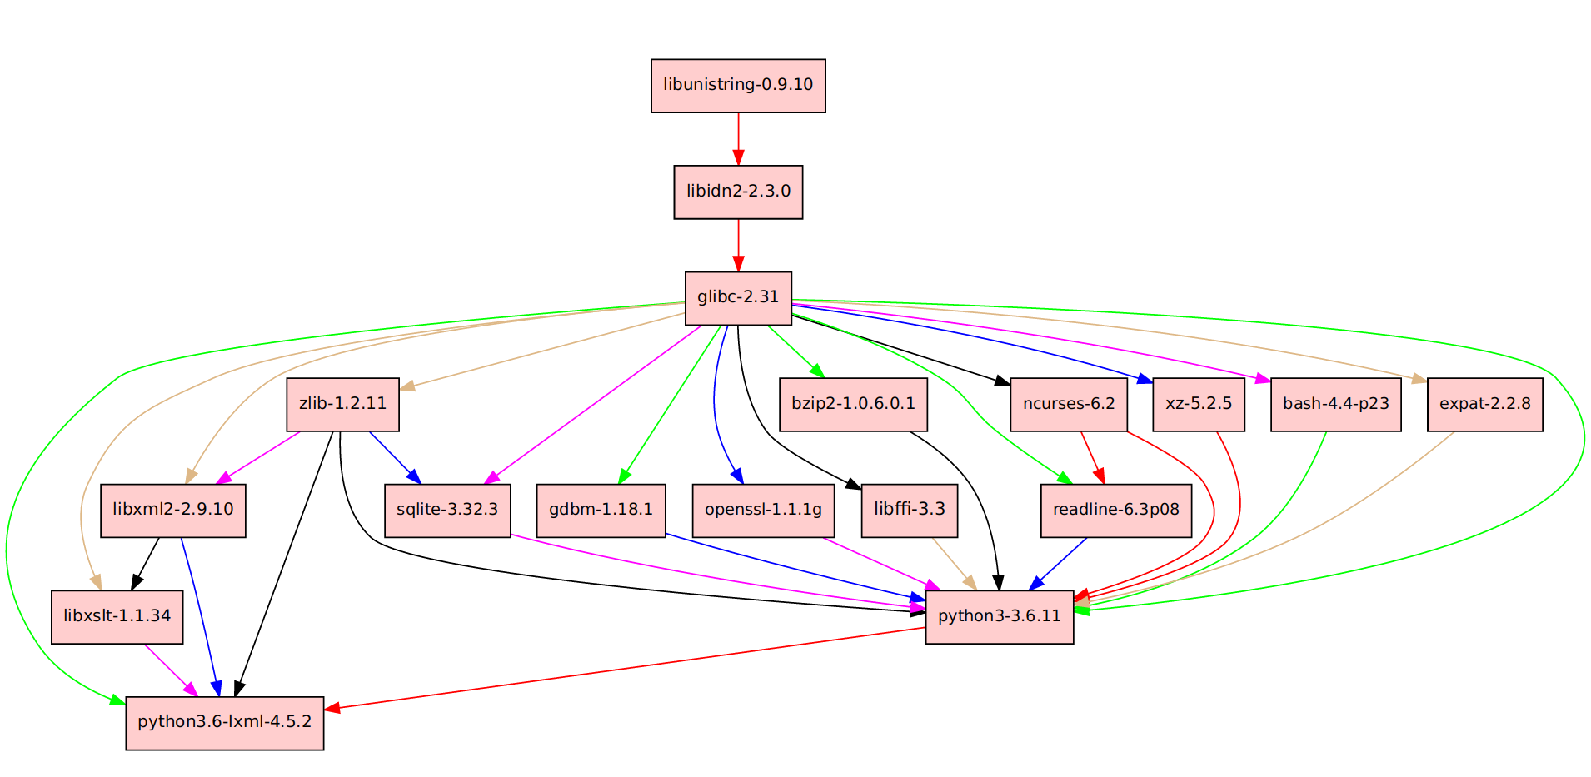

Slide 21
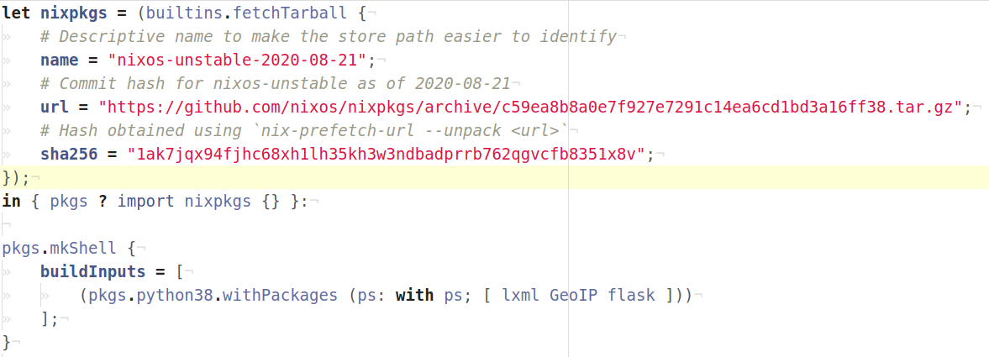
Pinning the Package Set

Slide 22
Tooling and Ecosystem

Slide 23
Many other tools included
Nix graph database as a platform, Nixpkgs as a standard library.
Functions and data-structures can be composed to provide:
Vim/Emacs configuration tools and plugins
Cross-compilation tool-chains
Docker image creation tools – Check out nixery.dev !
OS image building tools
Container/VM based system test tools

Slide 24
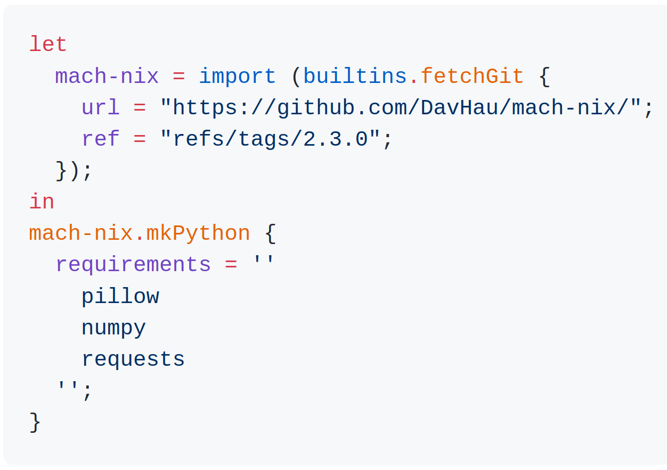

MachNix
Pros:
Easy to choose providers on a per-package basis.
Pulls packages from nixpkgs,
PyPi (sdist or wheels).
Mostly automatic dependency resolution with requirements files.
Cons:
Giant (~200MB) pypi-dep-db download.

Slide 25
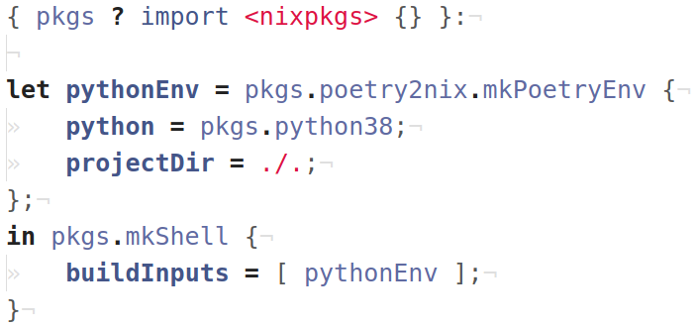
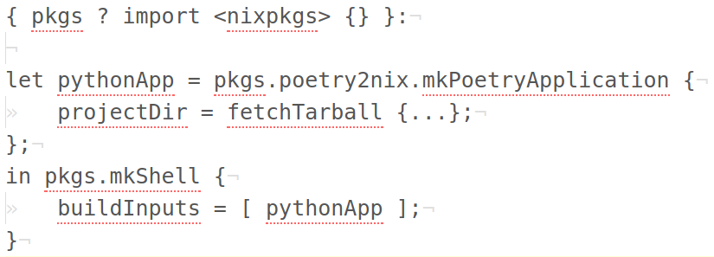
poetry2nix
poetry.nix
Pros:
Built into nixpkgs, no need to install
Consumes existing poetry TOML and lockfile
Poetry lockfile already contains hashes
Supports building from local or remote source
  Local source relative to nix file (./.)
  Remote source from web (fetchTarball)

Slide 26
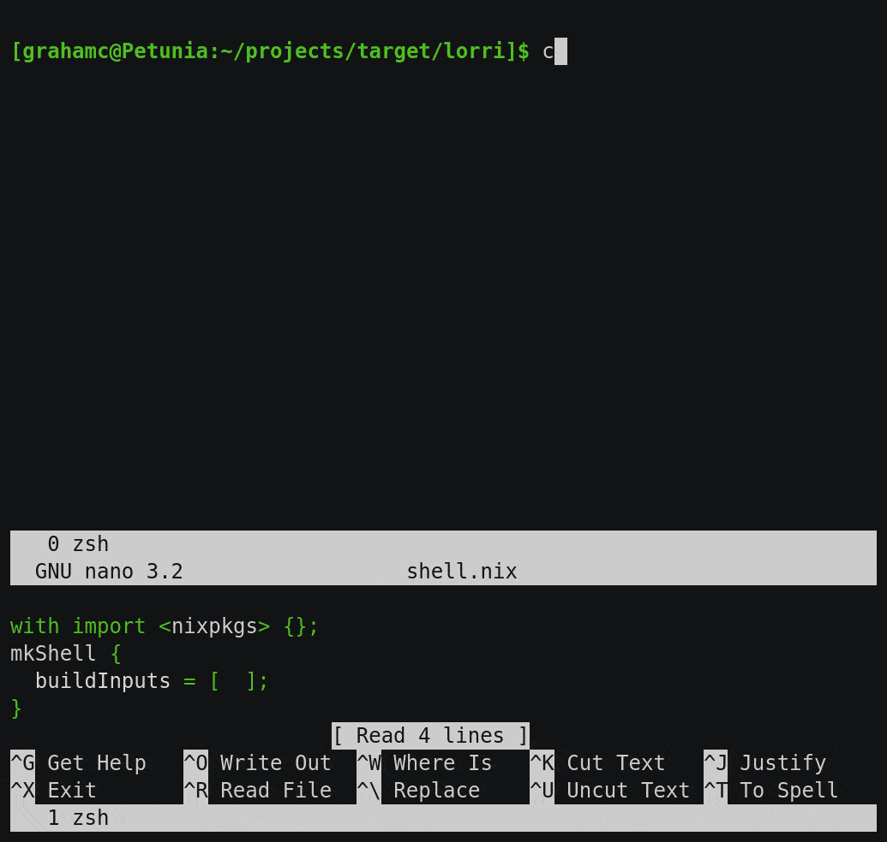
Lorri/direnv
Switches to your nix-shell environment when you cd into a project directory
$ nix-env --install direnv lorri
$ lorri init
$ direnv allow
Lorri daemon will rebuild/reload your shell environment when shell dependencies change

Slide 27
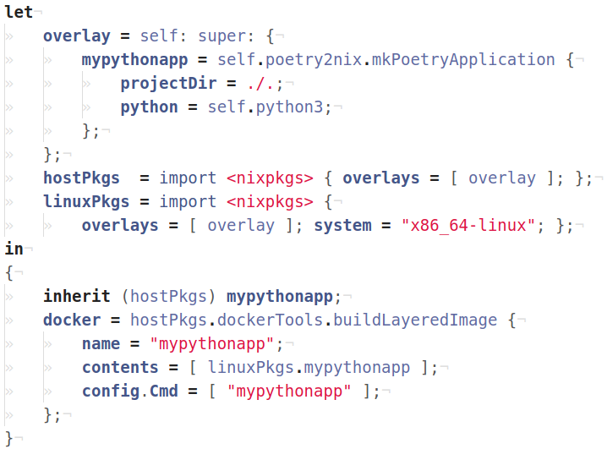
Deploying to docker
docker.nix
Docker image can be cross-built from mac
$ nix-build docker.nix \
-A docker -o image-out
Nix packs one dependency per layer
$ ./image-out | docker load
Loaded image: mypythonapp:…
Run docker container just like any other
$ docker run --rm -it mypythonapp
Hello PyCon 2020
Example code at https://github.com/twoolie/pyconau2020

Slide 28
Fantastic Resources
https://nix.dev – An opinionated guide for developers getting things done using the Nix ecosystem.
https://nixos.org/manual/nix/stable/ – The Nix Manual is incredibly comprehensive
https://nixos.org/guides/nix-pills/index.html – Step-by-Step guide from the ground up
https://nixos.wiki/wiki/Python – The Nix Wiki page for python has many tips and examples
https://github.com/nix-community/poetry2nix – The poetry2nix upstream project
https://discourse.nixos.org/ - NixOS/Nixpkgs forum and organizing platform. Ask many questions!
Using Nix for Repeatable Python Environments | SciPy 2019 | Daniel Wheeler
Beyond Python packaging with Nix | PyCon PL 2020 | Asko Soukka

Slide 29
Thanks for Watching
Questions?

