Slide 1
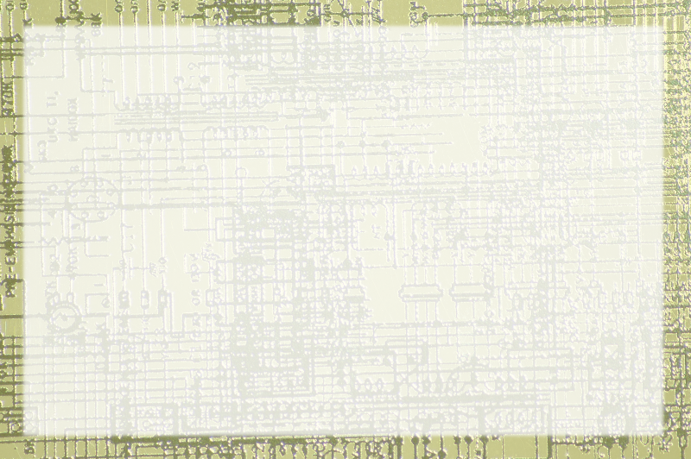
CSCI 230
Computer Science I

Slide 2
About DE
This course is distributed education
It isn't independent study
You'll probably need help
Please attend lab if you can
Don't get behind

Slide 3
Assignments
All assignments are on oncourse
Most are submitted through oncourse
A few are online quizzes and activities
Turn in on assignment page
If necessary, use drop box for backup
Normally graded within two weeks

Slide 4
Contacting me
Oncourse messages
I don't always read the chat room
Direct email: aharris@cs.iupui.edu
Stop by office hours: SL 280D
Phone: 274-8491

Slide 5
Exams
Both exams are online multiple choice
Both use oncourse
You'll get basic feedback immediately
I'll curve exams at end of semester (maybe earlier)
I never curve down

Slide 6
What you'll need at home
Decent computer (XP / Vista, Mac OS X, any reasonably recent form of Linux)
Decent Internet connection (dialup will not be satisfactory)
Additional free software (Java JDK, Eclipse Editor)
Time and place to work

Slide 7
Why come to labs?
Meet your classmates
Get a better overview of assignment
Get help if you needed
Help stay on schedule
I'd like to meet you in person

Slide 8
Final Project
Live section will present in class
You may present with live class if you wish
If you cannot do so, you will need to turn in a paper to describe your project
If you present, you only need a one-page project description.
Presentations last official day of classes (that we're scheduled to meet)

Slide 10
N342 Distributed Ed
Server - side Programming
Using PHP / MySQL / Apache

Slide 11
About DE
This course is distributed education
It isn't independent study
You'll probably need help
Please attend lab if you can
Don't get behind

Slide 12
Assignments
All assignments are on oncourse
We'll give you an apache server
Projects must be submitted on this server
You'll also need to supply source code
Normally graded within two weeks

Slide 13
Contacting me
Oncourse messages
I don't always read the chat room
Direct email: aharris@cs.iupui.edu
Stop by office hours: SL 280D
Phone: 274-8491

Slide 14
Grade Structure
Projects: 40%
Midterm Exam: 20%
Final Exam: 20%
Final Project: 20%

Slide 15
Exams
Both exams are online multiple choice
Both use oncourse
You'll get basic feedback immediately
I'll curve exams at end of semester (maybe earlier)
I never curve down

Slide 16
What you'll need at home
Decent computer (XP / Vista, Mac OS X, any reasonably recent form of Linux)
Decent Internet connection (dialup will not be satisfactory)
XAMPP or equivalent if you want to test on a local server
Time and place to work

Slide 17
PHP Versions
Videos were taped with PHP5
The book now uses PHP6
The server uses PHP5
The differences are relatively minor
You can use either style, but code must run on the server

Slide 18
Changes in 3rd Edition
XHTML Strict
No register global (filter_input instead)
Support for session variables
MySQL 5 (views!)
I'll add some mini-lectures to help with the changes.

Slide 19
Installing XAMPP
You don't absolutely need a web server at home
If you want one, I strongly recommend XAMPP.
It has everything you need in an easy installation.
If you use XAMPP, you can ignore all the installation videos.

Slide 20
Why come to labs?
Meet your classmates
Get a better overview of assignment
Get help if you needed
Help stay on schedule
I'd like to meet you in person

Slide 22
Definition of computer
Universal
Information
Manipulator

Slide 23
Universal
Works with all kinds of information
Does all kinds of stuff to it
Very few limitations

Slide 24
Information
Seems to be able to work with anything
Actually very limited
Tiny pieces of data combined into complex information

Slide 25
Manipulator
Seem able to do anything with data
Actually very limited
Simple commands combined into complex instructions

Slide 26
Analog and Digital
Most devices are analog
Computers are usually digital
This is the key to the power of computers
It's also the major limitation
What are the real meanings of analog and digital?
What are the inherent properties of these things?

