Slide 1

Analog and Digital Representation

Slide 2
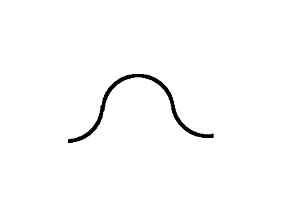
What does this mean?

Slide 3
Two, or green.

Slide 4
Computers aren't like the world
The world is analog
computers are digital
digital representation is mainly very poor
-but it has a few interesting advantages

Slide 5
Computers can’t do multimedia!
They seem to handle music videos, images, games, text
Ultimately, though, the computer can’t handle any of these things
All that works inside a computer is millions of little light switches

Slide 6
An analog thermometer

Slide 7
Analog representation of data
The world is analog
Infinite resolution
Infinite variety
Infinite room for error
Great precision, limited accuracy

Slide 8
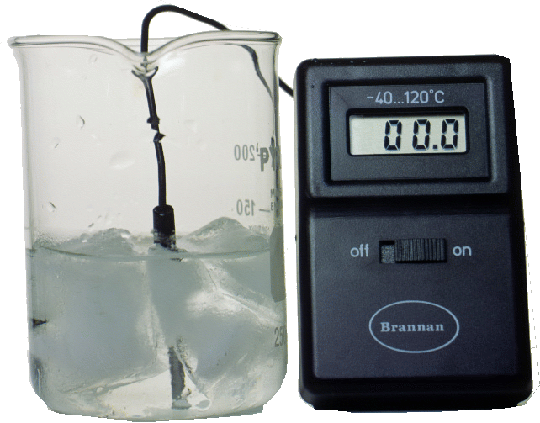
A digital thermometer

Slide 9
Digital representation
divides data into discrete chunks
finite resolution
less precision
built-in error correction
More accuracy

Slide 10
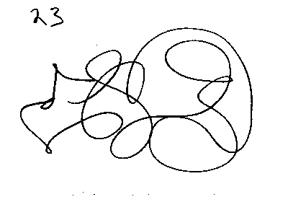
Experiment: before

Slide 11
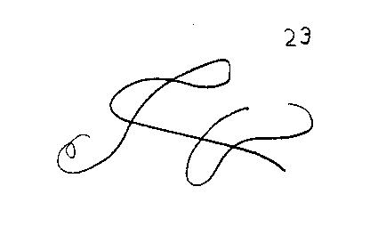
Experiment: after

Slide 12
An analog signal

Slide 13
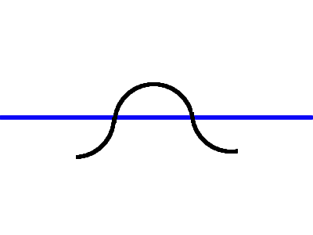
Adding a threshold

Slide 14
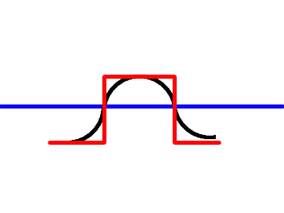
Interpreting as digital

