Slide 1
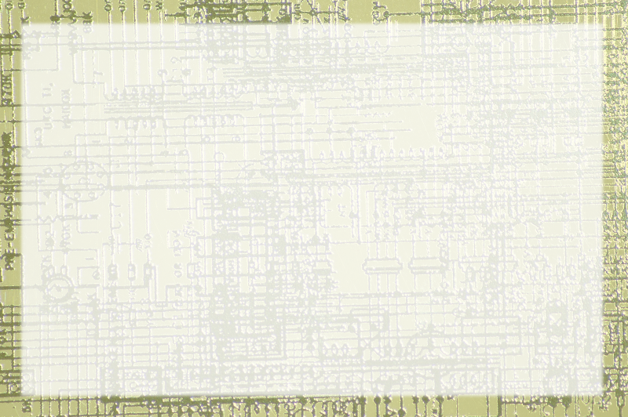
The Binary System

Slide 3
Computers and Information
Information limited to on/off impulses
Like a light switch
Infinite positions
Two outcomes
The light demo

Slide 4
Working with Multiple Switches
One switch - two messages
Two switches - four messages
Three switches - eight messages

Slide 5
Assigning Values to messages
Looking at the pattern
1, 2, 4, 8, 16, 32, 64, 128...
Seeing how it works.
The brick counter demo

Slide 6
Converting from Binary to base 10
Start with Grid
Right to left
Powers of Two
Substitute 1 with appropriate value

Slide 7
Converting from Base 10 to Binary
Start with grid
Find highest value
Subtract
Repeat

