Slide 1
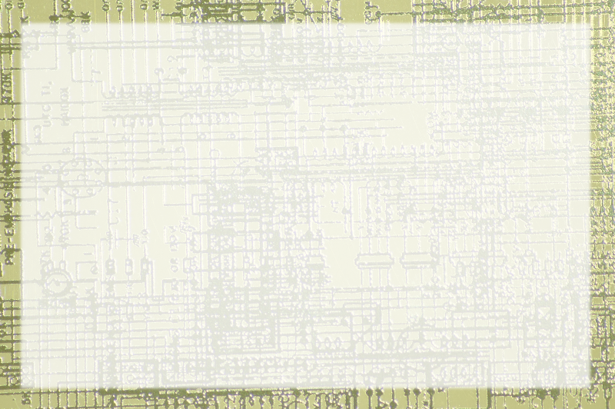
Overview of Programming Languages

Slide 2
Review of Fundamentals
A computer can only work on binary data
A computer has only 3 operations
The data is combined to make more interesting data types
The operations are combined to make more interesting instructions

Slide 3
Instructions in the Hardware
ALU operations are determined at the chip level
Programming directly in these instructions is Machine Language
Machine language is in binary, so a variation with mnemonics is Assembler

Slide 4
Low-Level Languages
Machine and assembler are low-level
They operate directly on hardware
Low level languages are extremely efficient (for the computer)
They are also extremely difficult to program with
Like building with sand rather than bricks

Slide 5
Other Low-Level Languages
Low-level languages relate directly to the processor
They are more intimately tied to the hardware
They frequently give better performance
They require more intimate knowledge of computing (EG direct memory management in C)

Slide 6
High-Level Languages
In computing, a high-level language is optimized for human readers
Details are abstracted
Higher-level languages are typically easier to program with
They are typically less efficient.

Slide 7
No Programming Language is Human
Humans communicate in expressive terms
Subtlety, Innuendo, non-verbal language all used in communication
A computer cannot handle this
Even the highest-level computer language is stilted in human terms

Slide 8
Interpreted vs. Compiled
High-level languages must be translated to machine code
An interpreted language translates the program as it's being run
A compiled language is translated before it is run

Slide 9
Interpreted Languages
Usually transmitted as readable code
Translated on user's machine
Requires interpreter software on user's machine
Generally more flexible than compiled
Generally less efficient (code speed and size)
Examples: JavaScript, Python, perl

Slide 10
Compiled Languages
Programmer runs code through a compiler
Compiler converts code to machine language
Encoded machine language is sent to users
No interpreter required on user machine
Code more efficient, less flexible
Examples: C, Pascal

Slide 11
Byte Code Languages
Somewhere between interpreted and compiled
Compiled to a virtual machine language
User has an interpreter that translates from virtual ml to actual ml
Many of the advantages of compiled and interpreted
Examples: Java, .NET

Slide 12
Java Characteristics
High Level
Byte code
Object-Oriented
Strictly typed

Slide 13
Java Overview
Developed by Sun Microsystems
Originally conceived as embedded systems language
Extends C++, which extends C
Once used heavily for applets
Used for standalone applications
Very common in server applications

Slide 14
Advantages of Java
Powerful
Free
Multi-Platform
Object-Oriented
Reasonably High-Level
Very Adaptable
Typical of Modern languages
Teaches good habits

Slide 15
Disadvantages of Java
Can be slower than compiled languages
Sometimes wordy
Sometimes considered restrictive
Strictness can be annoying

