Slide 1
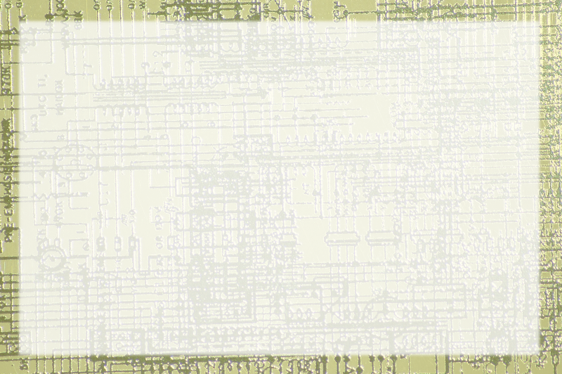
Logic Gates and Hardware

Slide 2
Limited Operations
Computer is universal information manipulator
Universal information turned out to be only 1 and 0
Manipulation also seems universal
It's only 3 things

Slide 3
And / Or / Not
Everything the computer can do to data ultimately boils down to and / or / and not
These operations can work on binary data
They can be combined to add, copy and move
These operations can be combined to do much more

Slide 4
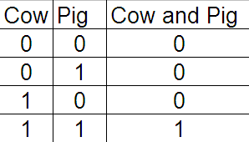
And
Usually false
Both must be true for operation to be true

Slide 5
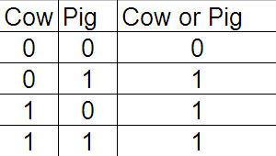
Or
Usually true
Both must be false for operation to be false

Slide 6
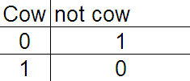
Not
Negates the input

Slide 7
Hardware implementation
Each of these operations can be re-created with hardware devices
A device that performs a logical operation is called a gate

Slide 8
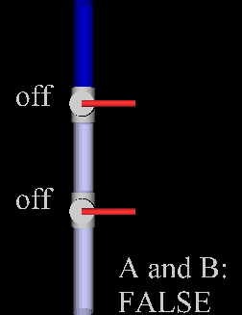
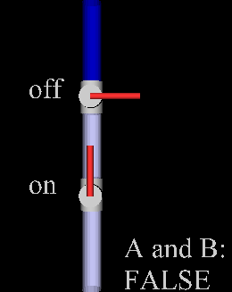
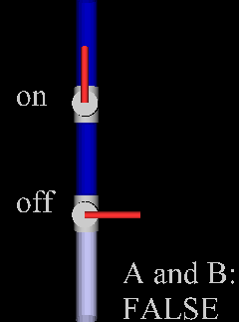
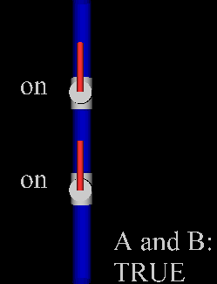
Hardware And Gate

Slide 9
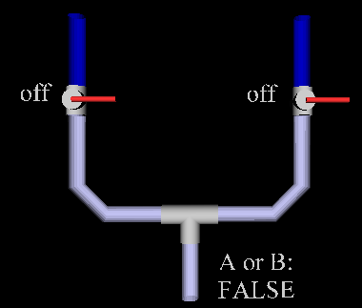
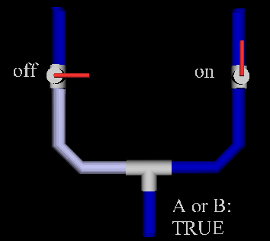
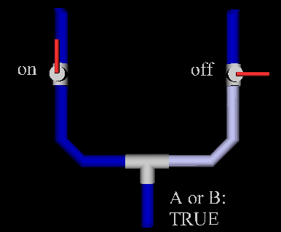
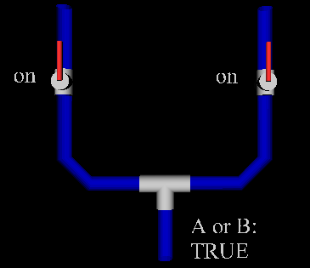
Hardware Or Gate

Slide 10
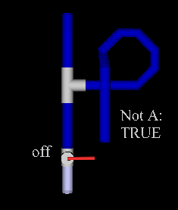
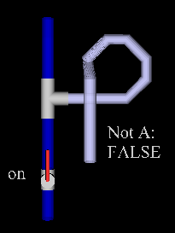
Hardware Not Gate

Slide 11
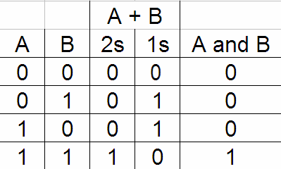
Adding in Hardware

Slide 12
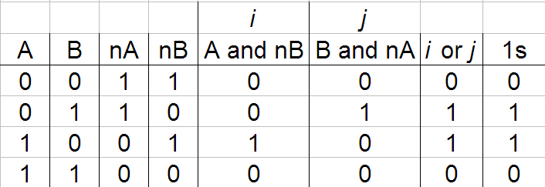
Getting the 1s Digit

