Slide 1
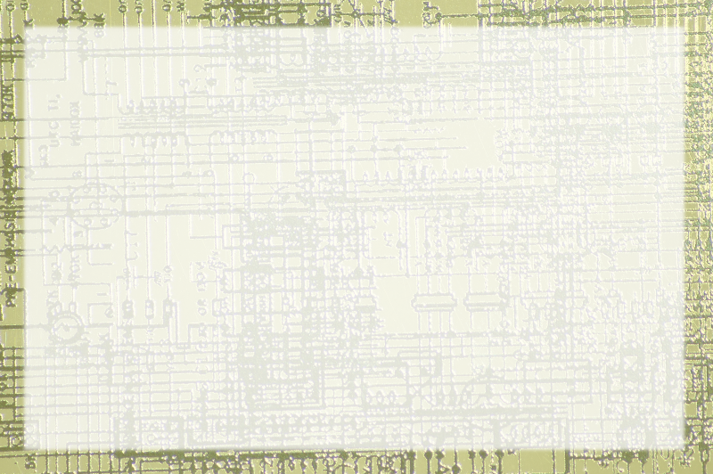
Method Input and Output

Slide 2
Methods are little programs
It's an independent entity
It has a name
It has its own variable space
Generally it's closed to the outside

Slide 3
Communicating with Methods
You can send data to a method
Parameters allow values to be sent to the method
You can also retrieve data from a method
Return values are sent from the method
Both are defined when you create a method

Slide 4
Returning a Value
Typically you don't want a method to directly interface with the user
It's better to have it send a value back
This way the same method can print to the screen, a message box, a file, or whatever

Slide 5
Using the Return Statement
Define the method with a type
Method types are just like variable types
The last line will be return <some value>
The method must return a value of the specified type

Slide 6
Using a method that returns values
The Scanner's nextLine() method returns a value
So does Random.nextInt()
When you use a method that returns a value, you'll typically print out that value or assign it to a variable.

Slide 7
Defining Parameters
You can specify one or more values to send into a method
These are called parameters.
Parameters are placed inside the parentheses following a method name
Methods require a type and a name
Inside the method, the parameter is just like a variable

