Slide 1
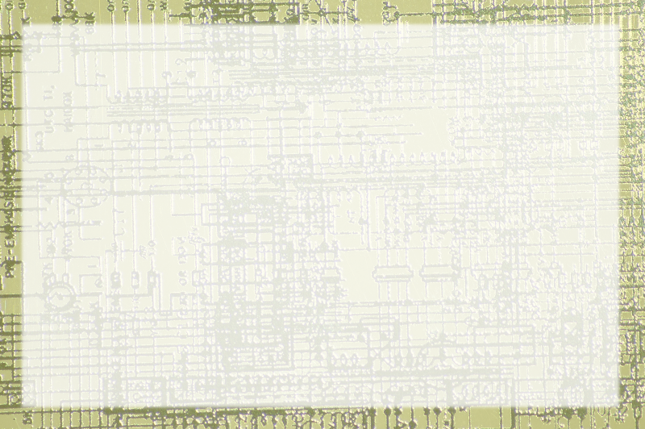
Introduction to Methods

Slide 2
Methods and Functions
As code gets longer, it gets more complex
Some organization scheme is needed
Most languages provides methods or functions for this purpose
Java uses methods, but they're very much like functions in other languages

Slide 3
Campfire Songs!
(v1) The ants go marching one by one, hurrah, hurrah….
(chorus) and they all go marching down…
(v2) The ants go marching two by two, hurrah, hurrah …
Roadmap:
  v1, chorus, v2, chorus, v3, chorus

Slide 4
Description of Methods
A little program
Contains its own data
Solves a single specific problem
Has a name
Has a type (void for now)

