Slide 1
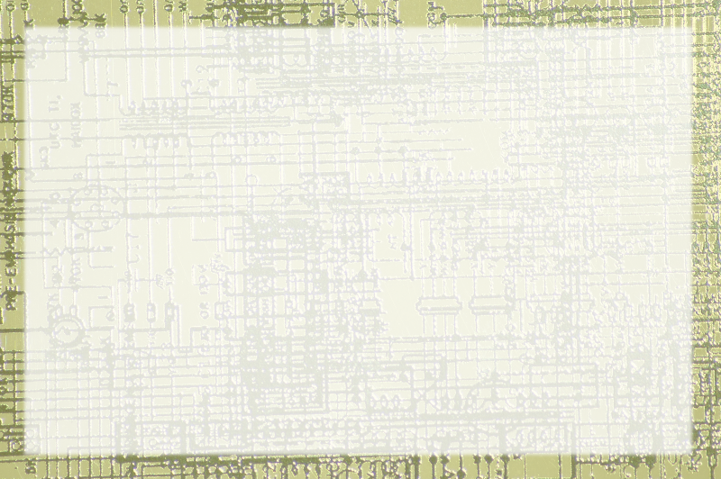
What is a Computer?

Slide 2
Working Definition:
Universal Information Manipulator

Slide 3
Universal
Appears to be capable of many things
Computers can act like phones, typewriters, paintbrushes, even elephants and submarines
Computers seem to be able to do anything with this stuff

Slide 4
Information
Computers are unique in working with information
The information can be generic
The information can be transformed
Just about any information can be manipulated

Slide 5
Manipulator
Like the types of data, the types of manipulation seem endless
The computer can do anything with the data.

Slide 6
Or can it???
Actually, computers aren't universal at all…
They only have two types of data
They only do three things to it
Somehow those three operations on two values can be put together to build a computer

