Slide 1
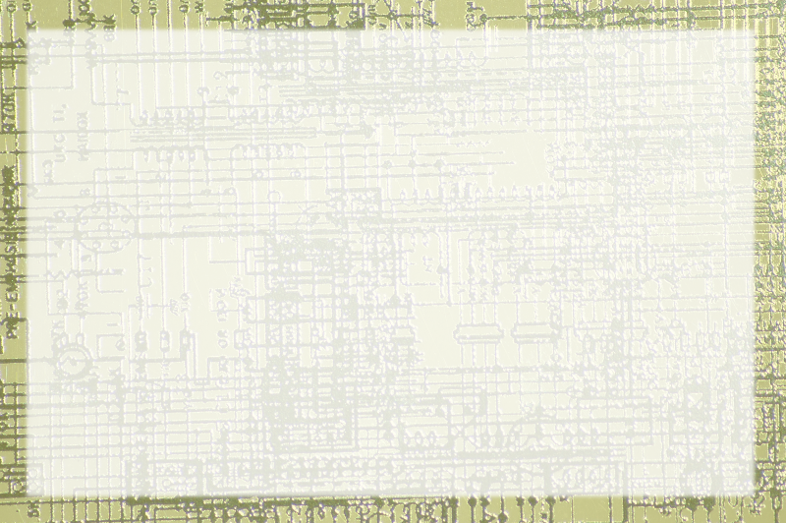
Von Neumann in a Nutshell

Slide 2
Combining Operations
You can combine and or and not to add
You can also build gates to copy
These can be used to build other basic operations
You can make a hardware machine with a number of basic operations
This device is called an ALU

Slide 3
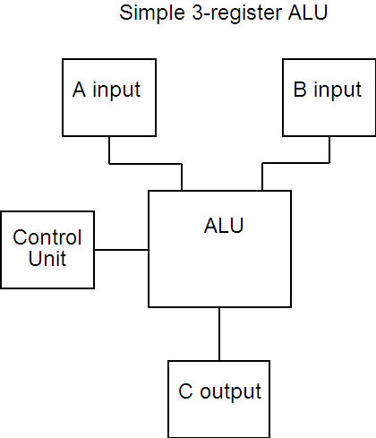
The Arithmetic Logic Unit

Slide 4
Common ALU Registers
Arithmetic Logic Unit
Typically has two data inputs
A control line input
An output
Often a special overflow unit
Program Counter

Slide 5
Registers and Memory
Most data is in memory (parking lot)
The ALU is the work area (repair bay)
ALU workflow:
  Bring data in
  Do something to it
  Store it back in memory
Registers are faster and more expensive than regular memory

Slide 6
The Beauty of Stored Programs
Even instructions are data!
The program itself is stored in memory
Grab an instruction from memory
Act on it
Get another
The computer can 'modify itself'

Slide 7
The Fetch Execute Cycle (simplified)
Find the address of the next instruction
Load the instruction from memory
Load data into input registers (if required)
Load command into control register
Process ALU
Store response in memory (if required)

Slide 8
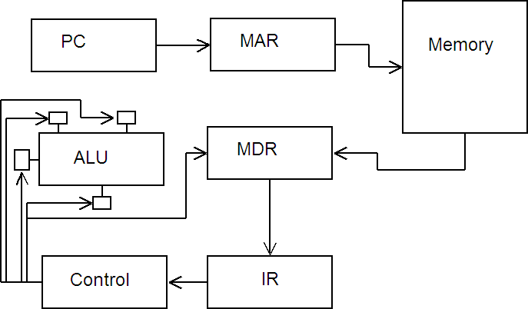
Control Overview

Slide 9
How Control Works
PC indicates next command address
MAR uses the address to fetch command from memory
Command placed in MDR - copied to IR
Control unit may place orders for other data
Data placed in registers
ALU committed
Result in ALU output
May be copied back to memory
PC incremented

Slide 10
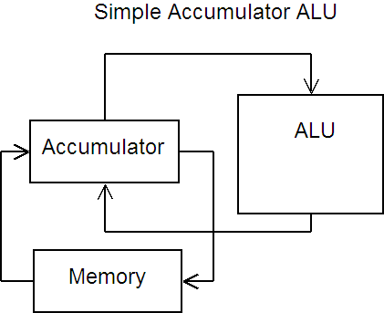
Using an accumulator
An accumulator can streamline memory access

Slide 11
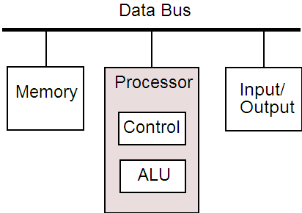
Von Neumann Architecture

Slide 12
Memory
Holds data
Typically volatile
Many levels - faster = more expensive

Slide 13
Processor
ALU
  brain of the computer
Control
  Control circuitry

Slide 14
Input / Output
Mechanism for communicating with devices
Monitor, keyboard, clock, mouse, other things
Has the ability to temporarily interrupt other processes

Slide 15
Data Bus
Mechanism for tying the whole thing together
Width of the bus (in bits) a major determinant of computer speed

Slide 16
Moore's Law
Every 18 months, Computing hardware doubles in speed and capacity
Predicted in 1965 by Intel co-founder Gordon Moore
Still true - trend seems to be continuing

Slide 17
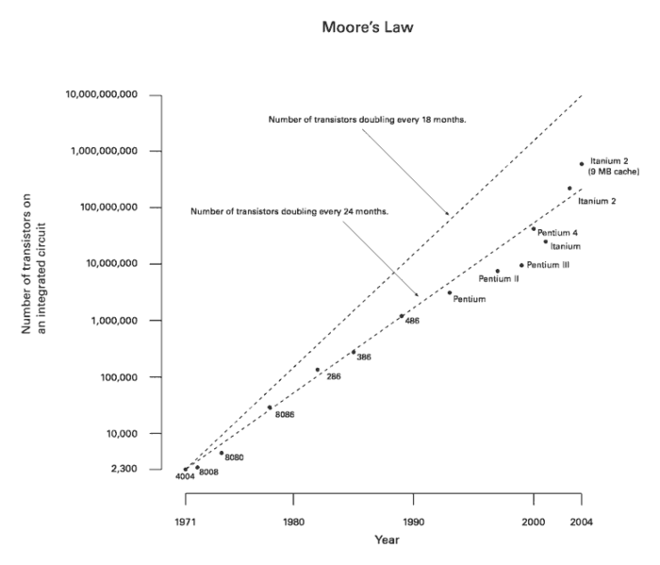
Image from wikipedia

