Slide 1

Introducing Arrays

Slide 2
Overview of Arrays
Composite Data
One variable with many values
Like a golfing scorecard
Holes are numeric index
Score is value
Hole | Score
1 | 3
2 | 5
3 | 8

Slide 3
Java Arrays
Each element must be same type
Size of array must be determined before use
Indices must be numeric
Value can be any type (as long as all elements have same type)

Slide 4
Defining an Array
Square braces indicate array ([])
String[] games = new String[5]
  Indicates a string array called games.
  String[] means create string array
  This array will have room for five String elements
  You still need to create each element in the array

Slide 5
Pre-Loading an array
String[] games = {
"Super Mario",
"Legend of Zelda",
"Pac-Man" };
Pre-loads array
Number of elements already determined
Useful when you know what will be in an array at run-time

Slide 6
Creating an Empty Array
Sometimes you'll be adding things to an array later:
String[] platforms = new String[4];
This creates an empty String array with room for four elements
You'll have to enter elements later

Slide 7
Interacting with Array Elements
Use square braces to describe an array element:
platforms[3] = "Wii";
System.out.println(platforms[3]);

Slide 8
Using Loops with Arrays
Arrays and for loops are natural companions
Use a for loop to iterate through an array
Use length as a maximum counter value to adapt to array length.

Slide 10
Multi-dimension Arrays

Slide 11
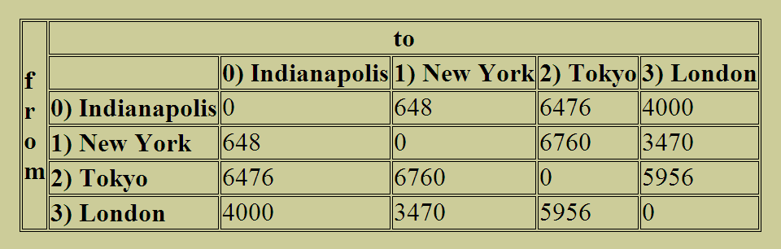
Two-dimensional data
Sometimes data comes in a tabular format:

Slide 12
Two-dimension arrays
You can create a special two-dimensional array.
Each element has two indices, one for row, and one for column
Two-dimension arrays are often read with nested for loops.
You can also make arrays of 3, 4, or more dimensions.

