Slide 1
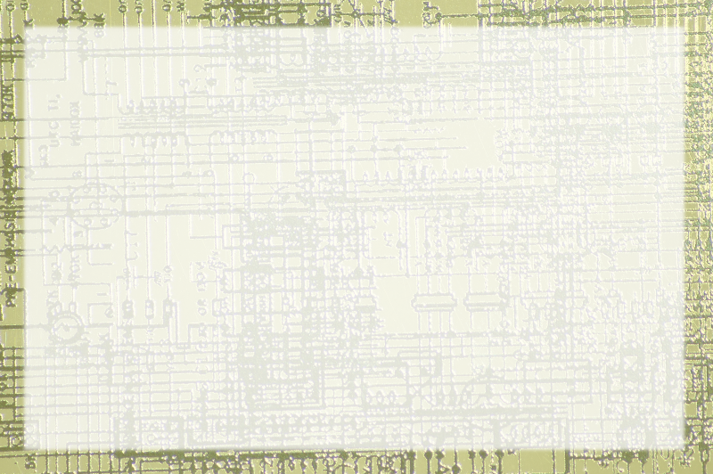
Using Classes for Data

Slide 2
Goal:
Demonstrate a reasonably complete app
Handle multiple buttons
Build complex interface
Store data in a Java-centric way

Slide 3
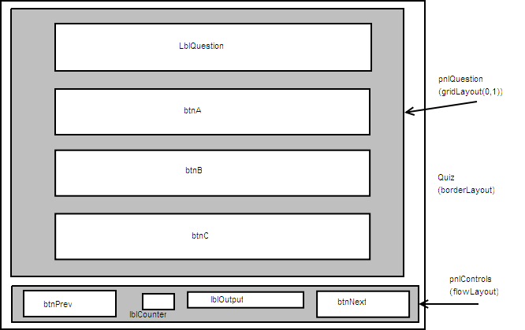
Diagram

Slide 4
Data Model
Problem
  Question
  AnswerA
  AnswerB
  AnswerC
  Correct
Constructor for input
Getters for output
Place in an array

