Slide 1
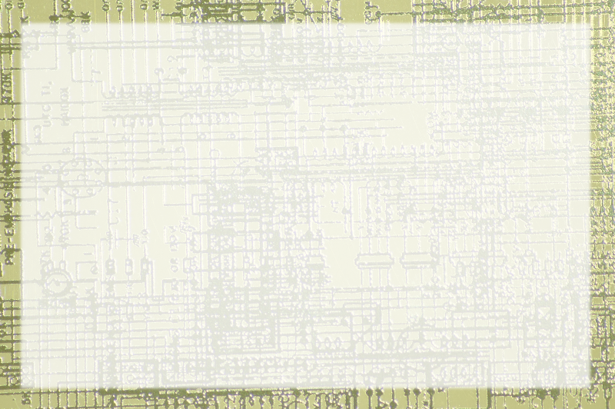
Handling GUI Events

Slide 2
Overview
A GUI usually uses event-driven programming
Set up the initial screen
Incorporate widgets which broadcast events
Respond to event
I/O is changing widget properties

Slide 3
Basic Events
Events are classes
So are event handlers
The ActionListener is a (sort of) class used for listening to events.
To respond to an event, make a subclass of ActionListener

Slide 4
Using an ActionListener
Create a subclass based on ActionListener
(use implements rather than extends - will be explained later)
Add an actionPerformed method
Accept ActionEvent as a parameter
Register the actionListener in the main code

Slide 5
The Multiple Inheritance Trap
Using a completely separate class is troublesome
Doesn't have access to main class
Main class should be extended from ActionListener
It should also be extended from JFrame
Java doesn't allow multiple inheritance

Slide 6
Adapters and Interfaces
An interface is a lightweight class
  No instance variables, just empty method bodies
It's a promise to include the indicated method.
Interfaces are implemented rather than extended.
You can implement as many interfaces as you wish

Slide 7
The ActionListener Interface
When you implement actionListener, you promise to have an actionPerformed method.
Now the main class can be registered as an actionListener
The actionPerformed method is a method of the main class, can access its instance variables.

Slide 8
Managing Multiple Inputs
It's possible to have many buttons (or other action widgets) on a screen.
Use e.getActionCommand() to determine the caption of each button.
If you wish, you can explicitly set the action command of a button.

