Slide 1
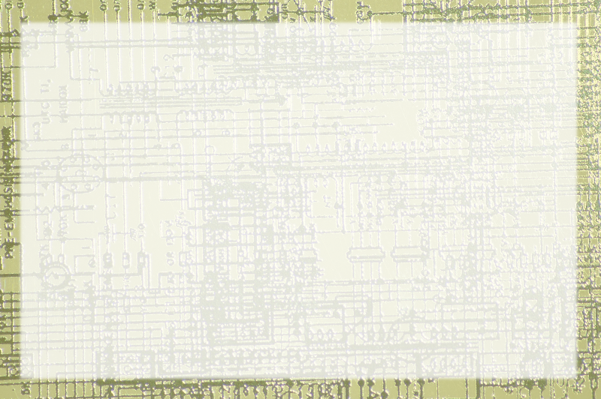
Floating Point Notation

Slide 2
Fractional values
Can you do fractions in binary?
How about the decimal (binary?) point
What does .1 mean in binary?
How about .01?

Slide 3
Reviewing binary notation
Values to the left of the point are two raised to positive exponents:
2³ 2² 2¹ 2⁰
8 4 2 1

Slide 4
Extending the notation
Values to the right of the point are 2 raised to negative exponents:
2⁻¹ 2⁻² 2⁻³ 2⁻⁴
½ ¼ 1/8 1/16
.5 .25 .125 .0625

Slide 5


Converting binary to decimal
Convert .101 (binary) to decimal
Use fractional values
Add 'em up

Slide 6
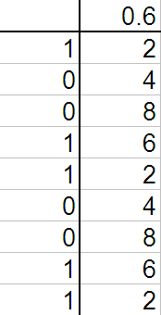
Converting decimal to binary
Find binary representation of .6
Multiply fractional part by two
Track integral part
Repeat

Slide 7
Problems with real numbers
Limited precision
You can't do .6 accurately in binary!
You can get close but never perfect
Many other numbers have this problem
(It was always there in base 10 too)

Slide 8
Floating point notation
So how do you record a decimal point in binary?
Two main approaches:
  Fixed point
  Floating point
Fixed is easier, but far less flexible
Floating point is now standard on most computers

Slide 9
Scientific notation
Avagadro's Number:
6.02 * 10²³
Scientific notation describes very large and very small numbers
6.02 is Mantissa
10 is Base
23 is Exponent

Slide 10
Devising an integer notation
Scientific notation can be modified for binary
Store mantissa and exponent as integers
Use 2 as the base
Eg .01 binary could be seen as
0001 * 2⁻²

Slide 11
A representative notation
For simplicity, let's devise our own format
ABBBBCDD
A = sign of mantissa
B = magnitude of mantissa
C = sign of exponent
D = magnitude of exponent

Slide 12
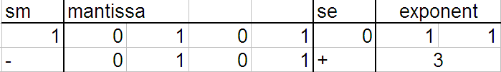
Using our notation
Start with a floating number
Break it into pieces
Resolve all but mantissa

Slide 13

Conversion cont'd
Begin with mantissa in binary
Move binary point
Solve as a binary conversion problem
(don't forget sign of mantissa)

Slide 14
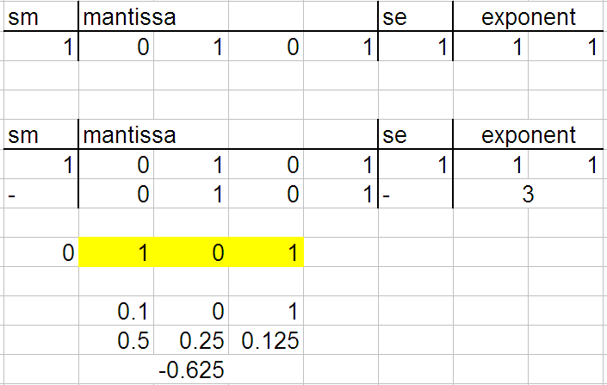
Working with negative exponents
Same, but move binary point to left

Slide 15


Decimal to float conversion
Start with a decimal value
Find the binary point approximation
Convert to 4-digit mantissa

Slide 16
Conversion cont'd
Draw grid
Fill in pieces
NOTE: there can sometimes be more than one answer

Slide 17
"Real" floating point notations
This form (ABBBBCDD) is an approximation
Numerous real forms exist
More digits
Binary point starts at left
Idea is the same

Slide 18
Limits of floating point
Number of digits limits precision
Size of exponent determines overall range
Size of mantissa determines precision
Both have limits
Some values are impossible
Floating point is harder on the CPU

