Slide 1
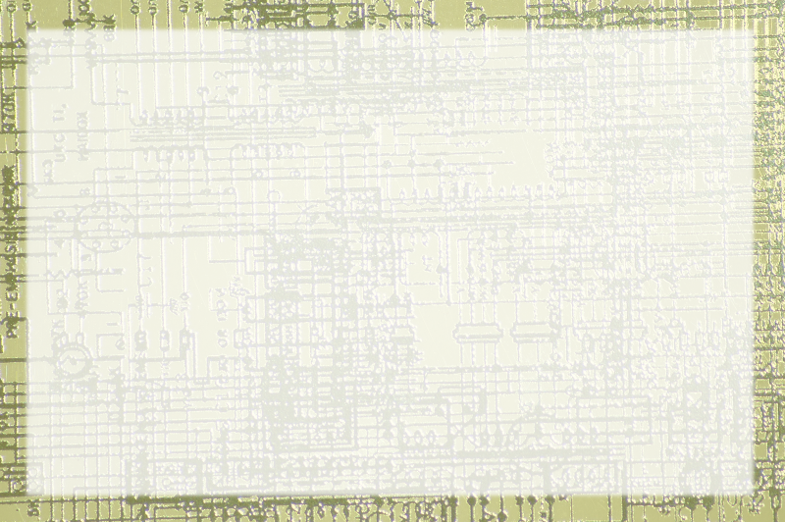
Repetition with loops

Slide 2
The For Loop
Used to repeat action a certain number of times
Sentry variable (usually an int)
Initialization
Condition (continue while true)
Update

Slide 3
The While loop
Repeats indefinitely
Relies on condition

Slide 4
Well-behaved loops
Initialization outside loop
Well-thought condition
Condition changes inside loop

