Slide 1
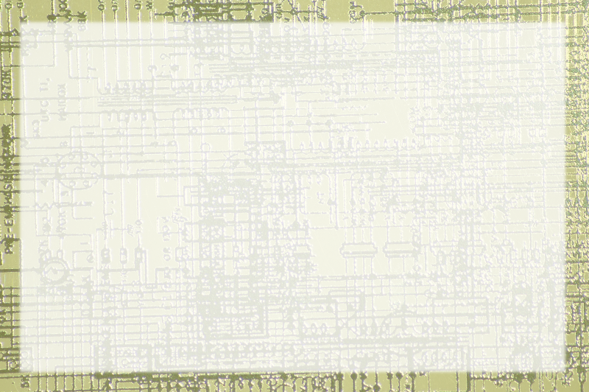
Machine Language Overview

Slide 2
xMachine
Simplified machine / assembly simulator
Uses small instruction set
Reasonably accurate
Small set of opcodes
Accumulator-based

Slide 3
xMachine Data Opcodes
LOD address
  Load contents of address into acc
LOD-C value
  Load constant value into acc
STO address
  Store contents of acc to address
Add address
  Add contents of address to acc, store sum in acc

Slide 4
xMachine Control Opcodes
HLT
  Stop program clock, halt execution
JMP address
  Set PC to address
JMZ address
  Set PC to address if acc == 0 (otherwise next line)

Slide 5
xMachine Conventions
Assembler in all upper-case
Comments begin with ;;
Labels end with :
White space is ignored

Slide 6
Challenge 1:
Store the value 10 in cell 5

Slide 7
Challenge 2:
Store the value 10 in a cell named "target"

Slide 8
Challenge 3:
Make cells a, b, and sum
Add a and b
Put result in sum

Slide 9
Challenge 4: Countdown
Create a cell named "countdown"
Initialize countdown to 10
Subtract 1 from countdown
Repeat until countdown is zero
Should work with any positive integer in countdown

Slide 10
Challenge 5: Count Up
Create a countdown cell (10)
Create a second counter cell (0)
As countdown goes down, make counter go up.
At end of run, countdown should be 0, counter should be 10
Should work with any positive integer in countdown

Slide 11
Challenge 6: Count by Threes
Create a program that counts by threes
Hint: it will be much like count up

Slide 12
Challenge 5: Multiplier

