Slide 1
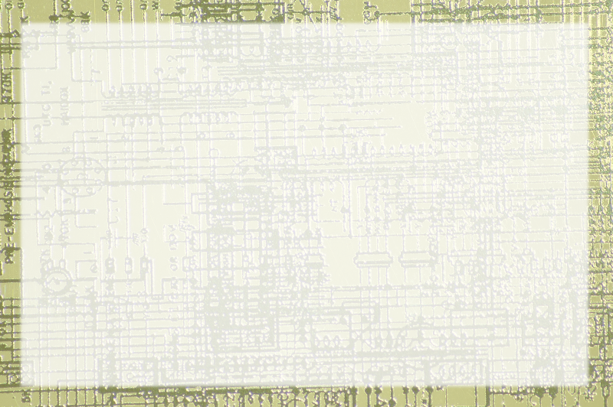
Binary to Octal and Hex

Slide 2
Binary is good…
Because it's the underlying format of computers
But
  it's a pain to work with.
  11001100001010
Base 10 is more natural for humans
Conversion is tedious

Slide 3
Base 8 (octal)
Rather than raising 10 or 2 to powers,
Use 8
123 base 8 =
3 * 8^0 (1) 3
+ 2 * 8^1 (8) 16
+ 1 * 8^2 (64) 64
83 base 10

Slide 4
Base 8 characteristics
Max: 7
Min: 0
Possible values: 8

Slide 5
3 Digits of binary
Max: 7
Min:0
Possible values: 8

Slide 6
PATTERN!
Whatever can be expressed in 3 digits of binary…
Can be expressed in one digit of octal!
101 binary is 5 octal
010 binary is 2 octal
For three digits of binary, converting to octal is just like converting to decimal

Slide 7
Converting Binary to Octal
111011
Break into groups of 3 (from right)
111 011
Solve each group of three as an independent problem
421 421
111 011
7 3 octal

Slide 8
Octal to Binary
45 base 8
Turn each octal digit to 3 digits of binary:
421 421
100 101 binary

Slide 9
The problem with Octal
Computers tend to work in bytes (8 bits)
Octal prefers lengths of 6 or 9
Eight bits fits in three digits of octal….
But what about 643 octal?
It's possible to have a three digit octal that doesn't fit in a byte.

Slide 10
Four digits of Binary
Max: 15
Min: 0
Number of values: 16
This would be like base 16. (Hexadecimal)

Slide 11
Converting Binary to Hex
10010111
Break to groups of four from right
8421 8421
1001 0111
9 7

Slide 12
But there's a problem…
What about this value?
1100
It comes out to 12 decimal,
But 12 hex means 16 +2 = 18!!
We can't use base 10 place value here.
We must 'invent' new numerals

Slide 13
The Sneaky Solution
10: A
11: B
12: C
13: D
14: E
15: F

