Slide 1
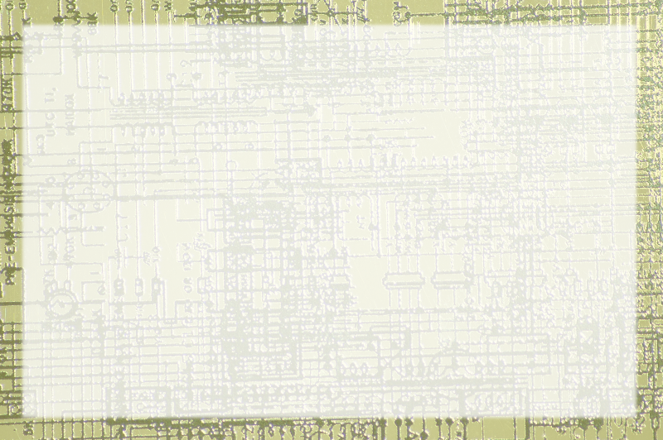
Two's Complement

Slide 2
Adding Binary Numbers
101 + 111 = ?

Slide 3
Subtracting binary numbers
101-11 = ?

Slide 4
Multiplying binary numers
101 * 101 = ?

Slide 5
Limit of unsigned ints
Values can get too big
No matter how many digits you have,
There will be a number too big to handle
No negative numbers!

Slide 6
Possible Negative Solutions
Sign Magnitude
  Two zeros!
  5 + (-)3 doesn't work
  'wasted bit'
Ones complement
  Seems possible
  Still causes same problems

Slide 7
Two's Complement
Just like unsigned - but
Leftmost digit is negative!
1001 is -8 + 1 = -7
All positive values have leading zeros
All negative values have leading ones
Adding negatives works!
5 + -3 = 2 0101 + 1110 = ?

Slide 8
Leading 1s
1 two's comp is -1
11 is -2 + 1 or … -1
111 is -4 + 2 + 1 … -1
11111111 is -1!
Negative numbers in twos comp have an infinite number of leading 1s
100 = 1100 = 111100 = -4
Normally we use eight digits to avoid confusion

