Slide 1
Mode Matching Technique
With 2 circular cross-section waveguides
Tworit Kumar Dash
Student Number: 4816315

Slide 2
Field distribution of one circular cross-section waveguide
Dimensions and properties:
Radius = 2.03 [cm]
Relative Permittivity
Relative Permeability
Covered with PEC walls
$$ϵ_{r}=1$$
$$μ_{r}=1$$

Slide 3
Field distribution of one circular cross-section waveguide (2)
$$TE^{z}modes$$
$$E_{ρ}=-\frac{1}{ϵρ}\frac{∂F_{z}}{∂ϕ}=-A_{mn}\frac{m}{ϵρ}J_{m}(β_{ρ}ρ)[-C_{2}sin(mϕ)+D_{2}cos(mϕ)]e^{-jβ_{z}z}$$
$$E_{ϕ}=\frac{1}{ϵ}\frac{∂F_{z}}{∂ρ}=A_{mn}\frac{β_{ρ}}{ϵ}J_{m}^{{}^{′}}(β_{ρ}ρ)[C_{2}cos(mϕ)+D_{2}sin(mϕ)]e^{-jβ_{z}z}$$
$$H_{ρ}=-j\frac{1}{ωμϵ}\frac{∂^{2}F_{z}}{∂ρ∂z}=-A_{mn}\frac{β_{ρ}β_{z}}{ωμϵ}J_{m}^{{}^{′}}(β_{ρ}ρ)[C_{2}cos(mϕ)+D_{2}sin(mϕ)]e^{-jβ_{z}z}$$
$$H_{ϕ}=-j\frac{1}{ωμϵ}\frac{1}{ρ}\frac{∂^{2}F_{z}}{∂ϕ∂z}=-A_{mn}\frac{mβ_{z}}{ωμϵ}\frac{1}{ρ}J_{m}(β_{ρ}ρ)[-C_{2}sin(mϕ)+D_{2}cos(mϕ)]e^{-jβ_{z}z}$$
$$H_{z}=-j\frac{1}{ωμϵ}(\frac{∂^{2}}{∂z^{2}}+β^{2})F_{z}=-jA_{mn}\frac{β_{ρ}^{2}}{ωμϵ}J_{m}(β_{ρ}ρ)[C_{2}cos(mϕ)+D_{2}sin(mϕ)]e^{-jβ_{z}z}$$
$$TM^{z}modes$$
$$H_{ρ}=\frac{1}{μρ}\frac{∂A_{z}}{∂ϕ}=B_{mn}\frac{m}{μρ}J_{m}(β_{ρ}ρ)[-C_{2}sin(mϕ)+D_{2}cos(mϕ)]e^{-jβ_{z}z}$$
$$H_{ϕ}=\frac{1}{μ}\frac{∂A_{z}}{∂ρ}=-B_{mn}\frac{β_{ρ}}{μ}J_{m}^{{}^{′}}(β_{ρ}ρ)[C_{2}cos(mϕ)+D_{2}sin(mϕ)]e^{-jβ_{z}z}$$
$$E_{ρ}=-j\frac{1}{ωμϵ}\frac{∂^{2}A_{z}}{∂ρ∂z}=-B_{mn}\frac{β_{ρ}β_{z}}{ωμϵ}J_{m}^{{}^{′}}(β_{ρ}ρ)[C_{2}cos(mϕ)+D_{2}sin(mϕ)]e^{-jβ_{z}z}$$
$$E_{ϕ}=-j\frac{1}{ωμϵ}\frac{1}{ρ}\frac{∂^{2}A_{z}}{∂ϕ∂z}=-B_{mn}\frac{mβ_{z}}{ωμϵ}\frac{1}{ρ}J_{m}(β_{ρ}ρ)[-C_{2}sin(mϕ)+D_{2}cos(mϕ)]e^{-jβ_{z}z}$$
$$E_{z}=-j\frac{1}{ωμϵ}(\frac{∂^{2}}{∂z^{2}}+β^{2})A_{z}=-jB_{mn}\frac{β_{ρ}^{2}}{ωμϵ}J_{m}(β_{ρ}ρ)[C_{2}cos(mϕ)+D_{2}sin(mϕ)]e^{-jβ_{z}z}$$

Slide 4
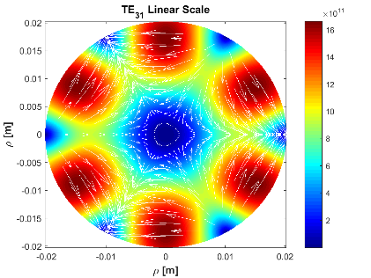
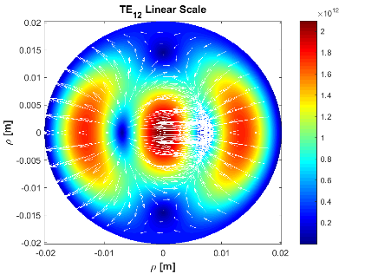
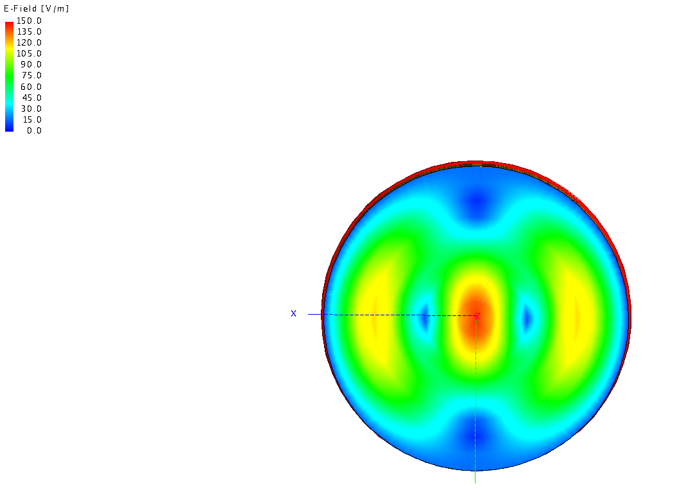
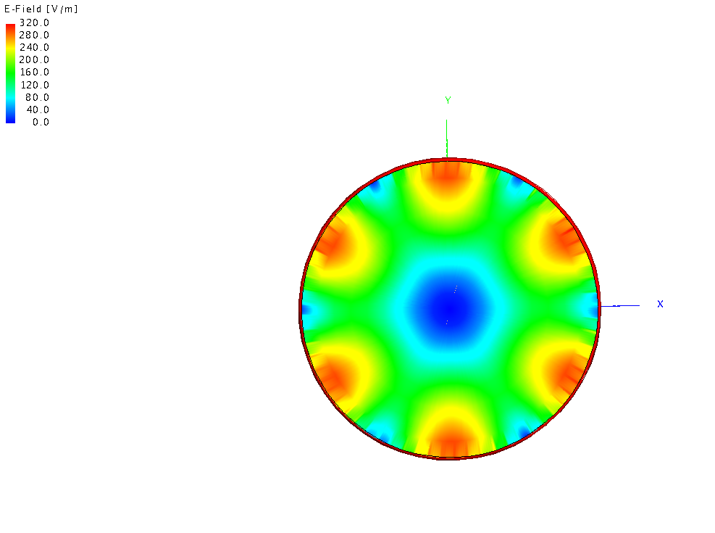
Field distribution of one circular cross-section waveguide (3) Results
MATLAB
MATLAB
$$TE_{12}$$
$$TE_{31}$$
Feko 2018
Feko 2018
$$TE_{12}$$
$$TE_{31}$$
Surface: E field
Quiver: H field For MATLAB

Slide 5
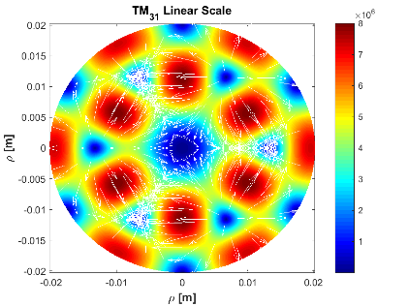
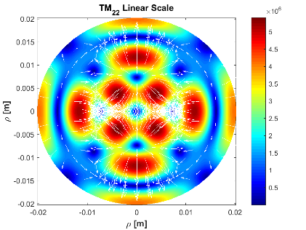
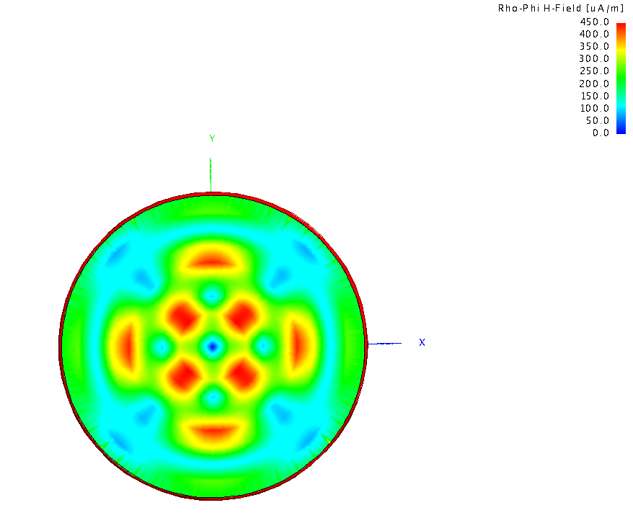
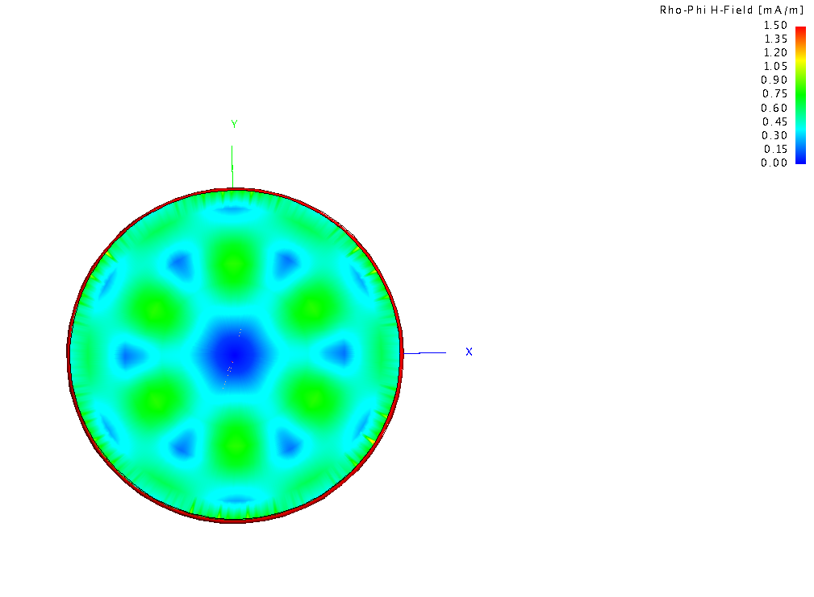
Field distribution of one circular cross-section waveguide (4) Results
MATLAB
MATLAB
$$TM_{22}$$
$$TM_{22}$$
Feko 2018
Feko 2018
$$TM_{22}$$
$$TM_{31}$$
Surface: H field
Quiver: E field For MATLAB

Slide 6
Normalization Constant - (1)
Normalization constant for a single circular cross section waveguide
( ):
Where:
$$Q_{n}$$
$$∫∫_{A_{area}}({\overset{⃗}{E}}_{n}^{area}×{\overset{⃗}{H}}_{m}^{area}).\overset{̂}{z}dS=Q_{n}^{area}δ_{nm},δ_{nm}(m=n)=1,0otherwise$$
$$⟹Q_{n}=∫∫_{A_{area}}[{\overset{⃗}{E}}_{ρn}^{area}{\overset{⃗}{H}}_{ϕm}^{area}-{\overset{⃗}{E}}_{ϕn}^{area}{\overset{⃗}{H}}_{ρm}^{area}]ρdρdϕ$$
$$⟹Q_{n}=∫∫_{A_{area}}K_{mn}[\frac{m^{2}}{ρ^{2}}J_{m}^{2}(β_{ρ(m,n)}ρ)\sin^{2}(mϕ)+β_{ρ(m,n)}^{2}J_{m}^{{}^{′}2}(β_{ρ(m,n)}ρ)]ρdρdϕ$$
$$K_{mnTE}=\frac{A_{mn}^{2}β_{z,mn}C_{2}^{2}}{ωμϵ^{2}}$$
$$K_{mnTM}=\frac{B_{mn}^{2}β_{z,mn}C_{2}^{2}}{ωϵμ^{2}}$$

Slide 7
Normalization Constant - (3)
Normalization constant (Using some Bessel Function properties):
Where:
Normalization constant (simplified):
$$Q_{n}^{area}δ_{nm}=K_{mn}\frac{β_{ρ(m,n)}^{2}}{4}[(I_{A}+I_{C})(I_{sin}+I_{cos})+2I_{B}(I_{sin}-I_{cos})]$$
$$I_{A}=∫_{0}^{r}J_{m-1}^{2}(β_{ρ(m,n)}ρ)ρdρ$$
$$I_{C}=∫_{0}^{r}J_{m+1}^{2}(β_{ρ(m,n)}ρ)ρdρ$$
$$I_{B}=∫_{0}^{r}J_{m-1}(β_{ρ(m,n)}ρ)J_{m+1}(β_{ρ(m,n)}ρ)ρdρ$$
$$I_{sin}=∫_{0}^{2π}sin^{2}(mϕ)dϕ=π$$
$$I_{cos}=∫_{0}^{2π}cos^{2}(mϕ)dϕ=π$$
$$Q_{n}^{area}δ_{nm}=K_{mn(TE/TM)}\frac{β_{ρ(m,n)}^{2}}{4}[(I_{A}+I_{C})(I_{sin}+I_{cos})]$$

Slide 8
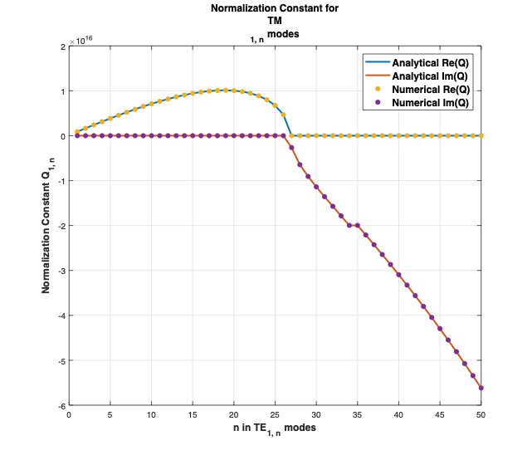
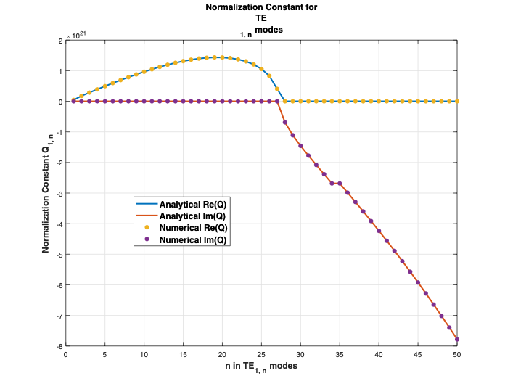
Normalization Constant - (2)
Solution to the integrals (Lommel’s Integrals)
$$I_{A}andI_{C}$$
$$∫_{0}^{a}J_{ν}^{2}(β_{ρ(m,n)}ρ)ρdρ=\frac{1}{2}a^{2}(J_{ν}(β_{ρ(m,n)}a)^{2}-J_{ν-1}(β_{ρ(m,n)}a)J_{ν+1}(β_{ρ(m,n)}a));$$
TE (1, n)
modes at 200 GHz
MATLAB
TM(1, n)
modes at 200 GHz
MATLAB

Slide 9
Inner Cross Product (2 Waveguides) - (1)
Inner cross product (X) : (Between waveguide P and waveguide R)
Where is a frequency dependent term.
Where:
$$X=∫∫_{A_{R}}({\overset{⃗}{E}}_{pm,pn}^{R}×{\overset{⃗}{H}}_{rm,rn}^{P}).\overset{̂}{z}dS=(Q_{rm}^{R})^{\frac{1}{2}}(Z_{rm}^{R})^{\frac{1}{2}}χ_{pr}^{}(Y_{pm}^{P})^{\frac{1}{2}}(Q_{pm}^{P})^{\frac{1}{2}}$$
$$χ_{pr}$$
$$χ_{pr}=∫∫_{A_{R}}({\overset{⃗}{Φ}}_{E_{pm,pn}}^{R}×{\overset{⃗}{Φ}}_{H_{rm,rn}}^{P}).\overset{̂}{z}dS=∫∫_{A_{R}}({\overset{⃗}{Φ}}_{E_{pm,pn}}^{R}.{\overset{⃗}{Φ}}_{E_{rm,rn}}^{P})dS=∫∫_{A_{R}}({\overset{⃗}{Φ}}_{H_{pm,pn}}^{R}.{\overset{⃗}{Φ}}_{H_{rm,rn}}^{P})dS$$
$${\overset{⃗}{Φ}}_{E_{m,n}}^{TE}=∇_{t}Φ_{m,n}^{TE}×\overset{̂}{z}$$
$${\overset{⃗}{Φ}}_{H_{m,n}}^{TM}=\overset{̂}{z}×∇_{t}Φ_{m,n}^{TE}$$
$${\overset{⃗}{Φ}}_{H_{m,n}}^{TE}=∇_{t}Φ_{m,n}^{TE}$$
$${\overset{⃗}{Φ}}_{E_{m,n}}^{TM}=∇_{t}Φ_{m,n}^{TM}$$

Slide 10
Inner Cross Product (2 Waveguides) - (2)
Scalar potentials:
Where:
$$Φ_{m,n}^{TE}=(N_{mn}^{TE})^{\frac{1}{2}}J_{m}(β_{ρ,mn}ρ)cos(mϕ)$$
$$Φ_{m,n}^{TM}=(N_{mn}^{TM})^{\frac{1}{2}}J_{m}(β_{ρ,mn}ρ)cos(mϕ)$$
$$N_{mn}^{TE}=\frac{1}{|ϵ\frac{π}{2}((β_{ρ,mn}r)^{2}-m^{2})J_{m}^{2}(β_{ρ,mn}r)|}$$
$$N_{mn}^{TM}=\frac{1}{|ϵ\frac{π}{2}(β_{ρ,mn}r)^{2}J_{m}^{{}^{′}2}(β_{ρ,mn}r)|}$$

Slide 11
Inner Cross Product (2 Waveguides) - (3)
For different configurations:
$$χ_{m,n}$$
 | 0
$$χ_{m,n}$$
$$TE_{P}$$
$$TM_{P}$$
$$∫∫_{A_{R}}∇_{t}Φ_{R}.∇_{t}Φ_{P}dS$$
$$∫∫_{A_{R}}(∇_{t}Φ_{R}×∇_{t}Φ_{P}).\overset{̂}{z}dS$$
$$TE_{R}$$
$$∫∫_{A_{R}}∇_{t}Φ_{R}.∇_{t}Φ_{P}dS$$
$$TM_{R}$$

Slide 12
Inner Cross Product (2 Waveguides) - (4)
Analytical expressions for for the combination of TE/TE or TM/TM:
Where:
And. Can be solved by the following Lommel’s integral:
$$χ_{m,n}$$
$$χ_{pr}=∫∫_{A_{R}}∇_{t}Φ_{R}.∇_{t}Φ_{P}dS=(N_{(pm,pn)}^{TE/TM}N_{(rm,rn)}^{TE/TM})^{\frac{1}{2}}\frac{β_{ρ(pm,pn)}β_{ρ(rm,rn)}}{4}[(I_{A}+I_{D})(I_{cos}+I_{sin})]$$
$$I_{A}=∫_{0}^{r}J_{pm-1}(β_{ρ(pm,pn)}ρ)J_{rm-1}(β_{ρ(rm,rn)}ρ)ρdρ$$
$$I_{D}=∫_{0}^{r}J_{pm+1}(β_{ρ(pm,pn)}ρ)J_{rm+1}(β_{ρ(rm,rn)}ρ)ρdρ$$
$$I_{sin}=∫_{0}^{2π}sin(pmϕ)sin(rmϕ)dϕ=π,pm=rm$$
$$I_{cos}=∫_{0}^{2π}cos(pmϕ)cos(rmϕ)dϕ=π,pm=rm$$
$$I_{A}$$
$$I_{D}$$
$$∫_{0}^{r}J_{ν}(β_{ν}ρ)J_{ν}(β_{μ}ρ)ρdρ=\frac{r}{(β_{ν}^{2}-β_{μ}^{2})}(-β_{ν}J_{ν-1}(β_{ν}r)J_{ν}(β_{μ}r)+β_{μ}J_{ν}(β_{ν}r)J_{ν-1}(β_{ν}r))$$

Slide 13
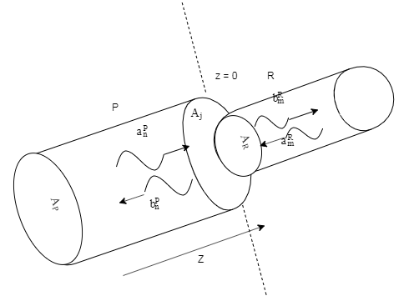
Mode Matching (2 Waveguides)
Boundary conditions at the junction (z = 0):
Electric field boundary condition:
Magnetic field boundary condition:
General Scattering matrix:
Where:
$$Q_{P}(a_{P}+b_{P})=X^{t}(a_{R}+b_{R})$$
$$Q_{R}(b_{R}-a_{R})=X(a_{P}-b_{P})$$
$$GSM=\left[\begin{matrix}Q_{P}^{-1}X^{t}FX-I_{P} & Q_{P}^{-1}X^{t}FQ_{R} \\ FX & FQ_{R}-I_{R}\end{matrix}\right]$$
$$F=2(Q_{R}+XQ_{P}^{-1}X^{t})^{-1}$$

Slide 14
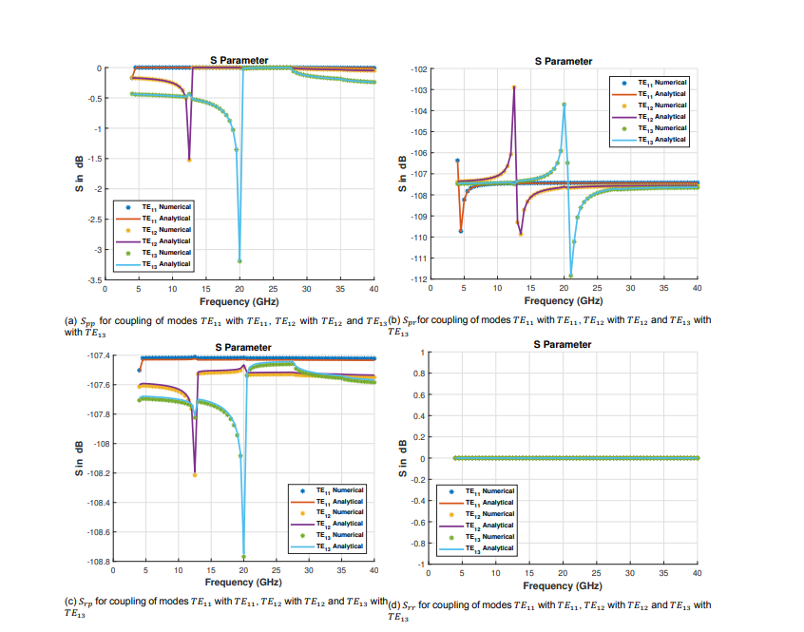
Results: MATLAB (TE) - (1)

Slide 15
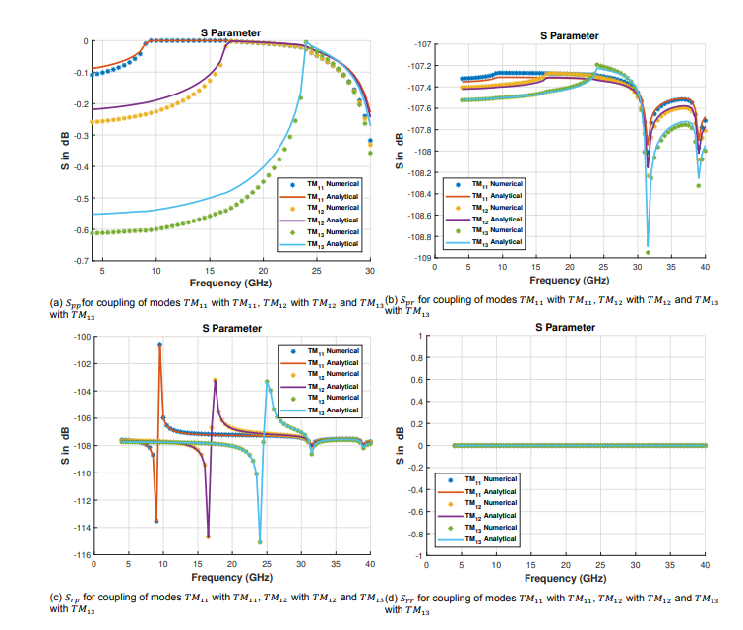
Results: MATLAB (TM) - (2)

Slide 16
Results: FEKO(TE) - (1)

Slide 17
Results: FEKO(TM) - (2)

