Slide 1
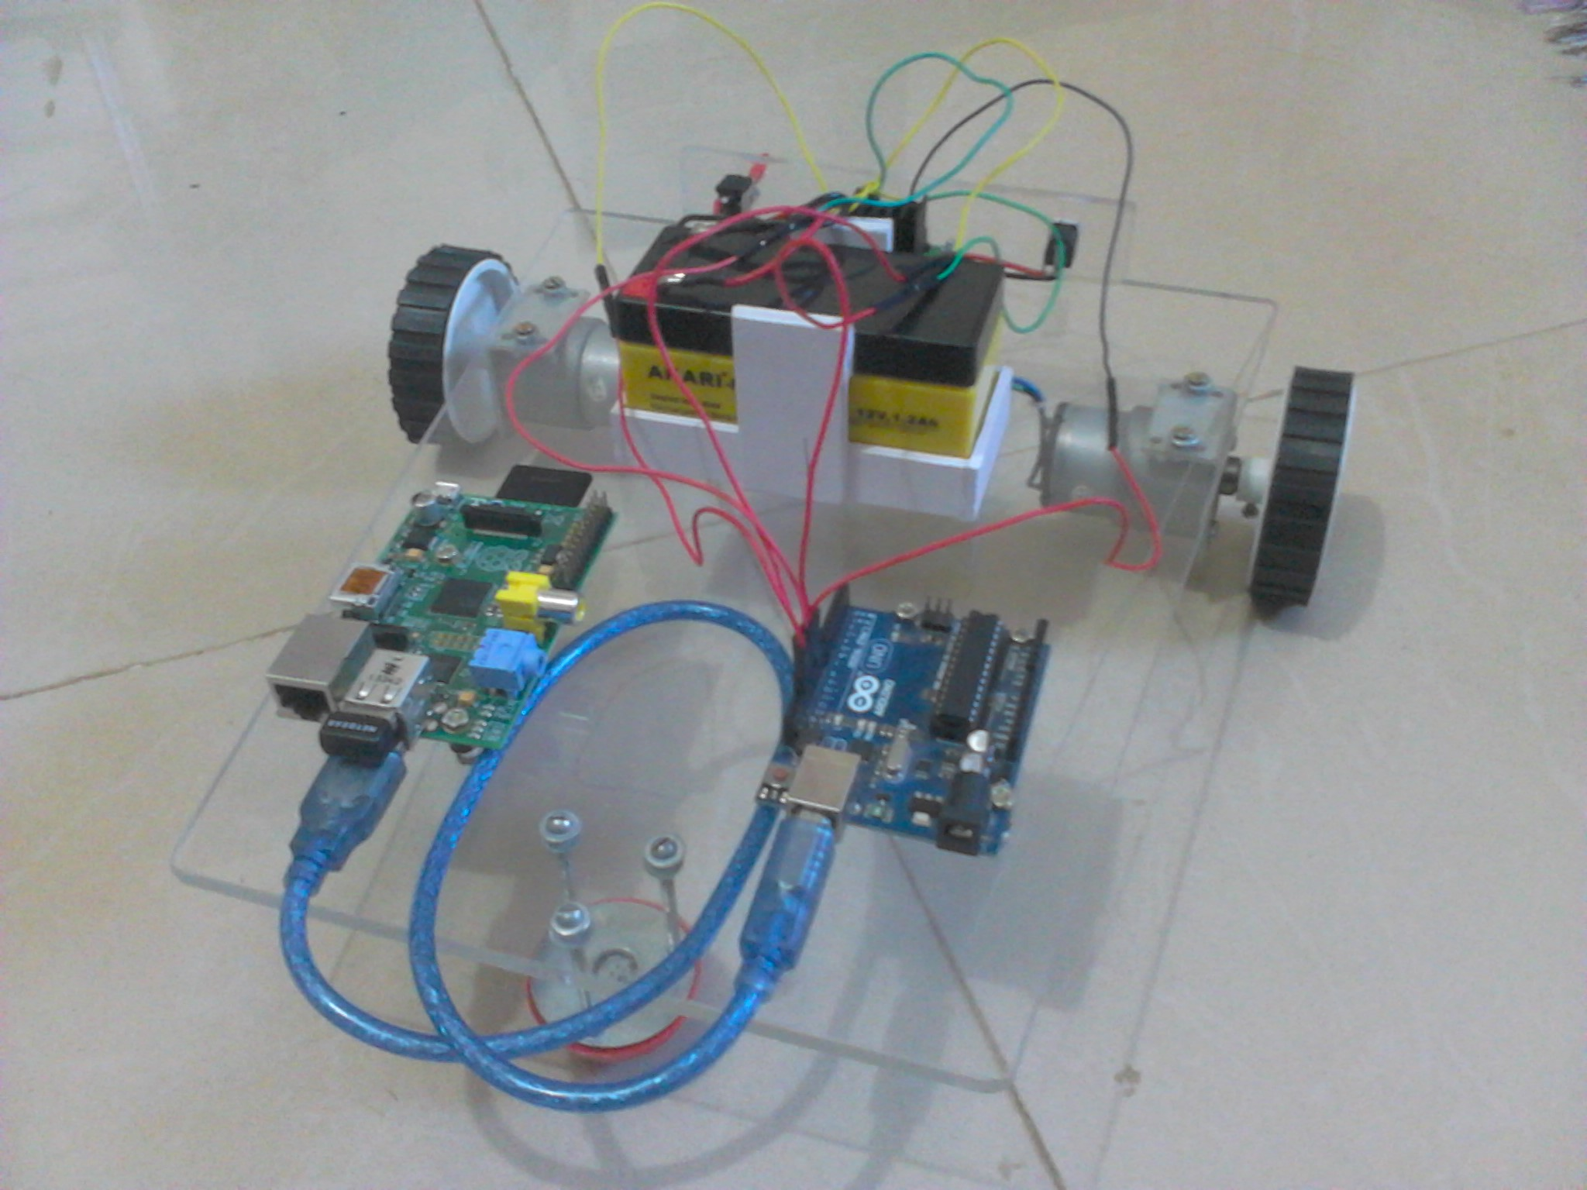
Web Controlled Automation

Slide 2
All That We Need
The idea is to control a system or hardware from anywhere around the globe by the help of internet.
Ruby Libraries
Microcontroller Board
Raspberry Pi
A Good Internet Connection

Slide 3
Ruby Libraries
Eventmachine
Eventmachine Websockets
Serialport
Sinatra (for the app)

Slide 4
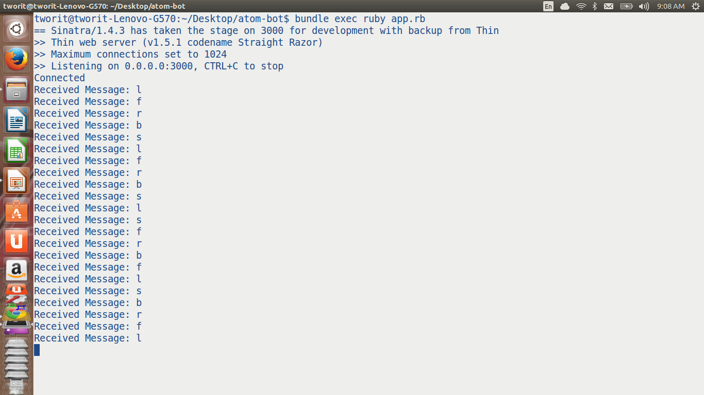
Connecting Clients

Slide 5
Websockets
websocket server
Websocket clients
The internal Channel connecting those two
Ping Pong

Slide 6
Serialport
This gem is built to use RS-232 serialports
The other client can send the message received from browser client to the serialport
Messages here are the commands represented as character constants

Slide 7
Arduino
UART
I/O pins
Hardware Control

Slide 8
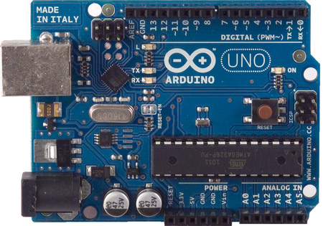
Arduino Uno

Slide 9
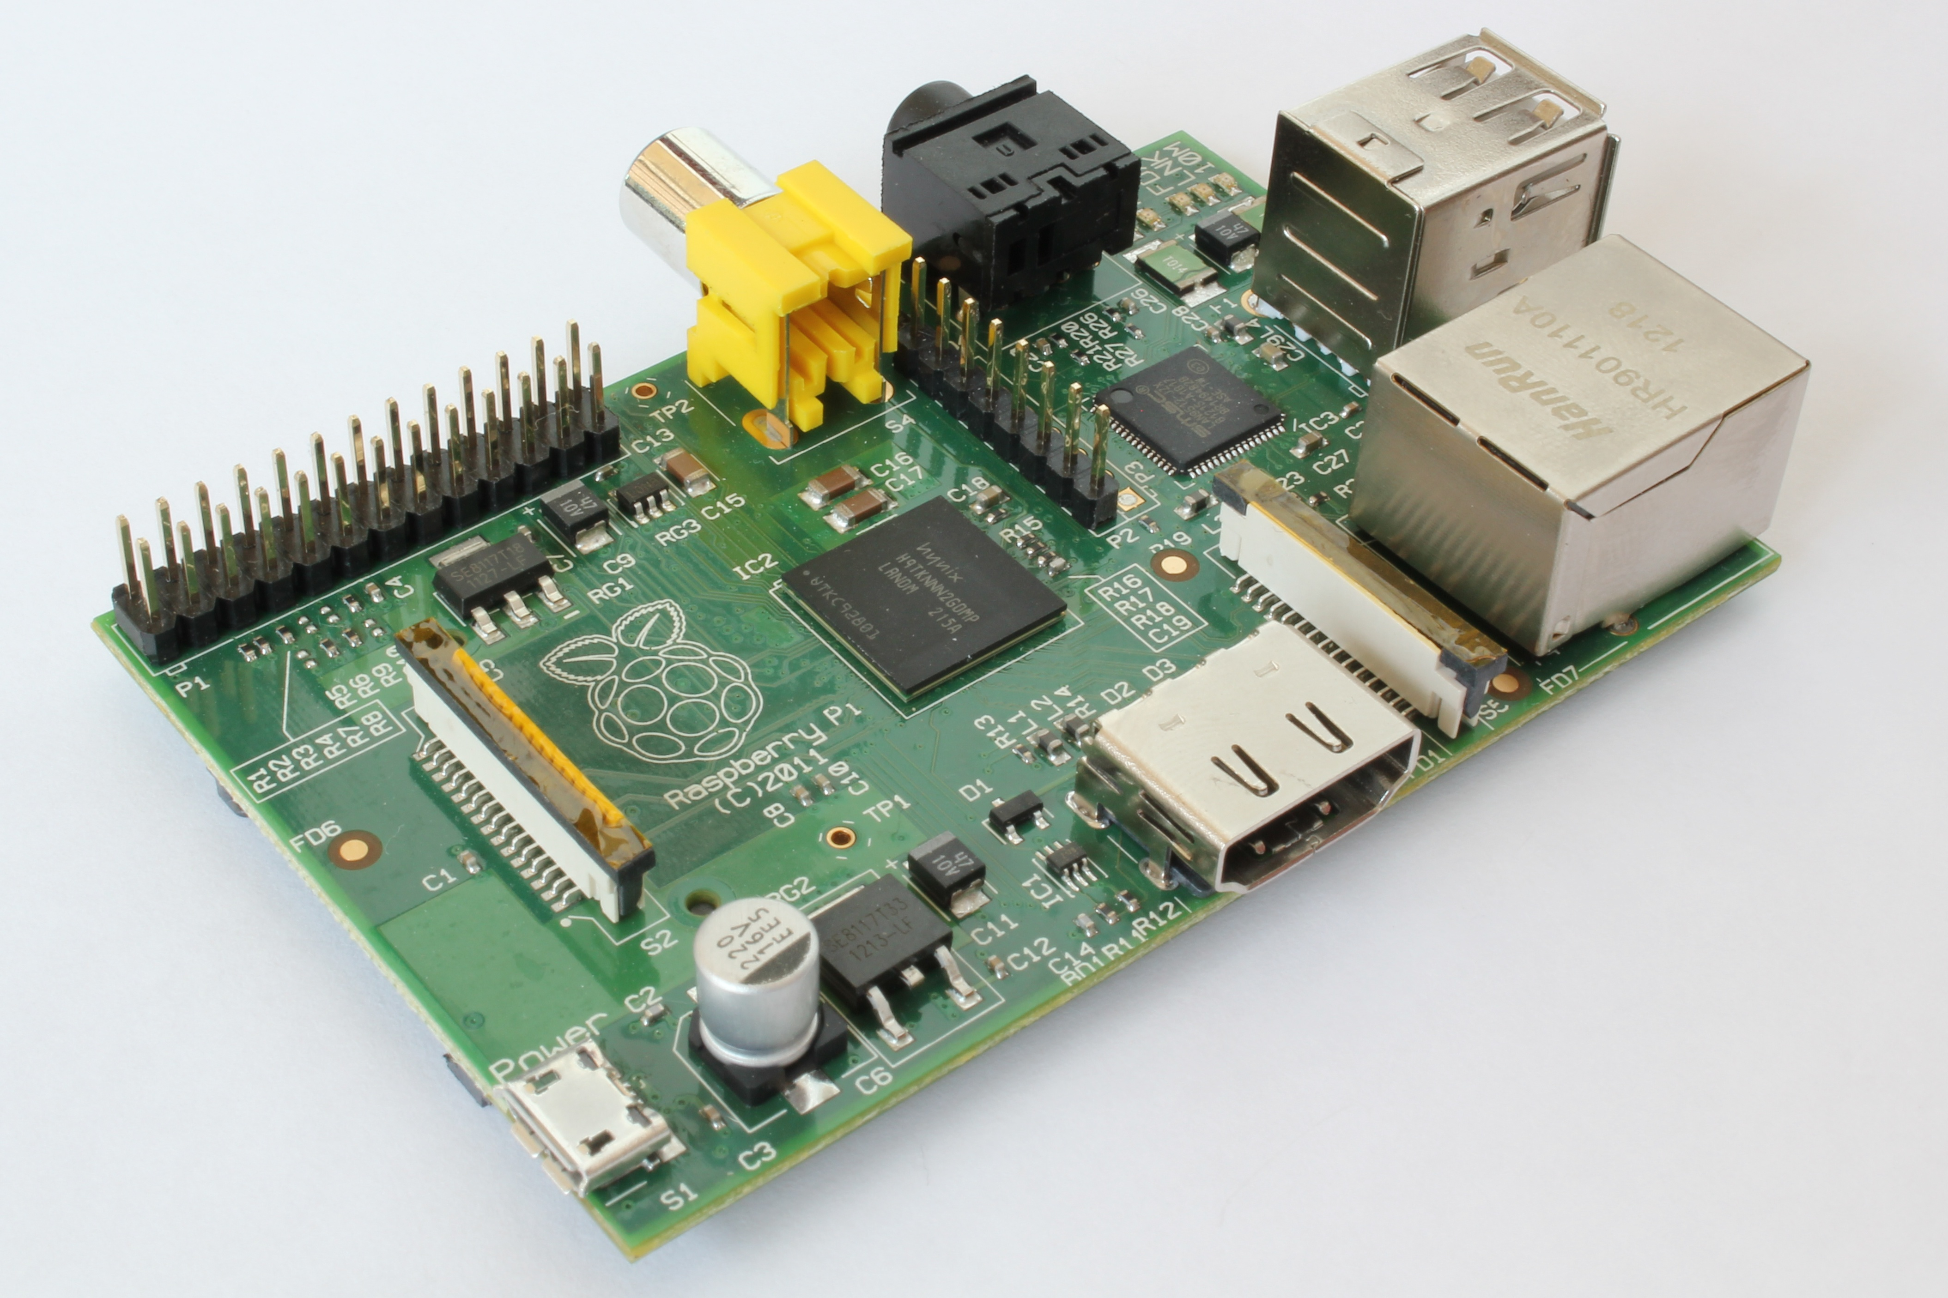
Raspberry Pi

Slide 10
My Prototype(Atom Bot)
It's a simple mini-robot car
I/O pins are connected to motors via a motor driver
The robot car moves forward, backward, left and right by following the respective commands from the browser client (just clicking some buttons)

Slide 11

Accelerometer
The browser client has an additional feature(The accelerometer)
Now we can control it through the motion sensors of mobile devices

Slide 12
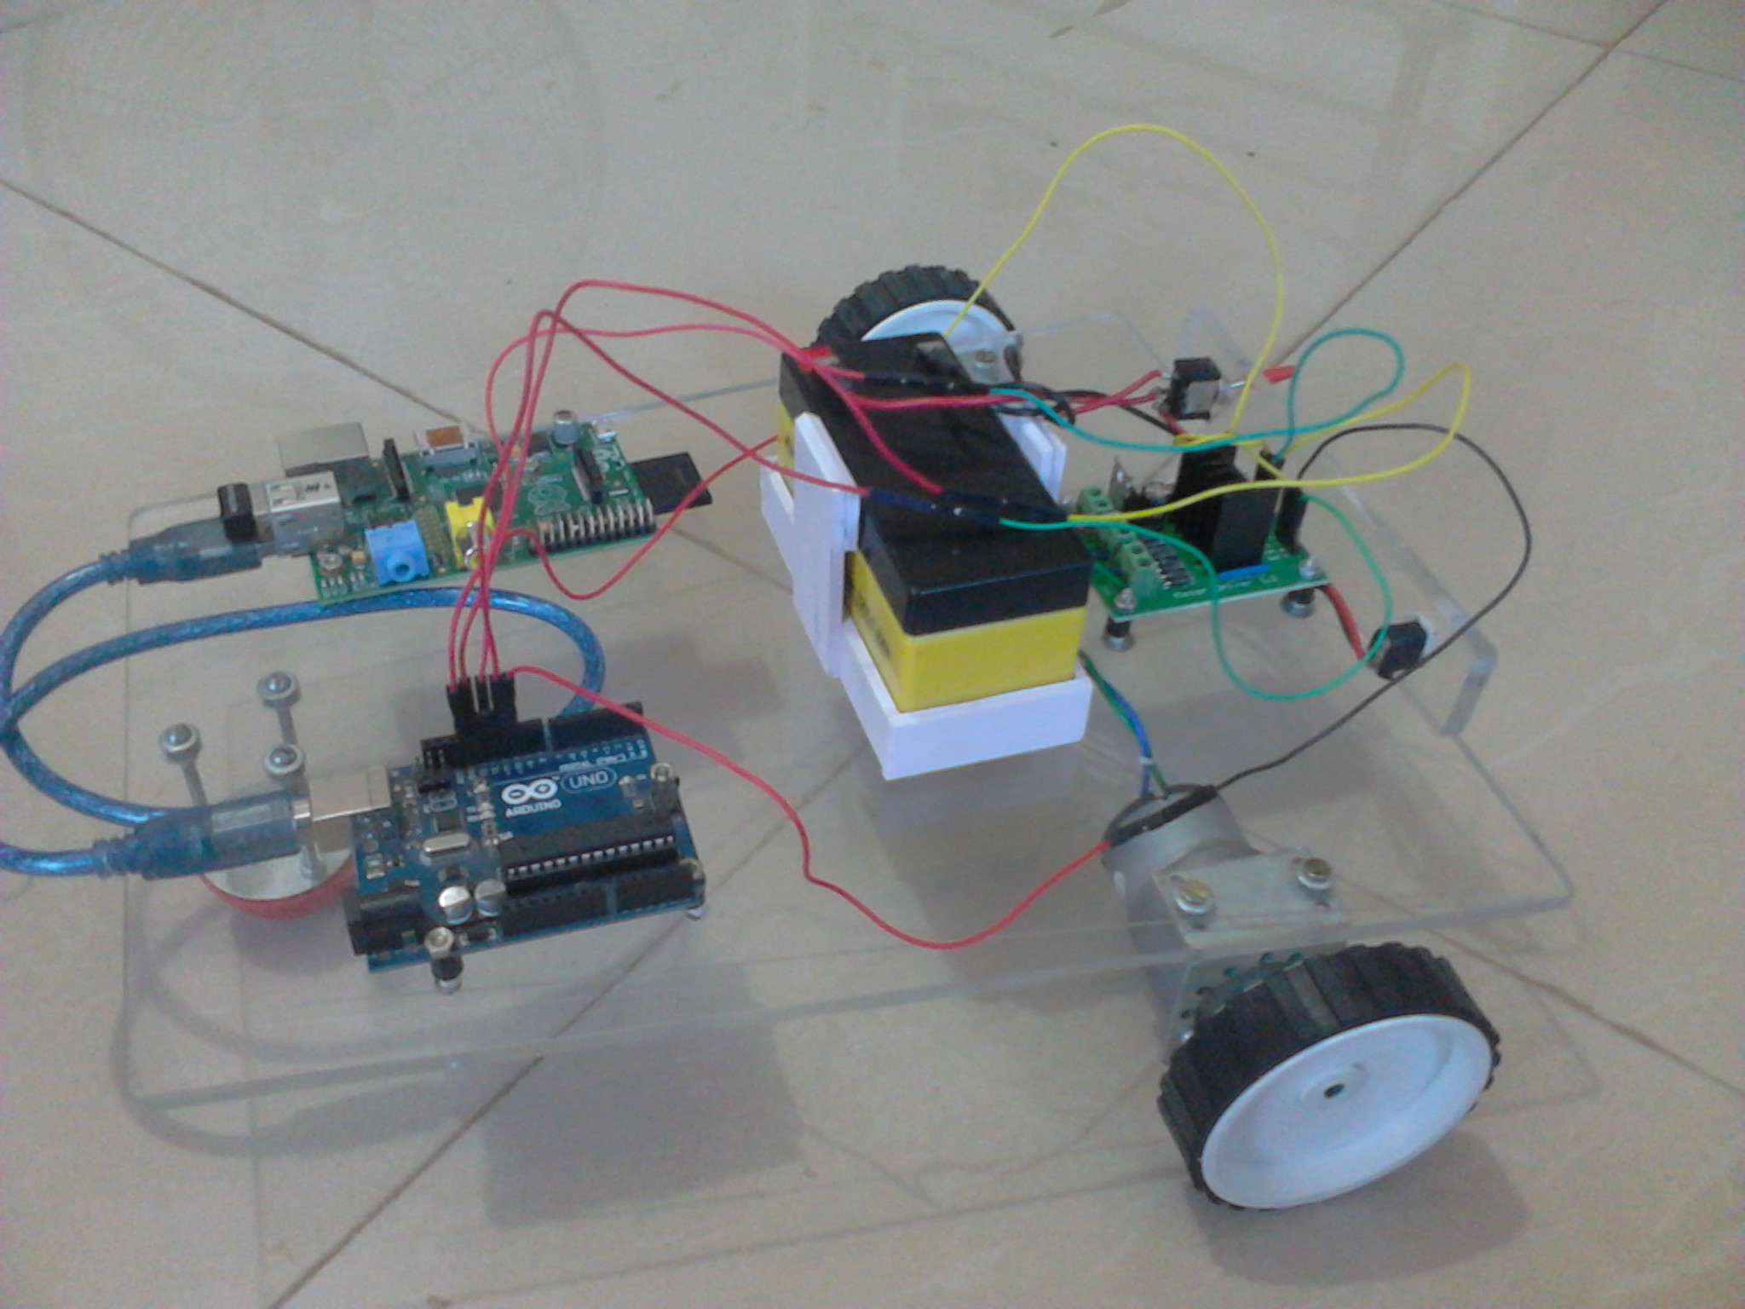
Now It's Working !! :)
ATOM BOT

Slide 13
Utilites
1. We can automate our home like we can turn on our oven just before reaching home or we can check if the door is locked or not.
2. Security notifications can be sent as a app notification over the internet.
3. Can be used in hospitals and in traffic systems

Slide 14

Further Improvements
Anything can be connected to the output of that controller
The system can be optimized so that it can receive commands from other sources

