Slide 1



Tihear Marble
By Mr.Tech_G

Slide 2
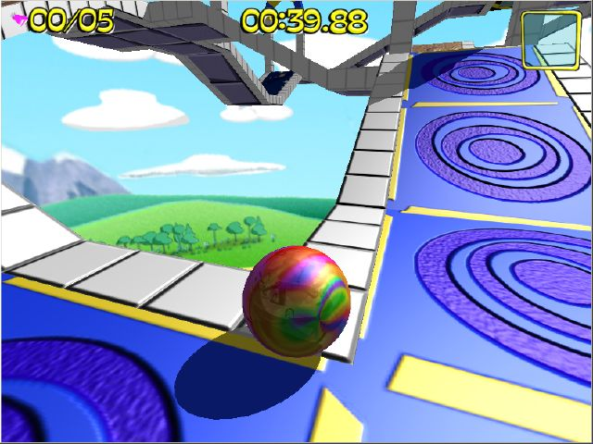
Game Concept
3D Platforming game
Rolling the marble to the finish

Slide 3
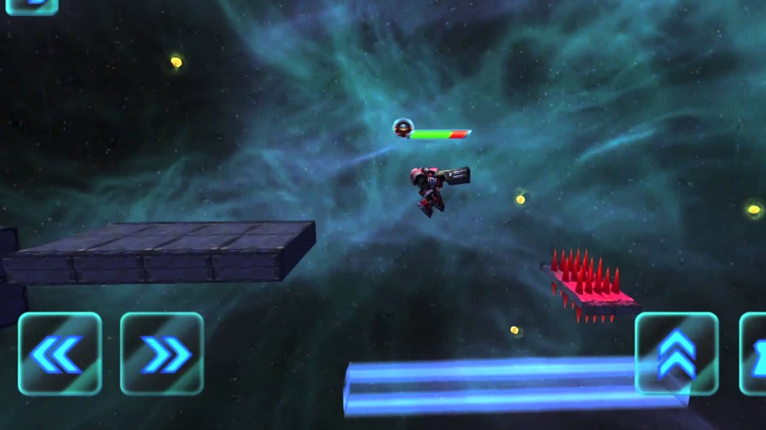
Theme
Sci-Fi theme
Using asset from Epic Game Store

Slide 4
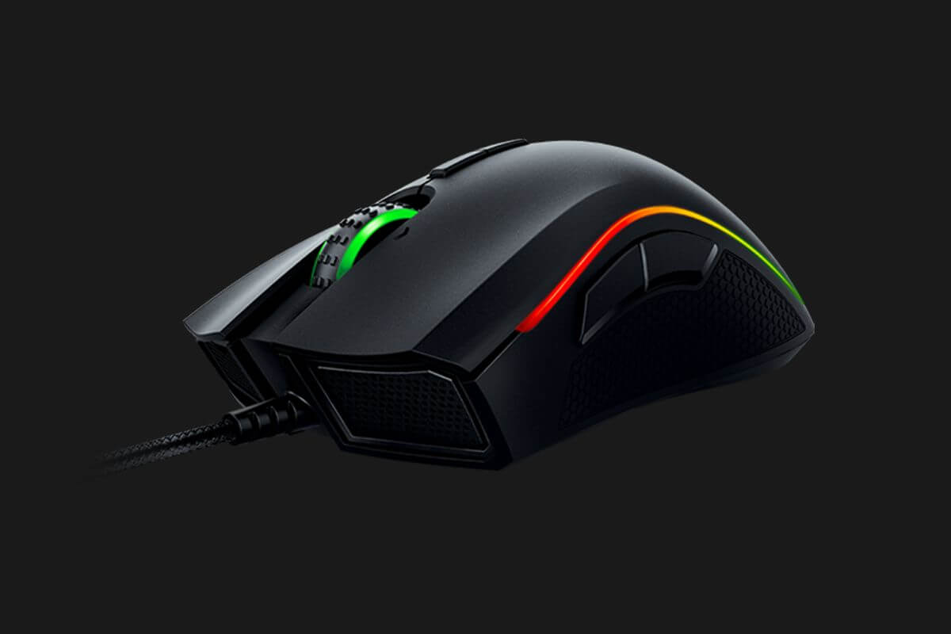
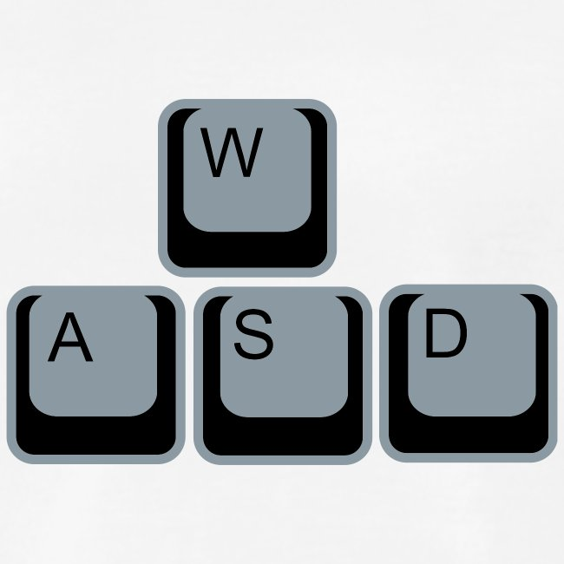
How to play
Use WASD for marble translation
Using move axis for rotate camera
Left mouse for using item

Slide 5


Goal and objective
Test in physical and mind challenge of the player
To make a good game from unreal engine

Slide 6
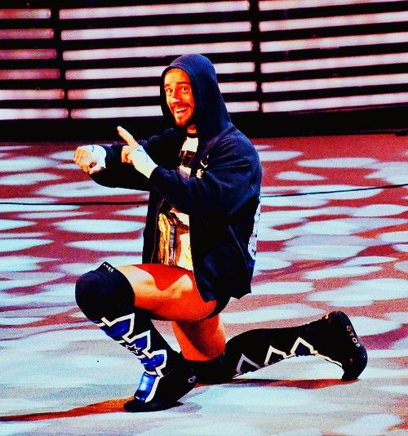
Future plan
Make marble rolling (Done)
Add awesome items (Not done)
Speed booster (Increase speed)
Ball maximizer (Increase ball Size)
Ballicopter (I believe I can fly)
Add at least 10 more levels (not done)

Slide 7
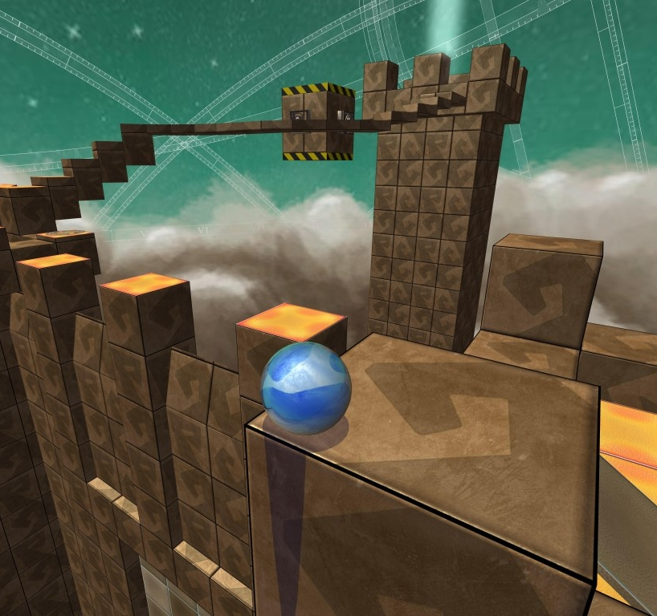
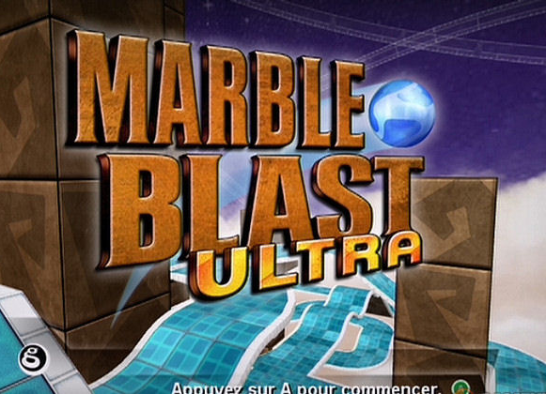
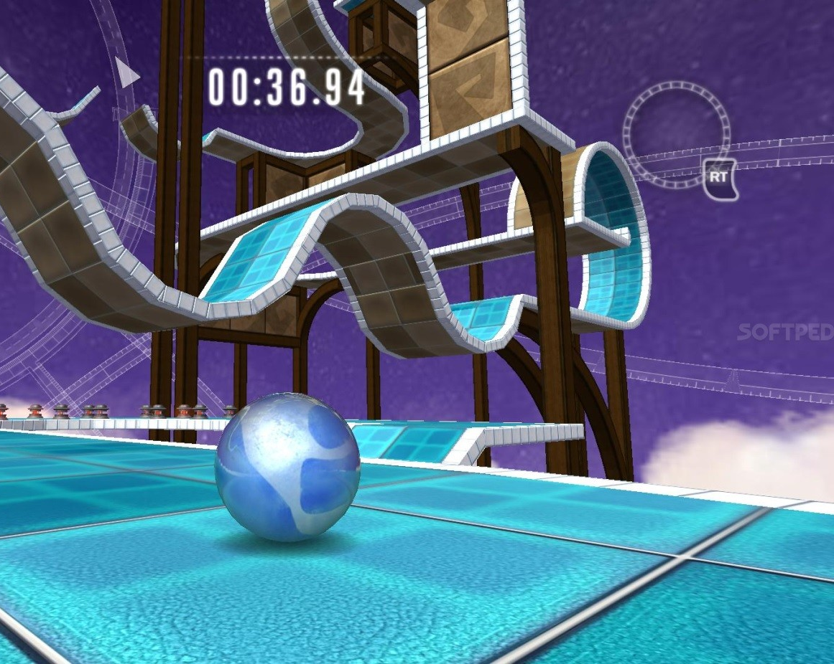
Reference

