Slide 1

RobinVM
Source
Carpall/rvm
Api
Release RobinVM

Slide 2
Details
Stack Based
Pointer Based
Object Typed
Supports Functions
Object Oriented
Supports Arrays
Supports Exceptions
Supports Extensions
?
?
?
?
?
?
?
?

Slide 3
Pointer Based
It does not use a switch case statement to interpret the array of instructions (function), but it uses an array of delegates (c# function pointers) that are called one by one by a cycle that increments, for each instruction.

Slide 4

Pointer Based
<

Slide 5
Object Oriented
Classes are simulated by a dictionary that stores a string as key, rappresenting the id of a class member, and an object as value, which can be a function declaration or a constant value in the case of global variables.
Classes contain their own ctor, runtime informations stored with the ‘$’ symbol and a member table called CacheTable

Slide 6
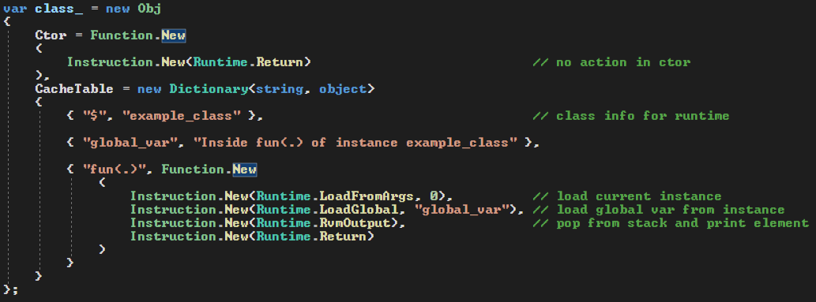
Object Oriented

Slide 7
Object Oriented
Adding the class to the image
Instantiating the object

Slide 8
Object Oriented
When the object is instantiated a new instance is pushed onto the stack and the ctor is called. The CallInstance instruction pops the instance from the stack and try to call the member with the name passed as instruction argument

Slide 9
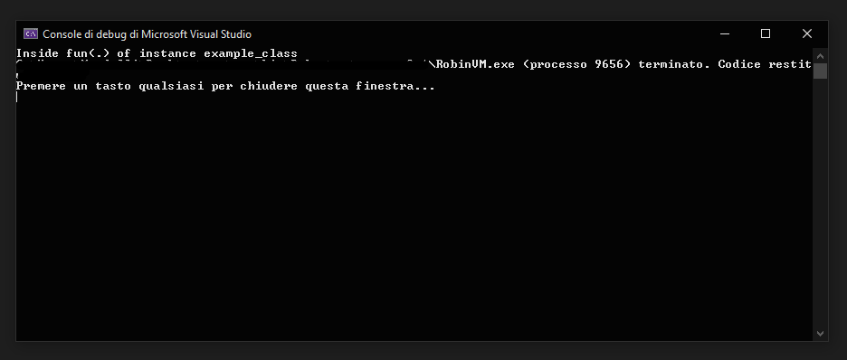
Object Oriented
Output
<

Slide 10
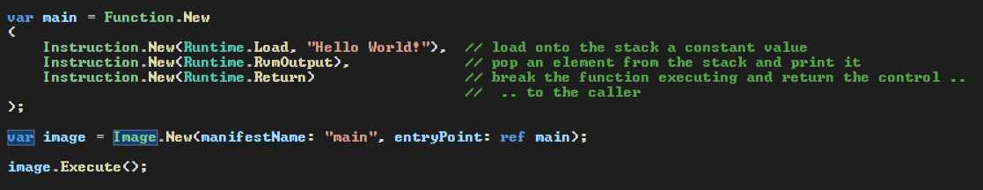
Functions
The Function struct contains function argument slots (parameters) and an array of the Instruction struct

Slide 11
Instructions
The Instruction struct contains a pointer that points to the function rappresenting the instruction.
The vm interprets the image, that can be built by calling its constructor and passing to it the assembly name and a reference to the entrypoint function that will be associated at the assembly name.
The image can be executed by calling the static method Robin.Execute(this Image), which is an extension and can be called directly from the instance of Image.

Slide 12
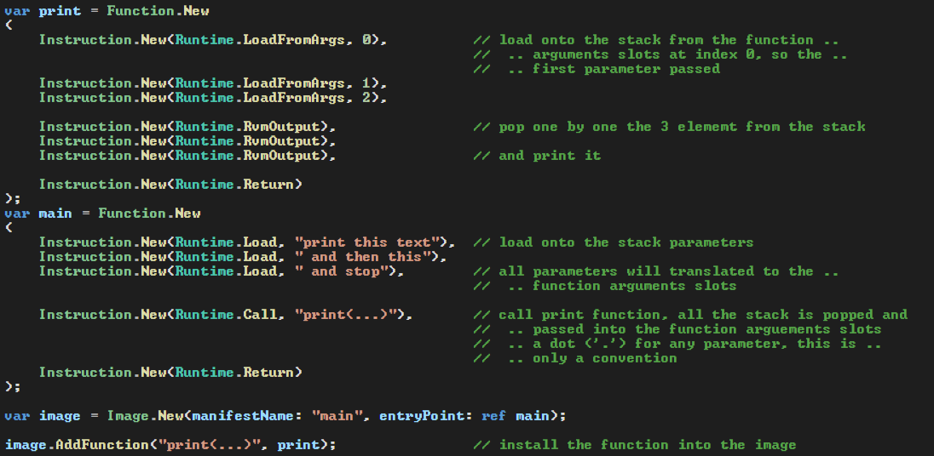
Function Calling
Call instruction calls a function added to image

Slide 13
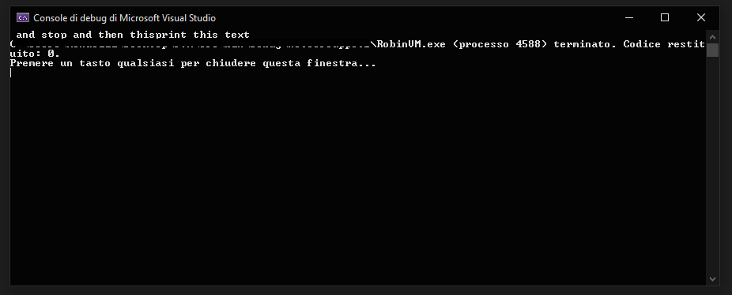
Function Calling
Output, that as you can see is reversed, beacause we loaded arguments one by one, from index 0 to 2, onto the stack and printing them the element on the top of the stack was the last we loaded, so ‘and stop’
<

Slide 14
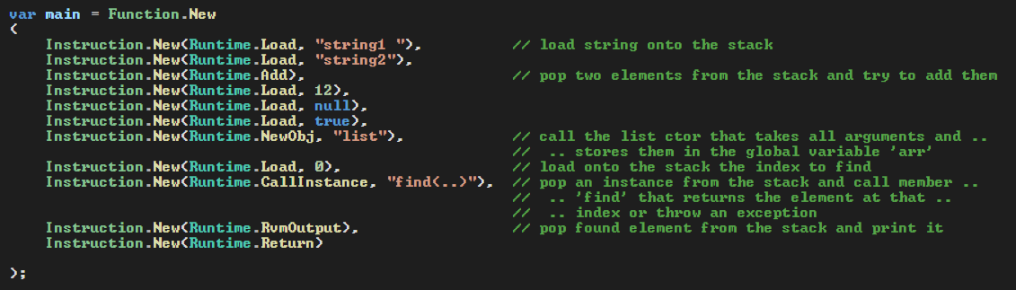
Arrays
Arrays are actually lists and can be built by instancing a new object of name ‘list’

Slide 15
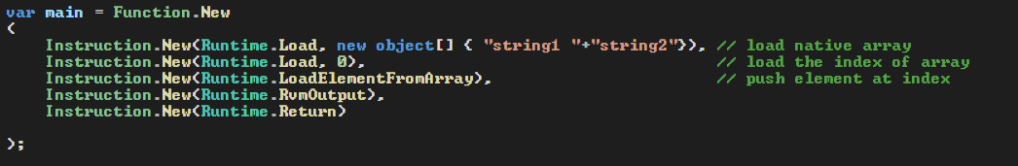
Native Arrays
You can also use native arrays to make the program faster, but them need of method implementations, because there are not so much instructions for native arrays

Slide 16
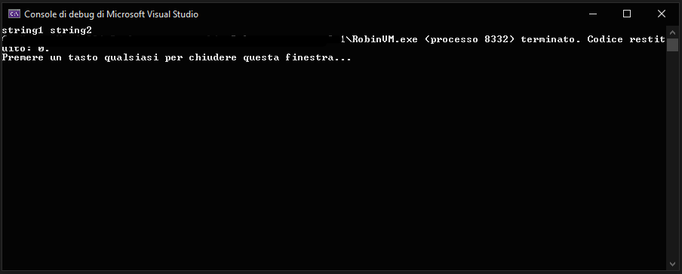
Arrays
Output
<

Slide 17
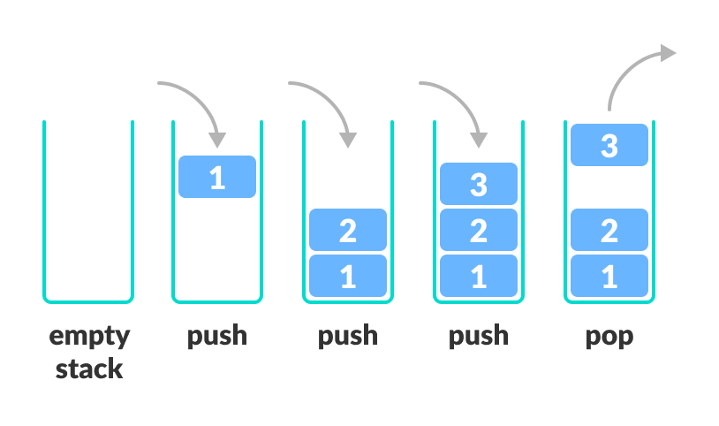
Stack
The stack is a part of the memory, in virtual machines it is simulated by a list.
It works with the LIFO mode: data is pushed onto a stack of elemets, can be read only the last elemet pushed and when it happens the last element will be removed from the stack.

Slide 18
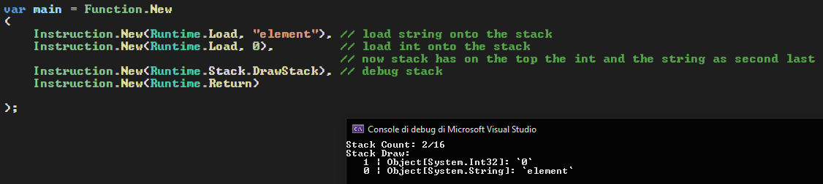
Stack Implementation
Load instruction pushes onto the stack a constanst
<

Slide 19
Exceptions
The vm supports the error handling and try-catch statement, called try-panic.
To throw an exception, you need to instantiate a ‘basepanic’ class and call the RvmThrow instruction.
The basepanic constructor requires following arguments:
Basepanic:ctor(string msg, int code, string type).
At function calling, the vm saves the function name in the trace of the program, and if the function executing ends without panicing then the function trail will be removed from the trace, else the vm prints the trace and exits from the program

Slide 20
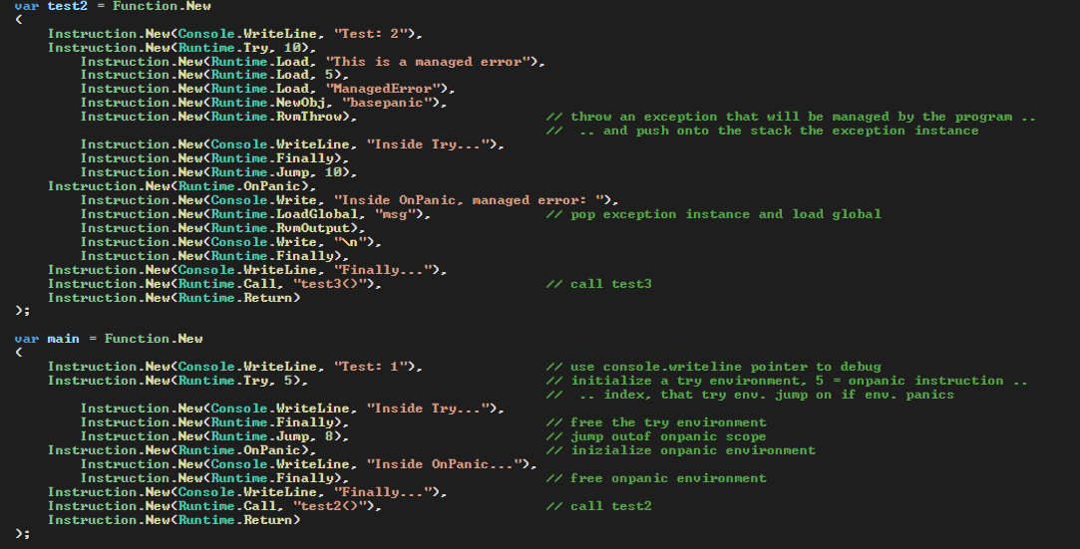
Exceptions
Source: main (no panic) and test2 (managed exception)

Slide 21
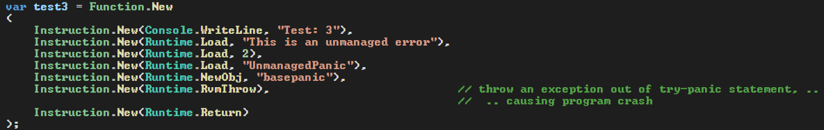
Exceptions
Source: test3 (unmanaged exception)

Slide 22
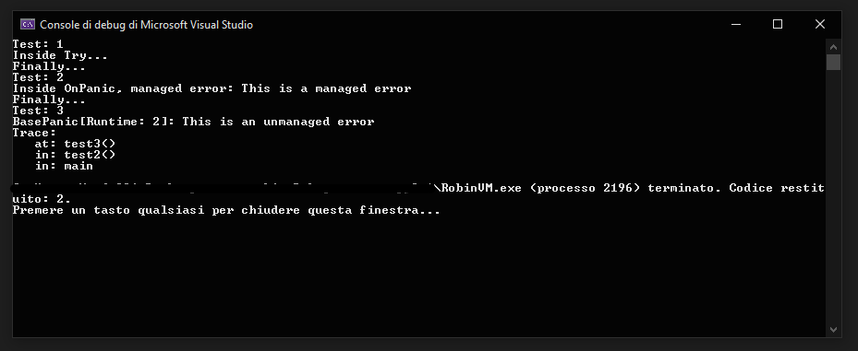
Exceptions
Output
<

Slide 23
Extensions
The vm can be extended by the user, with custom methods.
To extend the vm there are two main methods:
Write functions that matches with ‘void Runtime.RuntimePointer(object arg)’ delegate
and use it as standard instruction
2. Write void Runtime.CallPointer() and call it with the RvmCall instruction, that pop a CallPointer from the stack and call it

Slide 24
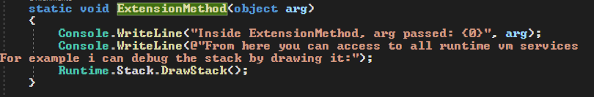
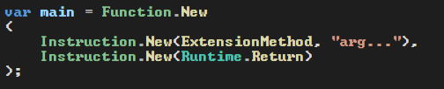
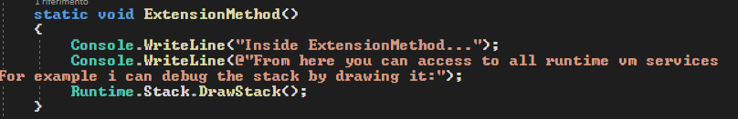
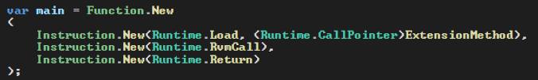
Extensions
First method
Second method

Slide 25
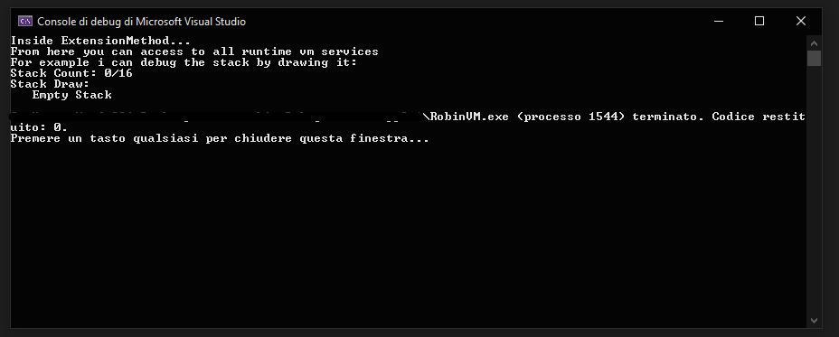
Extensions
Output
<

Slide 26
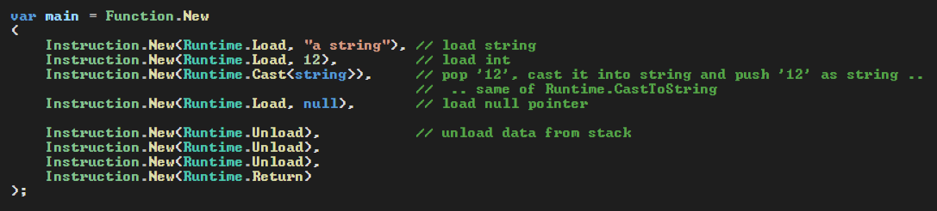
Object Typed
The vm uses the dotnet object as the data type of the stack, the local storage, function arguments slots. It is a cil managed type used as base class extension. It can store primitive data, instances, pointers, null pointers and all we can use in dotnet
<

Slide 27
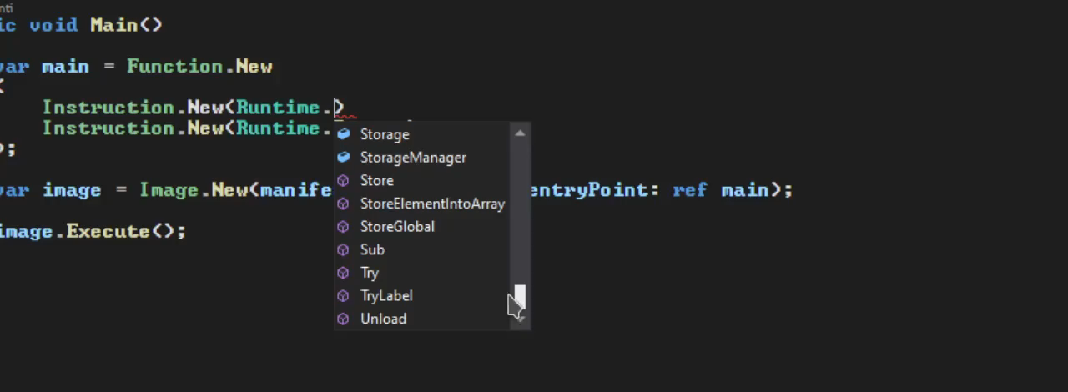
Base Instructions
Too many standard instructions, customizable and extensible

Slide 28
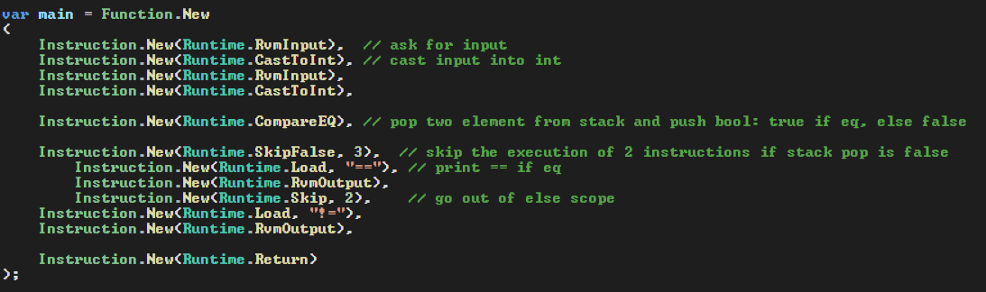
Program Example
Simple if else

Slide 29
Text Format Bytecode
In this moment the vm does not support text format yet, but the compiler to convert text into internal bytecode (image) will be the next implementation to work on.
Here some prototype
Test

Slide 30
Credits
Author: Carpal
Project: RobinVM
Written in: .Net Core C#

