Slide 1
INVESTMENT ASSIGNMENT SUBMISSION
Name: Rahul

Slide 2
Abstract
Perform an extensive study on the available datasets on investments and identify potential sectors in major economies as best candidates for spark fund investment. This study presents the best suitable investment type for spark fund within given constraints of funds which are English speaking country and budget limitations by identifying the sectors where similar budgets type funds have invested their maximum funds.

Slide 3
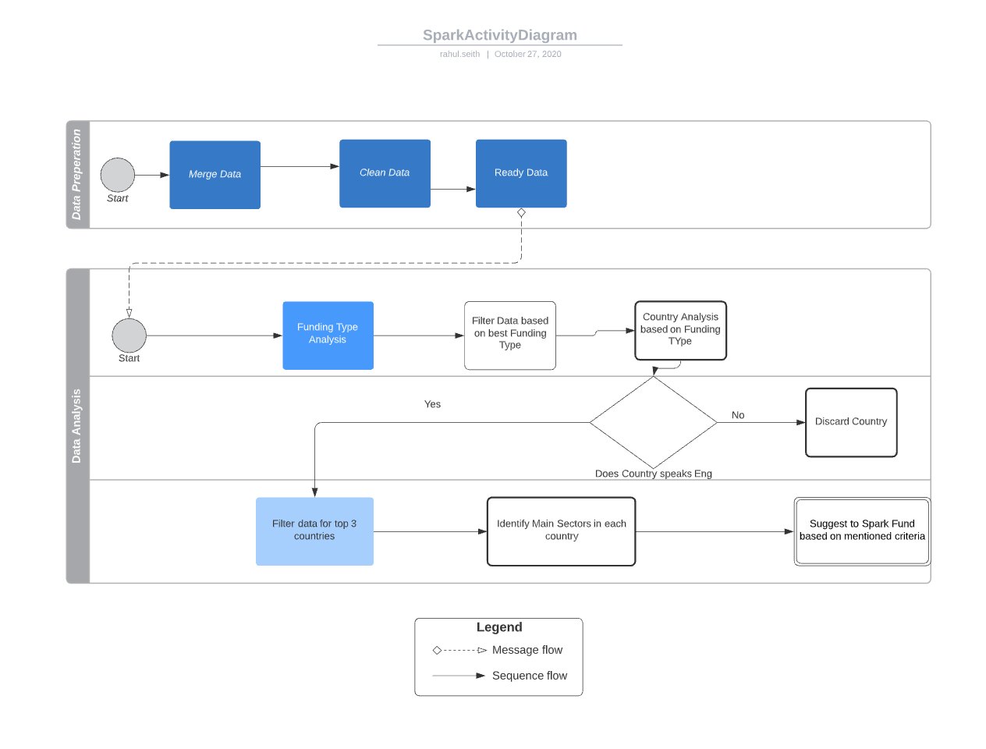
Flow Chart

Slide 4
Analysis
The analysis is divided into three parts:
Which type of funding is most suitable in given constraint
Which country have witnessed most funding
Given country and funding type which sectors has shown most potential

Slide 5
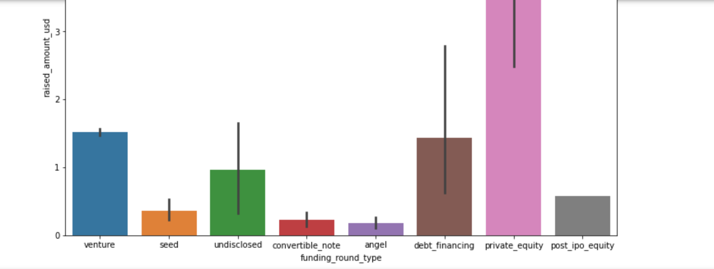
Most Suitable Investment
Most heavily invested sector is Private equity, but it misses our constraints
Next best Sector is Venture which also satisfies our constraints of investment b/w 5 to 15 million USD

Slide 6
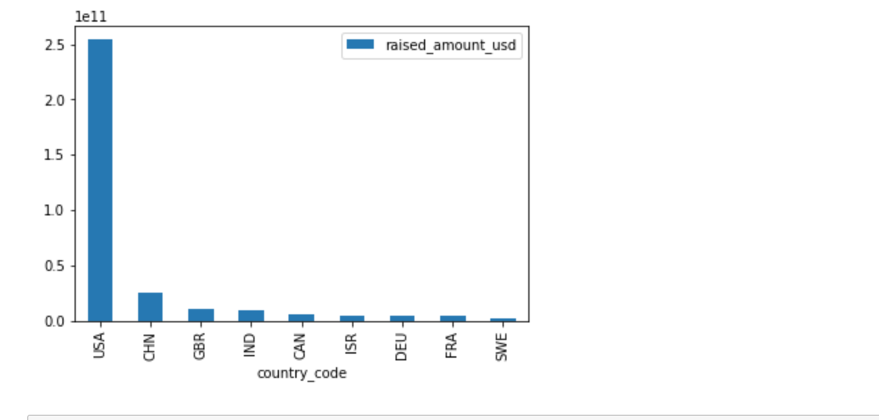
Top Countries:
USA has seen maximum investment,
Followed by China, Great Britain and then India.
Ignoring investment in China as it is not English Speaking Country

Slide 7
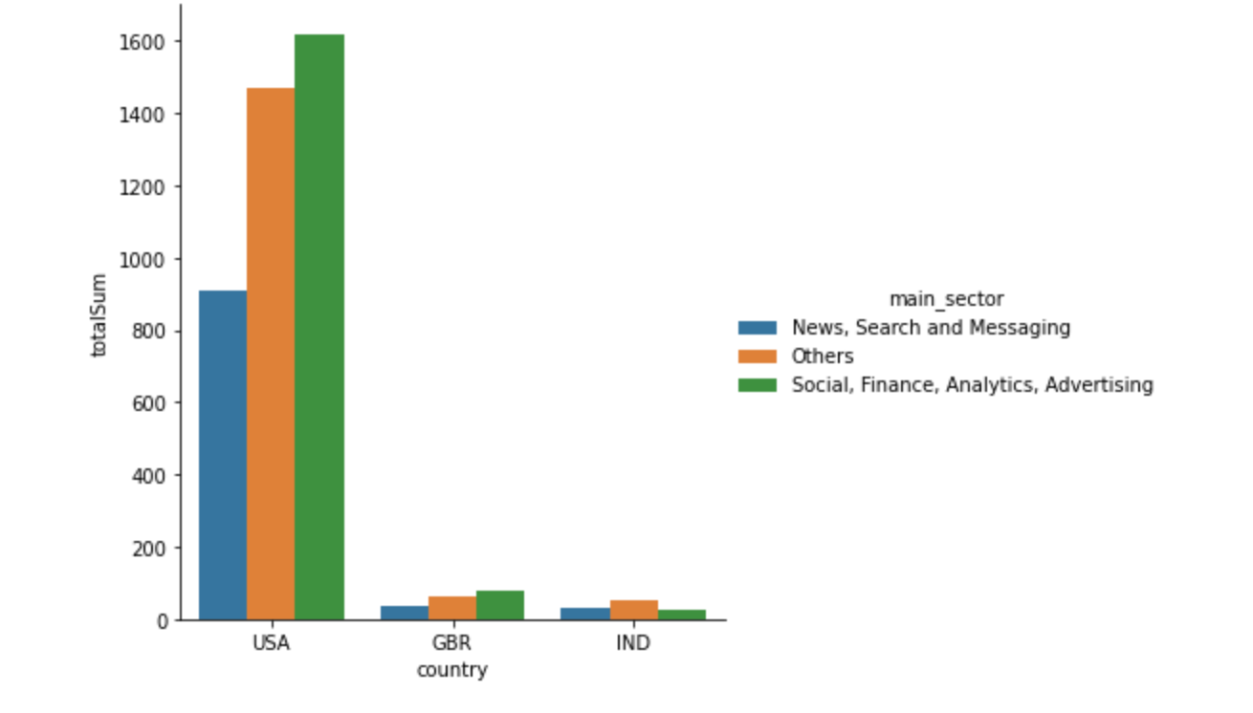
Best Sectors
In all three countries:
Social ,Finance ,Analytics and Advertising sector received maximum investment
USA has received maximum investment
India has shown deviation, where Others has received the maximum investment whereas Social,Finance,Aanalytics,Advertising has received minimum among top 3.

Slide 8
Conclusion :
Venture Capital is most suited option in USA then GBR then India .
Top Sectors which has seen most investment in above countries:
Social, Finance, Analytics, Advertising
Others
News, Search and Messaging

