Slide 1

Digital Dilemmas
Ethics and policy making on issues in technology

Slide 2
Topic #1:
Privacy

Slide 3
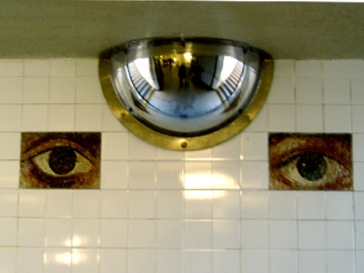
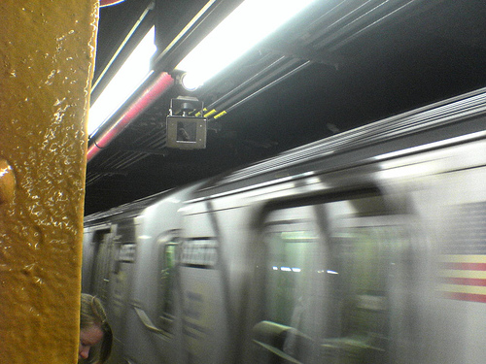
Before: Surveillance Cameras
The UK has ~1 camera for every 11 people.
  This is more than any other country in Europe.
  Used for enforcing traffic laws
  Also used to identify July 7, 2005 London bombers
  But…only 3% of street robberies solved using CCTV images
NYC Transit (MTA) has ~5,000 cameras in use
  Current security program budget is $250 million+
http://en.wikipedia.org/wiki/Closed-circuit_television
http://www.1to1media.com/View.aspx?DocId=31533
http://www.mta.info/news/stories/?story=103

Slide 4
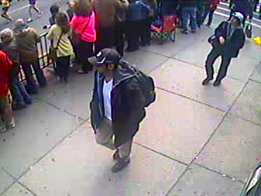
Before: Surveillance Cameras
Boston Marathon Bombing
  Thousands of people taking photos and videos at the time: help or hinder?

Slide 5
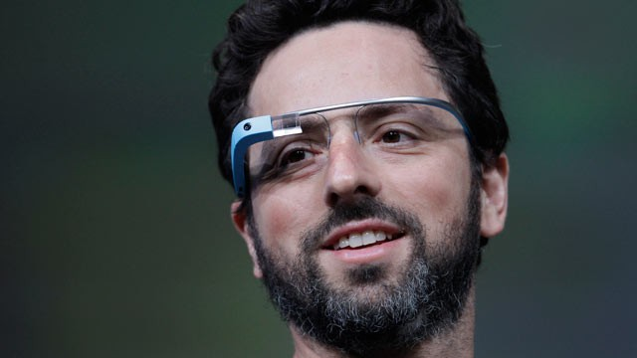
Google Glass
What are some pros and cons of having omnipresent portable cameras?

Slide 6
Activity #1
Come up with a solution for how video surveillance can be used while respecting people’s privacy.

Slide 7
Activity #1
Come up with a solution for how video surveillance can be used while respecting people’s privacy.
  Does your solution treat all situations equally?
    Terrorism
    Drug crimes
    Missing people

Slide 8
Activity #1
Come up with a solution for how video surveillance can be used while respecting people’s privacy.
  Does your solution treat all situations equally?
    Terrorism
    Drug crimes
    Missing people
  Does your solution differentiate between who owns the video?
    Government
    Company
    Individual

Slide 9
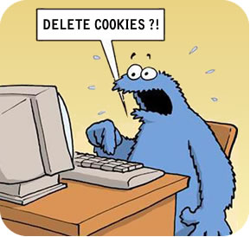
Cookies
A cookie is a small amount of data generated by a website and saved by your web browser. Its purpose is to remember information about you

Slide 10
The Web's New Gold Mine: Your Secrets
“One of the fastest-growing businesses on the Internet…is the business of spying on Internet users.” -WSJ
  A visit to an online dictionary site resulted over 200 tracking cookies being downloaded
  Companies use tracking software (“beacons”) to aggregate data from cookies and build up profiles on individuals
These profiles are loosely “anonymized” (names are removed) and sold to advertisers
http://online.wsj.com/article/SB10001424052748703940904575395073512989404.html

Slide 11

The Web's New Gold Mine: Your Secrets
"In no other milieu do so many people, from such a broad demographic swath, willingly answer so many intimate questions. It is a gold mine for social scientists. In the past nine months, OK Cupid has sold its raw data (redacted or made anonymous to protect the privacy of its customers) to half a dozen academics."
- 2011 article in The New Yorker
http://www.newyorker.com/reporting/2011/07/04/110704fa_fact_paumgarten#ixzz2DRVVeK00"

Slide 12
Don’t Worry, Your Data is Anonymized
In the 1990s a branch of the Massachusetts state government released a massive amount of health records from hospitals for researchers to use
Then Governor, William Weld assured the public that they had protected patient privacy by removing names
Latanya Sweeney, then a Computer Science Ph.D. student at MIT purchased a database of voter registration rolls for $20 and tried to combine the records
http://arstechnica.com/tech-policy/2009/09/your-secrets-live-online-in-databases-of-ruin/

Slide 13
Don’t Worry, Your Data is Anonymized
For the city the governor was registered in (Cambridge: population ~ 54,000)

Slide 14
Don’t Worry, Your Data is Anonymized
For the city the governor was registered in (Cambridge: population ~ 54,000)
  Only 6 people shared his birthdate

Slide 15
Don’t Worry, Your Data is Anonymized
For the city the governor was registered in (Cambridge: population ~ 54,000)
  Only 6 people shared his birthdate
  Only 3 of them were men

Slide 16
Don’t Worry, Your Data is Anonymized
For the city the governor was registered in (Cambridge: population ~ 54,000)
  Only 6 people shared his birthdate
  Only 3 of them were men
  He was the only one registered in his zip code

Slide 17
Don’t Worry, Your Data is Anonymized
For the city the governor was registered in (Cambridge: population ~ 54,000)
  Only 6 people shared his birthdate
  Only 3 of them were men
  He was the only one registered in his zip code
Sweeney sent the governor his health records (including his diagnoses and prescriptions)

Slide 18
Don’t Worry, Your Data is Anonymized
For the city the governor was registered in (Cambridge: population ~ 54,000)
  Only 6 people shared his birthdate
  Only 3 of them were men
  He was the only one registered in his zip code
Sweeney sent the governor his health records (including his diagnoses and prescriptions)
She later demonstrated that 87% of Americans can be uniquely identified by their birthdate, sex, and zip code

Slide 19
Don’t Worry, Your Data is Anonymized
“It would be difficult to overstate the influence of the Weld voter list attack on health privacy policy in the United States – it had a direct impact on the development of the de-identification provisions in the HIPAA Privacy rule”
  - Health Affairs Journal, 1996
The Health Insurance Portability and Accountability Act
  Established strict national standards for health care data
http://healthaffairs.org/blog/2012/08/10/the-debate-over-re-identification-of-health-information-what-do-we-risk/

Slide 20
Don’t Worry, Your Data is Anonymized
Your browser signature alone often provides enough information to uniquely identify you
https://panopticlick.eff.org/

Slide 21
Activity #2
Come up with a solution for how companies (Google, Facebook, etc.) can respect user privacy while also profiting from ads

Slide 22
Activity #2
Come up with a solution for how companies (Google, Facebook, etc.) can respect user privacy while also profiting from ads
  Should tacit consent be the standard to have your personal information used for advertising purposes?
  How does your solution deal with information that is aggregated over a network of sites??
  Must companies allow people to opt-out (or opt-in) to these services?

Slide 23
Topic #2:
Patents and Plagiarism

Slide 24
Patents
A patent grants exclusive rights to a patent holder to make, use, sell or import/export the claimed invention in that country for a limited period of time (20 years)
In order to be patented, an invention should be
  Novel
  Useful
  Non-obvious
Patents are supposed to support innovation by incentivizing research

Slide 25
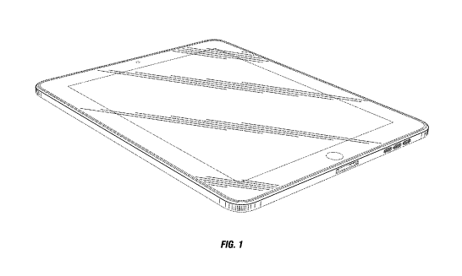
A Patent of Apple’s
U. S. Patent Number D504,889

Slide 26
Patents
Apple sued Samsung for violating its patent on “a thin rectangular cuboid with rounded corners” in 2012
  And other patents about their mobile user interface and style
  won over a billion dollars in damages
"If people had understood how patents would be granted when most of today’s ideas were invented, and had taken out patents, the industry would be at a complete standstill today”
  - Bill Gates

Slide 27
Software Patents
The Java Platform was developed for the company Sun Microsystems in 1991, including
    The programming language
    The virtual machine
    A set of libraries to be used with the language
Oracle bought Sun Microsystems
Google’s Android included a software development kit (SDK) that including some of the original Java APIs
  Oracle claimed infringement on 37 Java packages

Slide 28
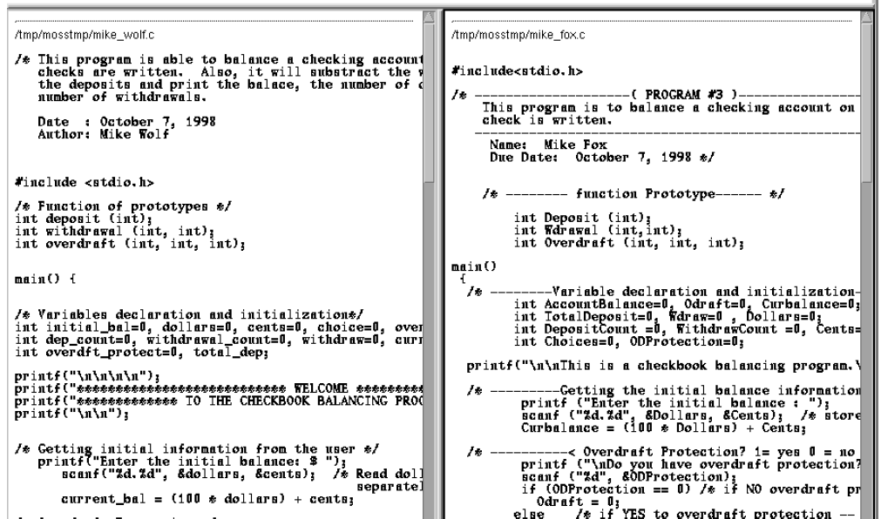
Plagiarism
http://theory.stanford.edu/~aiken/moss/

Slide 29
Open Source
Open Source
  software for which the original source code is made freely available and may be redistributed and modified
  Allows programmers to share code and build off of each other’s work
General Public License (GPL)
  Most common open source license
  Says that the code it is attached with can be freely copied distributed and modified
  Often included in the readme

Slide 30
Software Plagiarism in the ‘Real World’
Software patents
  If you have a product idea and someone implements it first using the same open-source libraries, who does it belong to? (Think “The Social Network”)
Open Source vs. Closed Source or proprietary software
  At a company like Microsoft which sells its software as a proprietary product, engineers are legally forbidden from copying code from open source projects, since this code is often licensed such that it is free and open for public use

Slide 31
Activity #3
Define what it means for a piece of software to be “copying” another one

Slide 32
Activity #3
Define what it means for a piece of software to be “copying” another one
  How would your definition deal with different algorithms that do the same thing (i.e. insertion sort and selection sort)?
  How would it handle large software projects with many interrelated components?
  Would a law to prevent copying software as you defined it be enforceable?

Slide 33
Topic #3:
Censorship

Slide 34
Great Firewall of China
Censorship
  e.g. YouTube, Facebook, blogging sites, popular Tibetan sites
  “superstitious, pornographic, violence-related, gambling and other harmful information.”
  Political topics: Falun Gong, police brutality, Tiananmen Square protests of 1989, freedom of speech, democracy, Taiwan independence, Tibetan independence, and the Tuidang movement.
  Foreign media websites: BBC News, Yahoo! Hong Kong and the Voice of America.
Monitoring
  Amnesty International notes that China “has the largest recorded number of imprisoned journalists and cyber-dissidents in the world.”
http://www.timesonline.co.uk/tol/news/world/asia/article5972245.ece
http://en.wikipedia.org/wiki/Internet_censorship_in_the_People's_Republic_of_China
Notes:
Re: Turkey bans twitter (but that’s been overturned)

Slide 35
Censoring Search Results
Google search censors results depending on the country.
France & Germany censor hate speech and Holocaust denial
USA: sites infringing on copyright (someone can send a DMCA – Digital Millennium Copyright Act – complaint to Google), child pornography.
http://en.wikipedia.org/wiki/Censorship_by_Google
http://blogoscoped.com/archive/2007-03-02-n19.html

Slide 36
Activity #4
To what extent should a government control its citizens’ access to the Internet (or any international computer network)?

Slide 37
Activity #4
To what extent should a government control its citizens’ access to the Internet (or any international computer network)?
  What about protecting copyrights?
  What about illegal activities?
  What about issues that involve national security?

Slide 38
Topic #4:
Security & Hacking

Slide 39
Security Research: Encryption
Publishing an algorithm
  The author of one encryption program, Pretty Good Privacy (PGP), published his algorithm. The US government sued him for “munitions export.”
  “Under some laws, a researcher could find himself prosecuted for simply looking for website vulnerability, much less disclosing it publicly”
http://en.wikipedia.org/wiki/Pretty_Good_Privacy#Criminal_investigation
http://abcnews.go.com/Technology/PCWorld/story?id=3267723

Slide 40
Hacking
Exploiting a weakness in a computer system or network to get access to something without having authorization
Using knowledge of programmable systems to solve problems and build things
http://en.wikipedia.org/wiki/Pretty_Good_Privacy#Criminal_investigation
http://abcnews.go.com/Technology/PCWorld/story?id=3267723

Slide 41


Hacking

Slide 42
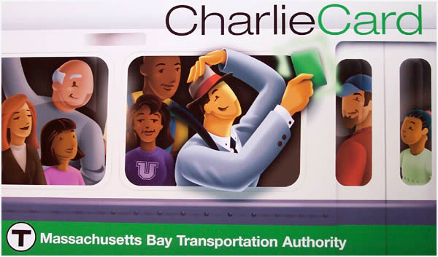
Anatomy of a Subway Hack
In May 2008, MIT students presented a final paper in class demonstrating weaknesses in the CharlieCard automated fare collection system (like our MetroCard).
  They showed that the data on the card can be easily read and overwritten (ie, how to add/remove money from the card)
They planned to present a paper on the vulnerability at a large security conference, DefCon.
The MBTA filed suit seeking a temporary restraining order to prevent the students from presenting or otherwise discussing their findings until its vendors had sufficient time to correct defects as well as seeking monetary damages.
http://en.wikipedia.org/wiki/MBTA_vs._Anderson

Slide 43
Activity #5
Should there be protections for ethical hackers?

Slide 44
Activity #5
Should there be protections for ethical hackers?
  Should hackers be obligated to alert a company when it is attempting to hack it?
  Should companies be legally able to prevent people from attempting to hack them?
  Should someone’s intention when hacking make a legal difference?

Slide 45
Conclusion
There are a lot of ethical issues associated with many aspects of computer science:
  Personal/data privacy
  Data security
  Ethical research
  Hacking
  Plagiarism, copyrights, and patenting
  Closed/open source software
  Censorship of Internet content
These are hard problems!

Slide 46

Computers & Society
Professor Steve Bellovin

