Slide 1
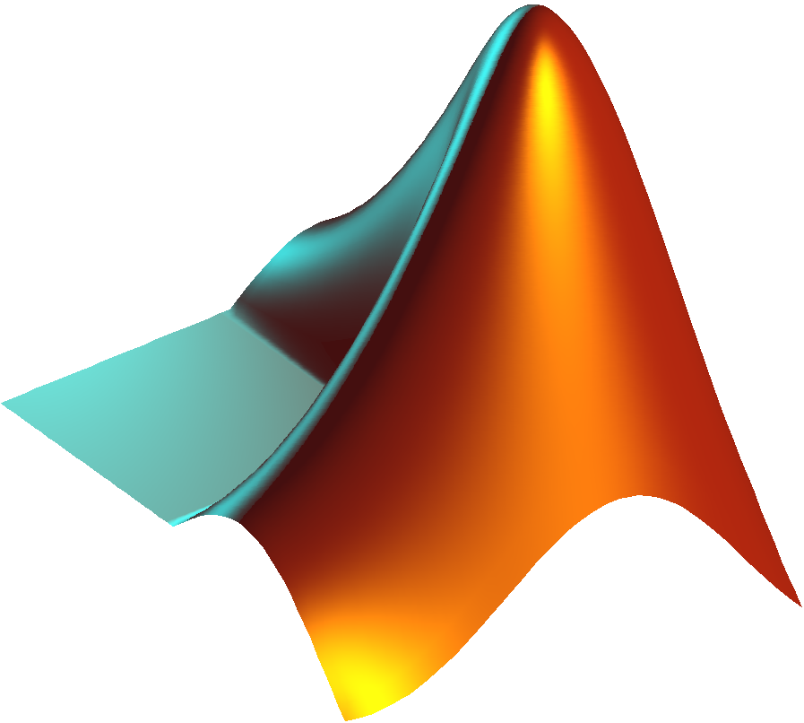

Testing Three Methods of Interpolation
using
CMIP5 Climate Model Output for the American North East
By:
Trevor Wright

Slide 2
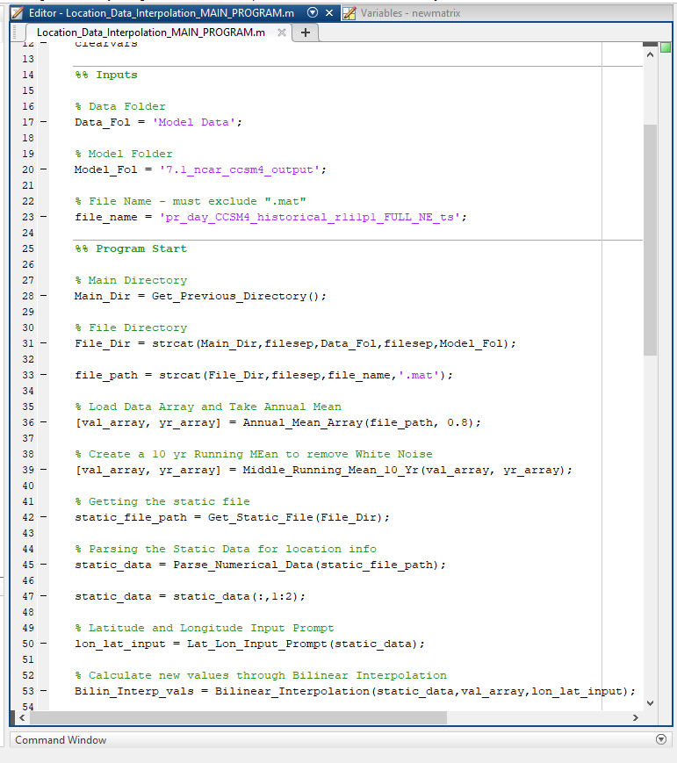
Main Program:
Location_Interpolation.m
Receives inputs – Data Folder Name, Model Folder Name, Data File Name
Runs each of the 10 functions
Organizes the Data between functions if necessary
Creates each of the three Annual Precipitation Plots
Creates a table to display the MSE value calculated for the leave-one-out cross validation

Slide 3
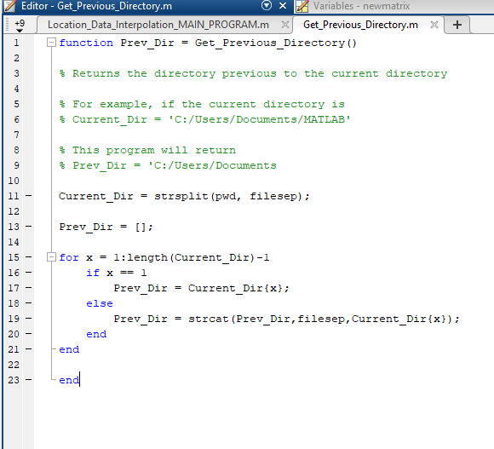
Get_Previous_Directory.m
Function that returns the full path for the directory previous to the directory that the Matlab file of the main program is in.
It does this by getting the name of the current directory using pwd, splitting the string by the file separator using filesep, and loops to combine everything but the last string in the list resulting in the previous directory.
This is used to combine with the three main program inputs to get the data file and static file later on.

Slide 4
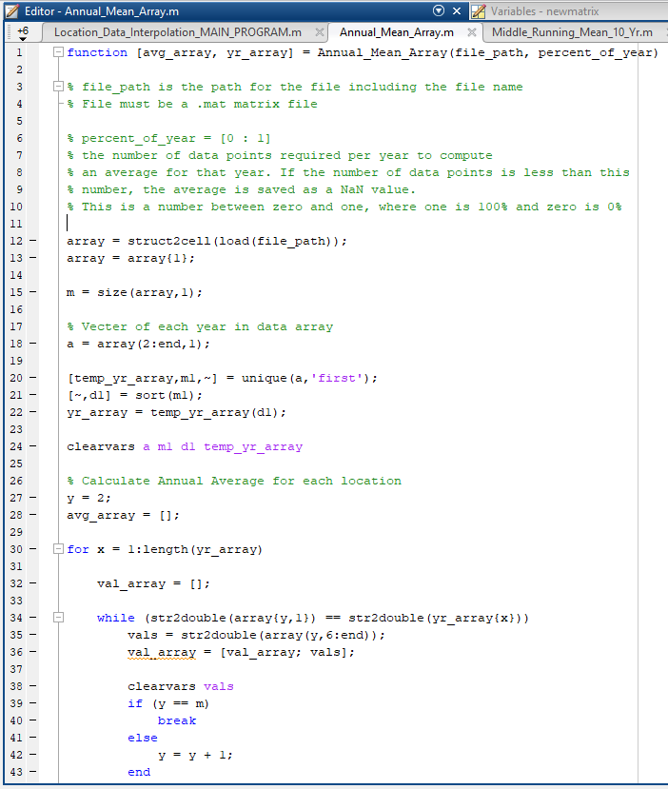
Annual_Mean_Array.m
Function that takes as inputs the file path for the data file that was input into main program and combined with output from Get_Previous_Directory.m and the percent (0 – 1) of year for which complete data is necessary.
It then loops through the daily data and calculates the average for each year if the percentage of data available is greater than or equal to the input percentage. If not, the average for that year is NaN.
The data is put into an array, where each column is a location and each row is a year, which is then returned with a vector of the years in the data.

Slide 5
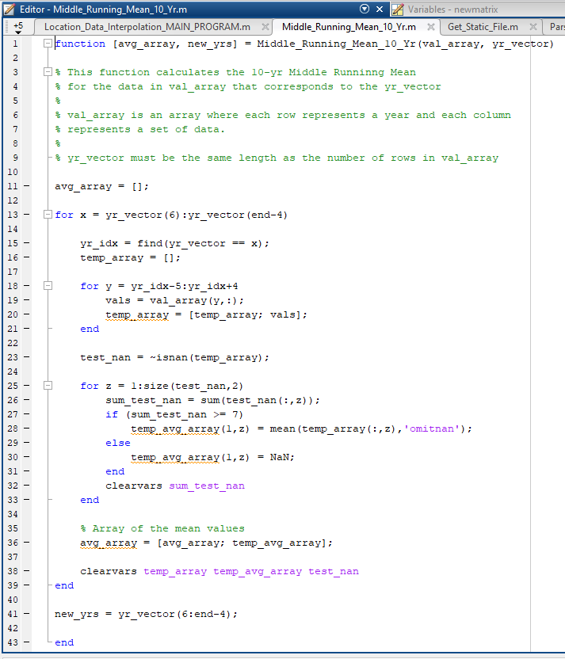
Middle_Running_Mean_10yr.m
Inputs the data array and the year array output by Annual_Mean_Array.m.
Loops through the 6th year in the list to the 5th to last year and takes the 10 year running mean, which is the average of the sum of that year, the preceding five and the following 4 for each year in the list.
This is done across each location and put into a new array that has less rows than the input. A new year vector is made that doesn’t include the left out years.
The new year vector and new data array are output by the function.

Slide 6
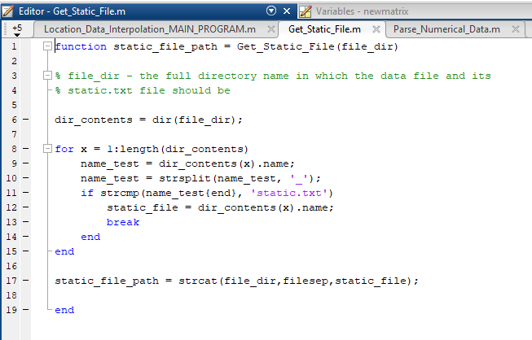
Get_Static_File.m
This function takes the file directory of the model folder as an input.
Using the dir function, the names of all the files in the folder are retrieved.
This list is then looped through to find the file that ends in “static.txt”, once found the loop is exited.
The file name is then added to the model folder path name to make a string that contains the whole file path which is then returned by the function.

Slide 7
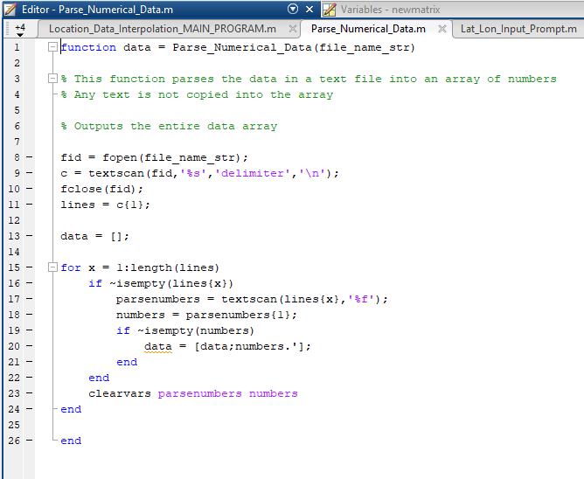
Parse_Numerical_Data.m
This function takes the file name output by Get_Static_File.m
The file is then opened, scanned for the text in the file, and the resulting strings are put in a vector.
This vector is looped through to split the strings and turn the numbers within the strings into doubles and put them in an array which is output by this function.
This array represents the location data of the points in the precipitation data array created by the previous functions.

Slide 8
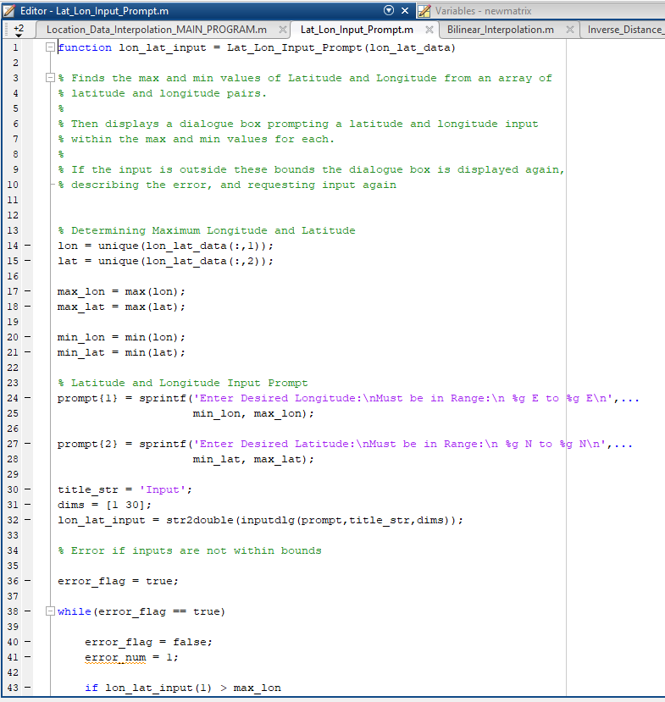
Lat_Lon_Input_Prompt.m
This function takes as input the location data retrieved by Parse_Numerical_Data.m.
The function then finds the max and minimum latitude and longitude values in the data.
It then displays a prompt box asking for a single latitude and longitude input between these bounds. If input is not between these bounds the box redisplays with an error asking for correct input. It does this indefinitely until correct input is retrieved.
It then outputs this pair of values as a vector. [Longitude, Latitude]

Slide 9
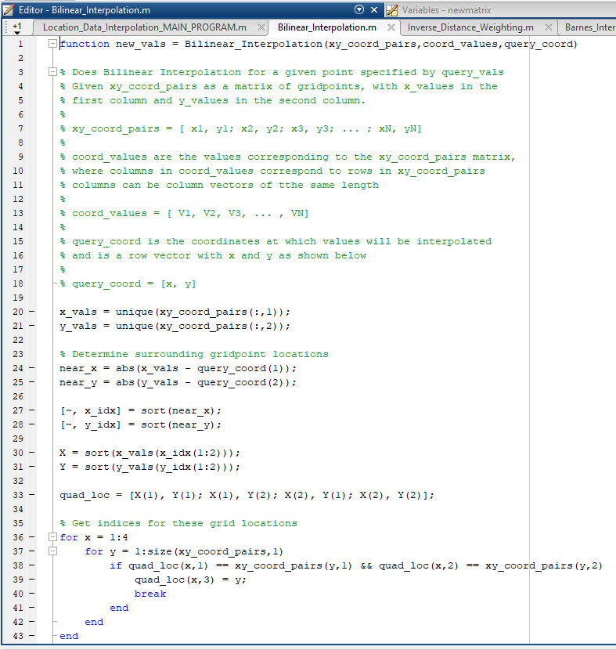
Bilinear_Interpolation.m
Takes as input the location data for all the points, the time series precipitation data for the corresponding points, and the query coordinates input from Lat_Lon_Input_Prompt.m
Performs Bilinear interpolation to the point designated by the query coordinates.
This produces an interpolated time series data set that is output by the program.

Slide 10
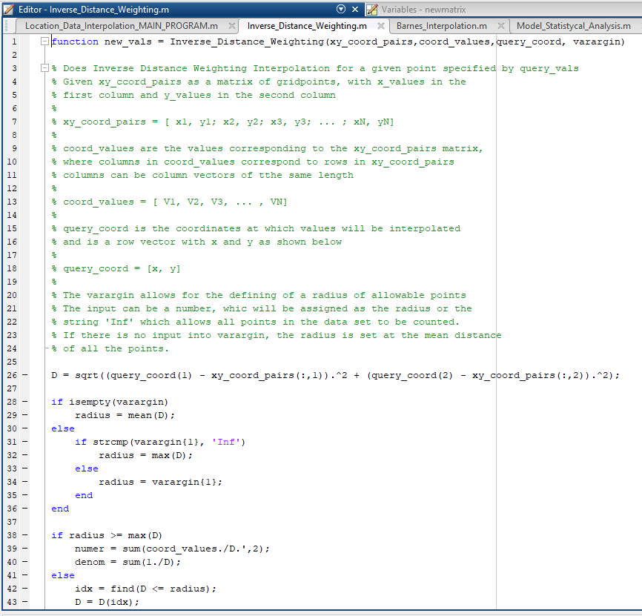
Inverse_Distance_Weighting.m
Takes as input the location data for all the points, the time series precipitation data for the corresponding points, and the query coordinates input from Lat_Lon_Input_Prompt.m
Performs an inverse distance weighting interpolation at the query point designated by the input coordinates by weighting the distances of each individual point in the data set.
This then returns the interpolated time series data set that is created by the program.

Slide 11
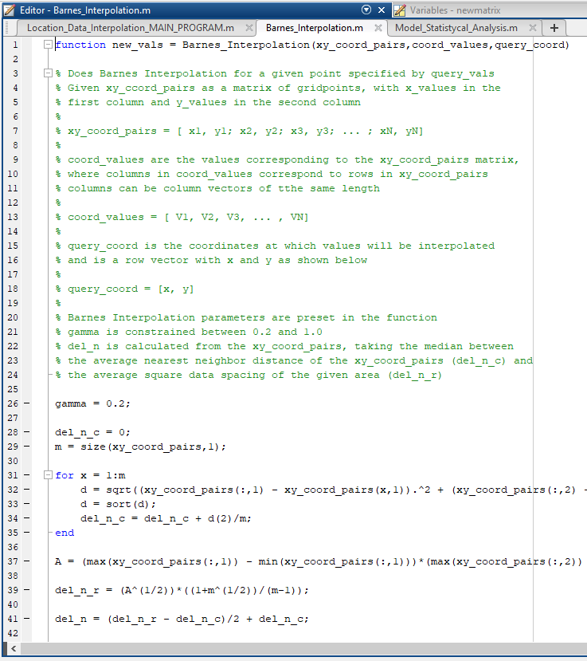
Barnes_Interpolation.m
Takes as input the location data for all the points, the time series precipitation data for the corresponding points, and the query coordinates input from Lat_Lon_Input_Prompt.m
Performs Barnes interpolation at the query point designated by the input coordinates through a complicated 2 phase process of gaussian weighting by distance and gaussian correction..
This then returns the interpolated time series data set that is created by the program.

Slide 12
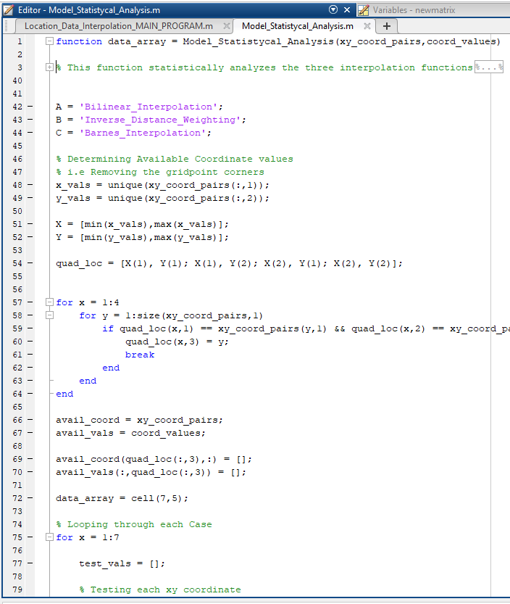
Model_Statistical_Analysis.m
Takes as input the location data for all the points, the time series precipitation data for the corresponding points, and the query coordinates input from Lat_Lon_Input_Prompt.m
Does leave-one-out cross validation on each model and combination of models to determine the effectiveness of each model. To do this, each of the 7 possible cases is looped through the cross validation, at each time series point determined a mean square error (MSE) and then an average MSE is taken for the model.
These MSE values are then put into a cell array with the model names and other information which is then output by the function.

Slide 13
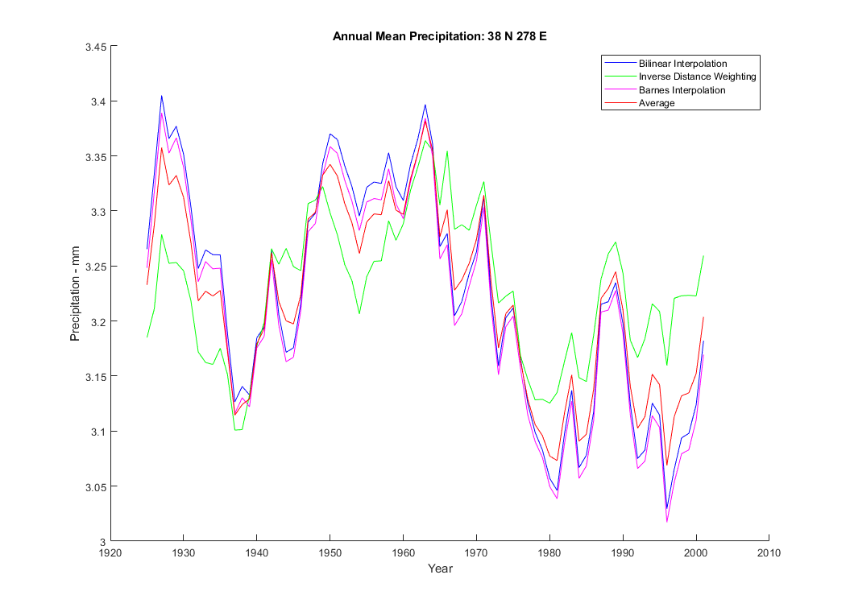
Program Output
Output of each of the individual models and the average between the three at the location of 38 N 278 E
For CCSM4_historical_r1i1p1 in 7.1_ncar_ccsm4_output

Slide 14
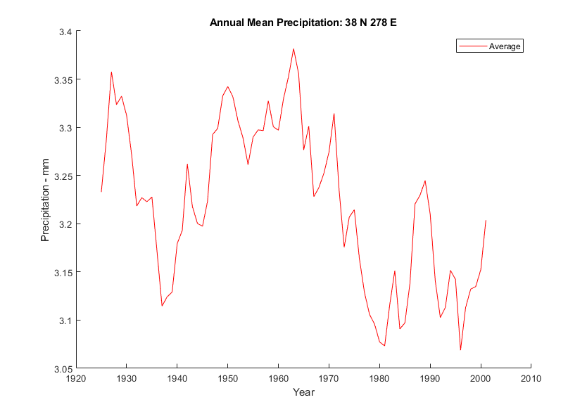
Program Output
Average output between the individual models at the location of 38 N 278 E
For CCSM4_historical_r1i1p1 in 7.1_ncar_ccsm4_output

Slide 15
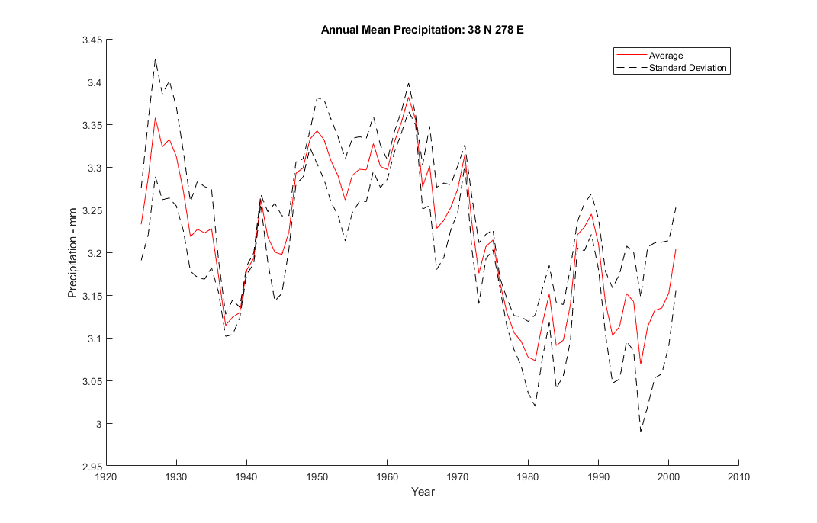
Program Output
Average output between the individual models and one standard deviation at the location of 38 N 278 E
For CCSM4_historical_r1i1p1 in 7.1_ncar_ccsm4_output

Slide 16
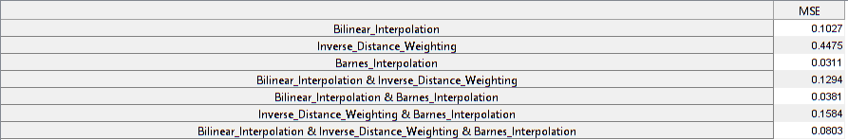
Program Output
Mean Square Error of the outputs of the different interpolation groups, where output of two or more models is the average between the outputs of the two.
It can be seen that averages between two models places the MSE between the individual models’ MSE values.
Judging by these MSE values, Barnes Interpolation on its own is the most accurate, with the combination of Barnes and Bilinear Interpolation being a close second.

