Slide 1
Metadata DB Search Metrics Meeting

Slide 2
Motivation
To properly represent flight tracks as metadata
Potential Use Cases - Granule Search or Subsetting needs:
Regional model assessments
Spatial Resolution: ~100s km
Regional Survey
Spatial Resolution: ~100s km
Vertical Resolution: ~ 1 km
Site Comparison
Spatial Resolution: ~3 km, depending on surface wind speed, ASL < ~1 km depending on terrain
Vertical Resolution: < ~0.1 m
Event/Case study
Spatial Resolution: ~10 km
Vertical Resolution: ~ variable
Satellite Validation
Spatial Resolution: ~10 km
Vertical Resolution: ~ 0.1 km for available column

Slide 3
Current Airborne In-Situ Metadata Representation for Sampling Locations
2-D
Bounding-boxes
Polygons and Multi-Point
Some LineString (CARVE datasets)
Time
False representation of data location
No altitude component
No time associated with each point
Location is dependent on time
Start Time→Stop Time
Issues with Current Representation

Slide 4
Summary of the Current Work
Ran line simplification algorithms on campaign navigation data
Constructed a DB with various representations of the data
Full-Res
Simplified Lines
Bounding Boxes
Multi-Point polygons (Completed for DISCOVERAQ-MD)
Looking to make recommendations to CMR/EarthData Airborne metadata
Specifically In-Situ measurements
Will expand to other types of measurements in time

Slide 5
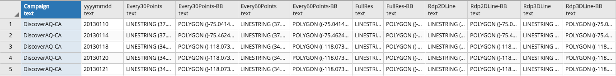
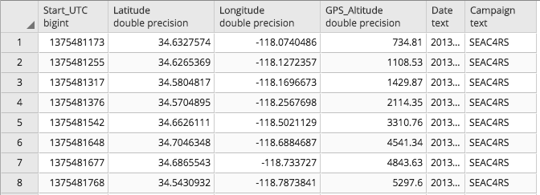
Current DB Structure
Flight Track Database
Spatial Temporal Metadata Database

Slide 6
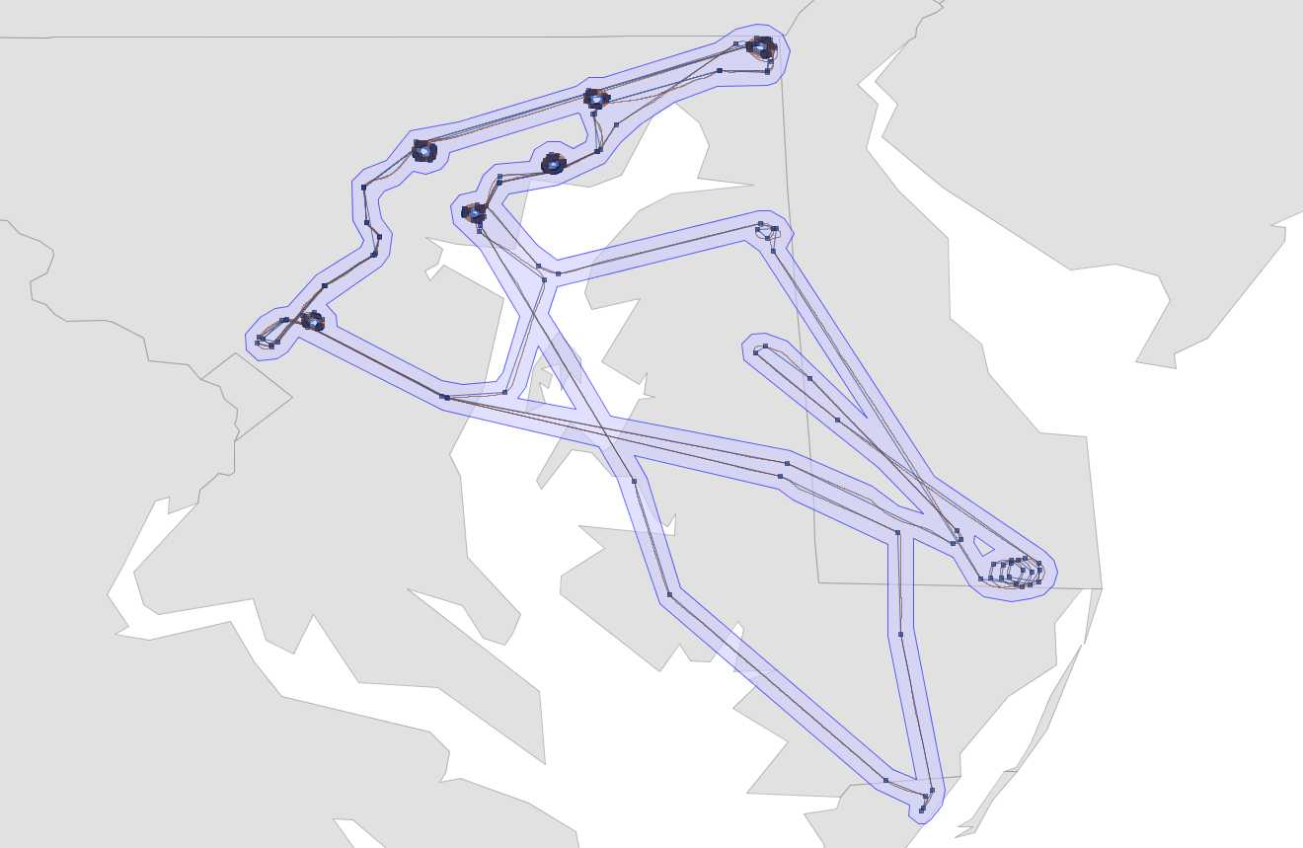
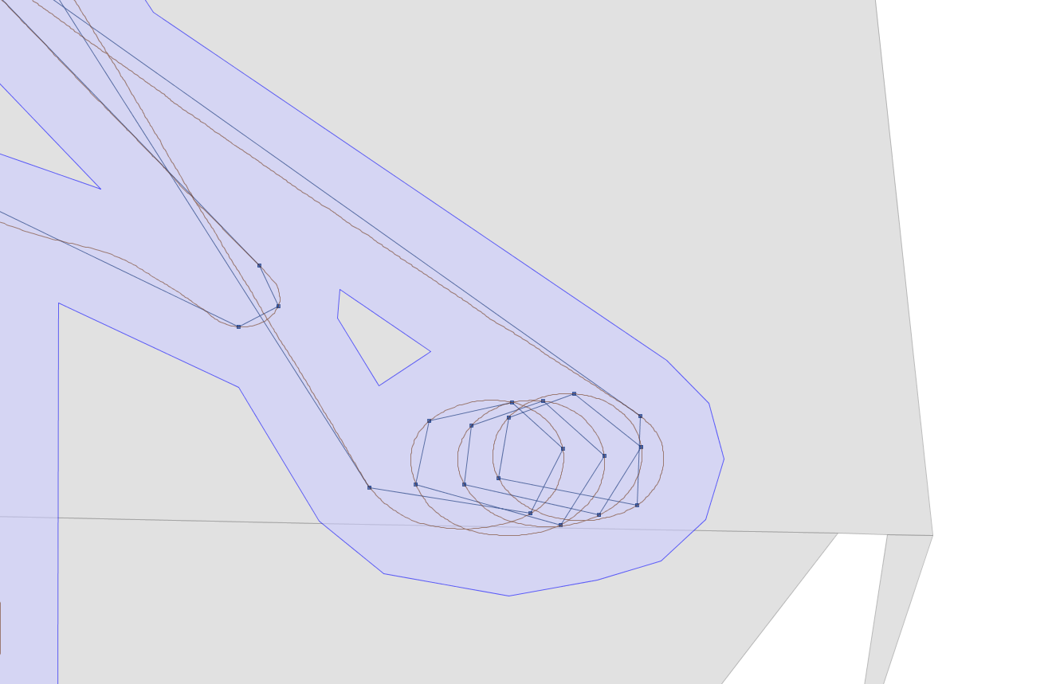
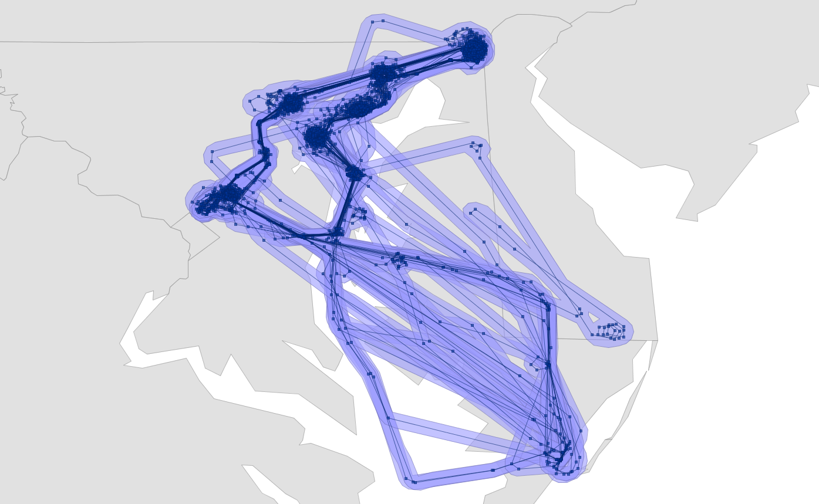
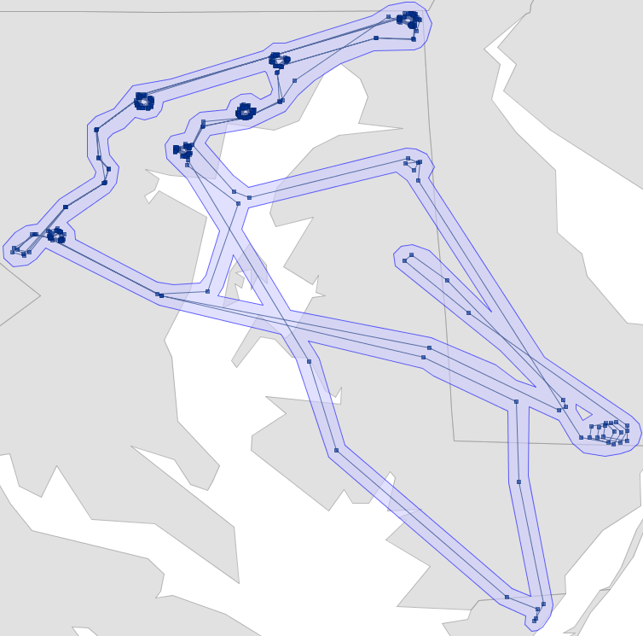
DiscoverAQ-MD Comparison
Representation | # of Points | % Of Original
Full Resolution | 364,240 | 100%
Every 30 Points | 12,146 | 3.33%
Every 60 Points | 6,078 | 1.67%
2D Line Simplification Alg | 5,777 | 1.59%
3D Line Simplification Alg | 18,402 | 5.05%
Multi-Polygon | 1,900 | 0.52%

Slide 7
DiscoverAQ-MD Comparison Cont.
Polygon has lowest number of points
Still has ‘good’ representation
3D has the highest, but some would argue is the most important due to the study
Altitude could potentially play a large role in searches for within spiral flight tracks
2D has many un-necessary points represented where spirals occur
Most likely not the best representation of flight track when multiple overlapping paths occur.

Slide 8
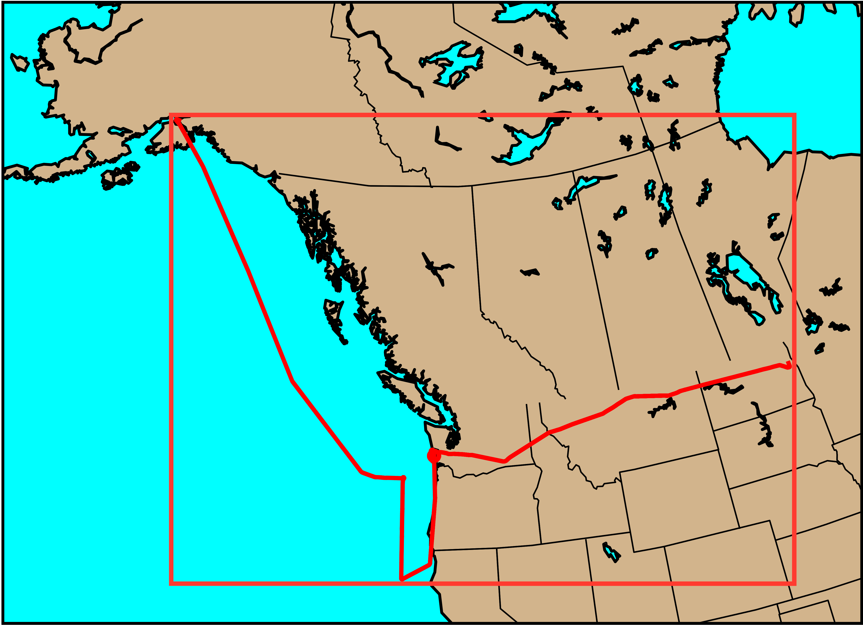
Recommendations
Incorporate point specific time
Incorporate point specific altitude
Require that all Aircraft related data be represented properly
Based on flight pattern
Raster flight patterns could serve well with a bounding box representation if it is the primary sampling goal. It can get complicated if several raster patterns were flown.
D-AQ flights benefit from line simplification and altitude
Based on instrument type
Many different ways to go about this
This will help to reduce the false representation of data location

Slide 9
Metrics for Quantification
We want to show that incorporating these recommendations into CRM/EarthData will not hinder performance in search time, and reduce the number of false positives associated with searches.
Potential Metrics:
Applicability to different types of flight patterns and use cases
False Positives returned
DB Storage Size
Search Times

