Slide 1
Swift + iOS Development
Tanner Stokes – Mobile Innovation Team

Slide 2
Who Am I
Life long learner
tannr.com | https://github.com/twstokes
Clemson since 2009
Mobile Innovation Team since Fall ‘15

Slide 3
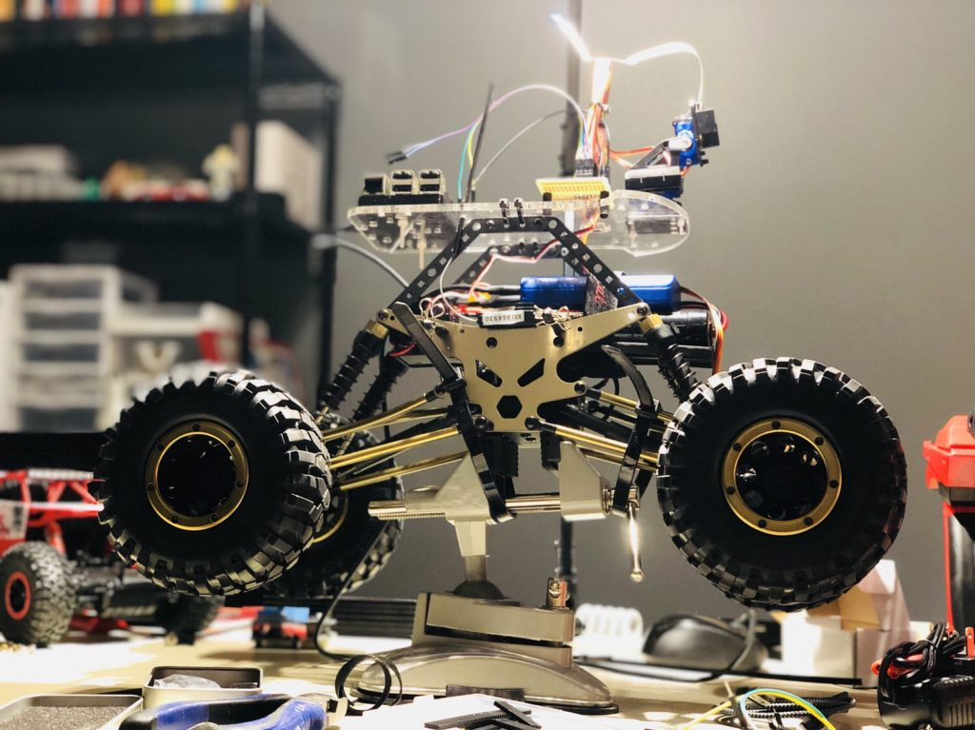
Latest Project

Slide 4
How this workshop will go
We don’t have much time!
Swift basics in Playground
Simple iOS app

Slide 5
Internship opportunities
Come work with our team as we build up the next my.Clemson
Docker
Go
Postgres
AWS
Kubernetes
iOS Native
React
mobile-admin@lists.clemson.edu

Slide 6
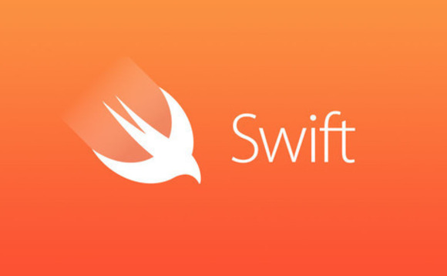
ABOUT Swift
Open Source (Linux friendly!)
Compiled, statically typed
No pointers and very safe!
Modern features

Slide 7
Swift features
Functions are first class citizens
Optionals
Optional binding
Chaining
Type inference
Closures
Tuples / multiple return values
Generics
Iteration over collections
Structs
Method support
Extensions
Protocols
Error handling (try / catch / throw)
Package manager

Slide 8
Let’s Play
Fire up Xcode
File -> New -> Playground
Select Blank -> Next
Save somewhere

Slide 9
Cocoa / Ios programming
Swift is the language, Cocoa is the platform (set of APIs)
Apple gives you a powerful API called UIkit that is the core of iOS apps
You get lots for “free“
Full suite of tools
Xcode
Simulator
Package manager
TestFlight

Slide 10
Apple wants beautiful
They had UI guides all the way back in the 80s because they knew how important it was
You get Adobe XD for free! Use it to mock up before you code.
Apple has design resources for it: https://developer.apple.com/design/resources/
Simpler can be better

Slide 11
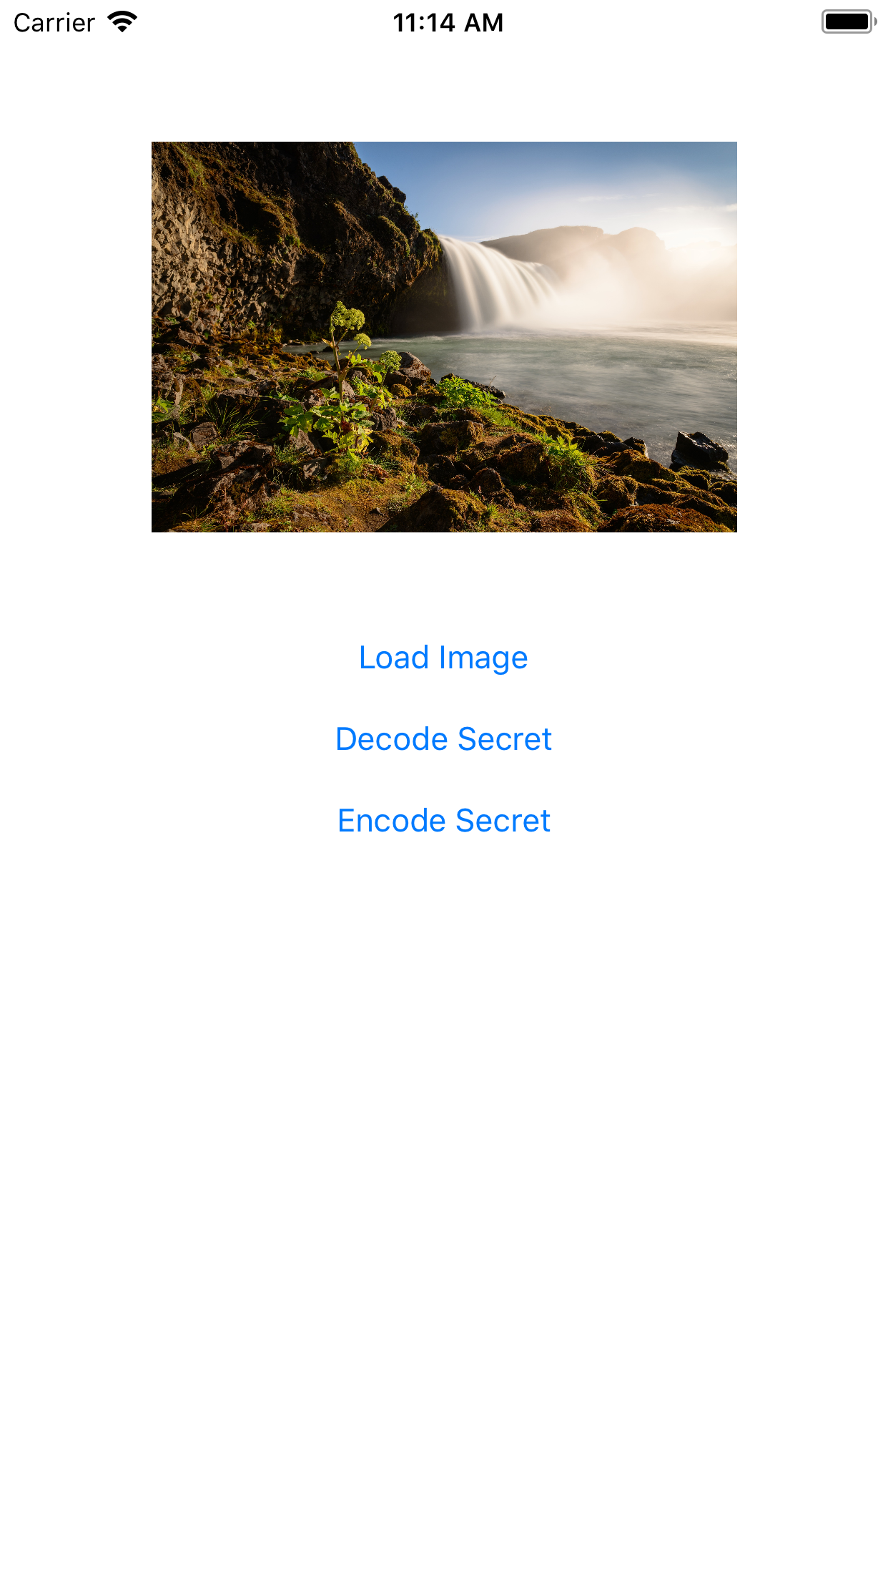
Let’s build something
A simple (not so beautiful) app
Accesses your camera roll
Encodes and decodes a secret to an image
A simple, naïve steganography app

Slide 12
You’ve heard of oo
Look into “Protocol Oriented Programming”
https://developer.apple.com/videos/play/wwdc2015/408/
A paradigm to loosely couple types with responsibility

Slide 13
pieces to understand
Optionals (?!?!?!?)
Protocols
Delegates
Closures
Callbacks (and callback hell) (check out PromiseKit)
View Controller vs View vs Navigation Controller, etc.
Autolayout (A BEAST and not so ”auto”)
Overinflated App Delegate / View Controller
Running in appropriate threads

Slide 14
Important things that are overlooked
In Production
Accessibility
Localization
In Development
Testing
Linting

Slide 15
Resources
A Swift Tour - https://goo.gl/MVREW8
Language guide - https://goo.gl/6sA63T
Big Nerd iOS Programming - https://www.bignerdranch.com/books/ios-programming/
Stanford iOS class on YouTube - https://www.youtube.com/channel/UCYVp6suz7ztKAKY8jpfACXA
Apple UI / UX: https://developer.apple.com/ios/human-interface-guidelines/overview/themes/

