Slide 1
OneTooCalendar

Slide 2
Need for the project

Slide 3
Timeline

Slide 4
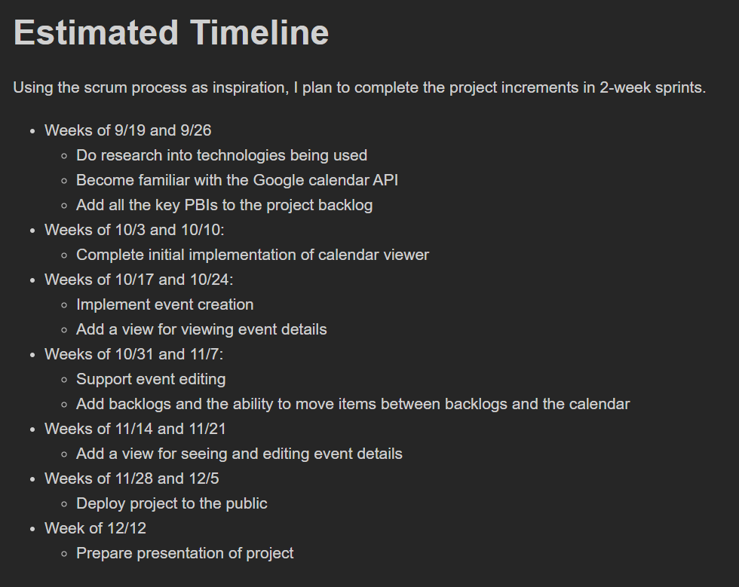

Slide 5
Github planning

Slide 6
Burndown charts

Slide 7
Use case and activity diagram

Slide 8
Demonstration

