Slide 1
OneTooCalendar

Slide 2
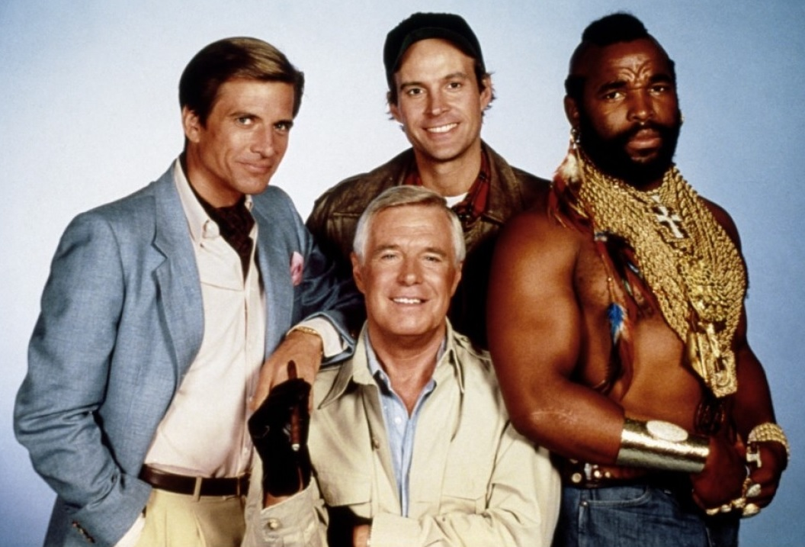
Meet the team

Slide 3
Purpose
Enhance Google Calendar users’ experiences
Provide a “backlog” of tasks that have not had a time planned out for them

Slide 4
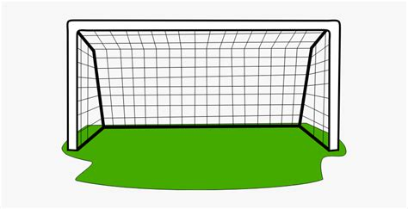
Goals
Provide a user experience similar to Google Calendar
Provide a backlog for events

Slide 5
Timing
Was about ~85% on track with my plan
Some things were completed in a different order than planned
Backlog before drag and drop
Event caching after editing
Some things took a little more time than anticipated
Editing
Drag and drop
Caching
Some things are still not yet completed (but that’s okay!)
Adding new events
Keeping/editing time durations in the backlog
“Resize” events to adjust durations
Installer

Slide 6
What’s new?
For the midterm, there was presented a simple calendar viewer
Grabbed events from Google Calendar
Displayed them in a grid using a random color for each calendar
What’s changed:
Event editing
Drag and drop
Backlog
Colors are correct
Dynamic column creation for overlapping events
Caching events fetched and changes to them

Slide 7
Change management
Present it as an alternative to Google Calendar
Emphasize the security and convenience of the application
Will be adopted organically
In the future, a self-contained installer will make setup trivial
Webinars available to teach usage
GitHub issues and a contact email will be used for help/reporting problems

Slide 8
Live demo

Slide 9
Challenges
Drag and drop was a lot harder than expected
Keeping track of what was cached, and what in the cache was out of date/up to date
Attempting visual consistency with Google Calendar
Synchronizing quickly
Not flopping if there were connection errors
Column calculations

Slide 10
Thanks!

