Slide 1
The Hippocampus vs The Amygdala
By Tim Vaughn

Slide 2


What are Expressed Genes?
Genes that are read from a sample tissue(Sequenced RNA values)
What does a gene say about a sample?

Slide 3

GTEx Dataset
Cleaning (Gene must have reads > 150,000)
Similarity of Tissues
Dissimilarity

Slide 4
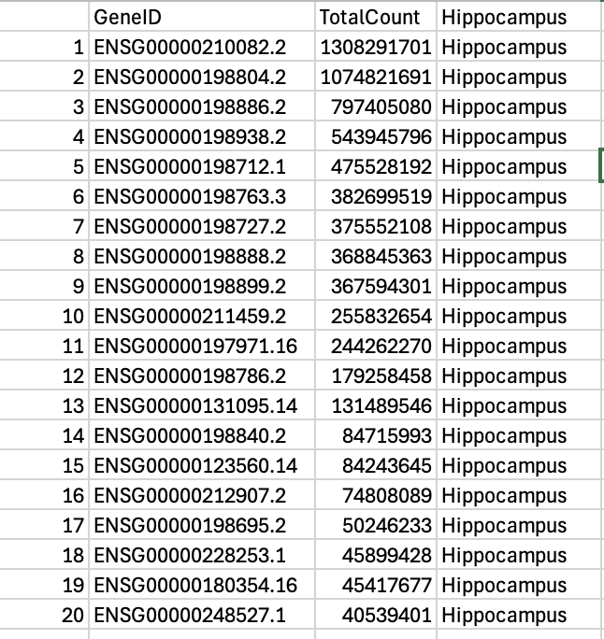
The Most Expressed Genes - Hippocampus
Top 5 Genes Most Total Expressed
ENSG00000198763.3
Electron transfer from NADH → ubiquinone (coenzyme Q10)
Proton pumping across the inner mitochondrial membrane

Slide 5
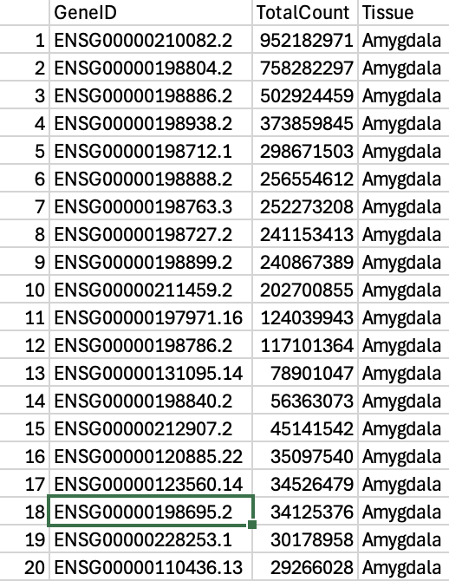
The Most Expressed Genes - Amygdala
Top 5 Genes Most Total Expressed
ENSG00000198888.2
Mitochondrially encoded NADH:ubiquinone oxidoreductase core subunit 1
Ion-Channeling
Leber's Hereditary Optic Neuropathy (LHON) → leading to vision loss
Mitochondrial encephalomyopathy,

Slide 6
Amygdala

Slide 7
Hippocampus

Slide 8
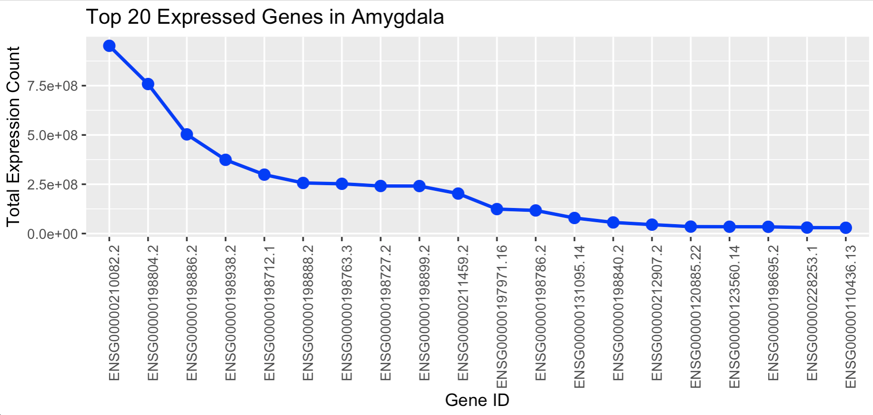
Similar Trends

Slide 9
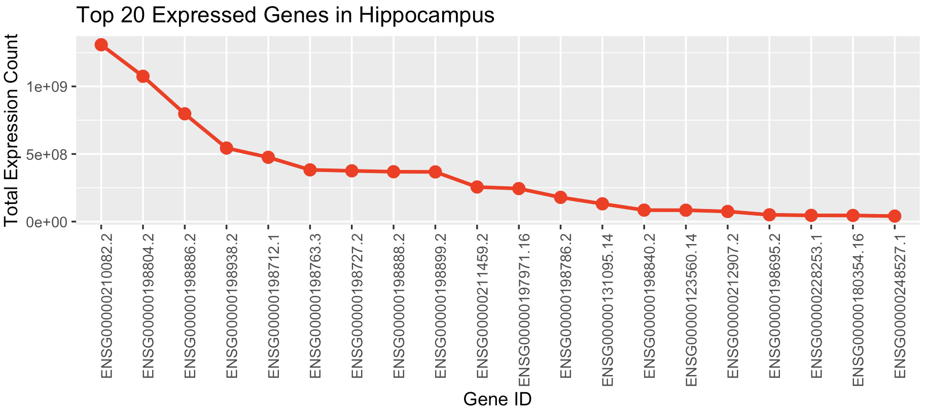
Similar Trends

Slide 10
What are these Genes Doing?
13 Mitochondrial Genes
7 Nuclear Genes
ENSG00000197971.16 – MBP Encodes myelin basic protein, a major component of the myelin sheath in the central nervous system, essential for proper nerve conduction.
ENSG00000131095.14 – GFAP Encodes glial fibrillary acidic protein, an intermediate filament protein expressed by astrocytes, providing structural support in the central nervous system.

Slide 11
An In-Depth Regression Model
Commonly Expressed Genes don’t Predict well (Imagine Determining the Make of a Car by having Four Wheels)
Need Tens of Thousands for Accuracy

Slide 12
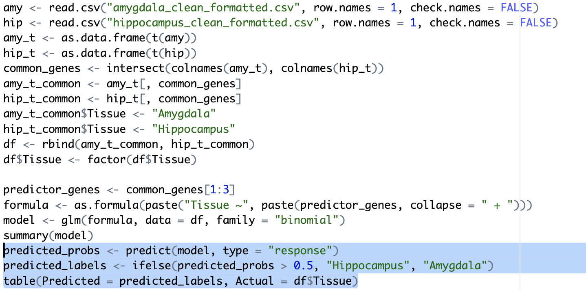
Regression Model Code

Slide 13
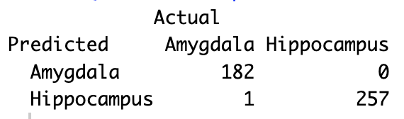
Regression Results

