Slide 1
EE6470 Midterm Project
109061613 黃柏凱

Slide 2
Outline
Emboss Filter
Spilt/no spilt
Pipeline
Batch row
Result
Demo

Slide 3
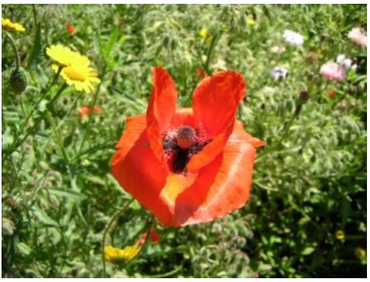
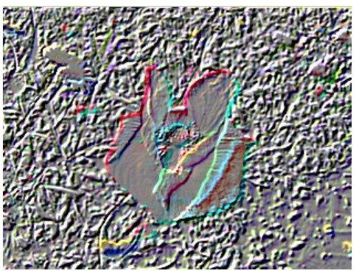
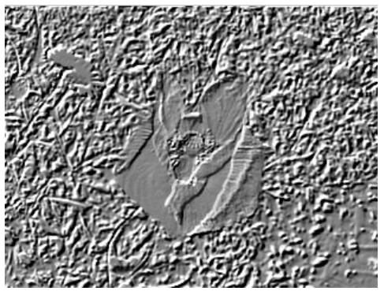
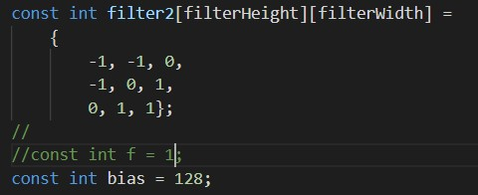
Emboss Filter
[1]

Slide 4
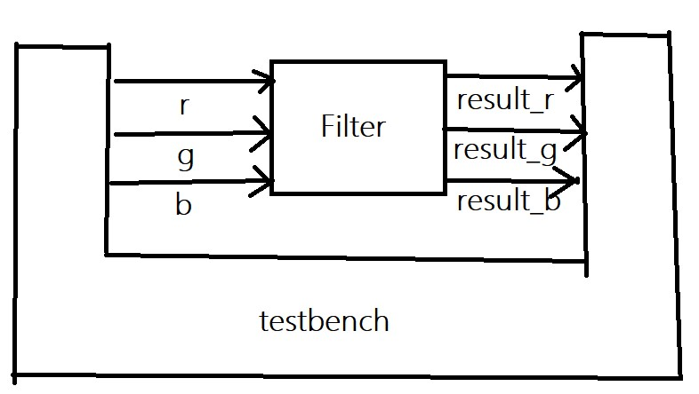
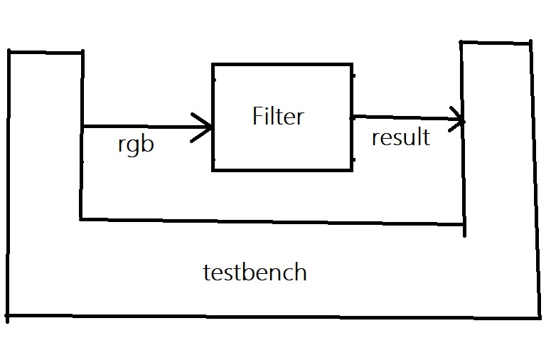
Spilt/no spilt

Slide 5
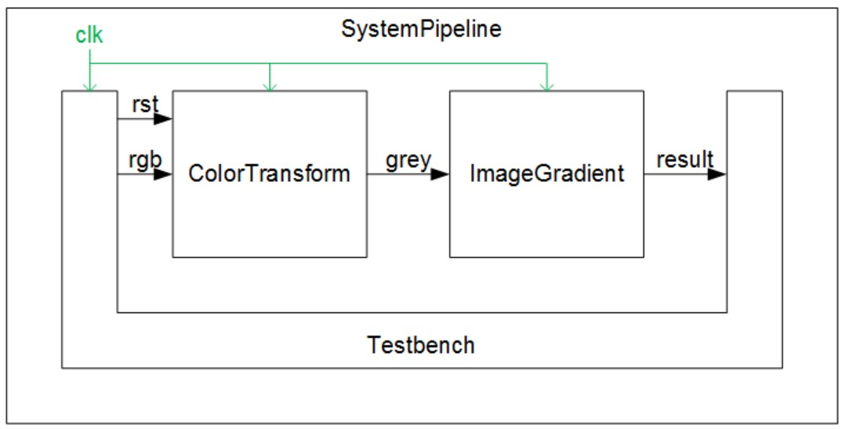
Pipeline

Slide 6
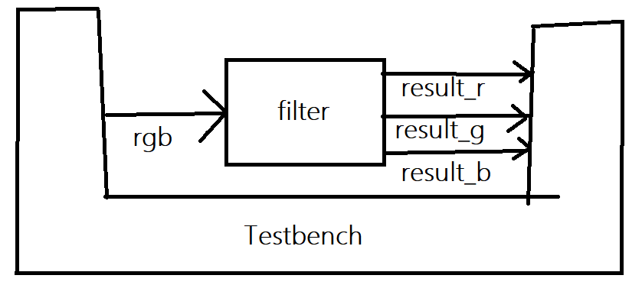
Batch row

Slide 7

Batch row
Step1. create variable to store row of data
Step2. Read 2 row first
Step3. In while loop, read the third row then do conv
Step4. after send data to tb , change(shift) the row data
1 | 2 | …. | 511 | 512
2
⋮
511
512
1 | 2 | 3 | 4 | …. | …. | 509 | 510 | 511 | 512
2 |  |  |  | …. | ….
3 |  |  |  | …. | ….

Slide 8
Result of HLS
 |  | simulated time(ns) | estimated area
Sim_B | No spilt | 52,428,850
 | spilt | 104,857,650
Sim_V_BAISC | No spilt | 99,614,775 | 5269.9
 | spilt | 152,043,575 | 3493.9
Sim_V_DPA | No spilt | 78,643,255 | 2448.3
 | spilt | 131,072,055 | 2138.7
(Clock period = 10)

Slide 9
Result of HLS
 |  | simulated time(ns) | estimated area
Sim_B | No spilt | 52,428,850
 | spilt | 104,857,650
Sim_V_BAISC | No spilt | 99,614,775 | 5269.9
 | spilt | 152,043,575 | 3493.9
Sim_V_DPA | No spilt | 78,643,255 | 2448.3
 | spilt | 131,072,055 | 2138.7
 |  | simulated time(ns) | Color Transform (area) | Image Gradient (area) | Total estimated area
Sim_B | Pipeline | 47,185,990
 | Batch | 15,687,740
Sim_V_BAISC | Pipeline | 125,829,225 | 2519.5 | 1286.5 | 3806
 | Batch | 459,520,095 |  |  | 5933.2
Sim_V_DPA | Pipeline | 96,993,355 | 1068.5 | 1197.6 | 2266.1
 | Batch | 151,444,545 |  |  | 3254.5
(Clock period = 10)

Slide 10
With/without CONSTRAIN_LATENCY
 |  | simulated time(ns) | estimated area
Sim_B | No spilt | 52,428,850
 | spilt | 104,857,650
Sim_V_BAISC | No spilt | 99,614,775 | 5269.9
 | spilt | 152,043,575 | 3493.9
Sim_V_DPA | No spilt | 78,643,255 | 2448.3
 | spilt | 131,072,055 | 2138.7
 | Batch rows | simulated time(ns) | Total estimated area
Sim_B | [3][512] | 15,687,740
 | [4][512] | 15,667,260
 | [4][512]with CONSTRAIN_LATENCY | 15,667,260
 | [5][512]with CONSTRAIN_LATENCY | 15,646,780
Sim_V_BAISC | [3][512] | 459,520,095 | 5933.2
 | [4][512] | 474,234,985 | 5847.5
 | [4][512]with CONSTRAIN_LATENCY | 57,328,705 | 6770.8
 | [5][512]with CONSTRAIN_LATENCY | 62,417,985 | 7101.4
Sim_V_DPA | [3][512] | 151,444,545 | 3254.5
 | [4][512] | 156,359,745 | 3376.6
 | [4][512]with CONSTRAIN_LATENCY | 62,540,865 | 3218.3
 | [5][512]with CONSTRAIN_LATENCY | 67,619,905 | 3294.0
(Clock period = 10)

Slide 11
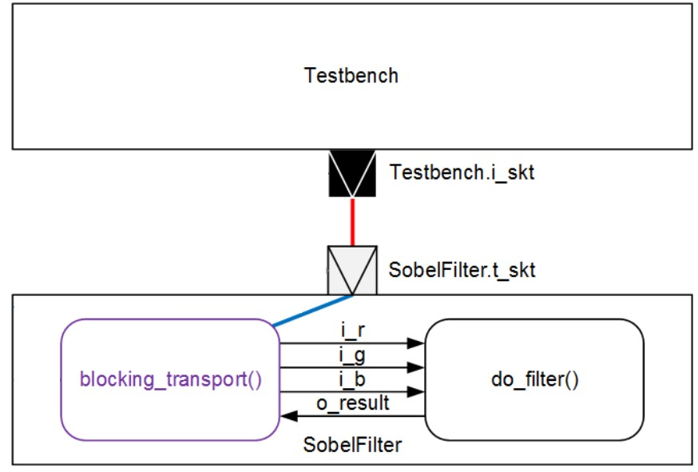

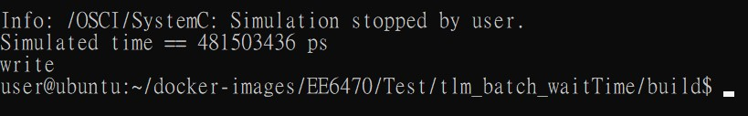
Result of TLM
 |  | simulated time(ns)
 | TLM, batch | 481,503
Sim_B | Batch(HLS) | 15,687,740
(Clock period = 10)

Slide 12

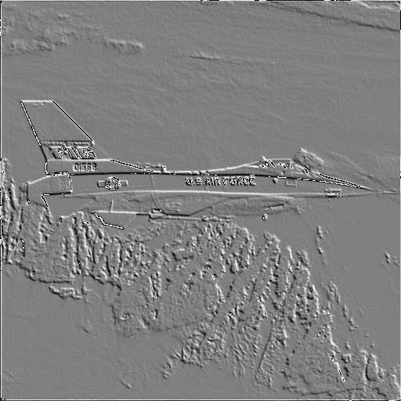
Demo

