Slide 1
EE6470 Final Project
109061613 黃柏凱

Slide 2
Outline
Introduction : CRC, qsort
CRC32 algorithm
Result/demo

Slide 3
Introduction : CRC & qsort
CRC is an error-detecting code used in digital networks and storage devices to detect accidental changes to raw data.
CRC operation uses XOR, AND , polynomial to do binary division.
CRC32 algorithm
qsort , a function to sort elements of array, will modify the context of the array

Slide 4
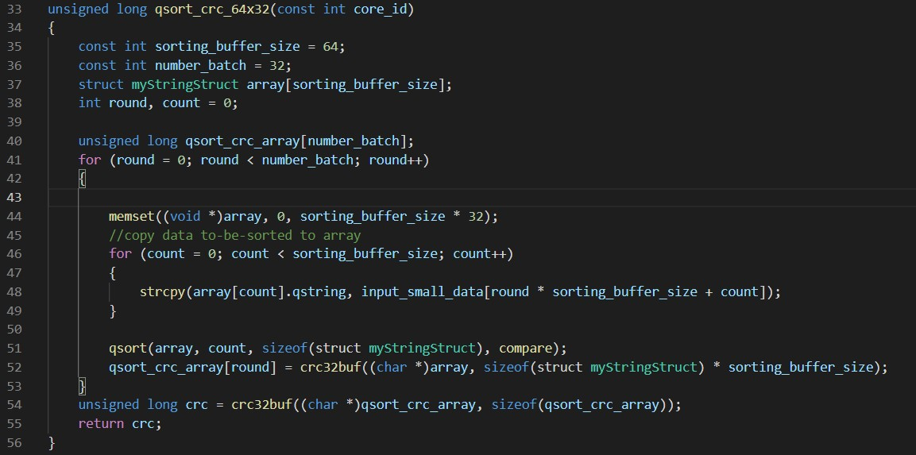
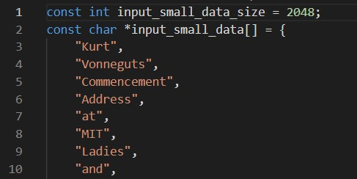
CRC32 algorithm
1. qsort_crc_64x32() :
Input_small_data

Slide 5
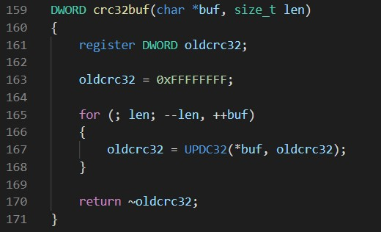
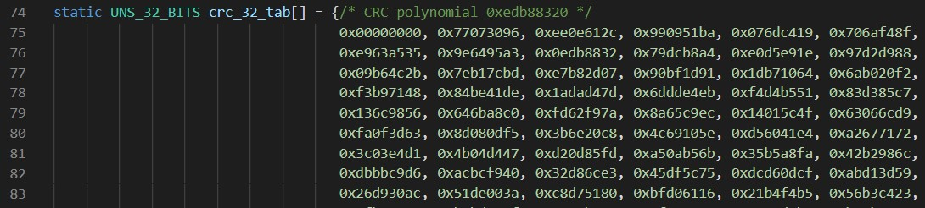
CRC32 algorithm
2. crc32buf()
3. UPDC
crc_32_tab[256] , polynomial

Slide 6
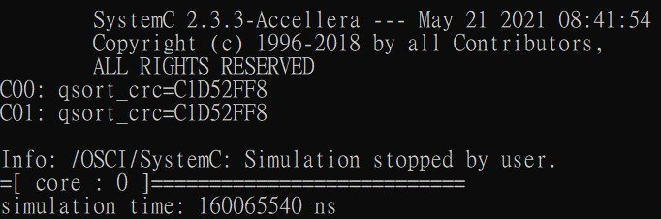
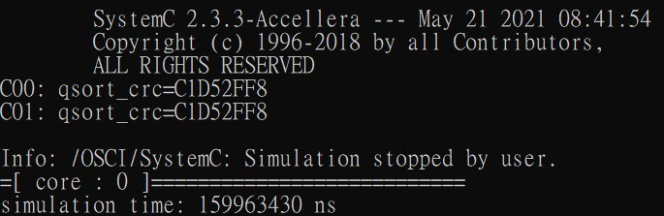

Result/demo
1core 2 core
simulation time | single core | Two core
Core0(ns) | 160065540 | 159963430
Core1(ns) |  | 159963430
Total simulation time(ms) | 160.06554 | 319.92686

