Slide 1
CV - Journal Club
Pluralistic Image Completion
C
Chuanxia Zheng, Tat-Jen Cham, and Jianfei Cai
School of Computer Science and Engineering
Nanyang Technological University, Singapore
Presented by Yunting Chiu
CSC-676 Computer Vision at American University

Slide 2
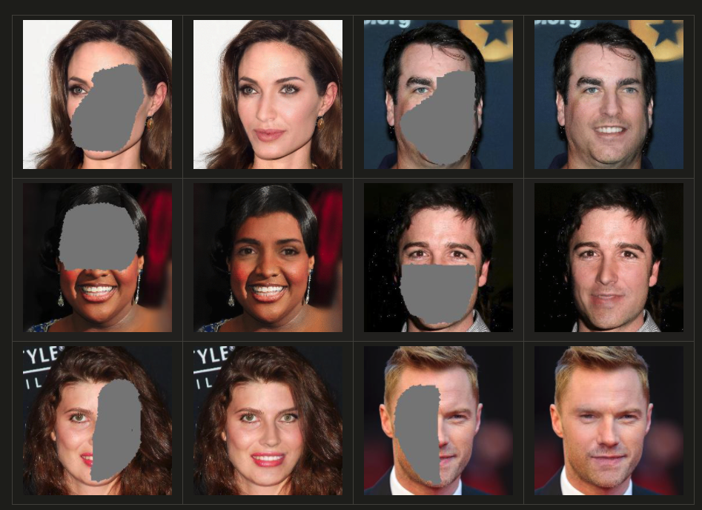
Purpose
Summary
Approach
Experiments
Ablation Studies
Critiques
References
Overview
Photo Credit: Pluralistic Image Completion

Slide 3
Purpose
Early image completion assumes that blanks should be filled with similar content to that of the background.
The majority of image completion methods only produce ONE result for each input
Most methods concentrate on reconstructing the original image during the training

Slide 4
Summary
PICNet[1] returns a variety of plausible results for a single masked image.
Produce a wide range of possible results with different structure, color, and texture
The output is of high quality, particularly for large holes.

Slide 5
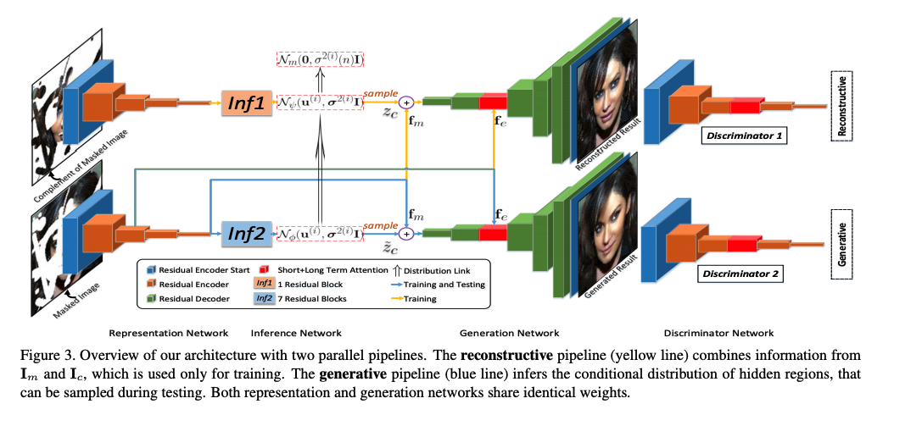
Approach
Pluralistic Image Completion Network (PICNet)
Ig is the original image, and Im is the masked image. The method is mapping Ig to Im.
Define Ic as the converse of Im, which is constructed from the masked image.
This paper final goal is to take sample from p(Ic|Im) to inpaint images.
Source: Pluralistic Image Completion

Slide 6
Experiments
Implementation Details
SA-GAN, growing-GAN
Datasets
Face Dataset: 24183 training images and 2824 test images from CelebA and use the algorithm of Growing GANs to get the high-resolution CelebA-HQ dataset
Building Dataset: 14900 training images and 100 test images from Paris
Natural Scenery: original training and val images from Places2
Object: original training images from ImageNet.
Data Visualization
visdom and dominate to visualize the image and loss plot

Slide 7
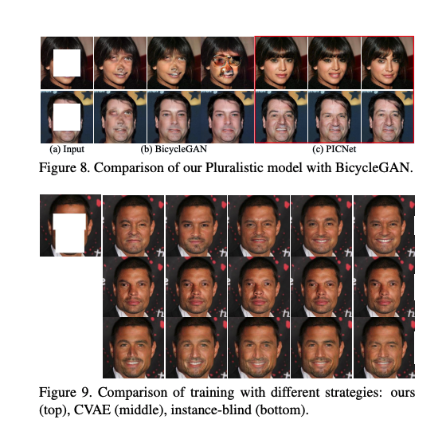
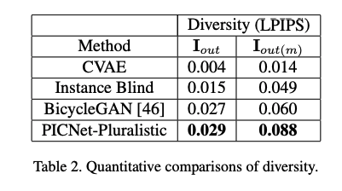
Ablation Studies
Learned Perceptual Image Patch Similarity (LPIPS)
Source: Pluralistic Image Completion
Challenge: Only one “ground truth” is available during the training
Solution: rank the top 10 samples from the discriminator, which is close to the ground truth.

Slide 8
Critiques
Pros
PICNet can be solved to large masked images, especially for large holes[2]
A single image can generate 49 different types of images.
Provide variously realistic content in the absence of missing regions
Cons
How to "recover" the image rather than "produce"[3] the image that is realistic-looking
In reality, sometimes the image recovering requirement is from historical images or fully destroyed images.
Compared to their ablation studies, The outputs are not similar to the original one.

Slide 9
References
[1] Zheng, C., Cham, T. J., & Cai, J. (2019). Pluralistic image completion. In Proceedings of the IEEE/CVF Conference on Computer Vision and Pattern Recognition (pp. 1438-1447).
[2] Qureshi, M., Deriche, M., Beghdadi, A., & Amin, A. (2017). A critical survey of state-of-the-art image inpainting quality assessment metrics. Journal of Visual Communication and Image Representation, 49, 177–191. https://doi.org/10.1016/j.jvcir.2017.09.006
[3] Zhang, R., Isola, P., & Efros, A. A. (2016, October). Colorful image colorization. In European conference on computer vision (pp. 649-666). Springer, Cham.

Slide 10
Thank you
Have a wonderful weekend

