Slide 1
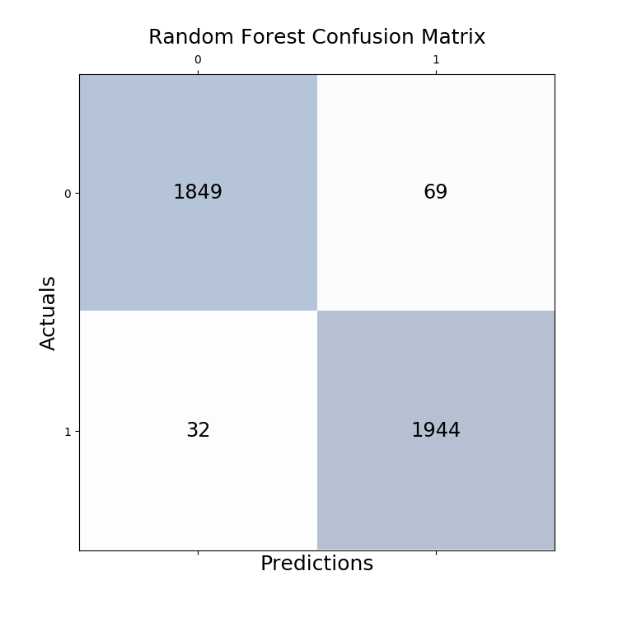
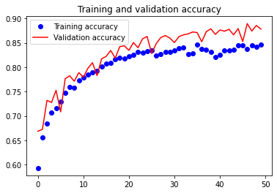
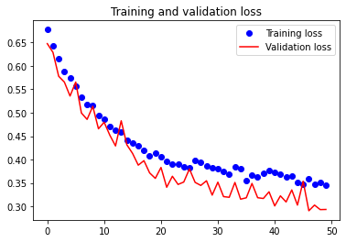
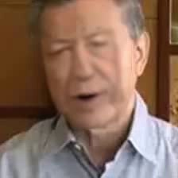
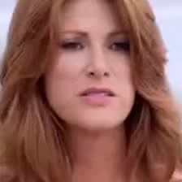
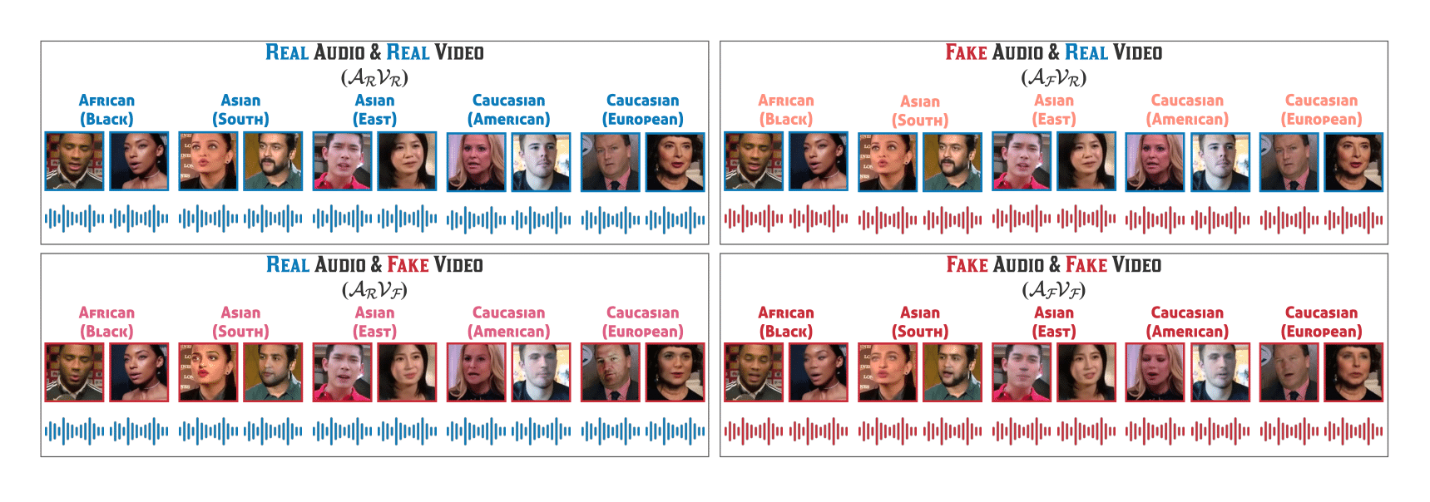


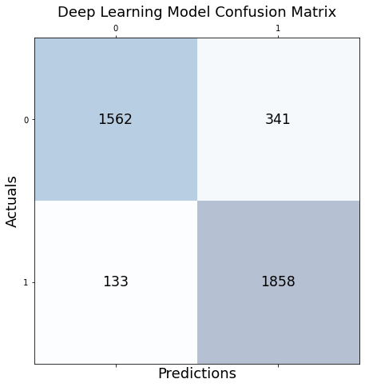
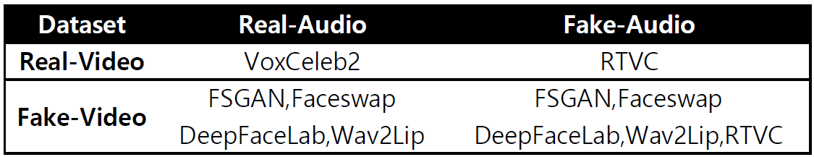
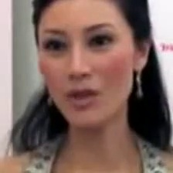
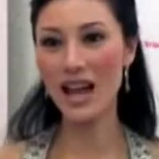
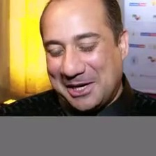
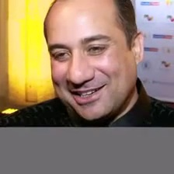
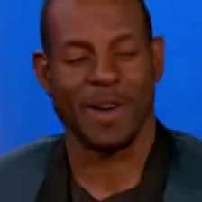

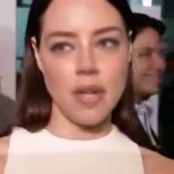

Deepfake Video Classifiers – Capture Images and Texts from Deepfake & Real YouTube Videos as Features
Yunting Chiu
M.S. in Data Science, Department of Mathematics & Statistics at American University
INTRODUCTION
3. Extract Facial Features Using a Pre-Trained MTCNN Model
MTCNN (Multi-Task Cascaded Convolutional Neural Networks) is a type of neural network that recognizes faces and facial landmarks in images. It was published by Zhang et al. in 2016. MTCNN is a good face detector that provides exactly pixel positions of precise nose, mouth, left eye, right eye, and face boundary. Thanks for the prior research, I can now simply install a `MTCNN` package to capture the facial features.
Hyperparameters Tuning the Random Forest Model
I leverage grid search in training set, the selected parameters are:
grid['n_estimators'] = [100, 500]
grid['max_depth'] = [5, 10, 50, 100]
Random Forest Model Results
Testing Accuracy: 97.41%
Random Forest Model Confusion Matrix
Random Forest Model Classification Report
Hyperparameters Tuning the Deep Learning Model
Train-test split: 80 % training, 20 % testing. I also use the testing set for validation during training.
Learning Rate: 0.0001
Optimizer: Adam
Loss Function: Binary Crossentropy
Grid Search: batch size = [64, 128], epochs = [10, 20, 50], 3-fold cv
Training and Validation
Deep Learning Model Results
Testing Accuracy: 87.83%
Deep Learning Model Confusion Matrix
Deep Learning Model Classification Report
Motivation
Deepfake Videos may fool people nowadays and they are causing trouble.
Contributions
I successfully extract two important video features: images and texts. Then, I concatenate them as a data frame for model training.
I construct two different classification models to identify Deepfake videos with 97 % and 88 % accuracy scores.
Keywords
Computer Vision, Natural Language Processing, Machine Learning, Neural Network
 | Fake | Real
Before MTCNN
After MTCNN
FakeAVCeleb DATASET
The authors propose a novel Audio-Video Deepfake dataset (FakeAVCeleb [1]) that contains not only deepfake videos but also respective synthesized lip-synced fake audios. FakeAVCeleb is generated using recent most popular deepfake generation methods. To generate a more realistic dataset, the authors selected real YouTube videos of celebrities having four racial backgrounds (Caucasian, Black, East Asian, and South Asian) to counter the racial bias issue.
pc: FakeAVCeleb
 | precision | recall | F1-score | support
fake | 0.98 | 0.96 | 0.97 | 1918
real | 0.97 | 0.98 | 0.97 | 1976
accuracy |  |  | 0.97 | 3894
macro avg | 0.97 | 0.97 | 0.97 | 3894
weighted avg | 0.97 | 0.97 | 0.97 | 3894
My task for this session is to save each image as a one-dimensional array. The images are three-dimensional in nature (RGB channels). I need to change the dimensions from 64 x 64 x 3 to 1 x 12288. I flatten each pixel as 1D array to each observation. Also, all data points have normalized from 0-255 to 0-1.
pc: FakeAVCeleb
F: I choose RTVC as the fake subset in terms of real-video and fake-audio
F: I choose FSGAN as the fake subset in terms of fake-video and real-audio
F: I choose Faceswap as the fake subset in terms of fake-video and fake-audio
R: I choose VoxCeleb2 as the real subset in terms of real-video and real-audio
3. Vectorize Texts Using a Pre-Trained word2vec Model
After tokenizing, converting to lowercase, and removing stop words and numbers, the texts now are cleaned. I keep punctuation and emoticon symbols since they might be necessary for the vectorization procedure that follows. A popular pre-trained option is the Google News dataset model, containing 300-dimensional embeddings for 3 millions words and phrases. For constructing vector representations of words, this tool provides an efficient implementation of the continuous bag-of-words and skip-gram designs. A single video of texts is now a 1 x 300 array after vectorization.
4. Concatenate Image Feature and Text Features
Finally, I column-wise concatenate image and text features and save them as a new data frame from which we will begin building the models.
DATA PREPROCESSING
DEEP LEARNING MODEL
1. Capture Images from Videos
Fake Images :
RTVC: 360 videos x 4 frames = 1440 frames
FSGAN: 1884 videos x 2 frames = 3768 frames
Faceswap: 2256 videos x 2 frames = 4512 frames
Real Images:
VoxCeleb2 : 390 videos x 25 frames = 9750 frames
Why Deep Learning
I would like to experiment with incrementally learning high-level features from data in order to capture more underlying relationships in the data.
Neuron Network Architecture
Model: "sequential"
_________________________________________________________________
Layer (type) Output Shape Param # Activation
=================================================================
dense (Dense) (None, 8192) 103129088 [relu]
dropout (Dropout) (None, 8192) 0
dense_1 (Dense) (None, 4096) 33558528 [relu]
dropout_1 (Dropout) (None, 4096) 0
dense_2 (Dense) (None, 1024) 4195328
dense_3 (Dense) (None, 512) 524800 [sigmoid]
dense_4 (Dense) (None, 256) 131328 [softmax]
dense_5 (Dense) (None, 64) 16448
dense_6 (Dense) (None, 1) 65 [sigmoid]
=================================================================
Total params: 141,555,585
Trainable params: 141,555,585
Non-trainable params: 0
_________________________________________________________________
 | precision | recall | F1-score | support
fake | 0.92 | 0.82 | 0.87 | 1903
real | 0.84 | 0.93 | 0.89 | 1991
accuracy |  |  | 0.88 | 3894
macro avg | 0.88 | 0.88 | 0.88 | 3894
weighted avg | 0.88 | 0.88 | 0.88 | 3894
EXPLORATORY DATA ANALYSIS
REAL
X Features
Data dimension: 19470 rows x 12288 columns
9720 observations from the fake set, 9750 observations from the real set
12288 features from the images, 300 features from the texts
Y Labels
Label 0 as fake videos, label 1 as real videos. Each observation is labeled, so this is supervised learning.
IMPROVEMENTS AND FURTHER WORKS
FAKE
Data Fusion
One thing I can do is use a CNN model to directly capture 3D image features at the beginning. After flattening the image data in a CNN model, extract these features and concatenate them to text features to save as a new data.
More Hyperparameters Tuning
If I have an abundance of computation resources, I will use grid or random search with more combinations to find the best estimators in both models.
Source Code
Please refer to my GitHub repo: twyunting/Deepfake_Video_Classifier2.0
2. Capture Audios from Videos and then Transfer Them to Texts
Leverage the SpeechRecognition package to covert audios to texts.
Fake Texts: “it's just be widespread casted like 12 cast members”, “attraction carries not that she's being that and then that's address and everything”
Real Texts: “beautiful I love the weather here I love like the warm climate I've loved every everywhere we go out to eat and”, “I said that you know God so had this plan where he thought I want”
MACHINE LEARNING MODEL
Random Forest
Train-test split: 80 % training, 20 % testing
Cross validation: (1) K-fold cross-validation, k = 5
(2) Utilize bootstrap samples to build trees
Why Random Forest
It can handle large features efficiently
It can reduce computation time
[1] Khalid, H., Tariq, S., Kim, M., & Woo, S. S. (2021). FakeAVCeleb: A Novel Audio-Video Multimodal Deepfake Dataset. arXiv preprint arXiv:2108.05080.
[2] Kastrati, Z., Imran, A. S., & Kurti, A. (2019). Integrating word embeddings and document topics with deep learning in a video classification framework. Pattern Recognition Letters, 128, 85-92.
Notes:
For assistance with this research poster template visit: https://www.posterpresentations.com/helpdesk.html

