Slide 1
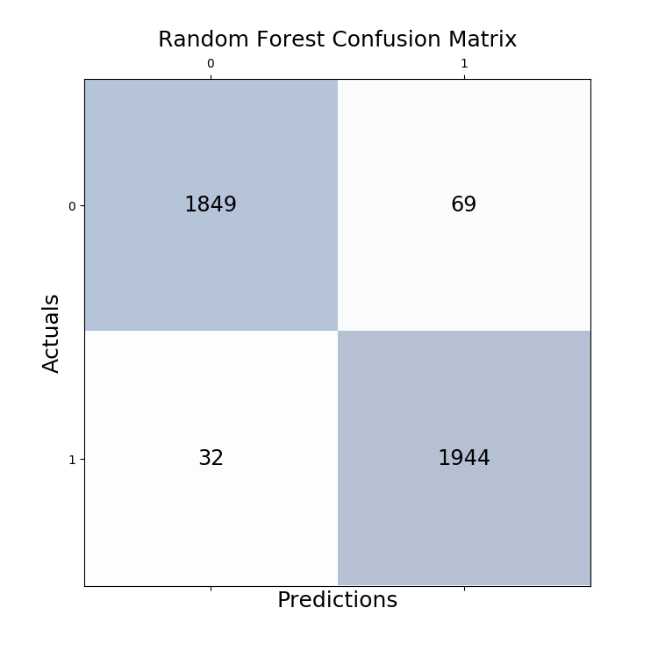
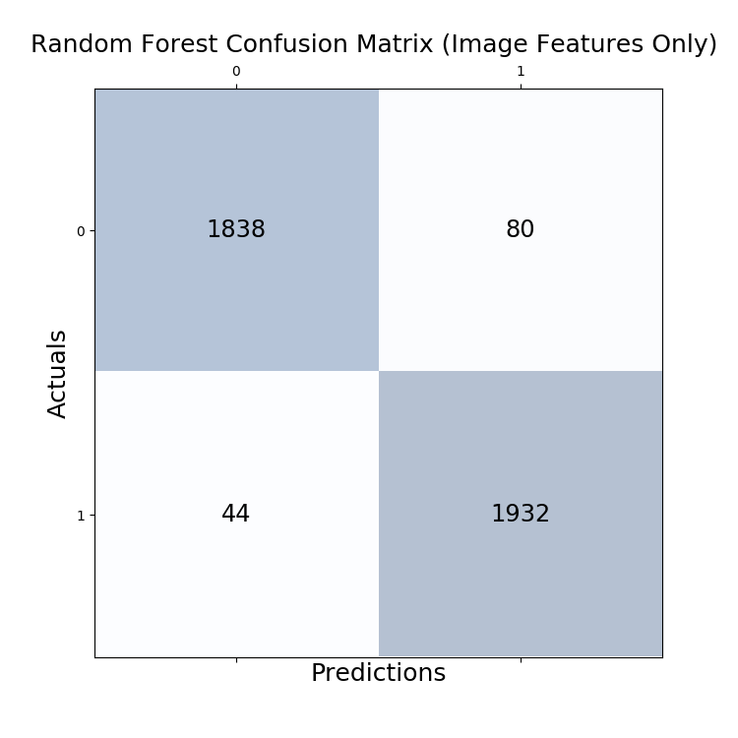
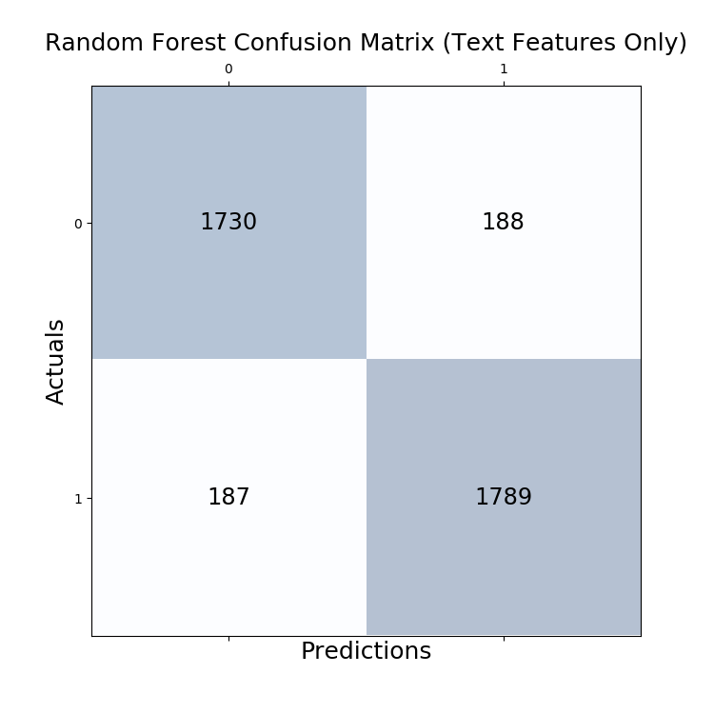
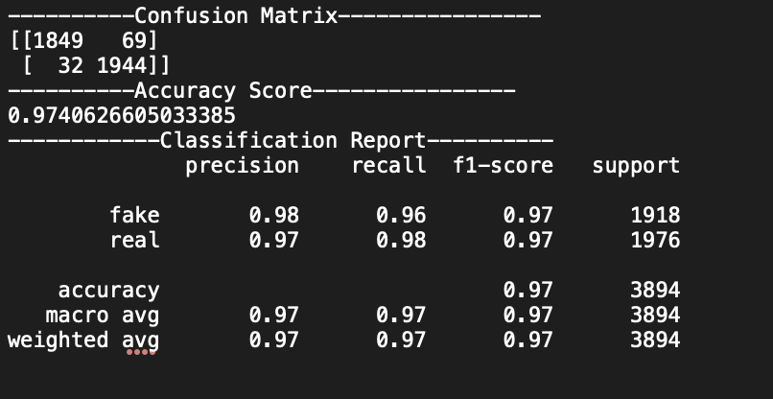
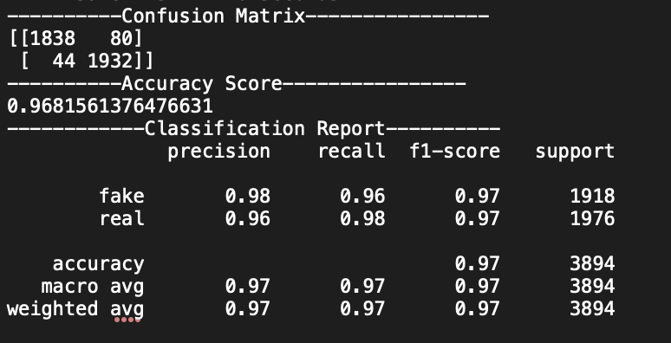
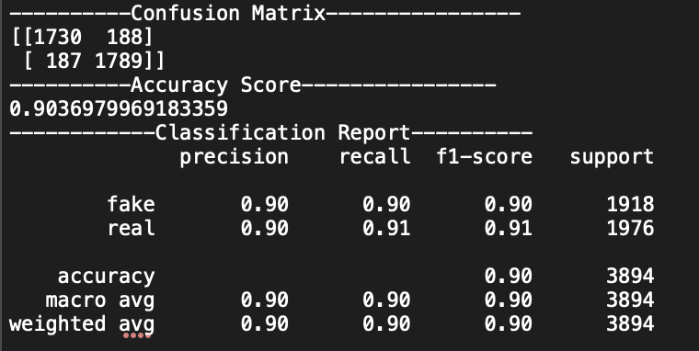
Deepfake Video Classifiers – The Comparison of Image and Text Features in Random Forest Model
Yunting Chiu
M.S. in Data Science, Department of Mathematics & Statistics at American University
IMAGE + TEXT FEATURES
IMAGE FEATURES ONLY
TEXT FEATURES ONLY
Hyperparameters Tuning the Random Forest Model
I leverage grid search in training set, the selected parameters are:
grid['n_estimators'] = [100, 500]
grid['max_depth'] = [5, 10, 50, 100]
Model Results
Testing Accuracy: 97.41%
Confusion Matrix
Classification Report
Hyperparameters Tuning the Random Forest Model
I leverage grid search in training set, the selected parameters are:
grid['n_estimators'] = [100, 500]
grid['max_depth'] = [5, 10, 50, 100]
Model Results
Testing Accuracy: 96.82%
Confusion Matrix
Classification Report
Hyperparameters Tuning the Random Forest Model
I leverage grid search in training set, the selected parameters are:
grid['n_estimators'] = [100, 500]
grid['max_depth'] = [5, 10, 50, 100]
Model Results
Testing Accuracy: 90.37%
Confusion Matrix
Classification Report
Notes:
For assistance with this research poster template visit: https://www.posterpresentations.com/helpdesk.html

