Slide 1
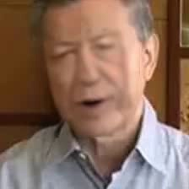

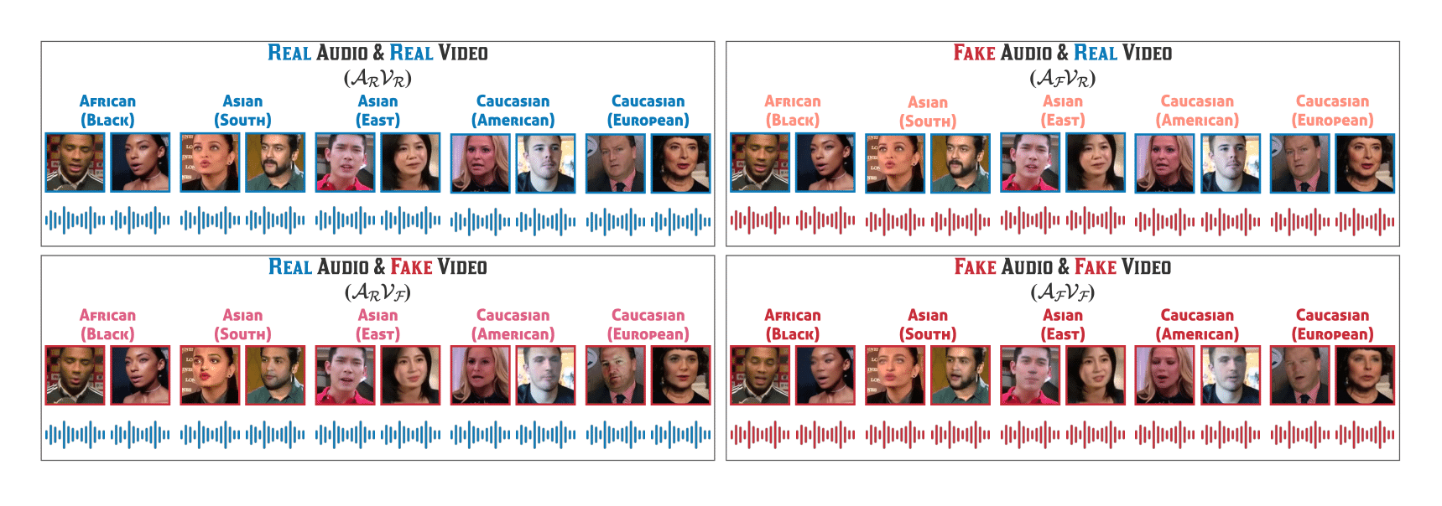


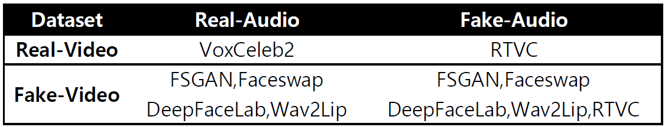
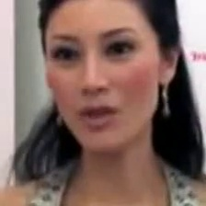
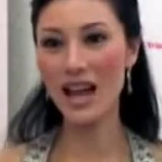
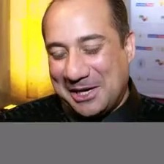
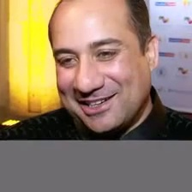


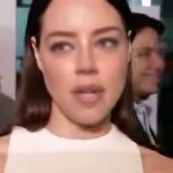

Deepfake Video Classifier – Capture Images and Texts from Deepfake and Original Videos as Features
Yunting Chiu
M.S. in Data Science, Department of Mathematics & Statistics at American University
INTRODUCTION
3. Extract Facial Features Using a Pre-Trained MTCNN Model
MTCNN (Multi-Task Cascaded Convolutional Neural Networks) is a type of neural network that recognizes faces and facial landmarks in images. It was published by Zhang et al. in 2016. MTCNN is a good face detector that provides exactly pixel positions of precise nose, mouth, left eye, right eye, and face boundary. Thanks for the prior research, I can now simply install a `MTCNN` package to capture the facial features.
Motivation
Deepfake Videos may fool people nowadays and they are causing trouble.
Help people to avoid the spread of misinformation in social media.
Contributions
I successfully extract two important video features: images and texts. Then, I concatenate them as a data frame for model training.
 | Fake | Real
Before MTCNN
After MTCNN
FakeAVCeleb DATASET
The authors propose a novel Audio-Video Deepfake dataset (FakeAVCeleb) that contains not only deepfake videos but also respective synthesized lip-synced fake audios. FakeAVCeleb is generated using recent most popular deepfake generation methods. To generate a more realistic dataset, the authors selected real YouTube videos of celebrities having four racial backgrounds (Caucasian, Black, East Asian, and South Asian) to counter the racial bias issue.
My task for this session is to save each image as a one-dimensional array. The images are three-dimensional in nature (RGB channels). I need to change the dimensions from 64 x 64 x 3 to 1 x 12288. I flatten each pixel as 1D array to each observation. Also, all data points have normalized from 0-255 to 0-1.
I choose RTVC as the fake subset in terms of real-video and fake-audio
I choose FSGAN as the fake subset in terms of fake-video and real-audio
I choose Faceswap as the fake subset in terms of fake-video and fake-audio
I choose VoxCeleb2 as the real subset in terms of real-video and
3. Vetorize Texts Using a Pre-Trained word2vec Model
After tokenizing, converting to lowercase, and removing stop words and numbers, the texts now are cleaned. I keep punctuation and emoticon symbols since they might be necessary for the vectorization procedure that follows. A popular pre-trained option is the Google News dataset model, containing 300-dimensional embeddings for 3 millions words and phrases. For constructing vector representations of words, this tool provides an efficient implementation of the continuous bag-of-words and skip-gram designs. A single video of texts is now a 1 x 300 array after vectorization.
4. Concatenate Image Feature and Text Features
Finally, I column-wise concatenate image and text features and save them as a new data frame from which we will begin building the models.
DATA PREPROCESSING
1. Capture Images from Videos
Fake Images :
RTVC: 360 videos x 4 frames = 1440 frames
FSGAN: 1884 videos x 2 frames = 3768 frames
Faceswap: 2256 videos x 2 frames = 4512 frames
Real Images:
VoxCeleb2 : 390 videos x 25 frames = 9750 frames
EXPLORATORY DATA ANALYSIS
REAL
X Features
Data dimension: 19470 rows x 12288 columns
9720 observations from the fake set, 9750 observations from the real set
12288 features from the images, 300 features from the texts
Y Labels
Label 0 as fake videos, label 1 as real videos. Because each observation is labeled, this is supervised learning.
FAKE
DEEP LEARNING MODEL
2. Capture Audios from Videos and then Transfer Them to Texts
Leverage a SpeechRecognition package to covert audios to texts.
Fake Texts: “it's just be widespread casted like 12 cast members”, “attraction carries not that she's being that and then that's address and everything”
Real Texts: “beautiful I love the weather here I love like the warm climate I've loved every everywhere we go out to eat and”, “I said that you know God so had this plan where he thought I want”
Notes:
For assistance with this research poster template visit: https://www.posterpresentations.com/helpdesk.html

