Slide 1
JavaScript from the Ground Up
Please sign in: https://tinyurl.com/qfolynb
Lesson 6: Asynchronous Javascript
Brian Cui | Web Basic | MAD 2015

Slide 2
General Schedule
Part 0: Expressions | Part 4: JavaScript <3 DOM (JavaScript for the Web)
Part 1: Statements pt. 1 Part 1.5: Statements pt. 2 | Part 5: Object Oriented JavaScript
Part 2: Objects | Part 6: Asynchronous JavaScript
Part 3: Functions | Part 7: Advanced JavaScript Concepts (JavaScript Graduation Day!)
We're back!

Slide 3
Recap: HTML/DOM + JS
Websites are composed of HTML tags that have a defined meaning. Tags can have attributes, children, and text content:
<ol>
<li>The Fellowship of the Ring</li>
<li>The Two Towers</li>
<li>The Return of the King</li>
</ol>
<a href="https://i.imgur.com/lbUbP2t.gifv">shock.gif</a>
<button id="surprise">Click me!</button>
<input type="text" id="myTextField" />
We can use JavaScript to "wire up" our HTML components to make our webpages dynamic:
document.getElementById("surprise").addEventListener("click", function() {
alert(document.getElementById("myTextField").value);
});

Slide 4
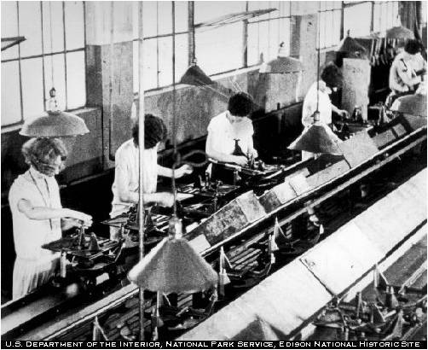
Thinking Synchronously
Most code runs synchronously. Lines of code run after the previous line has completed.
console.log("I'm a little teapot");
console.log("short and stout.");
This is nothing new! We can trace the order in which things execute - in the same order as we write them.
for(var i = 0; i < 3; i++) {
console.log(i);
} //never prints 0 2 1
function takeALongTime(time) {
var max = Date.now() + time;
while(Date.now() < max);
}
takeALongTime(5000); //5 second wait
console.log("I'm awake!");
Synchronous code.

Slide 5

Concept: Synchronous Callbacks
"x2: " + value
A callback is a function that is passed as an argument. Synchronous callbacks are simply callbacks that are invoked synchronously.
[1, 2, 3].forEach(function(value) {
console.log("The value is " + value);
});
[4, 5, 6].map(function(value) {
return value * 2;
})
.forEach(function(value) {
console.log("x2: " + value);
});
Again, this is nothing new: we expect the callbacks to be invoked one after another, in order.
"x2: " + value
"x2: " + value
value * 2
value * 2
value * 2

Slide 6

Concept: setTimeout
setTimeout is a function that takes two arguments: a callback, and a number.
setTimeout (callback, number-expression)
setTimeout asynchronously schedules the callback to execute number-expression milliseconds into the future.
function popup() {
console.log("My name is Clippy.");
}
setTimeout(popup, 4000);
setTimeout(popup, 4000);
setTimeout(popup, 0);
setTimeout(popup, 4000);
setTimeout(popup, 4000);
Advanced: alert() is non-blocking, so it produces weird results for this example.
Try it and see what happens!
Advanced: setTimeout does not use the calling stack frame for the callback,
so you won't stack overflow from nested setTimeout calls.
"Oh crap, a pop-up!"

Slide 7

Concept: Asynchronous Callbacks
An asynchronous callback does not execute in order like synchronous callbacks. They execute "later" when they are prompted outside of ordinary JavaScript execution. Consider:
function Select(id) {
return document.getElementById(id);
}
function Message(event) {
alert(select("words").value);
}
select("surprise").addEventListener("click", Message);
console.log("Ready!");
The function Message is not invoked until the user clicks on the element of surprise. In this sense, we cannot predict just by reading our "when" during execution Message will be invoked.
Asynchronous execution.

Slide 8

Motivation: Asynchronous Code
I/O is slow. Really slow. So slow, that we could execute a million instructions on the CPU while waiting for I/O. Consider this pseudocode which you might write in PHP:
movies.database.connect();
movies.database.lookup("James Bond");
movies.database.close();
Race it against this code:
for(var i = 0; i < 1000; i++)
console.log(i);
console.log("I win the race!");
Waiting is delaying. During the time in which execution is occurring out of our control (e.g. a remote database lookup), the local execution is doing nothing.
DB
CPU

Slide 9
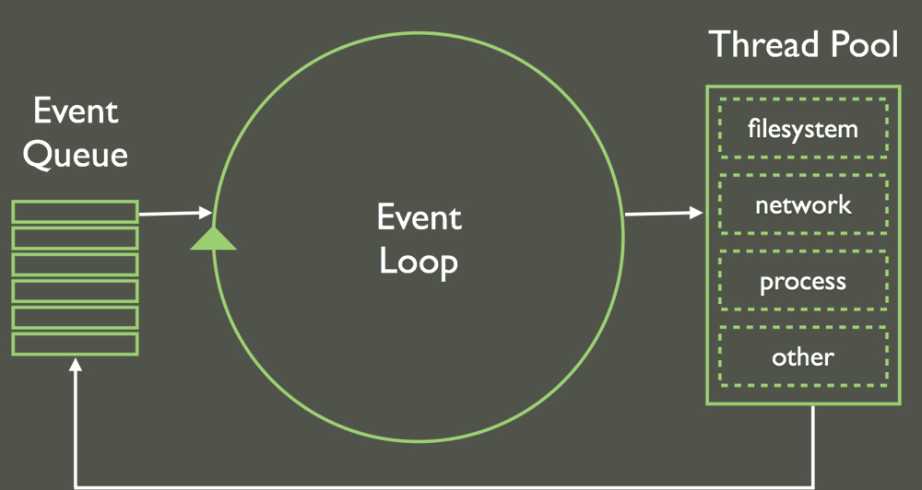
Concept: The Event Loop
Asynchronous callbacks occur at arbitrary points in the future. However, they will not execute until the current thread of execution completes. Consider:
function takeALongTime(time) {
var max = Date.now() + time;
while(Date.now() < max);
}
setTimeout(function() {
console.log("TIMED OUT"); },
5);
takeALongTime(5000);
Asynchronous callbacks ready to execute will be enqueued and invoked when execution completes.
This is called the event loop and motivates writing faster (synchronous) code.
Advanced: Unlike CPU interrupts, events never "interrupt" the current executing code. This eliminates many sources of race conditions in traditional "multithreaded" programming.
Notes:
Notice how despite setTimeout being set to 5 miliseconds, it is unable to invoke its callback until takeALongTime completes (which is essentially a busy loop).

Slide 10
Concept: setInterval
setInterval is a variant of setTimeout that schedules an asynchronous callback to execute at a given interval, forever.
setInterval (callback, number-expression)
setInterval(function() {
console.log("Hello, World!");
}, 100);
var myInterval = setInterval(function() {
console.log("Hello, Other World!");
}, 100);
It returns a value that you can call with clearInterval to stop the callback from occurring.
clearInterval(myInterval); //shut up
With your knowledge of the event loop, what do you think happens when setInterval is faster than the callbacks it's trying to schedule?
console.log("Just beat it, beat it!");
setInterval(function() { console.log("Aow!"); }, 0);
Notes:
setInterval is protected against overflowing the event queue by discarding function calls when it realizes there are too many queued up already.

Slide 11


Asynchronous Encounters
The power of asynchronous callbacks is that the CPU doesn't wait. The callbacks themselves are invoked as they become ready.
readFromDisk("passwords.txt",
function(result) {
console.log(result);
}
);
danceMyTroublesAway();
versus
var result = readFromDiskSync("passwords.txt");
danceMyTroublesAway();
(Almost) all I/O bound JavaScript operations are modeled asynchronously. Notice how the result of the operation is provided in the argument result.
Async: No waiting!
Sync: Loading...

Slide 12

Pseudocode Example: Read / Write
readFromDisk("passwords.txt",
function(result) {
console.log("Encrypting...");
var enc = encrypt(result);
writeToDisk("passwords_enc.txt",
function(successful) {
console.log(successful ? "Done!" : "Failed!");
}
);
danceMyTroublesAway();
}
);
danceMyTroublesAway();
Notice how until either the read or write operation completes, we can still dance (if we want to).

Slide 13
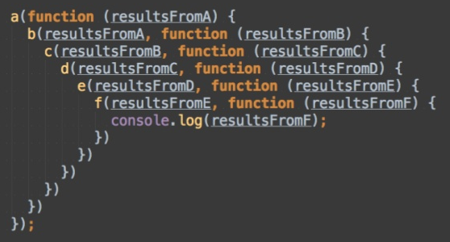
Beware Callback Hell
You've entered Callback Hell when your code looks like this:
How can we avoid writing code that goes further and further to the right?
Notes:
Answer: Define each callback function separately and have them call each other. This avoids "arrow code".
Advanced: Use promises! (Use google!)

Slide 14
Summary: Asynchronous Code
Most code is synchronous and runs in order.
An asynchronous callback is a special type of callback that does not invoke immediately, but at some "undefined" point in the future.
I/O bound operations are slow. We'd rather not have the CPU wait on them to complete.
We can use asynchronous callbacks with I/O to have a function run when I/O completes, rather than wait for I/O to completes.
The event loop enqueues ready-to-execute callbacks and invokes each one when the previous one completes.

Slide 15
Q&A + Feedback
Thanks for coming!
Please fill out the anonymous feedback form before you leave:
https://tinyurl.com/na4dybr
Next week's workshop:
Hmm…

Slide 16

Problem of the Day
Neo is trying to escape from the Matrix and Agent Smith needs to stop him. Let makePhoneCall() be a global function that transports Neo out the Matrix, which is called (heh) by the press of a button.
Agent Smith can power off the phone for about 5 seconds before he is deemed too powerful. Write and wire up a webpage that calls a function disablePhones() which temporarily causes makePhoneCall() to print an error message.
Bonus: Make subsequent calls to disablePhones() while the phones are disabled do nothing.

