Slide 1
JavaScript from the Ground Up Please sign in: http://bit.ly/1K5Xsbs
Lesson 0: Expressions
Brian Cui | Web Beginner | MAD 2015

Slide 2
JavaScript
"It's the only language that people feel they don't need to learn it before they start using it."
–Douglas Crockford

Slide 3
So… what is JavaScript?
It's the programming language of the web. JavaScript runs on any modern device with a browser.
It's a general purpose programming language. Run it on the desktop and server with Node.js, no browser required.
It's not Java. JavaScript and Java have radically different approaches in terms of design.

Slide 4
Why JavaScript from the Ground Up?
Learn the language, not the syntax. It’s easy to find snippets of code online that work, but it’s hard to find good explanations for why.
Read and write JavaScript with confidence. Understanding common JavaScript patterns will allow you to read and write practical, robust, and reusable code.
JavaScript is weird. Recognize and take advantage of JavaScript’s quirks as features, rather than bugs.
Notes:
jQuery shouldn’t be magic, it should be abstract.
Who is this presentation for? People who…
Have absolutely no JavaScript experience and would like to learn a new language
People who have some JavaScript experience, but are shaky when it comes to writing code from scratch (the copy pasters)
People who have JavaScript experience and want to recap the fundamentals
These workshops will start out slow and will start out dense.

Slide 5
General Schedule
Part 0: Expressions | Part 4: JavaScript <3 DOM (JavaScript for the Web)
Part 1: Statements | Part 5: Object Oriented JavaScript
Part 2: Objects | Part 6: Asynchronous JavaScript
Part 3: Functions | Part 7: Advanced JavaScript Concepts (JavaScript Graduation Day!)
Most classes will be held in GDC 1.304 in the basement. (If you have friends there right now, please tell them to come here - GDC 6.302!)

Slide 6
Presentation Format
This slide deck is used for the big ideas:
Concepts define key vocabulary.
Examples highlight common use cases.
Advanced material is for seasoned developers.
The browser (for now) is used to execute JavaScript. Try it: Open your browser and press F12 to access the console. Follow along, ask questions, and try things out!
Notes:
No, we won’t have vocabulary quizzes, but it’s important to understand and remember key vocabulary used when describing JavaScript code. This makes it much easier to read documentation and ask questions.
We will start with slides and, throughout the year, transition into practical applications with the browser.

Slide 7
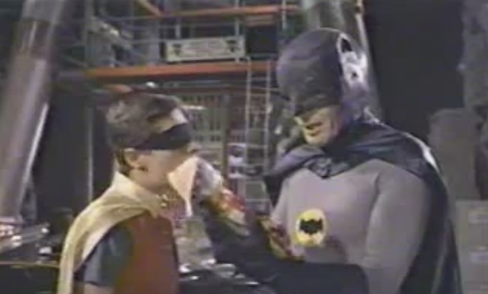
Problem of the Day
Write a JavaScript expression that evaluates to:
“Holy hole in a donut, Batman!”
Notes:
I thought this would be a fun spin on Hello World. It came up on the programming puzzles stack exchange.

Slide 8
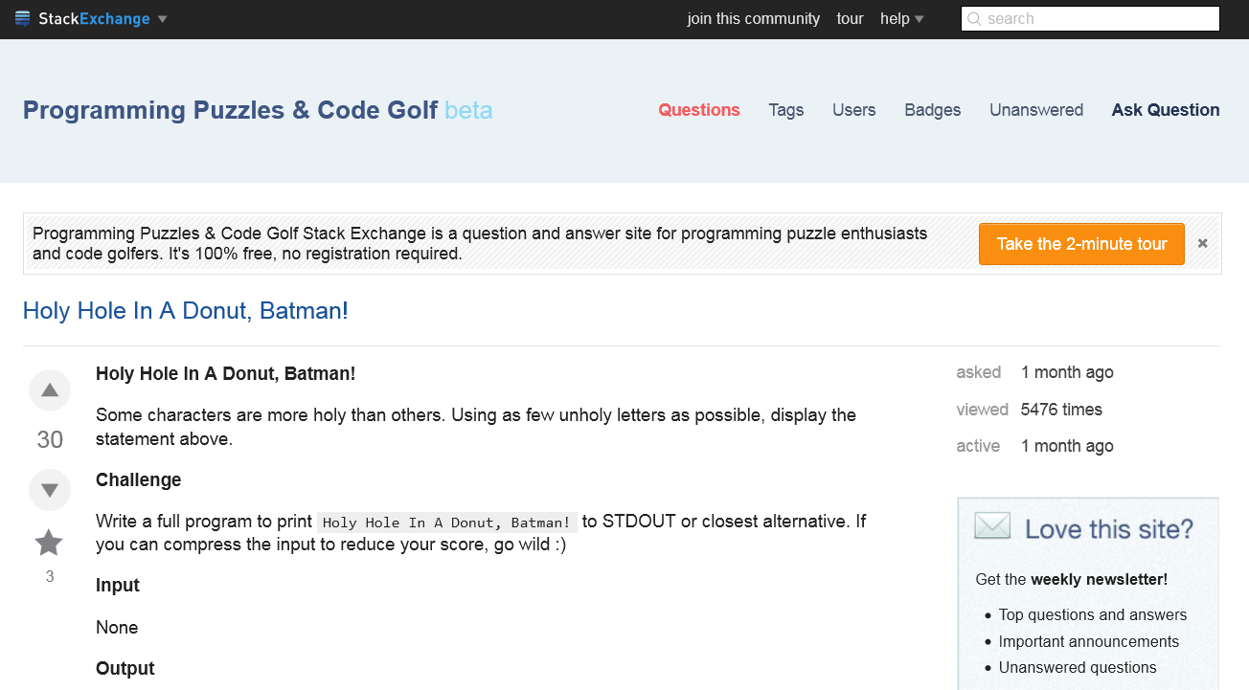
Notes:
Proof. We’re technically not even printing to standard output, so emphasis on “expression”.

Slide 9
Concept: Expression
An expression is anything that evaluates to something.
The JavaScript console evaluates expressions!
0 => 0
1 + 1 => 2
"Hello, World!" => "Hello, World!"
(5 * 2) % 4 + "1" => ???
Nearly everything is an expression!
Expressions!
Notes:
Type the text to the left of the arrow and press enter in the console.
The text to the left is a complete expression. The text to the right is what it evaluates to, another expression. Both are expressions!
The third one is funky and is going to go over a lot of people's heads. We'll get to it! We will also use the term "express" and "expresses" instead of "evaluates".

Slide 10
Concept: Number Literal
A number literal is, well, literally, a number. You can express any* real number with literals.
1 => 1
-12 => -12
1298546 => 1298546
-0.123456 => -0.123456
*Advanced: All numbers in JavaScript are IEEE 64-bit floating point, a superset of 32-bit integers and 32-bit floating point. You can also express numbers literals in any base; the default being 10.
Notes:
A literal is the simplest form of expression. It expresses to itself. We will commonly refer to the type of an expression as what kind of thing it evaluates to, e.g. number literals are of the Number type.

Slide 11
Concept: Operator
An operator is used to combine expressions (called operands) to form new expressions.
expression [operand] expression => expression (…for now)
+ (addition) 1 + 2 + 3 + 4.5 => 10.5
- (subtraction) 999 – 888 + 12 => 123
/ (division) 12 / 3 / 2 - 6 => -4
* (multiplication) 0.1 * 4 * 3 / 3 => 0.4000000000000001
% (modulo) 5 % 4 => 1
() (grouping) 3 * (-2 + 4) => 6
Notes:
There are plenty more operators to use in JavaScript; the ones listed here are the ones you'll use with numbers.
The Modulo operator isn't taught in math class, so it may help to do some additional examples with them.
1+1+1 => 3
1 - 1 => 0
123 + 456 => 579
12 / 4 => 3
3 / 3 => 1
2 / 3 => 0.666…

Slide 12
Concept: String Literal
A string literal is literally a string, represented in single or double quotes.
"Hello, World!" => "Hello, World!"
"I Can't Believe It's Not Java" => "I Can't Believe It's Not Java"
'"The Journey of 1000 Miles Starts with a Single Commit"' => ""The Journey of 1000 Miles Starts with a Single Commit""
"\"I've grown impatient with these malevolent reptiles on this aircraft.\" –Samuel L. Jackson, Snakes on a Plane" => ""I've grown impatient with these malevolent reptiles on this aircraft." –Samuel L. Jackson, Snakes on a Plane"
Advanced: Unlike Numbers, Strings can have infinite length and are immutable. (Why?)

Slide 13

+, the lone String Operator
Concatenate strings using + :
"Hello" + "World" => "HelloWorld"
"I'm here to kick ass" + " and chew bubble gum" => "I'm here to kick ass and chew bubble gum"
'I' + ' am' + ' out' + " of" + " + bananas." => "I am out of + bananas."
What do you think the following express to?
"hi" – "bye" => ???
1 + "1" * "2" => ???
CONCATENATE STRINGS
OPERATOR
Notes:
Concatenate. To link together. Multiple strings can be concatenated, evaluating into one contiguous string.
+ is the only operator guaranteed to express to a String, given two String operands.
An expression terminates at the end of a line unless another operand is expected. That means you can't split a string literal across multiple lines, but you can concatenate string literals across multiple lines: "I need your clothes, " +
"your boots, " +
"and your motorcycle."

Slide 14
Expressions Have Type!
Number [Operand] Number => Number
String [Operand] String => String
Number [Operand] String => ??? (Valid!)
String [Operand] Number => ??? (Valid!)
JavaScript is a weakly typed language.
The type of an expression is determined when it gets evaluated.
Advanced: JavaScript is weakly and dynamically typed. In contrast, Ruby is strongly and dynamically typed. Java is strongly and statically typed. C is weakly and statically typed, but the compiler will whine about it sometimes. Expressions have class! (1 + "TWO" + 3).toLowerCase() => "1two3" is totally cool! More on this in a couple lessons…
Notes:
We've learned so far that operators are used to combine expressions. What happens when you have two expressions of

Slide 15
Implicit Type Conversion
As + is the only operator with a special purpose for Strings, it is the only operator which implicitly converts its operands into Strings.
Number + String => String
The Number is converted implicitly into a String.
String [other numerical Operand] Number => Number
The String is converted implicitly into a Number.
Advanced: JavaScript does the equivalent of parseInt(expression) when it does an implicit conversion of an expression. You can manually call parseInt, a global property, to be more explicit, and even pass in a base as the second argument to convert from.
Notes:
Conversion is also called casting.
We've learned so far that operators are used to combine expressions. What happens when you have two expressions of different type?
1 + "1" => "11"
1 – "1" => 0
10 * "5" => 50
4 – "-08" => 12
1 % "not a string lol" => NaN
Notice how instead of an error, for something that's not a string, we get a unique value called NaN, or Not a Number. Seeing NaN is indicative of

Slide 16
Concept: Boolean Literal
A Boolean is a type which has two possible values: true and false. The Boolean literal is just that simple:
true => true
false => true
Boolean literals are rarely seen alone; they are often used in conjunction with other expressions.
Advanced: true and false are reserved keywords. Don't try using them like other identifiers.

Slide 17

(Boolean) Operators
Have some more operators, typically used with Boolean expressions:
&& (logical AND)
|| (logical OR)
! (bang! logical NOT)
Some examples:
!false => true
true && true || false => true
!(true && false) => true
true + false && true => ???
Advanced: There's also bitwise AND, OR, NOT, and XOR.
You have to memorize it!
Notes:
We won't be taking the time to discuss formal logic; these you will learn in CS 311.
Now would be a good time to bring up operator precedence on MDN.

Slide 18
Type Conversion, Boolean Edition
true to Number is 1 . true to String is "true" .
false to Number is 0 . true to String is "false" .
We can extend the same rules from before: if we see a String with +, the operands are converted to Strings. Otherwise, they become numbers.
true + true => 2
"true" + false => "truefalse"
0 / (true || false) => 0
"Get to the chopper!" – 1 && true => ???
Notes:
You'll rarely ever actually use Boolean literals with non-Boolean operators, but there is defined behavior for it.

Slide 19
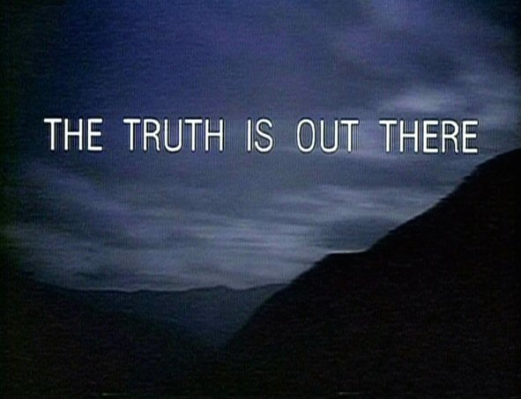
Concept: Truthiness
ALL expressions in JavaScript are either "truthy" or "falsy", which dictates how they evaluate with logical operators.
The rules, for what we've covered so far, are simple:
0 is falsy.
NaN is falsy.
"" is falsy.
All other Numbers and Strings are truthy.
!!0 => true
1 && true => true
-1 || false => -1
true && "" => ""
false && ("x" + "files") => false
Notes:
Short circuit evaluation means, as soon as the result of the Boolean expression is known, the expression becomes the last value evaluated.
Truthiness seems kind of pointless now, but it will become useful in the future. A common pattern is the expression (expression1 || expression2), where expression1 is dynamic and expression2 is the default value for when expression1 is falsy. Poor man's input validation.

Slide 20
Equality Operators
The equality operators are guaranteed to evaluate into a Boolean expression.
== (equality after type conversion), != (not equal)
=== (strict equality, no type conversion, "identical"), !== (not identical)
== works for the most part, and has some neat tricks…
-5 == 5 => true
"It's showtime!" == "It's showtime!" => true
false != true => true
1 == "1" => true
false == '0' => true
-123 == '-0123' => true
Notes:
The equals and identical operators tend to cause a lot of confusion because other languages that use == are often strongly typed. When in doubt, use triple equals.

Slide 21
Equality Operators
The equality operators are guaranteed to evaluate into a Boolean expression.
== (equality after type conversion)
=== (strict equality, no type conversion, "identical")
…but also makes no sense at times.
true == "true" => false
When in doubt, use the === operator, which enforces type.
1 === 1 => true
"Here's Johnny!" === "Here's Johnny!" => true
true === false => true
"999" !== 999 => true
Notes:
The equals and identical operators tend to cause a lot of confusion because other languages that use == are often strongly typed. When in doubt, use triple equals.
Take this moment to review grouping ( ).

Slide 22
Comparison Operators
Comparison operators are also guaranteed to evaluate into Boolean expressions.
> (greater than)
< (less than)
>= (greater than or equal to)
<= (less than or equal to)
Use it with numbers:
1 > 0 => true
5 >= -12 => true
-1 <= 82 => false
3 < 3 => false
Advanced: You can use the comparison operators with Strings. Strings "greater" than other strings would be sorted after the other in ascending order.

Slide 23
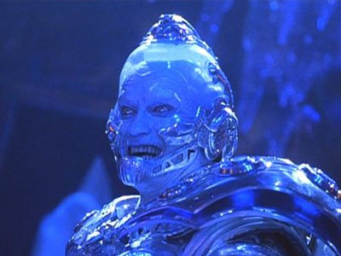
Putting it All Together
Try to figure out the following expressions in your head.
"1" + ((4 * "4") >= 12)
(true && "03" + "4") || (1 === "1")
"Allow me " + " to break " + " the ice " - " the ice "
!!true && !!"'" && !!1 && !!-1 && !!'0'
((2 % 2) && "true") == "0") === false
(.4 / 2 === .2) + "8" - "8"
Notes:
Answers:
"1true"
"034"
NaN
false
true
NaN

Slide 24
One last thing…
We've seen…
expression [operator] expression => expression
There are also single operand operators:
[operator] expression => expression
typeof evaluates to a string describing the type of an expression:
typeof "pintos is the devil" => "string"
typeof 123.45 => "number"
typeof true => "boolean"
typeof ("this is truthy" || false) => "string"
Notes:
Recall that the expressions used with operators are also called operands.
Be careful about typeof's precedence: typeof false && true => true

Slide 25
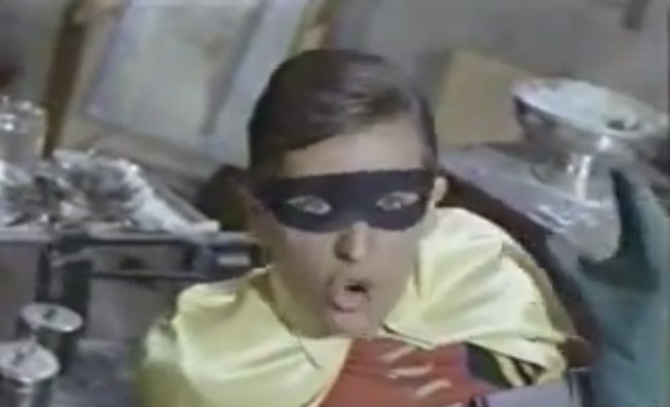
Wrap Up
An expression is anything that evaluates to something. The JavaScript console evaluates expressions for us.
There are three primitive types with literals that we learned today: Number, String, and Boolean. Literals express to themselves.
We can combine expressions using operators to form new expressions.
The type of an expression is determined at run time, and we can mix types in our expressions.
"Holy hole in a donut, Batman!" => "Holy hole in a donut, Batman!"

Slide 26
Q&A + Feedback
Thanks for coming!
Remember: next Wednesday, 9/16, we'll be meeting in GDC 1.304 at 6:30p
Before you leave, please fill out this anonymous survey: http://bit.ly/1g7zpwS

