Slide 1
JavaScript from the Ground Up Please sign in: http://bit.ly/1VEPoGc
Lesson (3?) 4: OBJECTS
Brian Cui | Web Basic | MAD 2015

Slide 2
Last time on JavaScript from the Ground Up
Expressions can have side effects! The assignment = operator expresses to the new value of the variable.
The ++ and -- operators increment/decrement a number variable, and express based on where the operator is located.
JavaScript has two forms of "null": undefined and null. undefined is like "unexpected nothingness" while null is what the developer (you!) assigns. undefined == null => true
The switch statement evaluates statements based on what a given expression equals (===). It's like a super-if-statement.
The control flow loop statements while, do while, and for allow us to repeat execution of statements based on a given expression.

Slide 3
Thoughts from last time…
I was in limbo state at the end of presentation. (Optimus Prime web page)
How did you do that last part???!?!?! (Also, do you always have to initiate with var)
WERE WE SUPPOSED TO KNOW HOW TO HTML Also, what text editor were you using?
how do you know all this? mad respect for you
Notes:
A lot of people asked "why is JavaScript relevant" - and there you have it.
YES. For some reason, there's this rumor going around that "JavaScript is that language where you don't have to declare variables." Can you do it? Yes. Should you do it? Absolutely not. Variables that are used without declaring them are in the global scope, clutter up the namespace, and are difficult to debug. Never, ever, ever use a variable without declaring it first.
You didn't have to know HTML. If you were able to attend last week's session, great! While we won't spend a day on HTML, we'll cover the bits you need to know in a future workshop for dynamically generated webpages. It will definitely help to know some HTML though, so if you haven't yet, spend an hour or two reading HTML tutorials. It's super easy to pick up.
The editor I was using was using Emacs for Windows.
I started web development in around 2002-2003, and have been learning more ever since. It's never too late to start.

Slide 4
General Schedule
Part 0: Expressions | Part 4: JavaScript <3 DOM (JavaScript for the Web)
Part 1: Statements pt. 1 Part 1.5: Statements pt. 2 | Part 5: Object Oriented JavaScript
Part 2: Objects | Part 6: Asynchronous JavaScript
Part 3: Functions | Part 7: Advanced JavaScript Concepts (JavaScript Graduation Day!)

Slide 5

Problem of the Day
Cyberdyne is developing the T-800 and they need a way of storing information in memory for its next line of household service robots.
Information can be looked up by name
"Sarah Connor"
New information can be saved by name
"Promise" -> "I swear I will not kill anyone."
Information should have unlimited, editable properties
"T-800"
CPU: "Neural net processor. A learning computer"
Body: "Living tissue over metal endoskeleton"
Get the source code at:
https://tinyurl.com/o6kvuj7

Slide 6

Concept: Object
"There are objects, and there are Objects. This is the latter."
Casino Royale (2006)
Notes:
You want to be as cool as James Bond? Know what the difference between Objects and objects are!

Slide 7
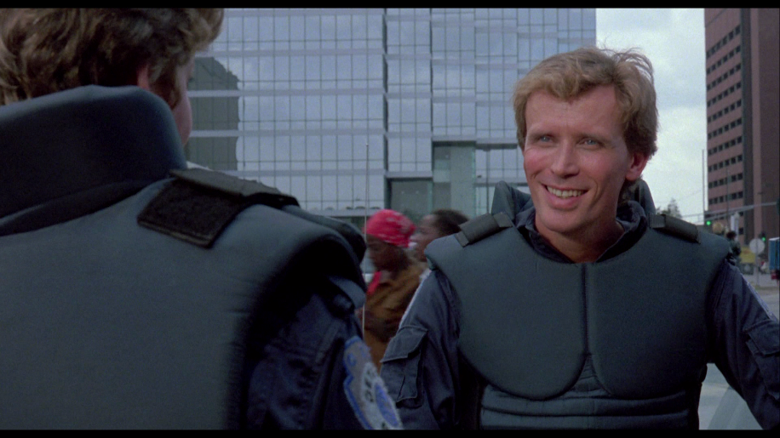
Concept: Object
An Object is a representation of an "object" with properties. The Object Literal is the simplest Object. It has no properties.*
var robocop = {};
We can add properties to an Object at runtime:
robocop.name = "Alex" + "Murphy";
Properties are accessed via dot notation:
robocop.name => "Alex Murphy"
robocop.age => undefined
*Advanced: Because Object Literals are of the Object prototype, the empty Object Literal still has (enumerable) properties. If you really want to create an empty object, you can try Object.create(null);
Notes:
Be careful not to confuse the Object Literal with statement blocks!

Slide 8
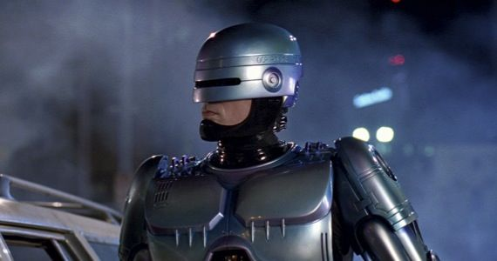
Concept: Object
Advanced: In ES6, you can have expression based property names in the initializer!
obj = { [ "prop_" + foo() ]: 42 }
Initialize an object with properties with comma separated key/value pairs:
var murdered = true; var robocop = { name: "Alex" + "Murphy", species: (murdered ? "cyborg" : "human") };
robocop.partner = "Anne Lewis";
console.log(robocop.name + " and " + robocop.partner + " stop crime together"); //prints Alex Murphy and Anne Lewis stop crime together

Slide 9
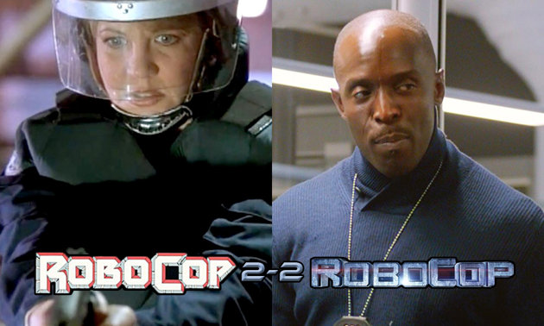
Concept: Object
var robocop = { name: "Alex" + "Murphy", hair: "bald", species: "cyborg", partner: "Anne Lewis" };
Properties can be redefined, to different types:
robocop.name = 209;
robocop.partner = { name: "Not Anne Lewis", hair: "bald" }
robocop.partner.name => "Not Anne Lewis"
Reassignment.
Advanced: Setting a property to undefined is not the same as deleting it with the delete keyword – user set undefined does not get garbage collected.

Slide 10
We've been using "objects" all along!
"some string".length => 11
var k = "the fast " + "and the furious"; k.length => 24
"What else is new?" -- You, the smug programmer
k.length = 5; k => ???
var u = k; u = "the slow and the old"; k => ???
var whitespace = " asdf "; whitespace.toLowerCase => ???
whitespace.toLowerCase() => ??? whitespace => ???
Advanced: All methods for the primitive types are constructive.

Slide 11

Concept: Object
"All expressions are objects, but some objects are more Object-like than others."
George Orwell, Programmer Farm
PROGRAMMER
Notes:
Apparently there was an animated film made in the 50's. Who knew?

Slide 12
Concept Redux: Primitive Types
So… the primitive types have properties.
"".length => 0
"SHOUT".toLowerCase => function
true.toString => function
3.14159.valueOf => function
Does that make them Objects? Kind of.
typeof "superstring" => "string"
typeof {} => "object"
typeof new String("superstring") => "object"

Slide 13


Objects vs Primitive Types
Expressions have properties. They depend on the evaluation of the expression.
var str = "ding!"; var bird = { species: "hawk" }; var falcon = bird; falcon.species => hawk
falcon = str; falcon.species => undefined falcon.length => 5
falcon.length = 3; falcon.length => 5
Primitive types (String, Boolean, Number) are actually turned into objects for properties and are reverted back to primitives.

Slide 14
Object References
Objects are too big to copy, so a reference is copied instead.
var obj = { stick: "mud" }; var rod = obj; //obj and rod store pointers to the same object!
rod.stick = "grass"; //modify rod === obj obj.stick => "grass" //obj is modified too
rod = "not an object"; //rod now stores a primitive
rod => "not an object"; obj => Object { stick: "mud" }
Advanced: JavaScript is "pass by reference by value" much like Java. You cannot explicitly retrieve an Object's reference like in C (much like Java).
Notes:
There are ways to clone Objects such that affecting the properties of one Object does not modify the properties of the other.

Slide 15
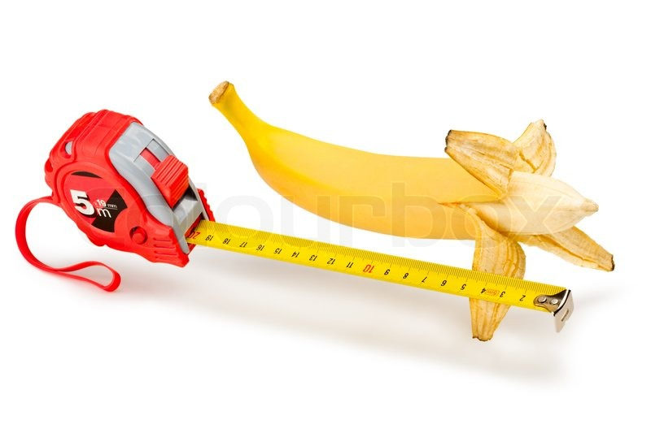
Concept: Bracket Notation
Bracket Notation is a way of accessing properties with a string expression:
object[expression]
Bracket Notation is perhaps the most useful and important feature you will ever learn about JavaScript.
"banana"["length"] => 6
"Why would I use bracket notation over dot notation?"
var map = {}; map["Austin"] = "Texas"; map["Little Rock"] = "Arkansas";
map.Little Rock //Syntax Error
Advanced: You can actually set a property which is the empty string. Properties are case sensitive.
Notes:
The expression provided is coerced into a String. So, you can actually use number values. (Foreshadows the Array Object)

Slide 16
Bracket Notation: Still not convinced?
object["property name"]
var terminators = { T-800: "Living tissue" T-600: "Rubber skin" T-100: "Robot with treads" }; var modelNumber = 800;
terminators["T-" + modelNumber] => "Living Tissue"
Notes:
Suppose modelNumber was a string the user entered on their keyboard. We, as developers, would have no way of predicting user behavior and hardcoding an identifier using dot notation. With bracket notation, objects can be treated as mappings with properties that can be looked up as strings.

Slide 17
JavaScript Object vs. Java Class
class Computer {
public string cpu;
public string manufacturer;
public boolean disk_drive;
public int tomshardware_rating;
public Computer(String processor) {
this.cpu = processor;
}
}
...
Computer computer = new Computer("i5 4670k");
computer.manufacturer = "ASUS";
computer.disk_drive = true;
computer.tomshardware_rating = 9;
System.out.println(computer.gpu);
Main.java:20: error: cannot find symbol
System.out.println(computer.gpu);
^
symbol: variable gpu
location: variable computer of type Computer
1 error
var computer = { cpu: "i5 4670K" };
computer["manufacturer"] = "ASUS";
computer["disk drive"] = true;
computer["tomshardware rating"] = 9;
var property = "cpu";
computer[property] => "i5 4670K"
var property = "Disk Drive"; computer[property] => true;
property = "GPU" computer[property] => undefined

Slide 18

JavaScript Object vs. Java HashMap
import java.util.*;
HashMap<String, String> computer = new String<String, String>();
computer.put("cpu", "i5 4670K");
computer.put("manufacturer", "ASUS");
computer.put("disk drive", true); //error: no suitable method found
computer.put("tomshardware rating", 9);
//error: no suitable method found
String property = "cpu";
computer.get(property) => "i5 4670k"
property = "GPU";
computer.get(property) => null
var computer = { cpu: "i5 4670K" };
computer["manufacturer"] = "ASUS";
computer["disk drive"] = true;
computer["tomshardware rating"] = 9;
var property = "cpu";
computer[property] => "i5 4670K"
var property = "Disk Drive"; computer[property] => true;
property = "GPU" computer[property] => undefined

Slide 19
Problem of the Day
Skynet is developing the T-800 and they need a way of storing information in memory for its next line of household service robots.
Information can be looked up by name
"Sarah Connor"
New information can be saved by name
"Promise" -> "I swear I will not kill anyone."
Information should have unlimited, editable properties
"T-800"
CPU: "Neural net processor. A learning computer"
Body: "Living tissue over metal endoskeleton"
Get the source code at:
https://tinyurl.com/o6kvuj7

Slide 20
Problem of the Day
Solution Structure:
Lookup text field and button
"Get the Object from memory stored in the lookup property"
Text fields for each property and button for updating
"Store the new property value into the selected Object"
Text field for adding new properties and add button
"Create a new property for the selected Object"

Slide 21
Q&A + Feedback
Thanks for coming!
Please fill out the anonymous feedback form before you leave:
https://tinyurl.com/pwkgaw2
Next week's workshop: Probably here. Probably me. (Check the Facebook group for the latest!)

