Slide 1
JavaScript from the Ground Up
Lesson 1: Statements
Brian Cui | Web Basic | MAD 2015

Slide 2
General Schedule
Part 0: Expressions | Part 4: JavaScript <3 DOM (JavaScript for the Web)
Part 1: Statements | Part 5: Object Oriented JavaScript
Part 2: Objects | Part 6: Asynchronous JavaScript
Part 3: Functions | Part 7: Advanced JavaScript Concepts (JavaScript Graduation Day!)

Slide 3
Expressions Recap
Last time we learned about expressions. The simplest expression is the literal, and expressions they can be used with operators to form new expressions. All expressions are truthy or falsy.
1 + 2 + "-3" => 0
"I'm a string" + true => "I'm a stringtrue"
!!0 && !!1 => true
(("" && true) + " ") || false) => " "
(typeof true === "boolean") => true

Slide 4
Before we get started…
We've seen…
expression [operator] expression => expression
There are also single operand operators:
[operator] expression => expression
typeof evaluates to a string describing the type of an expression:
typeof "pintos is the devil" => "string"
typeof 123.45 => "number"
typeof true => "boolean"
typeof ("this is truthy" || false) => "string"
Notes:
Recall that the expressions used with operators are also called operands.
Be careful about typeof's precedence: typeof false && true => true

Slide 5
Problem of the Day
FizzBuzz: Write a program that prints the numbers from 1 to 100. But for multiples of three print "Fizz" instead of the number and for multiples of five print "Buzz". For numbers which are multiples of both three and five print "FizzBuzz".

Slide 6
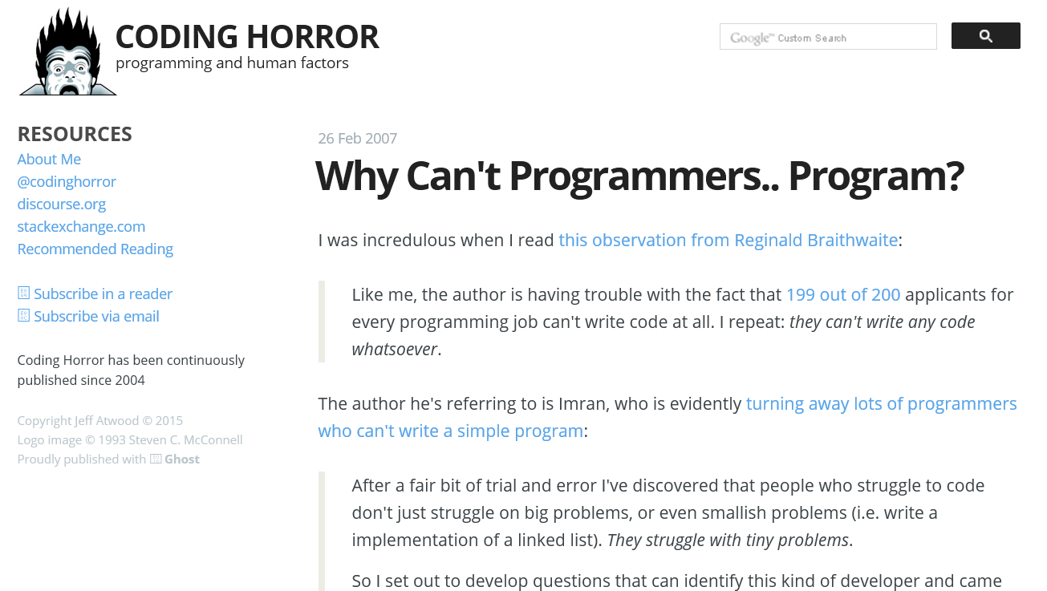

Slide 7
Concept: Statement
A statement is code that does something. If expressions are words, statements are sentences.
var i = 0; i++;
console.log("I'm " + "back!");
var a = 123 – "123" + 456;
if (1) console.log("Hello, World!");
while(true); //don't actually run this
Alternate definition: A statement is code that has side effects. A JavaScript program is a collection of statements.
Notes:
Side effects: they do more than simply have a value. They affect the program running state in some way.

Slide 8
Concept: Variables
A variable is a value with a name. var declares variables.
var myVariable; //Name: myVariable, Value: undefined
The assignment operator = assigns an expression to a variable.
var a = "the first letter of the alphabet";
var areYouAwesome = true;
var theAnswerToTheUniverse = 42;
Advanced: It is legal and harmless to declare a variable more than once with the var statement. The repeated declaration acts as an assignment. You can also declare/assign variables without the var statement, but then they become global variables.
Notes:
A variable assignment is the simplest kind of statement. Given an identifier, the assignment operator (=) assigns the value of the right hand expression to the identifier. Since var and = are both operators, you can declare and assign a variable in a single statement.
Imagine variables like buckets. We can put a name on buckets and put things in them. We can look up buckets by name. We can also remove items from buckets (reassigning the value) and add new items.
We say this has side effects because once we declare a variable, it stays declared (unless deleted), changing the state of our program. Notice how in the Console, we are able to access variables after declaring them, because they have been assigned in the global context of the Console.

Slide 9
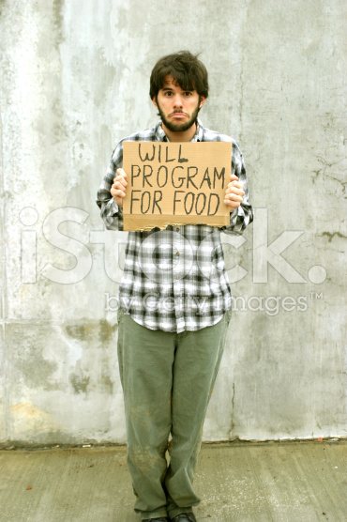
More on Variables
A variable's identifier expresses to the variable's value. We can use it anywhere in an expression!
var bean = "bag";
var shoppingThings = bean;
var myFurniture = "cardboard box and " + bean;
myFurniture => "cardboard box and bag"
The result:
bean => "bag"
shoppingThings => "bag"
myFurniture => "cardboard box and bag"

Slide 10


Variable Assignment: No Strict Types!
"An int is forever an int." - Java
"Be who you want to be." - JavaScript
Notes:
(Which kind of world do you want to live in?)

Slide 11
Variable Assignment: No Strict Types!
In Java, you might want to say…
int a = 4;
int b = a + 5;
a = "I don't want to be an integer" //ERROR
In JavaScript, variables do not enforce type.
var a = 4;
var b = a + 5;
a = "I can be a string!";
a => "I can be a string!"
Advanced: Since types are not declared along with variables, and the type of a variable is known only at runtime, JavaScript is a dynamically typed language. Java is statically typed - that means, the type of a variable is known at compile time.
Notes:
Why might this be useful? Suppose I have a variable used to describe something, such as an timestamp. Normally I might provide a number, perhaps representing milliseconds. But what if I don't have an exact timestamp? I might replace it with "not too long ago" instead. Then when the time comes around to report the value, I can get an appropriate value that's not limited to a given type.

Slide 12
With great power…
…something, something, responsibility. Be careful of mixing types:
var number = 4;
var equation = number / 2; //equation => 2
number = "I can't believe it's not a number";
equation = number / 2; //equation => NaN
Recall the typeof operator:
typeof number => "string"
If only there were some way to structure our code based on conditions…

Slide 13
Concept Redux: The JavaScript Console
The JavaScript console evaluates expressions, yes, but it's much more powerful than just that!

