Slide 1
JavaScript from the Ground Up Please sign in: https://tinyurl.com/q4hyzx7
Lesson 5: Javascript <3 DOM (Javascript for the web)
Brian Cui | Web Basic | MAD 2015

Slide 2
Last time on JavaScript from the Ground Up
The Array is a special kind of Object with enumerated properties. The Array Literal [] has no elements.
Arrays are accessed using bracket notation, have a .length property, and other useful methods like .push, .pop, .map, and .filter.
A function is an Object that can be invoked with arguments to execute statements that can produce a result. The function literal function () {} does nothing and returns undefined.
An immediately invoked function is a function definition that is invoked immediately after it is defined. It can be used to create expressions in-line using a block of statements.
As first class citizens, functions can be used as Objects and passed as arguments! A function used as an argument is called a callback.
Notes:
Except, the properties of the primitive types are immutable or unchangeable. Attempting to assign properties to a primitive type won't cause an error, but those properties w

Slide 3
Thoughts from last time…
I'm glad we are seeing some new movies.
SO MUCH BRAIN FRIED
still don't really know how to use/know what a pattern is
It was too fast…
Could you make a separate power point or I guess include in the power point really simple or easy to understand solutions and explanations the problem of the day... By the time we get to the problem of the day I understand but during the problem I have no idea what is happening at all.

Slide 4
General Schedule
Part 0: Expressions | Part 5: JavaScript <3 DOM (JavaScript for the Web)
Part 1: Statements pt. 1 Part 1.5: Statements pt. 2 | Part 6: Object Oriented JavaScript
Part 2/3: Objects | Part 7: Asynchronous JavaScript
Part 3/4: Functions | Part 8: Advanced JavaScript Concepts (JavaScript Graduation Day!)
The numbers are in order!

Slide 5



Slide 6

Problem of the Day
Batman needs to travel through space (and time) in order to save his bat-friends. To do this, he's building a bat-ship to go into space with. He needs your help deciding how much equipment and supplies to bring on his journey.
Build a bat-calculator that computes the total weight of a set of payloads, where each payload has unit weight and a configurable quantity.
Example payloads:
Sidekicks: 70 kg
Robots: 120 kg
Boosters: 91000 kg
Bonus: Make it possible to add additional payloads.

Slide 7
Concept: XML
XML stands for "Extensible Markup Language". While programming languages are executed, markup languages describe content.
An XML document is composed of elements, made of tags < > which commonly surround and enclose children:
<mytag> My Children Go Here And Other Literal Text </mytag>
Some tags are self-closing:
<br />
Elements are given attributes or properties inside the tags:
<img src="some_file.png" />
Elements can have children, which have more children, which have more children… This gives XML a tree-like structure with parent and children relationships.

Slide 8
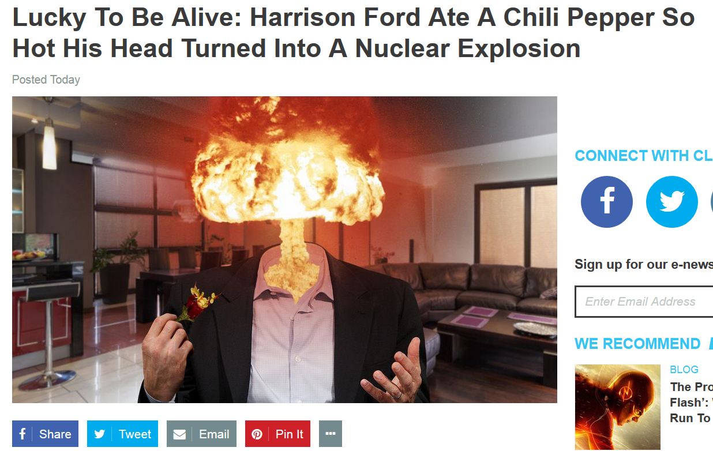
Concept: HTML
HTML stands for HyperText Markup Language, a standardized markup language for describing webpages. Browsers comply with this standard to render pages by giving certain tags meaning:
<h1>This text is a big header!</h1>
<p>This text is in a paragraph!</p> <p>This text is in another!</p>
<p> Here's a link to Google! <a href="http://www.google.com"> Go to Google</a> </p>
<img src="https://i.imgur.com/IPWwYXT.gif" />
Try it: Create a text file with HTML content, save it with a .html extension, and then open the file up in your browser.
With JavaScript, each element is an accessible Object with modifiable properties! As Objects are referenced, updating the Objects will cause the browser to update automatically.

Slide 9
DOM Interface: getElementById
A special property of HTML elements is the id property. It describes a unique identifier for the particular element.
<div id="myDiv"> This is myDiv. There are many like it, but this one is mine. </div>
The document Object is a globally scoped Object with methods we can use to select elements:
document.getElementById("myDiv") => a reference to myDiv
That's a lot to type! Let's simplify it:
function select(id) { return document.getElementById(id); }
select("myDiv") => the same reference to myDiv, just easier to type!
Advanced: Also see: getElementsByClassName and querySelectorAll

Slide 10
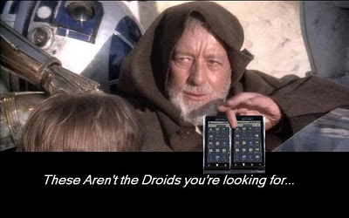
DOM Interface: innerHTML
Given an element, we can do modify its content and properties! The .innerHTML property lets you literally assign text to an element's "insides":
<div id="stormtroopers"> Let me see your identification. </div>
In our JavaScript:
function select(id) { return document.getElementById(id); }
select("stormtroopers").innerHTML = "These aren't the droids we're looking for."
Now, in the browser:
<div id="Stormtroopers"> These aren't the droids we're looking for. </div>
Advanced: The .innerText property escapes characters for you, so when you type literal HTML inside, it comes out as text. With .innerHTML , you can write literal HTML inside elements and the HTML will render.

Slide 11
DOM Interface: children
function select(id) { return document.getElementById(id); }
The children property of an element returns an array-like Object of child elements.
<ul id="haiku"> <li>Three things are certain:</li> <li>Death, taxes, and lost data.</li> <li>Guess which has occurred.</li> </ui>
select("haiku").children => [HtmlElement, HtmlElement, HtmlElement]
Let's dereference and manipulate, with our old friend bracket notation:
var list = select("haiku"); list[0].innerHTML = "Ring, Hello, IT."; list[1].innerHTML = "Sigh, Have you tried turning it"; list[2].innerHTML = "On and off again?";
Advanced: There is actually a distinction between the Element and Node interface. Element inherits from Node, and hence, all Elements have access to the Node interface. Google's your friend here.

Slide 12

DOM Interface: createElement, appendChild
The document object has a createElement method we can use to build new HTML elements. It takes a single string expression that represents the element type.
<ol id="starWars"> <li>Episode IV: A New Hope</li> <li>Episode V: The Empire Strikes Back</li> <li>Episode VI: Return of the Jedi</li> </ol>
var newMovie = document.createElement("li"); newMovie.innerHTML = "Episode VII: The Force Awakens";
The appendChild method appends an element as a last child to the selected element:
select("starWars").appendChild(newMovie);
Let's simplify createElement so it's not as verbose:
function create(type) { return document.createElement(type); }
Advanced: There's no appendFirstChild, but there is an insertBefore. Hm…
appendChild in action

Slide 13
DOM Interface: setAttribute, getAttribute
function create(type) { return document.createElement(type); }
The setAttribute method lets you assign attributes to elements. It takes two arguments, the first being the attribute, the second being the assignment.
<div id="pugbomb" class="something"> Insert pugs here! </div>
var place = select("pugbomb"); for(var i = 0; i < 100; i++) { var pug = create("img"); pug.setAttribute("src", "https://i.imgur.com/DksLx75.jpg"); place.appendChild(pug); }
The getAttribute returns the value of the attribute provided:
select("pugbomb").getAttribute("class") => "something"
Advanced: You can't setAttribute to null to get rid of it, that makes it "null". Use removeAttribute instead.

Slide 14


Concept: Inline JavaScript
We can write JavaScript directly on our webpages for the browser to execute with the <script> tag. When the browser encounters it, it immediately executes any JavaScript inside.
<script> console.log("This code is in my HTML!"); console.log("I will now count to ten."); for(var i = 1; i <= 10; i++) console.log(i); </script>
We move this code to an external file with the src attribute:
<script src="count.js"></script>
A webpage can support any number of external scripts:
<script src="count.js"></script> <script src="count.js"></script> <script src="count.js"></script>
Is there a downside to external script loading?

Slide 15
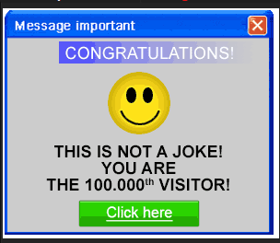
Concept: Event Handler
An event is something that happens. An event handler is a function that runs when the event occurs, or "fires".
<button id="surprise">Click me for a surprise!</button> <input type="text" id="prize" />
We bind an event handler to an element to assign a callback when an event fires. The addEventListener method on elements takes two* arguments, the first being the event type, and the second being the callback.
select("surprise").addEventListener("click", function() { alert("You are the 100,000th visitor!"); alert("You win " + select("prize").value); });
There are dozens of DOM events available to use! (Google 'em all!) mousedown, keyup, change, focus, blur…
*Advanced: it accepts three arguments, the third being a boolean deciding whether the event should capture or bubble. See MDN, and event order: https://tinyurl.com/2w8653

Slide 16
Event Handlers, Continued
Event handler callbacks take a single argument which represents the event being fired. The Event Object has useful properties to make our callbacks reusable:
<input type="text" id="repeat" /> <input type="text" id="alsoRepeat" />
var echo = function(event) { var element = event.target; // Element reference var time = event.timeStamp; // Event fired time var type = event.type; // Event type console.log(type + " " + time + ": " + element.value); }
select("repeat").addEventListener("keyup", echo); select("alsoRepeat").addEventListener("keyup", echo); //Same callback, different elements!
Advanced: The default behavior for event handlers on parents and children is to fire on the child first, then the parent. This behavior can be overridden, and the parent's callback even ignored.

Slide 17
DOM Interface Recap
document.getElementById(expression) Returns a reference to an element on the document with expression id. Simplified:
function select(id) { return document.getElementById(id); }
Element.innerHTML The inner HTML content of the selected Element. When updated, the browser re-renders it.
Element.children An array-like Object of all the children elements of the selected Element.
document.createElement(expression) Returns a new element of the given type expression. Simplified:
function create(type) { return document.createElement(type); }
Element.appendChild(element) Adds an element as the last child of the selected Element.
Element.addEventListener(eventtype, callback) Registers an event handler callback to run whenever eventtype occurs on the Element.

Slide 18
Problem of the Day
Batman needs to travel through space (and time) in order to save his bat-friends. To do this, he's building a bat-ship to go into space with. He needs your help deciding how much equipment and supplies to bring on his journey.
Build a (bat)calculator that computes the total weight of a set of spaceship payloads, where each payload has unit weight and a configurable quantity.
Example payloads:
Sidekicks: 70 kg
Robots: 120 kg
Boosters: 91000 kg
Bonus: Make it possible to add additional payloads.

Slide 19
Q&A + Feedback
Thanks for coming!
Please fill out the anonymous feedback form before you leave:
https://tinyurl.com/nqpdaeq
Next week's workshop: Object Oriented JavaScript Constructors! Prototypes! Inheritance! Explosions!

