Slide 1
JavaScript from the Ground Up Please sign in: http://bit.ly/1gP0GnW
Lesson 1.5: Statements Part 2
Brian Cui | Web Basic | MAD 2015

Slide 2
Last time on JavaScript from the Ground Up
Expressions have value. They can be truthy and falsy. We can save them into variables, akin to buckets, that we can reuse.
var myVariable = "Brian";
Variables are not bounded by type!
myVariable = 4; //No problemo
The JavaScript Console lets us interact with the state of the current page.
The if/else statement lets us structure code based on expressions:
if(myVariable) console.log(myVariable); else console.log("that was falsy");

Slide 3
Thoughts from last time…
How does this contribute to web development in general??
don't ask the audience, "do you understand/ you got it/ anyone have any questions/ everyone understand why ____" explain it anyways please because some people may be too shy to speak up that they don't get it.
We started from the very basics. I hope courses get faster in other workshops.
it went really fast :/
I didn't come last week but it was still pretty easy to follow along, well-paced, good examples. Thank you!
Please teach the Android workshop to do this as well.
Notes:
One more question:
IDE's for JS? I use the WebStorm IDE. It's made by JetBrains (IntelliJ) and is free for students. It's got code completion and will display errors and warnings in-line. However, for what we're learning for these workshops, and IDE isn't really necessary.

Slide 4
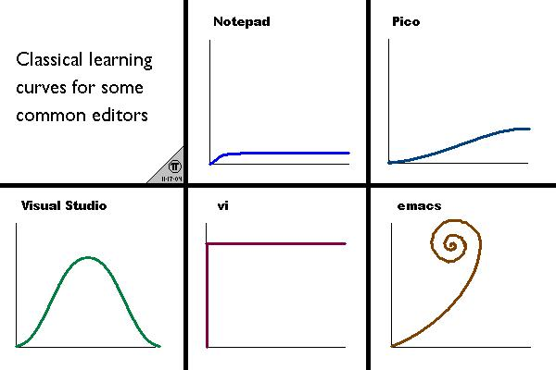
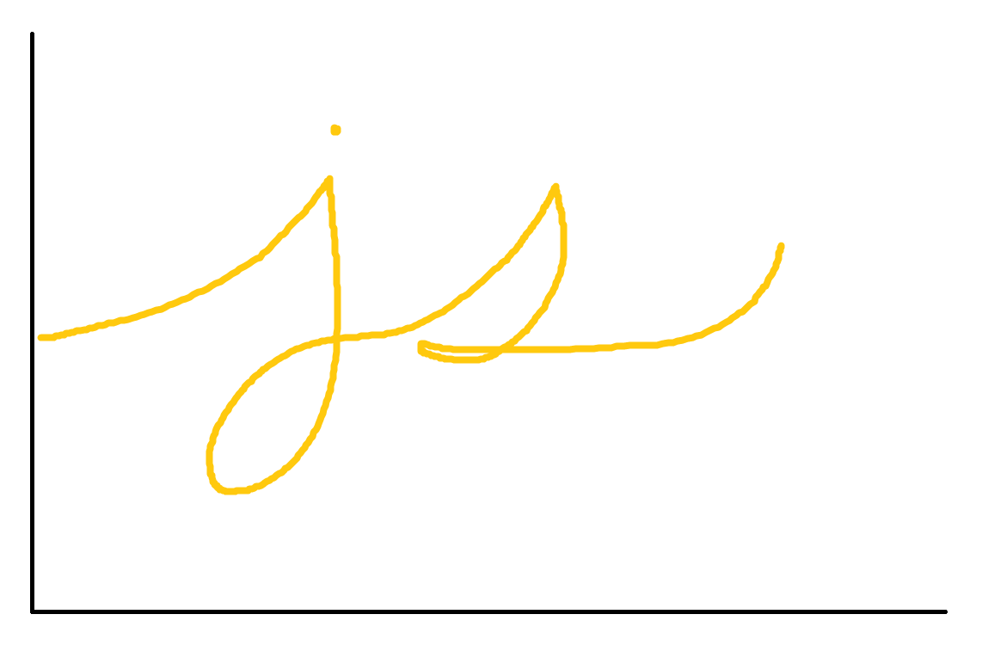


JavaScript Learning Curve
statements
expressions
functions
this
closures
objects
prototype inheritance

Slide 5
General Schedule
Part 0: Expressions | Part 4: JavaScript <3 DOM (JavaScript for the Web)
Part 1: Statements pt. 1 Part 1.5: Statements pt. 2 | Part 5: Object Oriented JavaScript
Part 2: Objects | Part 6: Asynchronous JavaScript
Part 3: Functions | Part 7: Advanced JavaScript Concepts (JavaScript Graduation Day!)
No workshop next week (9/30)! (If there is one, it won't be taught by me)
Notes:
How long until the material gets interesting for the average CS student? SOON. The further we go down the rabbit hole, the more things we'll see that are unique to the JavaScript language. The next workshop, covering Objects, is going to be pretty radical.
I've got an exam and a lot of interviews in the way, so I won't be able to teach next week's workshop. Take a break, learn some HTML, and get ready for the real deal next time, the week after.

Slide 6
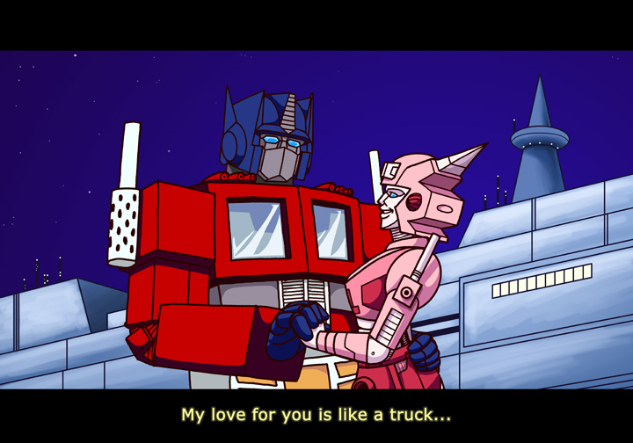
Problem of the Day
Optimus Prime is feeling lonely and would like to set up a dating profile. He's asked you to make a profile website for him, with the following criteria:
It has a picture of Optimus Prime
It lists all the prime numbers between 1 and 1000
Bonus: Modify your code so it prints exactly n prime numbers starting from 2.
(Please don't hardcode all the prime numbers by hand)
Notes:
Google Images is fine.

Slide 7
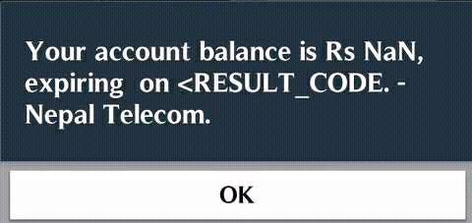
Old Friends and New Operators
The = (assignment) operator expresses to the new value of the variable.
var n = 1; if(n = 5) console.log(n); //prints 5
We can reassign the number to be based on itself with an expression:
n = n + 1; n => 6
The ++ and -- operators increment and decrement a number variable:
n++; n => 7
n--; n => 6
var k = "kay"; k++; k => NaN
Operate responsibly.

Slide 8
More on ++ --
Remember: expressions can have side effects. The ++ and -- operators express differently based on where you put them:
var a = 0; if(a++) console.log("if " + a); else console.log("else " + a); //post-increment: prints "else 1"
var b = 0; if(++b) console.log("if " + b); else console.log("else " + b); //pre-increment: prints "if 1"
Notes:
You can save yourself a couple of characters by having this knowledge, but it's always good to be explicit (e.g. write out i = i + 1) to be safe.

Slide 9
undefined vs. null
We've seen undefined when we declare, but don't assign a variable. You can also manually set variables to be undefined:
var notDefined; notDefined => undefined
var unset = undefined; unset => undefined
But wait, there's also null:
var nothing = null; nothing => null
null === undefined => false
Both undefined and null are falsy!
Advanced: undefined is its own type, while null is an Object. Tell that to your interviewer! typeof undefined => "undefined" typeof null = "object"
Notes:
undefined vs. null is a common case of confusion for JavaScript developers, as most other languages only have one form of "nothingness". Know the difference!

Slide 10
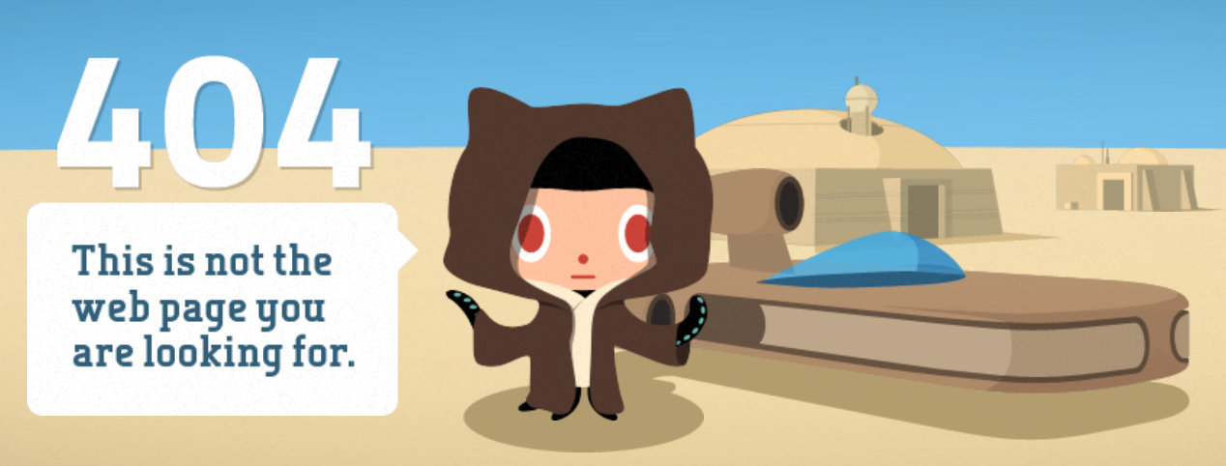
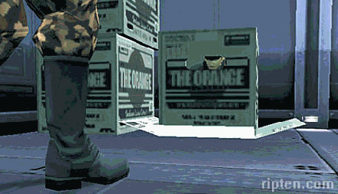
undefined vs. null
Think of undefined like "unexpected nothingness" and null like "there is intentionally nothing here."
var u = undefined;
var n = null;
u == n => true
u === n => false
JavaScript will never set values to null unless you (the user) explicitly do so.
Advanced: undefined doesn't exist in the JSON format, but null does. var a = { u: undefined, n: null }; JSON.stringify(a) => "{ "n": null }"
var page = undefined;
var snake = null;
Notes:
You can assign values to undefined, but it's better practice to use null.
Much like the 404 page, undefined is a placeholder for something that doesn't and has never existed.
Null is a bit more like Big Boss: there's something there, but it's meant to represent nothingness.

Slide 11
Concept: switch control flow statement
The switch statement lets you control code based on what an expression equals (===). The special break keyword prevents cases from falling through.
switch (expression) {
case expression1:
statement1;
break;
case expression2:
case expression3:
statement2;
default:
statement3;
}
The if statement way (yuck!):
if(expression === expression1) statement1; if(expression !== statement1 &&
(expression === expression2 || expression === expression3))
statement2;
if(expression !== expression1)
statement3;
Advanced: Breaking out of a switch statement anywhere ensures no other case will execute, even if the expressions for other cases are also identical.
Notes:
A common case for switch is checking variable types:
switch (typeof myVariable) {
case "string":
console.log("a is a string!");
break;
case "number":
console.log("a is a number!");
break;
default:
console.log("a is something else!");
}

Slide 12





A case for switch
"Talk to the hand."
switch(terminator) { case 3: console.log("Talk to the hand."); break; case 5: console.log("Old, not obsolete."); case 2: console.log("Come with me if you" + "want to live."); case 4: case 1: console.log("I'll be back."); }
"Old, not obsolete."
"Come with me if you want to live."
"I'll be back."

Slide 13
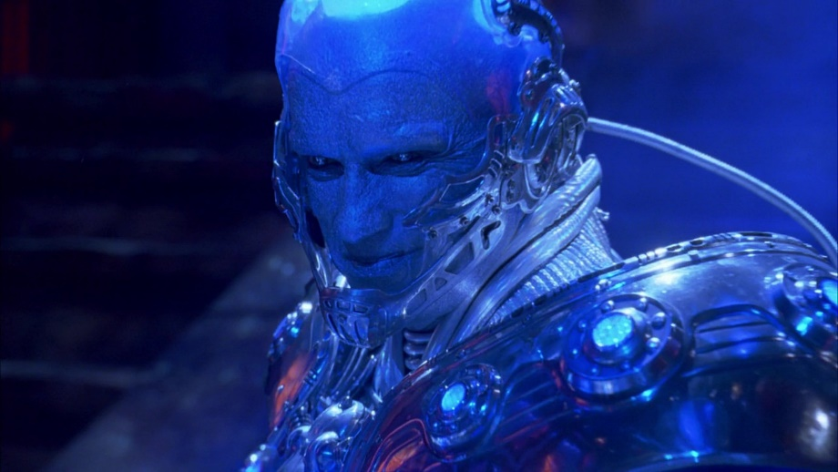
Concept: while loop
The while loop repeats a statement until a given expression is falsy.
while(expression) statement
while(true) console.log("Freeze!");
var i = 0; while(i < 10) console.log(i++);
var done = false; var count = 1; while(!done) { console.log(count = count * 2); if(count >= 4096) done = true; }
while(false) console.log("this won't print");

Slide 14
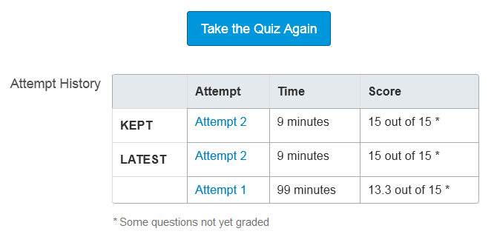
Concept: do-while loop
The do-while loop executes a statement, and then repeats the statement until a given expression is falsy. The key difference is that statement is guaranteed to execute at least once.
do statement while(expression)
do console.log("can't stop") while(false);
do console.log("won't stop") while(true);
var i = 0; do { console.log(i++); } while(i === 0);
do quiz.take(); while(quiz.grade < 100);

Slide 15
Concept: for loop
for(initialization; condition; iteration-statement) statement;
for(var i = 0; i < 10; i++) //prints 0 - 9 console.log(i);
for(var n = 4; n < -0; n--) //does nothing: condition false console.log(n);
var limit = 50; for(var k = 0; k < 0 ? (-k <= limit) : (k <= limit); k = -k) { console.log(k); if (k < 0) k--; else k++; }
Advanced: You can skip initialization and iteration statements by using the blank statement ;. For example (heh), for(; true; ) is an infinite loop.
Notes:
The for loop takes the common pattern of initialization, conditional, and iteration statements and packs them all together.

Slide 16
break and continue
All 3 loop styles support the special break and continue keywords, which allow us to "break" out of loops or skip to the iteration step early, respectively.
for(var i = 0; i < 10; i++) { if(i % 2) continue; console.log(i); }
var i = 1; while(i++) { if(i === 100) break; console.log(i); }
Advanced: You can define specific statement blocks to break and continue out of. It's essentially a poor man's goto: a: { b: { break b; console.log("b"); } console.log("a"); } //prints "a"
Notes:
How can we speed up the first for loop?

Slide 17
Loop Practice
What do the following loops produce in the console?
var status = null; do console.log(status); while(status);
var j = k = 1; //double assignment while (k < 1000) { console.log(j); var temp = k; k = k + j; j = temp; }
var c = 12; var res = c; for(var u = c - 1; u > 0; res = res * u--); console.log(res);
Advanced: Playing code golf? You can squeeze a surprising amount of stuff out of the for loop.

Slide 18
Problem of the Day
Optimus Prime is feeling lonely and would like to set up a dating profile. He's asked you to make a profile website for him, with the following criteria:
It has a picture of Optimus Prime
It lists all the prime numbers between 1 and 1000
Bonus: Modify your code so it prints exactly n prime numbers starting from 2.
(Please don't hardcode all the prime numbers by hand)
Notes:
Start off by writing a solution for the prime numbers problem using raw JavaScript.
Then, let's build a basic webpage and augment the page such that it meets our requirements.
Solutions to this problem are in the solutions folder.

Slide 19
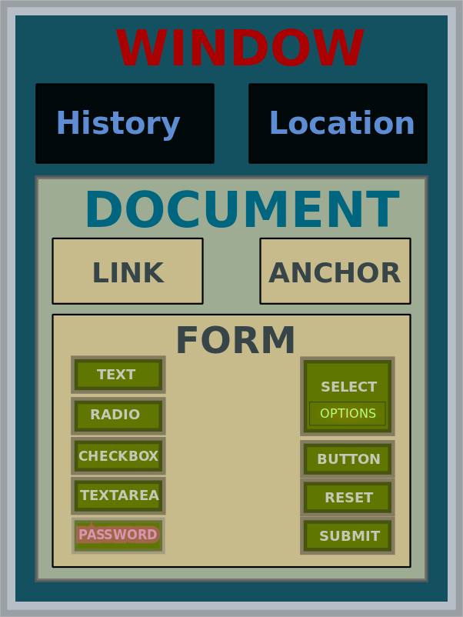
Concept: Document Object Model
The Document Object Model describes the representation and structure of HTML (and XHTML, XML) documents.
Elements, or nodes, in *ML consist of tags that open and close around content and children.
<p>Hello, World!</p>
<img src="my_picture.png" />
<p> Here is my picture: <img src="my_picture.png" /> </p>
Elements can have properties, like src or id.
Notes:
The DOM is a rather abstract concept. You don't have to memorize what it is, just know what it refers to.
Your First Webpage: Open your favorite text editor, add some tags with content like the paragraph tag…
<p>Hello, World!</p>
Then open the page with your browser. Tada!

Slide 20
JavaScript <3 DOM: A Preview
As JavaScript was built for the web, we can dynamically interact with DOM elements! Here are some useful statements to start:
var element = document.getElementById( expression );
Selects the DOM element with an id property of expression.
var newElement = document.createElement( expression );
Creates a new DOM element in memory.
newElement.innerHTML = expression;
Assigns the DOM element's content to a value.
element.appendChild( newElement );
Inserts an element as a child of another element.
Notes:
There are dozens of ways to interact with the DOM; these are some basic commands to start out with. Don't worry about memorizing them - it makes more sense when we start to use these statements on an actual webpage.
In a couple of workshops, we'll spend the entire session playing with DOM manipulation.

Slide 21
Q&A + Feedback
Thanks for coming!
Please fill out the anonymous feedback form before you leave:
http://bit.ly/1Wjuw43
There is no workshop (held by me) next week on 9/30.
Take a break and learn some HTML!

