Slide 1
JavaScript from the Ground Up Please sign in: https://tinyurl.com/nl6ysvr
Lesson 4: Functions
Brian Cui | Web Basic | MAD 2015

Slide 2
Last time on JavaScript from the Ground Up
"All expressions are objects, but some objects are more Object-like than others."
George Orwell, Programmer Farm
We learned about the Object (with a capital O), a type that can store key value pairs as properties. The object literal {} has no key value pairs* (*All objects actually have a special prototype property that we'll learn about soon).
Objects can be referenced using dot notation or bracket notation.
Bracket notation allows you to set and retrieve properties with a given string expression. This lets JavaScript objects to behave as maps.
Objects are not copied, they are referenced when assigned.
The primitive types have properties too! "hey".length => 3
Notes:
Except, the properties of the primitive types are immutable or unchangeable. Attempting to assign properties to a primitive type won't cause an error, but those properties w

Slide 3
Thoughts from last time…
I missed the html/css workshop. How can I catch up.
I didn't even know how you got the database thing to come up, are you still using the webbrowser by this point or is this a seperate program?
I liked the webpage at the end. I didn't really follow it entirely, but it's nice to have something to play with and figure out.
dw dude I kept up LOL it wasn't too confusing. only cause there was a bunch of stuff we haven't learned yet in the javascript code
Are YOU the Next Steve Jobs?
Notes:
My HTML background actually comes from W3Schools. This was before MDN existed, and Firefox was literally in beta. W3Schools is generally not a very good reference website, it has no actual affiliation with the W3C organization, and you should generally use Mozilla Developer Network. However, for basic stuff, it is usable, and I can at least recommend its HTML course. Don't venture onto its other tutorials though; they tend to provide bad practices and you should look elsewhere. http://www.w3schools.com/html/
Yes! I showed you this example to show off the power of the web platform. If you didn't know how to use Git, I apologize: you can go ahead and download everything as .zip if you want the source code. HTML documents stored on the hard drive can be opened directly in the browser, no "emulator" required. Take that, Android.
Hooah! Our next workshop is going to be entirely about creating dynamic webpages and by that point you'll be able to understand past examples. Hang in there!
That's the spirit.
Maybe. The real question you should ask is are you the next Steve Jobs?

Slide 4
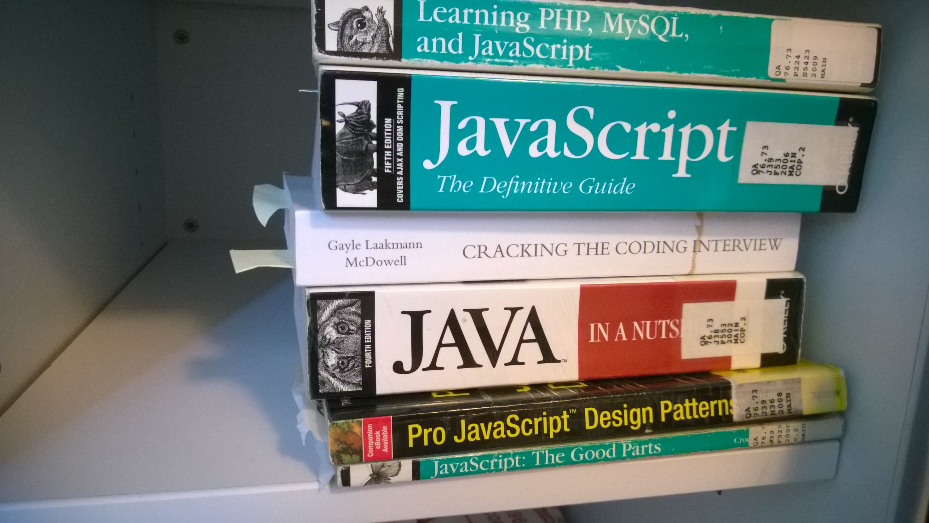

Slide 5
General Schedule
Part 0: Expressions | Part 4: JavaScript <3 DOM (JavaScript for the Web)
Part 1: Statements pt. 1 Part 1.5: Statements pt. 2 | Part 5: Object Oriented JavaScript
Part 2: Objects | Part 6: Asynchronous JavaScript
Part 3: Functions | Part 7: Advanced JavaScript Concepts (JavaScript Graduation Day!)
All the numbers are a bit off. This is the "fourth" JS lesson but is indexed "third", but technically it's the "fifth" or "sixth" because there was a special one on HTML/CSS not on the schedule.
Just think "Fast and Furious" movies. The order is 1, 2, 4, 5, 6/4/7/6/7.

Slide 6


Problem(s) of the Day
Professor Xavier is developing Cerebro and wants to compile a list of mutant powers (properties) and mutants (Objects).
Write a function Cerebro that takes two Object arguments, the first being powers list so far, and the second being the mutant encountered. For each of the mutant's powers, add his/her name to the list accordingly.
Magento has other plans and seeks to steal all the powers (properties) of other mutants (Objects).
Write a function Magneto that takes two Object arguments and steals (removes) all the properties from the second Object and gives them (replaces) to the first.
Bonus: Have Magneto take a single argument, the target, and modify an Object that is not publicly accessible.

Slide 7
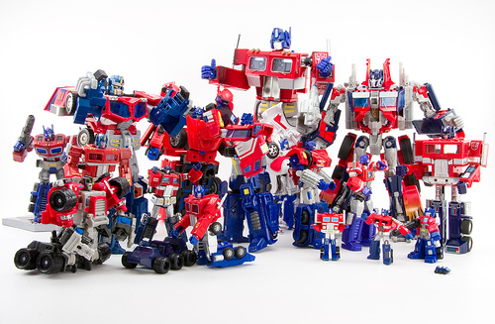
Concept: Array
An Array is a special kind of Object that has ordered number properties according to index. The array literal [] is an empty array.
var emptyArray = [];
Initialize an array with properties using comma separated values:
var primes = [2, 3, 5, 7, 11];
Get and set elements with bracket notation:
primes[0] => 2
primes[5] = 13; //primes[5] => 13
primes["5"] => 13
Arrays do not have a fixed length or type!
primes[6] = {}; primes[6].number = 17;
Advanced: Because identifiers can only start with underscores, the dollar sign, and letters, you can't reference array properties with dot notation, i.e. primes.4 is not allowed.

Slide 8
Concept: Array Length
Advanced: Watch out for Array-like Objects, which are pseudo Arrays. Modern JavaScript avoids these, but older standards can give you Array-like Objects that are indexed and have a .length property, but are not actually of the Array class.
var primes = [2, 3, 5, 7, 11]; // primes.length => 5
The .length property of Arrays is the number of elements in the array.
Let's print out all the elements in our array using a loop:
int i = 0; while(i < primes.length) console.log(primes[i]);
The .length property is always the max(indices with set values) + 1. Consider:
primes[99] = "I dunno lol"; // primes.length => 100
primes[primes.length] = "100!" // primes.length => 101
As an Object, we can manually get and set the length property!
primes.length = 1234; // primes.length => 1234
Notes:
We can simplify the while loop into a for loop.
"set values" means all the values that you, the developer, have assigned. This includes undefined. primes[primes.length] = undefined will increase the length of primes, but primes[99999] is undefined.
As Objects, we can also add more properties to Arrays! Properties that are not numbers will not contribute to the length of the Array. It's best that you avoid assigning non-ordered properties to Arrays because it's confusing behavior.

Slide 9

Concept: Function
A function is… well, let's figure it out as we go. Here's the function literal, used to define function.
function(args) { statements }
A function is like a machine that you feed (arguments, sometimes nothing), then executes statements (with possible side effects), and sometimes spits out things (return values).
var i = 0; // define a Number var myFunction = function() { // define a Function i = i + 1; // modify i } i => ??? // what is i now?
A function is invoked ("fed") with parentheses surrounding comma separated expressions. It expresses to the return value ("spit out value"), undefined if there is none.
myFunction() => undefined // invoke myFunction, returns nothing i => ??? // what is i now?
function(args)
expressions

Slide 10

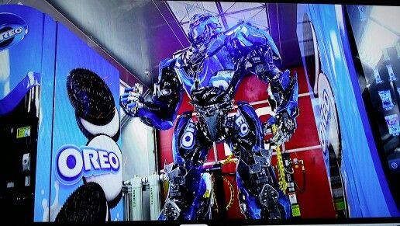

Concept: Function
function(args) { statements }
We define identifiers for arguments in our function definition to refer to later. When the function is invoked, the identifiers are set to the values passed:
var printPlus = function(value) { console.log(value + 1); } printPlus(54) //prints 55
The return statement immediately exits the function and determines what the function evaluates to when invoked.
var vendingBot = function(iAm) { if (iAm === "thirsty") return "mountain dew"; else if(iAm === "hungry") return "oreos"; return "shrapnel"; }
vendingBot("thirsty") => "mountain dew" vendingBot("hungry") => "oreos" vendingBot("nothing") => "shrapnel"
Thirsty?
Hungry?
Neither?
Notes:
Suppose I remove the else statement from vendingBot. Does the function run correcty?

Slide 11
Concept: Function Arguments
function(args) { statements }
There are no strict types with function arguments, in fact, you can pass an arbitrary number of arguments to any function:
var printIfTruthy = function(print) { console.log(print ? print : print + " isn't truthy!"); }
printIfTruthy(); // prints "undefined isn't truthy!" printIfTruthy("ding!"); // prints "ding!" printIfTruthy(1); // prints "1" printIfTruthy(false); // prints "false isn't truthy!"
printIfTruthy("hey", "I", "just", "met", "you"); // prints ??? printIfTruthy({}); // prints ??? printIfTruthy(new String("")) // prints ???
Advanced: unlike Java, there's no function overloading in JavaScript. (Plus, you shouldn't define a function twice.)
Notes:
Notice how if arguments aren't provided, they're set to undefined.
If more arguments are provided than a function has defined, only the ones defined, in order, are assigned to the defined identifiers.

Slide 12

Concept: Function arguments
Each function has a special arguments Array that, when invoked, stores all the arguments passed to the function, in order. Here's a function that adds all of its arguments together:
var concat = function() { if(arguments === undefined) return null; var result = arguments[0]; for(var i = 1; i < arguments.length; i++) result = result + arguments[i]; return result; }
concat() => null concat("birds") => "birds" concat("this", "is", "my", "branch") => "thisismybranch" concat(1, 2, 3) => 6
Advanced: The Java equivalent for variable arguments is something like public void foo(String... args) to accept unlimited comma separated strings.

Slide 13

Concept: Method
A method is a function that is the property of an Object. We can manually assign functions to Object properties:
var batman = {}; batman.prompt = function(target) { return "(to " + target + "): "; }; batman.seduce = function(target) { console.log(this.prompt(target) + "THEN YOU'RE GONNA LOVE ME."); }; batman.threaten = function(target) { console.log(this.prompt(target) + "YOU'LL BE IN A PADDED CELL FOREVER."); };
batman.threaten("joker"); //prints "(to joker): YOU'LL BE IN A PADDED CELL FOREVER."

Slide 14
Fun Methods for Fun Programmers
JavaScript comes packed with a lot of fun methods that you'll find useful:
expression.toString() // returns a string version of the expression
string-expression.toLowerCase() // returns a new string in lowercase string-expression.toUpperCase() // returns a new string in uppercase string-expression.trim() // returns a new string without whitespace padding string-expression.split(expression) /* returns a new array that represents the string broken up into pieces, split at expression */
array.push(expression) //adds expression to the end of the array array.pop() /* removes and returns the element at the end of the array, and decrements the length */ array.shift() /* removes and returns the element at the front of the array, and moves all elements forwards */ array.unshift(expression) /* adds expression to the front of the array, shifting all the elements backwards */
There's plenty more methods to find! Just use Google!

Slide 15

Pattern: Immediately-Invoked Functions
Remember: A literal is the simplest form of expression. In that sense, we don't have to assign an expression to a variable before we can do stuff with it:
"literally a string".length => 18
In that same sense, we can invoke functions immediately without assignment:
var one = (function() { return 1; })(); // one => 1
var counts = { values: (function(max) { var res = []; for(var i = 0; i < max; i++) res[i] = i + 1; return res; })(100), name: "ascending counting numbers" }
Self invoking functions allow you to build complex expressions using statements, in places where expressions are expected!
Notes:
if((function() { return 1 })()) console.log("truth!");

Slide 16

JavaScript Functions: First Class Citizens
Functions are Objects, and can be used just like them!
var funk = function(input) { return input * -1; };
funk(5) => -5 funk(-123) => 123
var minus = funk;
minus(82) => -82 minus(0) => 0
You can even pass them as arguments!
function invoke(func) { return func({}); }
invoke(function(arg) { return "" + arg }) => ???
"We hold these truths to be sacred and undeniable; that all Objects are created equal…"
– Thomas Jefferson

Slide 17
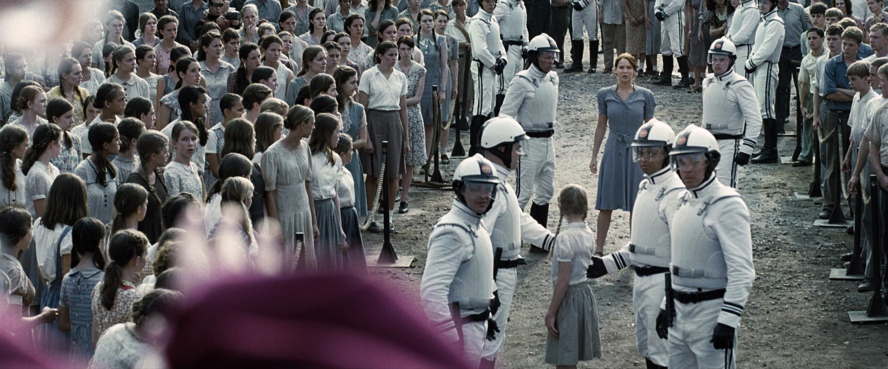
Java Functions: Second Class Citizens
Advanced: The closest thing to Java functions as arguments is a class that implements the Comparator interface, which ensures it has a compare method to be called.
private int
private void
implements Comparator
public void
protected String
private void
new Guard()
new Guard()
public int compare
new Citizen()

Slide 18
Concept: Variable Scope
Consider the following code:
var a = "I think, therefore I am"; if([]) { var a = "I Object, therefore I Truthy"; } console.log(a); => prints ???
JavaScript has function scope, not block scope.
Variables declared inside functions are only accessible from the function itself and other functions inside of it.
Variables can be declared and assigned twice with no problem
Advanced: Variables are "hoisted" to the top of the function, regardless of when defined. Ruby does this too!
Variables declared outside of functions are in the global scope or global namespace, as in, they can be accessed anywhere.
A function runs in the scope in which it was defined, not the scope with which it executes. The "exception" is the this keyword, which we'll talk about later.
Notes:
The output is "I Object, therefore I Truthy"

Slide 19
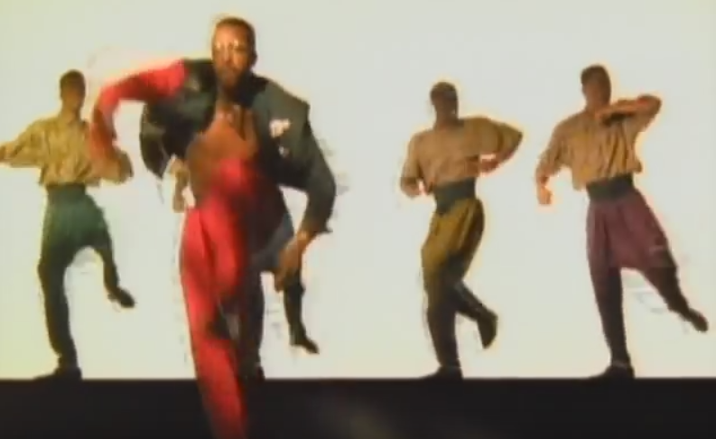
Function Scope in Practice
Functions can access variables outside of themselves, but not variables from nested functions.
var cantTouchThis = function() { var u = "MC Hammer"; return u; } console.log(u) => undefined console.log(cantTouchThis()) => "MC Hammer"
What happens when the outer function has completed execution?
var i = 0; var nest = (function() { var i = 282; return function() { console.log(i); }; })();
nest(); //prints ???

Slide 20

Concept: Named Function
A named function is a function declaration that has an identifier assigned to it.
function name(args) { statements }
Named functions are special because they are defined at parse time, before run time. They can be referred to before the function is even declared in the code!
var now = { year: new Date().getFullYear() }; timeTravel(now, 1985);
function timeTravel(time, date) { console.log(date > new Date().getFullYear() ? "Where we're going, we don't need roads!" : "We're sending you back to the future!"); if(time instanceof Object) time.year = date; else time = { year: date }; return time; }
Notes:
Notice the procedural style of programming being used here. We aren't referring to a global variable in the timeTravel function (other than Date, which is a library class and OK), and instead, we're mutating the argument time. This makes our code more modular and the function re-usable.
var now = { year: new Date().getFullYear() }; timeTravel(now, 1985);
function timeTravel(time, date) { console.log(date > new Date().getFullYear() ? "Where we're going, we don't need roads!" : "We're sending you back to the future!"); if(time instanceof Object) time.year = date; else time = { year: date }; return time; }

Slide 21
Concept: Callback
A callback is a broad term for a function passed as an argument. Typically, the callback is executed (invoked) at least once. Consider:
The Array class has a map method that returns a new array with the results of calling a function argument on every element in the array.
function abs(value) { return value < 0 ? -value : value; }
[-5, 2, 0, -9].map(abs) => [5, 2, 0, 9]
Another useful method is filter, which returns a new array of elements only containing those that, when called on the provided function, express truthy.
[-93, 328, 3, -4, 17].map(abs).filter(function(value) { return !(value % 2) }) => [328, 4]
We'll encounter and use callbacks all over JavaScript! Advanced: There's an Array.reduce too!
Notes:
Now would be a good time to open up MDN:
https://developer.mozilla.org/en-US/docs/Web/JavaScript/Reference/Global_Objects/Array/map
function abs(value) { return value < 0 ? -value : value; }
[-5, 2, 0, -9].map(abs) => [5, 2, 0, 9]
[-93, 328, 3, -4, 17].map(abs).filter(function(value) { return !(value % 2) }) => [328, 4]

Slide 22
Problem(s) of the Day
Professor Xavier is developing Cerebro and wants to compile a list of mutant powers (properties) and mutants (Objects).
Write a function Cerebro that takes two Object arguments, the first being powers list so far, and the second being the mutant encountered. For each of the mutant's powers, add his/her name to the list accordingly.
Magento has other plans and seeks to steal all the powers (properties) of other mutants (Objects).
Write a function Magneto that takes two Object arguments and steals (removes) all the properties from the second Object and gives them (replaces) to the first.
Bonus: Have Magneto take a single argument, the target, and modify an Object that is not publicly accessible.

Slide 23
Q&A + Feedback
Thanks for coming!
Please fill out the anonymous feedback form before you leave:
https://tinyurl.com/na7sjjv
Next week's workshop: JavaScript + DOM = Dynamic Webpages! (The workshop you've been waiting for!) (Check the Facebook group for the latest!)

