Slide 1
JavaScript from the Ground Up Please sign in: https://tinyurl.com/q7xp3j9
THE FINAL LESSON: Advanced Javascript Concepts
Brian Cui | Web Basic | MAD 2015

Slide 2

General Schedule
Part 0: Expressions | Part 4: JavaScript <3 DOM (JavaScript for the Web)
Part 1: Statements pt. 1 Part 1.5: Statements pt. 2 | Part 5: Object Oriented JavaScript
Part 2: Objects | Part 6: Asynchronous JavaScript
Part 3: Functions | Part 7: Advanced JavaScript Concepts (JavaScript Graduation Day!)
Adele. Skyfall.

Slide 3

A closer look at this
The this keyword references the object that a function was invoked "on". The simplest way to think of this is the "object before the dot":
var batman = { rule: "Avoid killing people.", remark: function() { console.log("I HAVE ONE RULE: " + this.rule.toUpperCase()); } }
batman.remark(); /* prints "I HAVE ONE RULE: AVOID KILLING PEOPLE." batman is this because remark a property of batman */

Slide 4

this without a soul
What happens if you remove the object the function is invoked on?
var batman = { rule: "Avoid killing people.", remark: function() { console.log("I HAVE ONE RULE: " + this.rule.toUpperCase()); } }
var haha = batman.remark; haha(); //where's this? what's the output?
TypeError: this.rule is undefined (why not "I HAVE ONE RULE: undefined"?)
For functions that are not invoked as properties of objects, the this context defaults to the global namespace (window).
var rule = "Not to have rules.";
haha(); //prints "I HAVE ONE RULE: NOT TO HAVE RULES."

Slide 5
this in nested functions
Because a function literal has no object to use for this, functions nested inside functions lose the this scope of the outer (parent) function.
var tables = { numbers: [1, 2, 3, 4], multipliers: [3, 5, 1, 4], multiply: function() { this.numbers.forEach(function(number) { console.log(this.multipliers * number); }); } }; //Wrong! Callback has no this context
tables.multiply(); //prints NaN NaN NaN NaN
Well, that sucks... We can rewrite away some callbacks, but not others.

Slide 6
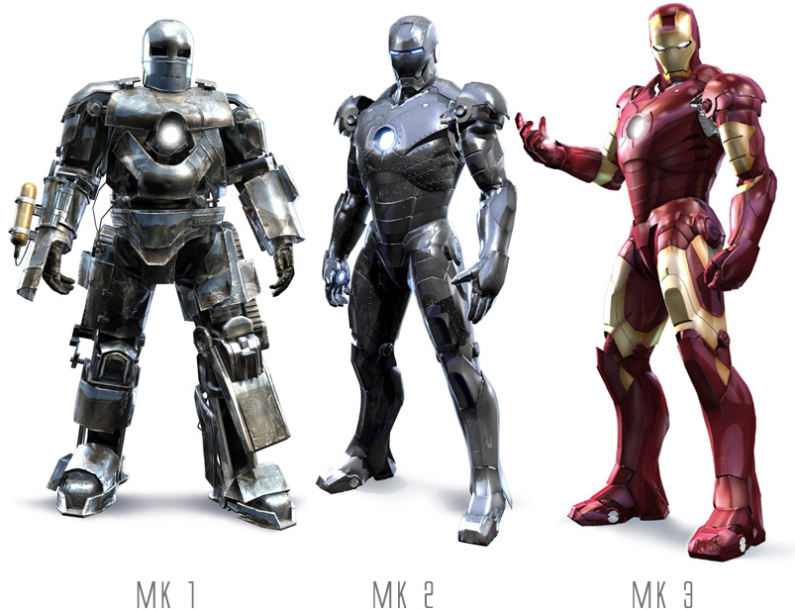
Concept: .bind
The .bind method of functions returns a function with the this context set to the argument.
var ironmen = { suits: [1, 2, 3], colors: ["grey", "silver", "gold"], examine: function() { this.suits.forEach((function(suit, index) { console.log("Mark " + suit + " color: " + this.colors[index]); }).bind(this)); } }
The .bind(this) forces the nested callback of forEach to run with this set to the same value of this as the parent (calling) function.
ironmen.examine(); // prints Mark 1 color: grey, Mark 2 color: silver, Mark 3 color: gold

Slide 7

A case for this
Consider the following Object that describes an alert message:
var newMail = { content: "check back later", attach: function(id) { document.getElementById(id).addEventListener("click", (function() { alert(this.content); }).bind(this)) }
<button id="update">Click me for news</button>
newMail.attach("update");
By storing variables inside an Object, making modifications to those variables are transparent. We don't necessarily know (or care) what event listeners are wired up.
newMail.content = "you've got mail!";

Slide 8
Concept: .call
.call is like the bigger brother of .bind. It is a method of functions that takes an argument for this and additional arguments, and invokes the function in the context of this and with the passed arguments.
Here's some code that I wrote to leverage the switch statement in a constructor. By making the assignment the result of an immediately-invoked function, we encapsulate all the code necessary to determine the result within that function and avoid initializing to undefined.
this.enabled = (function (setting) { switch (typeof setting) { case 'boolean': return setting; case 'string': return setting.trim().toLowerCase() !== 'false'; default: return this.defaultEnabled; } }).call(this, configWatcher.enabled);

Slide 9
this with constructors
Remember the new keyword? In conjunction with constructors, it produces out "new" Objects with a "new" this context:
function AlertComponent(content, eventType) { this.content = content; this.eventType = eventType; } AlertComponent.prototype.attach = function(element) { element.attachEventListener(this.eventType, (function() { alert(this.content) }).bind(this)); }
var hoverAlert = new AlertComponent("YOU HOVER!", "mouseover");
<span id="pop">hoverme</span>
hoverAlert.attach(document.getElementById("pop"));

Slide 10

Constructors, Again: Privacy Please!
One common argument against JavaScript is that there are no private properties of Objects. This is only true for Object literals:
var freeForAll = { publicProp: 1 }
freeForAll.publicProp => 1 freeForAll.publicProp = 2;
Let's re-examine the constructor. Unlike literals, we can execute normal code within them:
function Arnold(model) { console.log("HEY CHRISTMAS TREE"); this.model = model; }
var governator = new Arnold("human"); //still prints
JavaScript has no private variables!
WRONG!

Slide 11

Private Variables in Constructors
Recall that JavaScript has function scope, and not block scope. Let's play around a bit with constructors and the new keyword:
function Book(title, contents) { this.title = title; this.contents = contents; this.read = function() { console.log(this.contents); }; }
We'd like title, author, and contents to all be private. However, creating a new Book(...) only gives us an Object with public properties, as dictated by what is assigned to this.
var kids = new Book("Feelings and how to destroy them", null, null);
kids.title = "Here's Waldo!"; //We'd like this to be impossible
How could we save title, contents in a way that makes them publicly inaccessible, but still read-able (with "getters")?

Slide 12

Private Variables in Constructors
We can take advantage of function scope to create private members by declaring them inside the constructor but not assigning them to this.
function Book(title, contents) { var _title = title; var _contents = contents; this.getTitle = function() { return _title; }; this.read = function() { console.log(_contents); }; }
var twilight = new Book("new moo", "moooo");
twilight._title => undefined twilight.getTitle() => "new moo"
Notes:
Conventionally, private variables start with an underscore.

Slide 13

Concept: Closure
A closure is a function which can access variables within the scope it was created in, after that scope is no longer externally accessible.
function Book(title, contents) { this.getTitle = function() { return title; }; this.read = function() { console.log(contents); }; }
var novel = new Book("Who Ate the Damn Pizza Rolls", "Papa John");
novel.getTitle() => "Who Ate the Damn Pizza Rolls"
Despite the actual invocation of Book having completed, the getTitle and read methods can still be used to access the arguments (and other variables) within the constructor!

Slide 14

Putting it All Together
function Movie(title, actors) { this.getTitle = function() { return title; }; this.getActorList = function() { return actors.join(", "); }; this.boxOffice = 0; this.awards = []; }
var thatMovie = new Movie("Creed", ["Sylvester Stallone", "Michael B. Jordan"]);
thatMovie.title => undefined thatMovie.getTitle() => "Creed" thatMovie.getActorList() => "Sylvester Stallone, Michael B. Jordan"
thatMovie.boxOffice = 999999999999; thatMovie.awards.push("Best Old Man Actor");

Slide 15
Oh, JavaScript
The effect of function scope and closures can produce odd results (question taken from StackOverflow):
var funcs = []; for (var i = 0; i < 3; i++) { // let's create 3 functions funcs[i] = function() { // and store them in funcs console.log("value: " + i); // each should log its value. }; } for (var j = 0; j < 3; j++) { funcs[j](); // and now let's run each one to see }
The output is value value 3 value 3 value 3. What's up with that?
How can we get it to produce value 1 value 2 value 3 ?
Notes:
The argument passed to console.log is not known at runtime until the function itself is executed (and thereby evaluating the expression in the arguments). If the interpreter "knew" what the concatenation was, our computers could predict the future!

Slide 16

Pass by Value saves the day, for now
function printer(i) { return function() { console.log("value: " + i); }; }
var funcs = []; for (var i = 0; i < 3; i++) { funcs[i] = printer(i); } for (var j = 0; j < 3; j++) { funcs[j](); }
Here's one solution to getting value 1 value 2 value 3. Recall that JavaScript is pass by value and copies primitive types passed in function arguments. We're able to get the "correct" output by forming a new closure each time.
Notes:
The argument passed to console.log is not known at runtime until the function itself is executed (and thereby evaluating the expression in the arguments). If the interpreter "knew" what the concatenation was, our computers could predict the future!

Slide 17
Where to go from here
If you want to build websites… (this is, web basic after all), go learn HTML and CSS! There are plenty of fantastic free tutorials online.
If you want to build desktop & server software… download and install Node.js, and start running JavaScript from command line.
If you want to make something cool… check out the Socket.io chat tutorial. This class has covered just about all the syntax. http://socket.io/get-started/chat/
If you hunger for more… checkout a programming book from the PCL (sixth floor!). The O'Rielly (animal cover) books are well written and organized.

Slide 18
Q&A + Feedback
Congratulations! You've leveled up in life!
I hope this class has given you a solid foundation on reading, writing, and understanding JavaScript. It's been a wonderful adventure, and I hope to see you again around campus, and when I teach again (something different!) next spring.
Thanks for coming!
Please fill out the last anonymous feedback form before you leave:
https://tinyurl.com/po7w5ee

