Slide 1
CSS (and Responsive Design)
MAD Spring 2016
Brian Cui

Slide 2
HTML Crash Course: Syntax
HTML is a markup language. It describes content with a tree-like hierarchy of parents and children.
<p>This is a paragraph! With child text!</p>
<ul> <li>A Child 1</li> <li>Child two</li> <li>Adopted Child three</li> </ul>

Slide 3
HTML Crash Course: Attributes
Each HTML tag (there are many!) has a specific meaning.
<h1>BIG HEADER</h1>
<b>This text is bold!</b>
We can assign attributes to HTML elements by defining values within their tags.
<img src="https://i.imgur.com/hfIpqOL.jpg" />
<input type="text" placeholder="Credit Card" />

Slide 4
Your Mission
The owners of CAT PICTURE CENTRAL wants you to fix up their website. They'll pay you a box of kittens if you can meet the following requirements:
There should be no inline CSS on the page.
All cat pictures should be centered on their own line.
The navigation "bar" should be on a single line.
The website should look good on mobile.

Slide 5
Your New Best Friends
<div>
is a generic block element that has no default style
<span>
is a generic inline element that has no default style
We’ll use these elements to build our own custom tags.

Slide 6
Targeting Elements

Slide 7
CSS Selectors

Slide 8
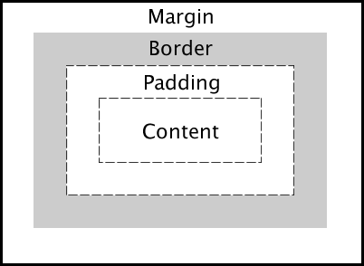
The CSS Box Model
HTML elements are boxes. The box takes up space.
We can customize our boxes using the margin, border, and padding properties.
#myDiv { margin-top: 300px; border: 5px solid brown; padding: 20px; }

Slide 9
Inline vs. Block vs. Inline-Block
Display Type | inline | block | inline-block
Description | Shows up inline with text. | Shows up on its own line and consumes full width of parent by default. | Shows up inline with text.
Properties | No width or height. Allows left & right margins/padding. | Really wide! Allows width/height, margin and padding everywhere. | Respects all properties.
Example Elements | <a> <span> <img> | <h1> <p> <div> | Whatever you can imagine.

