Slide 1

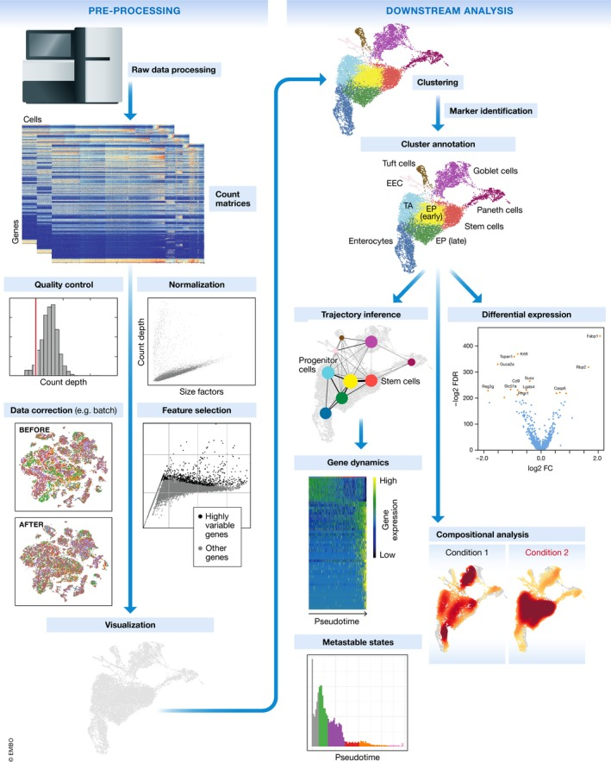
A.
B.
Fig1. Single-neuron projectome analysis pipelines

Slide 2
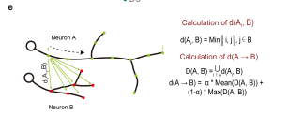

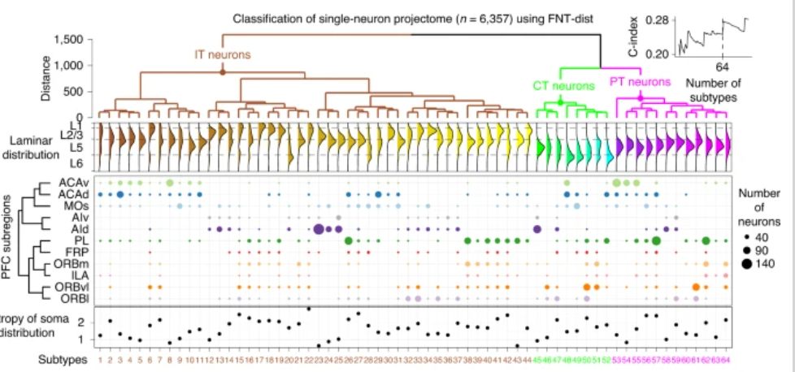

A.
B.
C.
D.
Fig2. A robust morphology-based clustering method

