Slide 1

2021 World Happiness Report
Mohit Badhan & Tian Xia

Slide 2
Introduction: The World Happiness Report
The report gains worldwide acknowledgment as organizations and governments utilize reports such as this one to influence their policy-making decisions.
It is a national average of the responses to the main life evaluation question asked in the Gallup World Poll, which uses the Cantril Ladder to survey bliss.
The 2021 data that we use in our project utilizes a Happiness score which is explained by GDP per capita, Healthy Life Expectancy, Social Support, Freedom to make life choices, etc.
Our project aims to show the data in a more presentable fashion by including ranges and certain values of countries along with an app!
Notes:
Mohit

Slide 3
Project Details
We will be using data published on Kaggle. The data contains 7 csv files from 2015 to 2022 ranking happiness across different regions and countries in the world.
2021 csv file, more focused on regions since there are too many countries
Variable Names: Janitor Work
Libraries used: dply, tidyverse, janitor, naniar, ggplot2, shiny, shinydashboard
Removing variables: All variables remained but not all were utilized or presented (No NA’s)
Joining data: None of the other csv files were joined with 2021 as the column names were not similar and R was not allowing us to.
Notes:
Mohit

Slide 4
Take a Guess!
Which Country in 2021 ranked highest based on overall Happiness?
Notes:
Tian

Slide 5
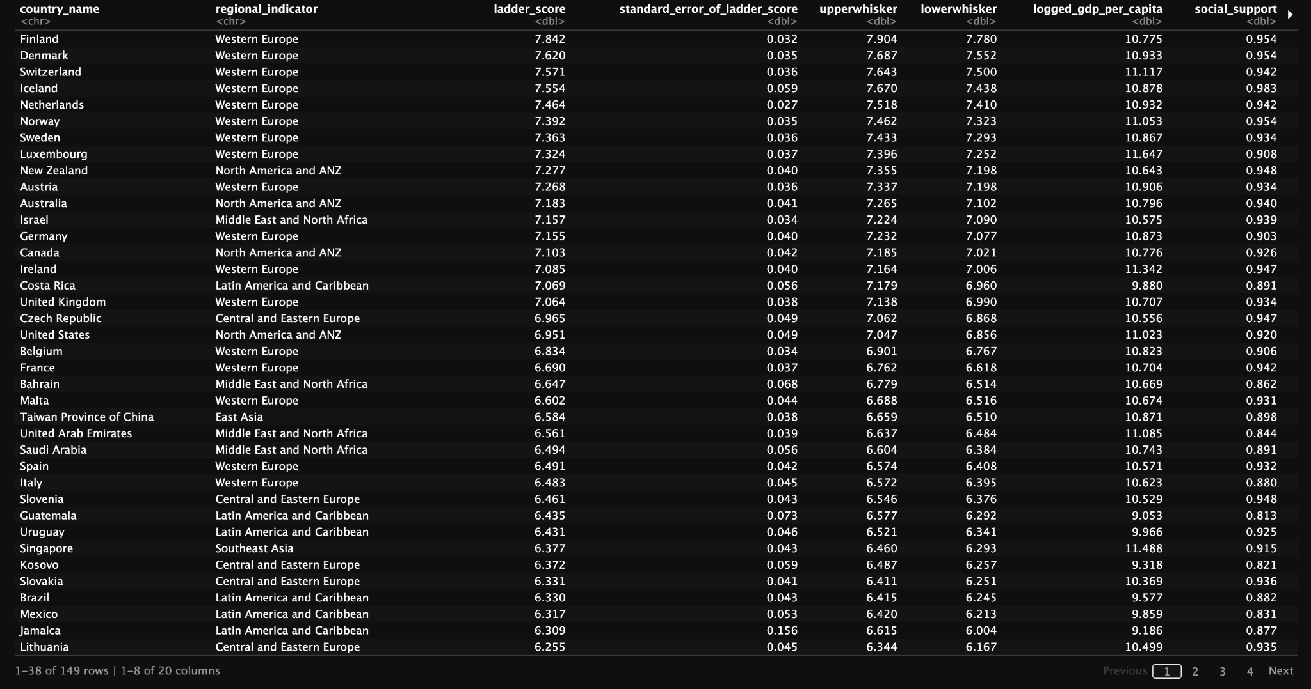
Notes:
Tian

Slide 6
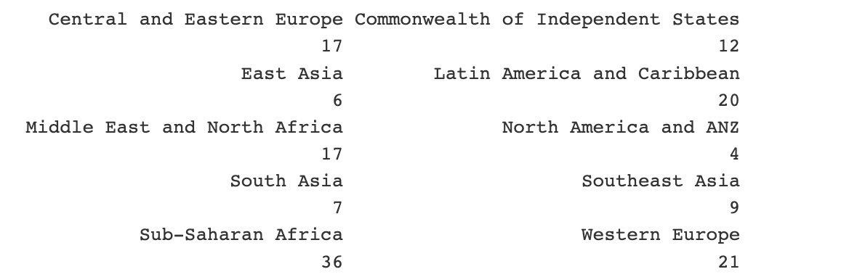
Number of Countries per Region
Total of 149 Countries with 10 different regions!
Notes:
Mohit

Slide 7
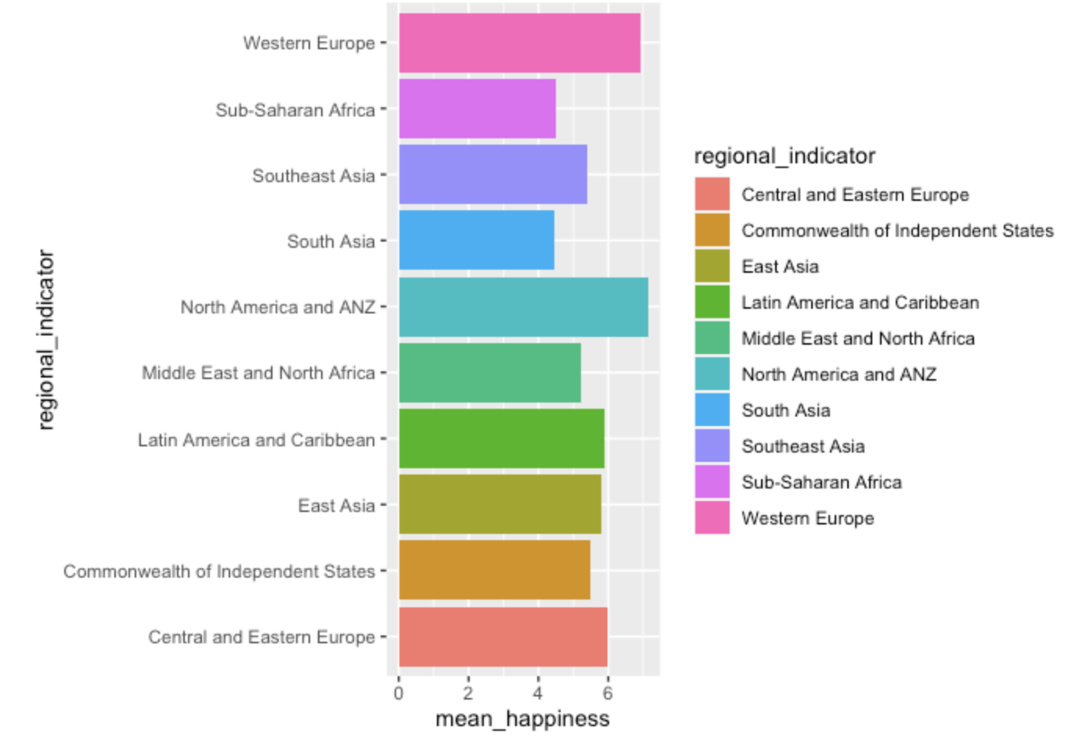
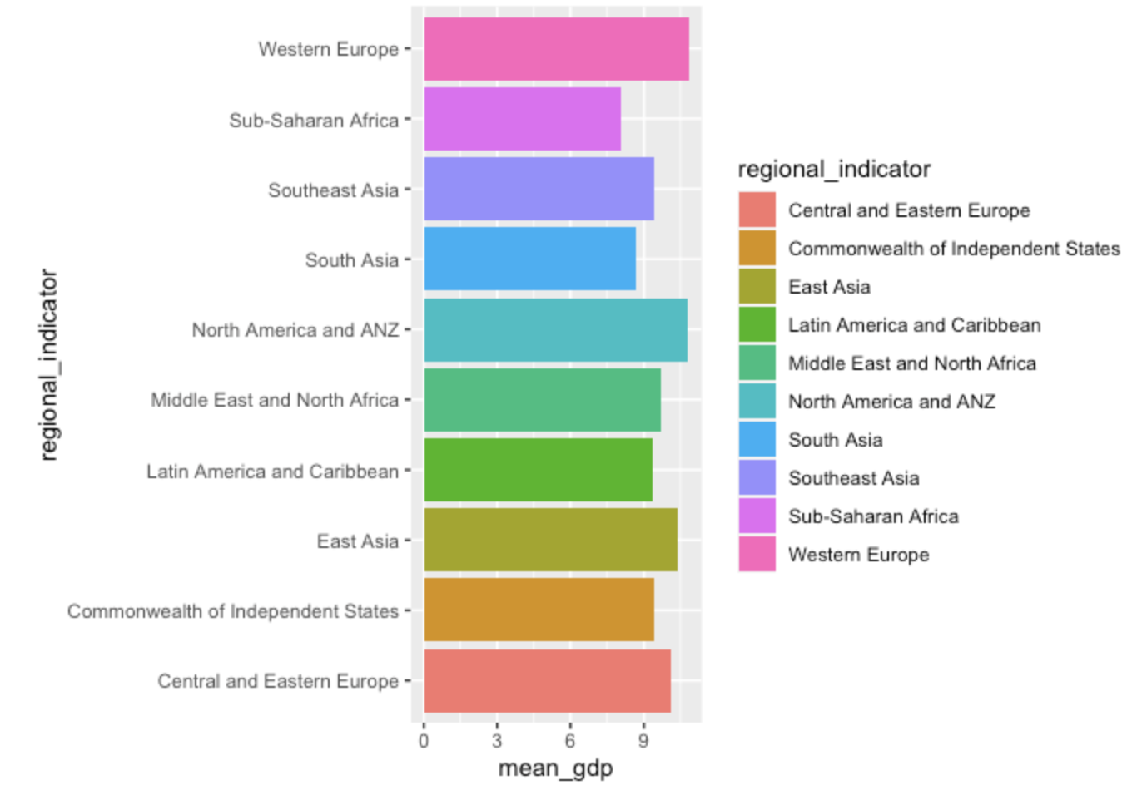
Average Happiness Score/GDP per Region
Notes:
Western Europe, North America and ANZ, and Central and Eastern Europe rank the highest in ladder scores (happiness)!
Sub-Saharan Africa, South Asia, and Middle East and North Africa rank the lowest in ladder scores (happiness)!
Western Europe, North America and ANZ, and East Asia rank the highest in logged GDP per capita (economy)!
Sub-Saharan Africa, South Asia, and Latin America and Carribean rank the lowest in logged GDP per capita (economy)!

Slide 8
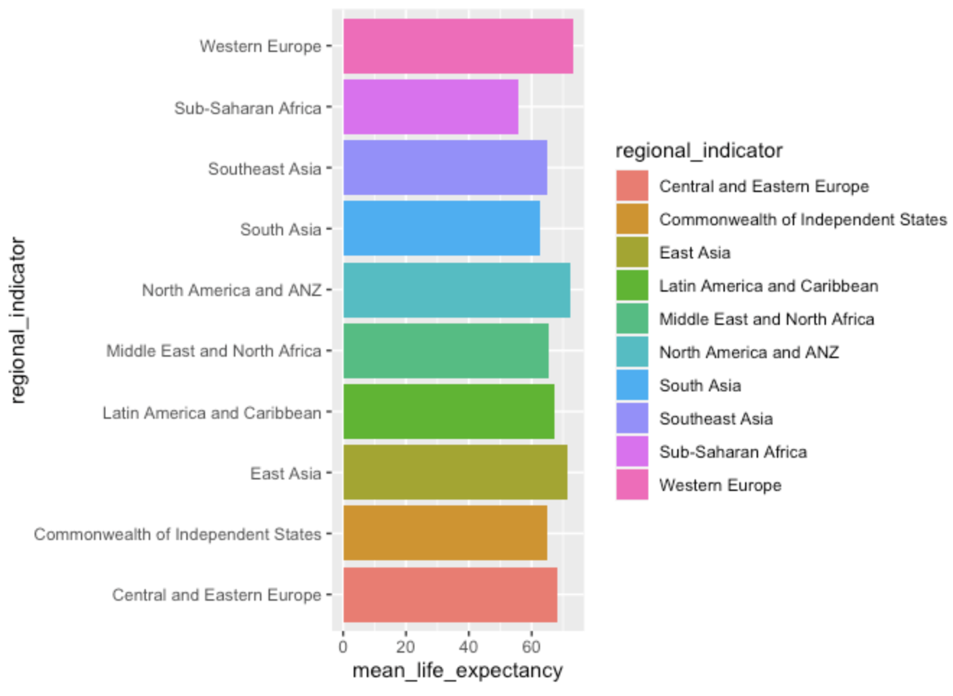
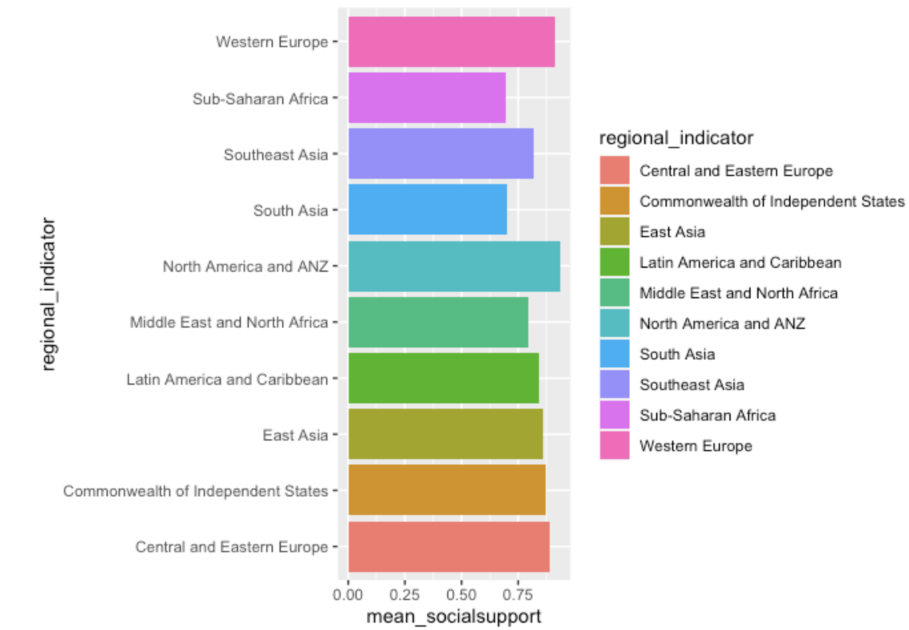
Average Life Expectancy/Social Support per Region
Notes:
Western Europe, North America and ANZ, and East Asia rank the highest in mean healthy life expectancy!
Sub-Saharan Africa, South Asia, and Commonwealth of Independent States rank the lowest in mean healthy life expectancy!
Western Europe, North America and ANZ, and Central and Eastern Europe rank the highest in mean social support!
Sub-Saharan Africa, South Asia, and Middle East and North Africa rank the lowest in mean mean social support!

Slide 9
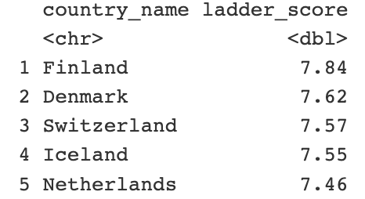
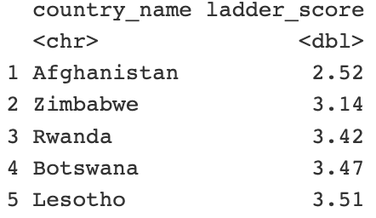

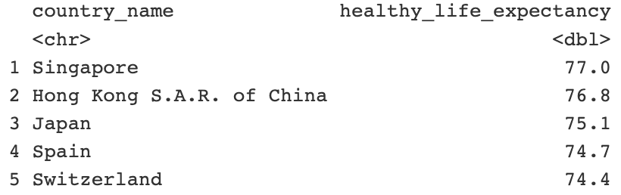
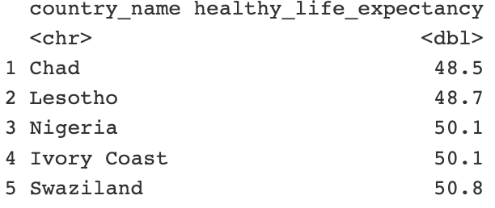
Highest/Lowest Ladder Score, Life Expectancy

Slide 10
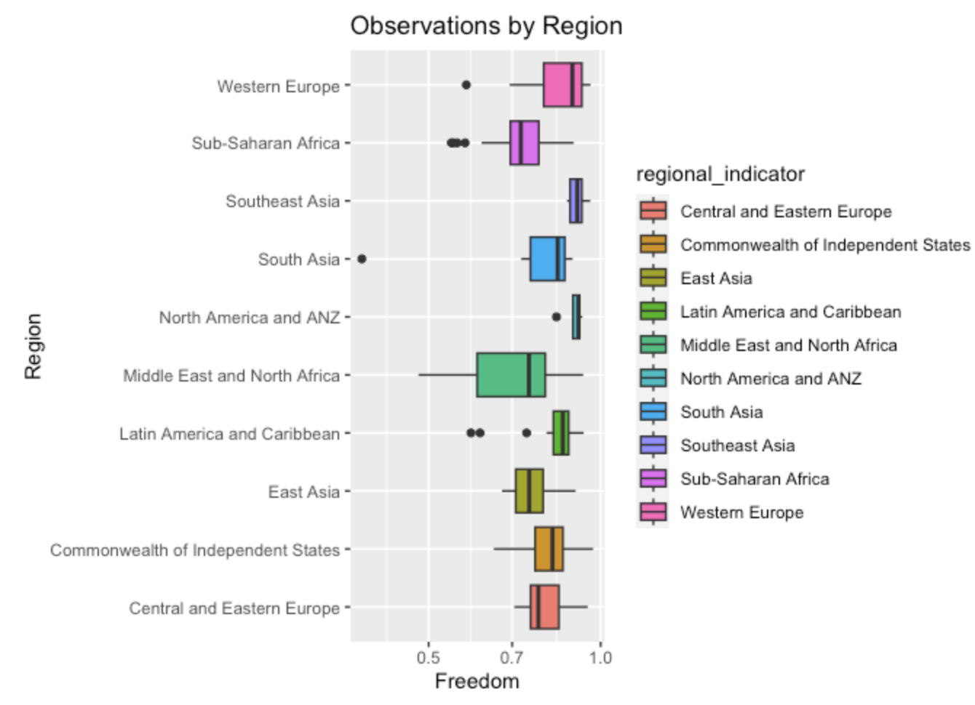
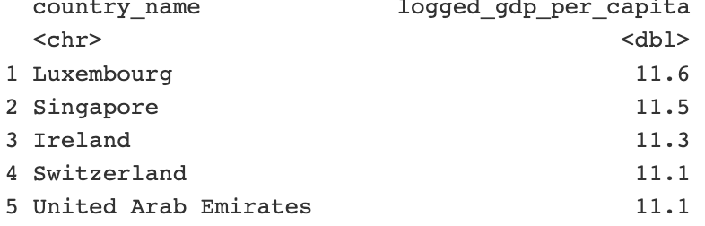
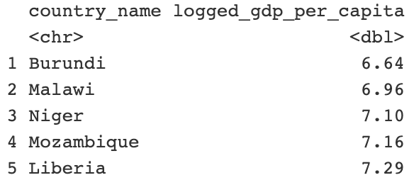
Highest/Lowest GDP and Range of Freedom

Slide 11
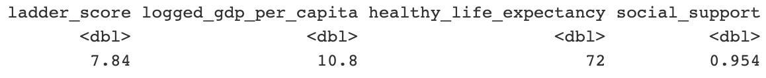
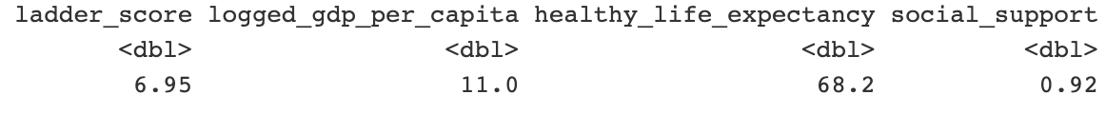
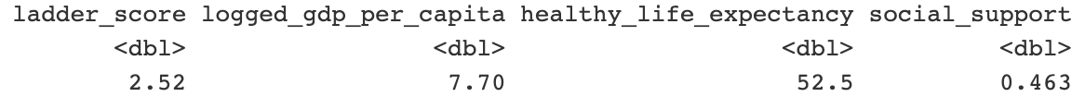
Let’s Compare Most and Least Happiest Country to Our Own!
Finland
United States
Afghanistan

Slide 12
Time for App!

