Slide 1
Early Prediction of Acute Kidney Injury in ICU using Machine Learning
Tianshu Xin
2026/3/14

Slide 2
What is AKI
Acute Kidney Injury = sudden loss of kidney function
Affects ~20% of ICU patients (your data confirms 22%)
Associated with increased mortality, longer hospital stay, higher costs
Key point: Early detection is critical — treatment is most effective in first 24–48h

Slide 3
Objective & Approach
Goal: Predict AKI within the first 24h of ICU admission using routine lab values
Data: MIMIC-III clinical database (real de-identified ICU data, Beth Israel Deaconess Medical Center)
Method: Binary classification (AKI = 1, No AKI = 0)

Slide 4
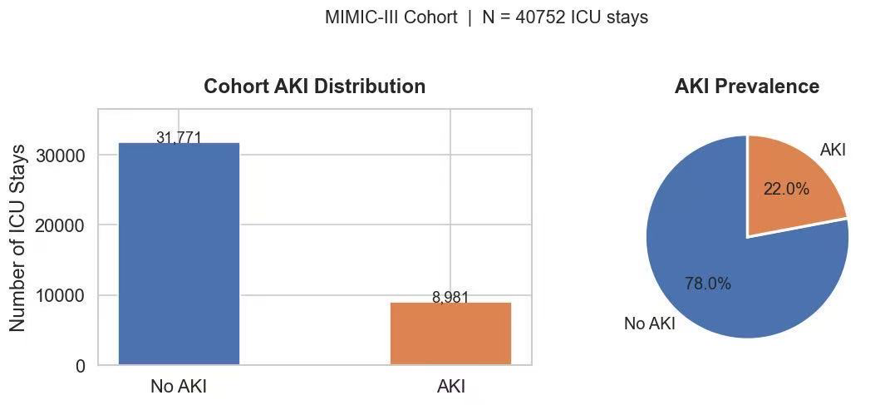
Dataset & Cohort
46,520 patients → 40,752 eligible ICU stays (after filtering adults with lab data)
AKI label based on creatinine rise (KDIGO-style criterion)
Features: first-24h labs + age

Slide 5
Features used
Feature | Source
Creatinine(min/max/mean) | Lab
Hemoglobin | Lab
BUN | Lab
Sodium | Lab
Potassium | Lab
Bicarbonate | Lab
Age | Demographics
All from the first 24 hours of ICU stay only

Slide 6
Methodology Pipeline
Raw MIMIC-III CSVs
↓
Cohort Selection (adult ICU stays)
↓
AKI Labeling (creatinine criteria)
↓
Feature Extraction (first-24h labs)
↓
Train / Val / Test Split (70/15/15%)
↓
Model Training (LR, RF, XGBoost)
↓
Evaluation (AUC, F1, Accuracy)

Slide 7
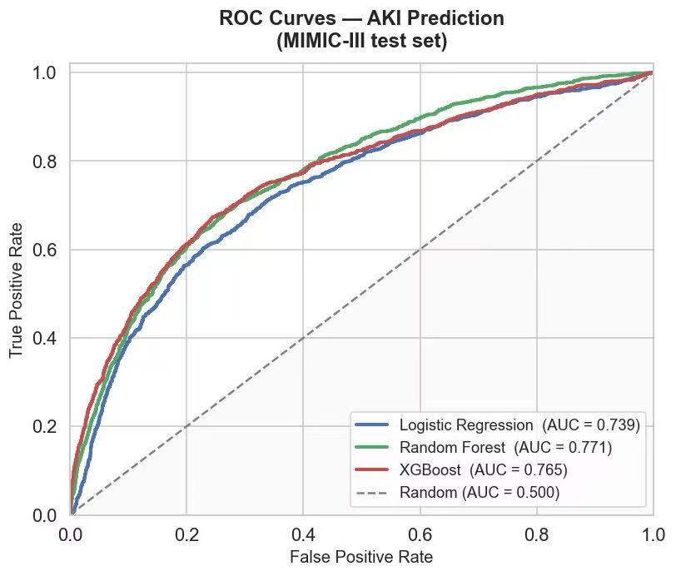
Results: ROC Curves
Random Forest best: AUC = 0.771
All models significantly above random baseline

Slide 8
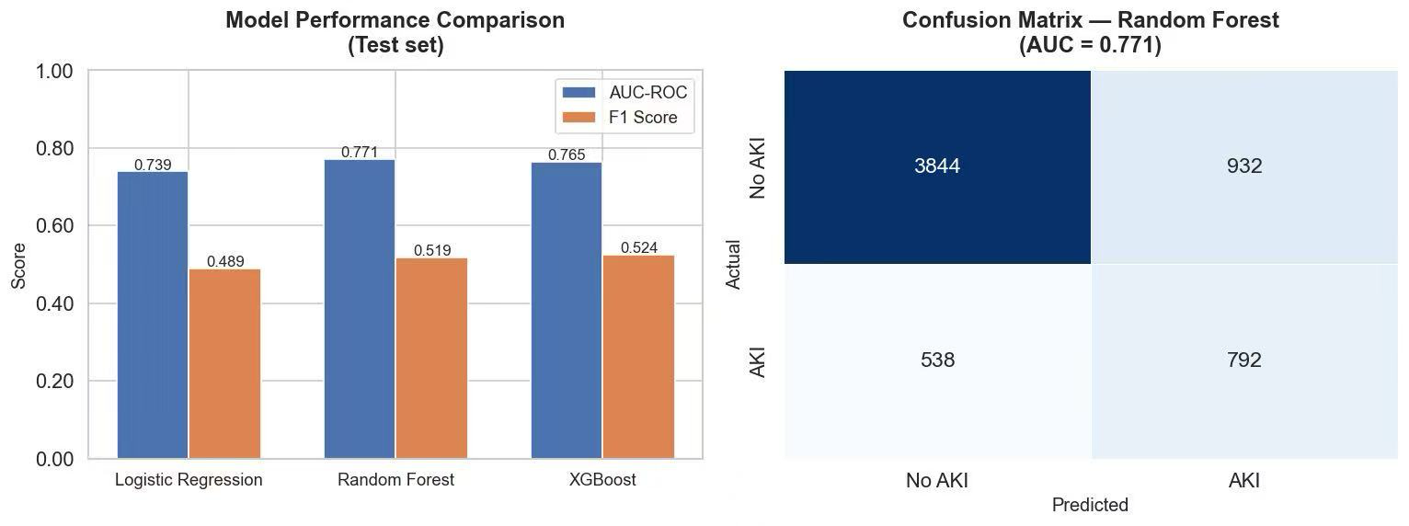
Results: Model Comparison
Random Forest: AUC 0.771, F1 0.519
XGBoost: AUC 0.765, F1 0.524
Logistic Regression: AUC 0.739, F1 0.489

Slide 9
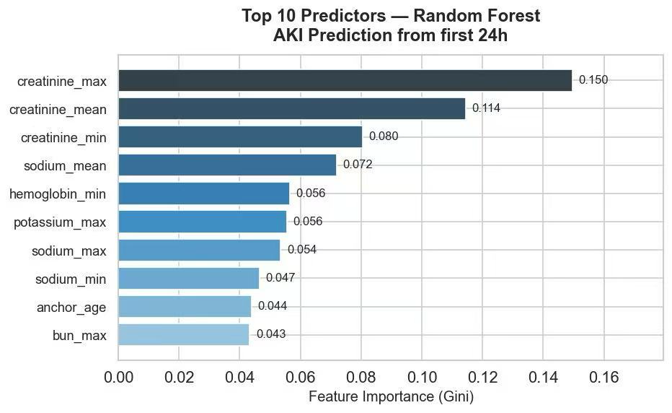
Key Predictors
Creatinine (max/mean/min) dominates — clinically expected
Sodium and hemoglobin also contribute
Age is a moderate predictor

Slide 10
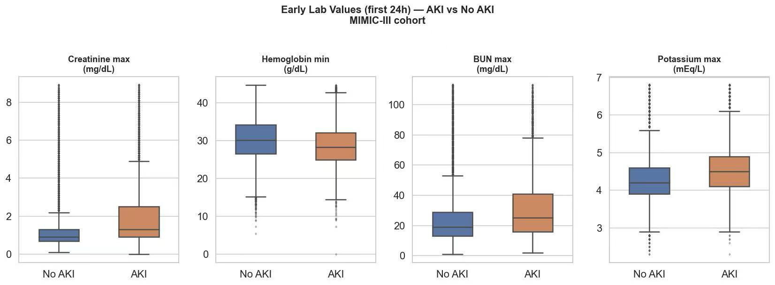
Lab Differences
AKI patients show elevated creatinine and BUN even in the first 24h
This validates the features are clinically meaningful

Slide 11
Limitations & Future Work Limitations
Limitations
AKI defined by creatinine only (no urine output data)
Single-center dataset (BIDMC) — may not generalize
No temporal modeling (labs treated as summary statistics)
Future Work
Add vital signs (heart rate, blood pressure, SpO₂)
Use LSTM/Transformer for time-series modeling
Apply SHAP for clinical explainability

Slide 12
Conclusion
Built an end-to-end AKI prediction pipeline from real ICU data
Random Forest achieves AUC = 0.771 using only first-24h routine labs
Demonstrates that early AKI risk stratification is feasible with standard clinical data
Could support clinical decision-making if validated prospectively
https://github.com/txin214/self-learning-txin

